Slide 1
Making Interactive Graphics
With Github and Shiny

Slide 2
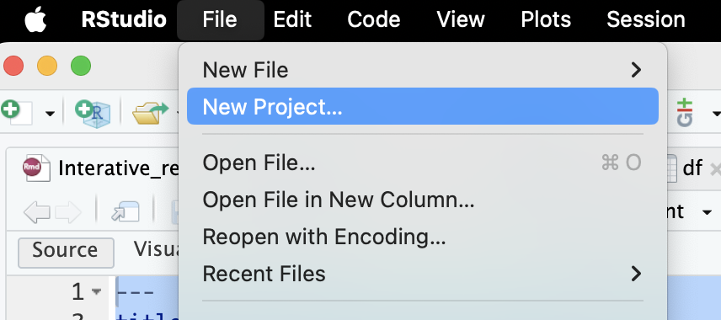
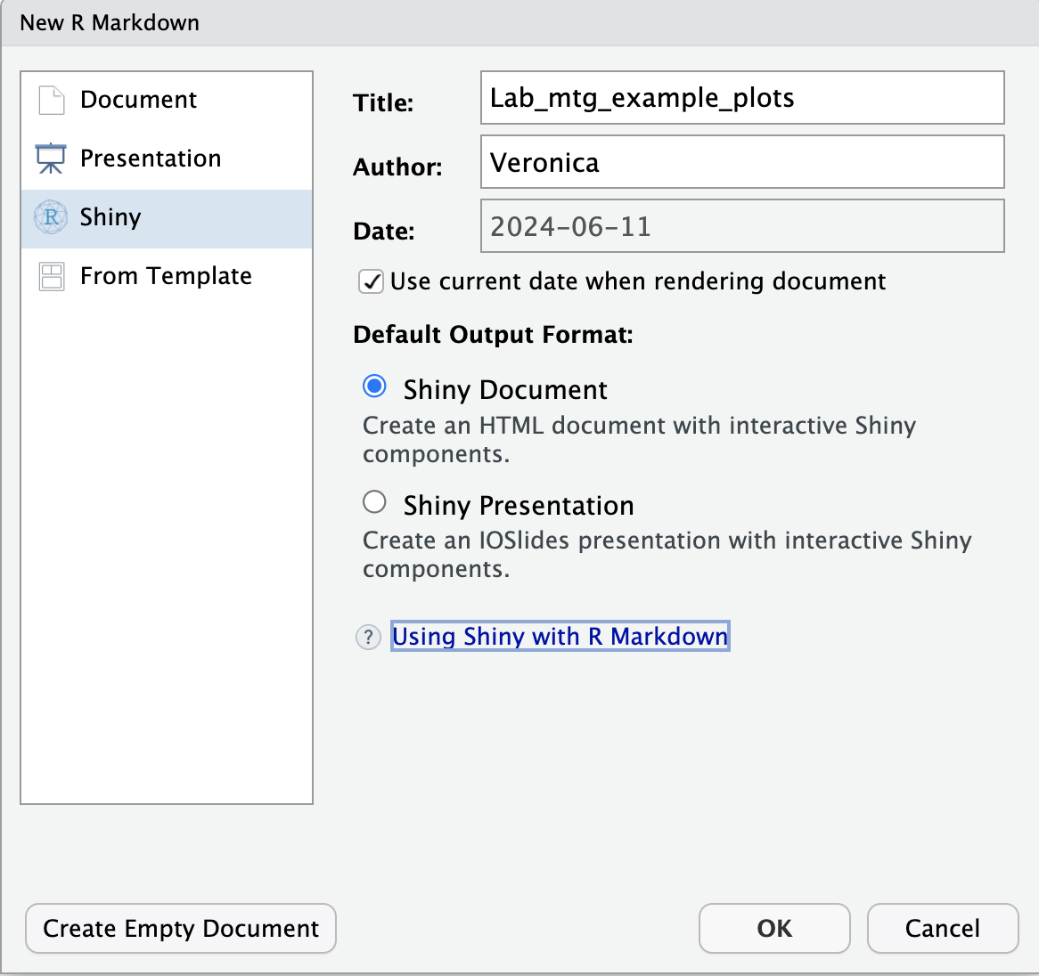
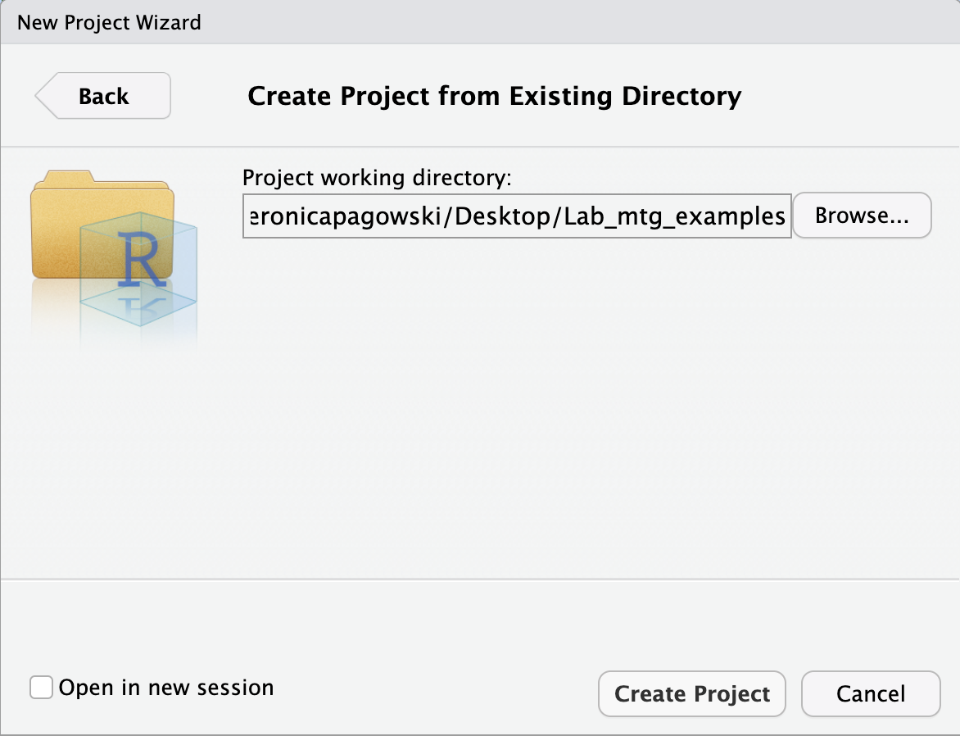
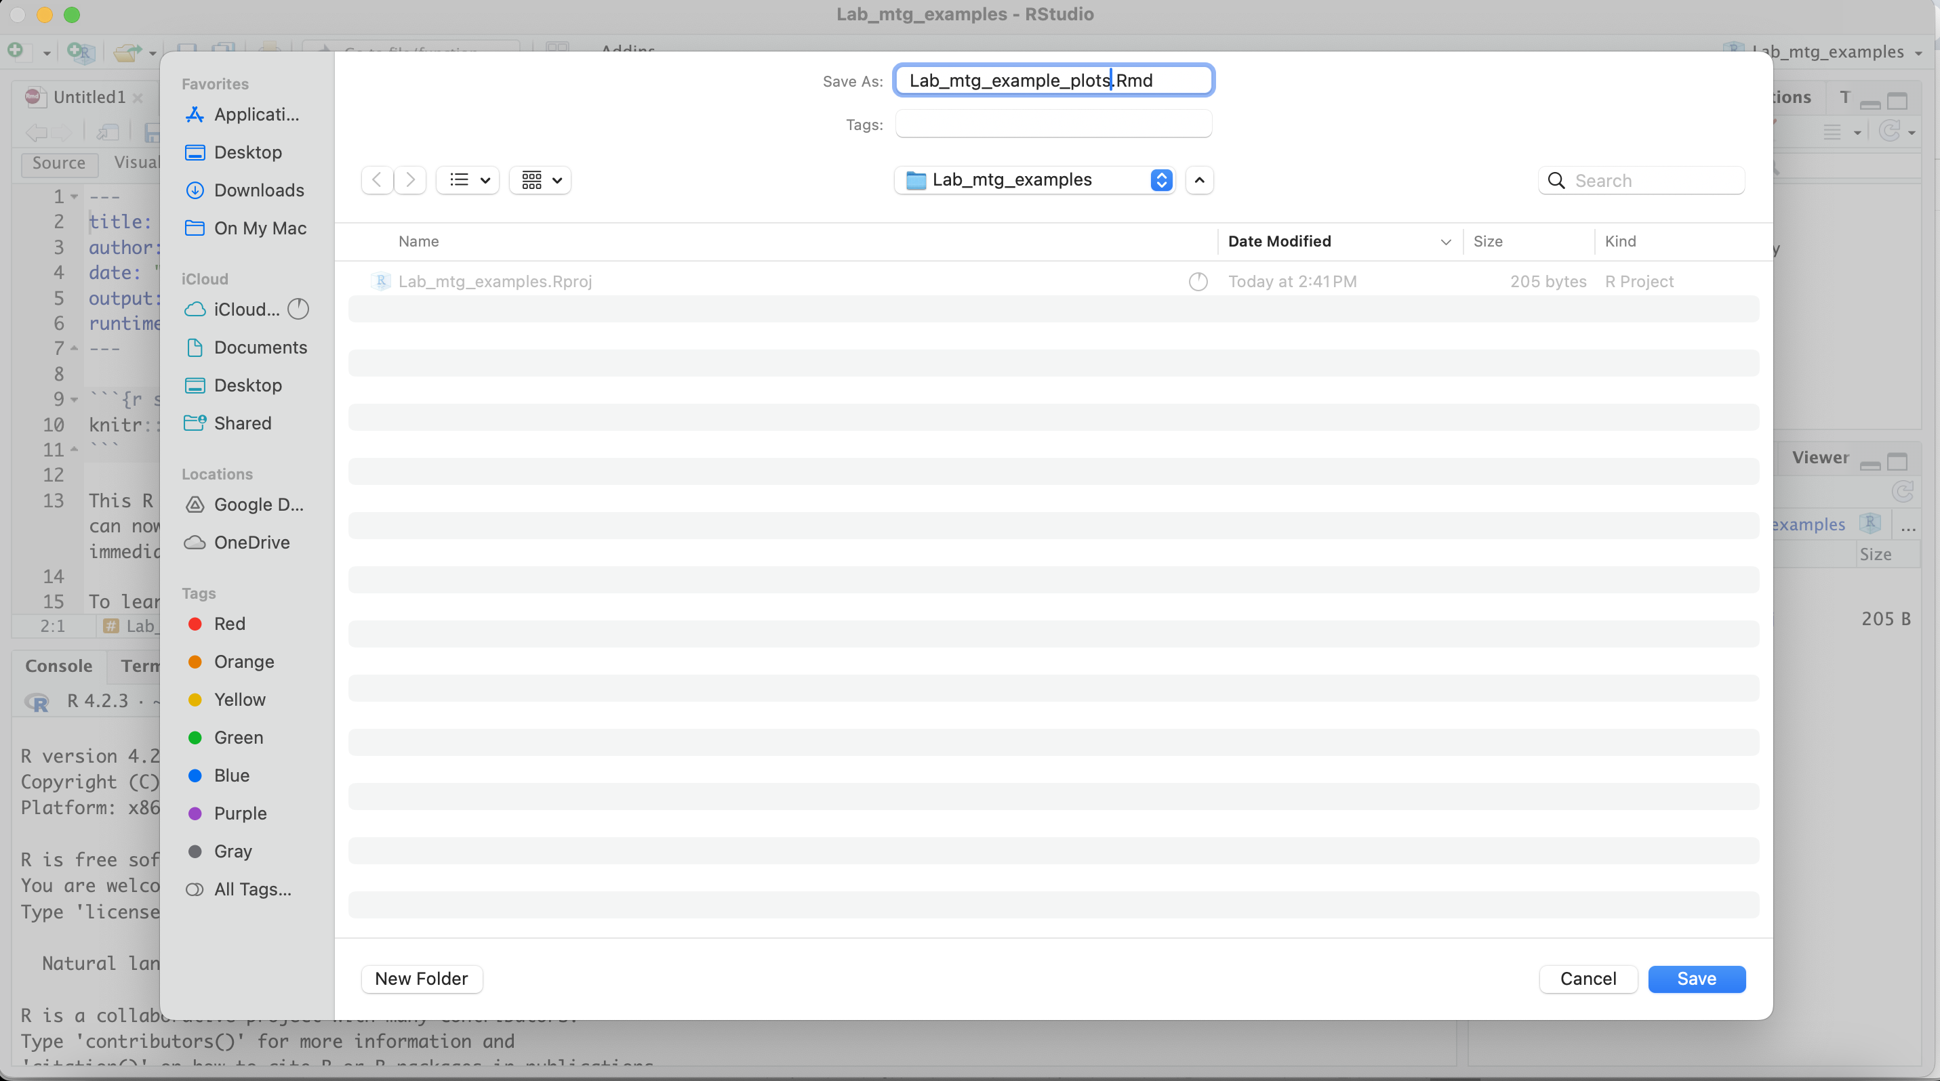
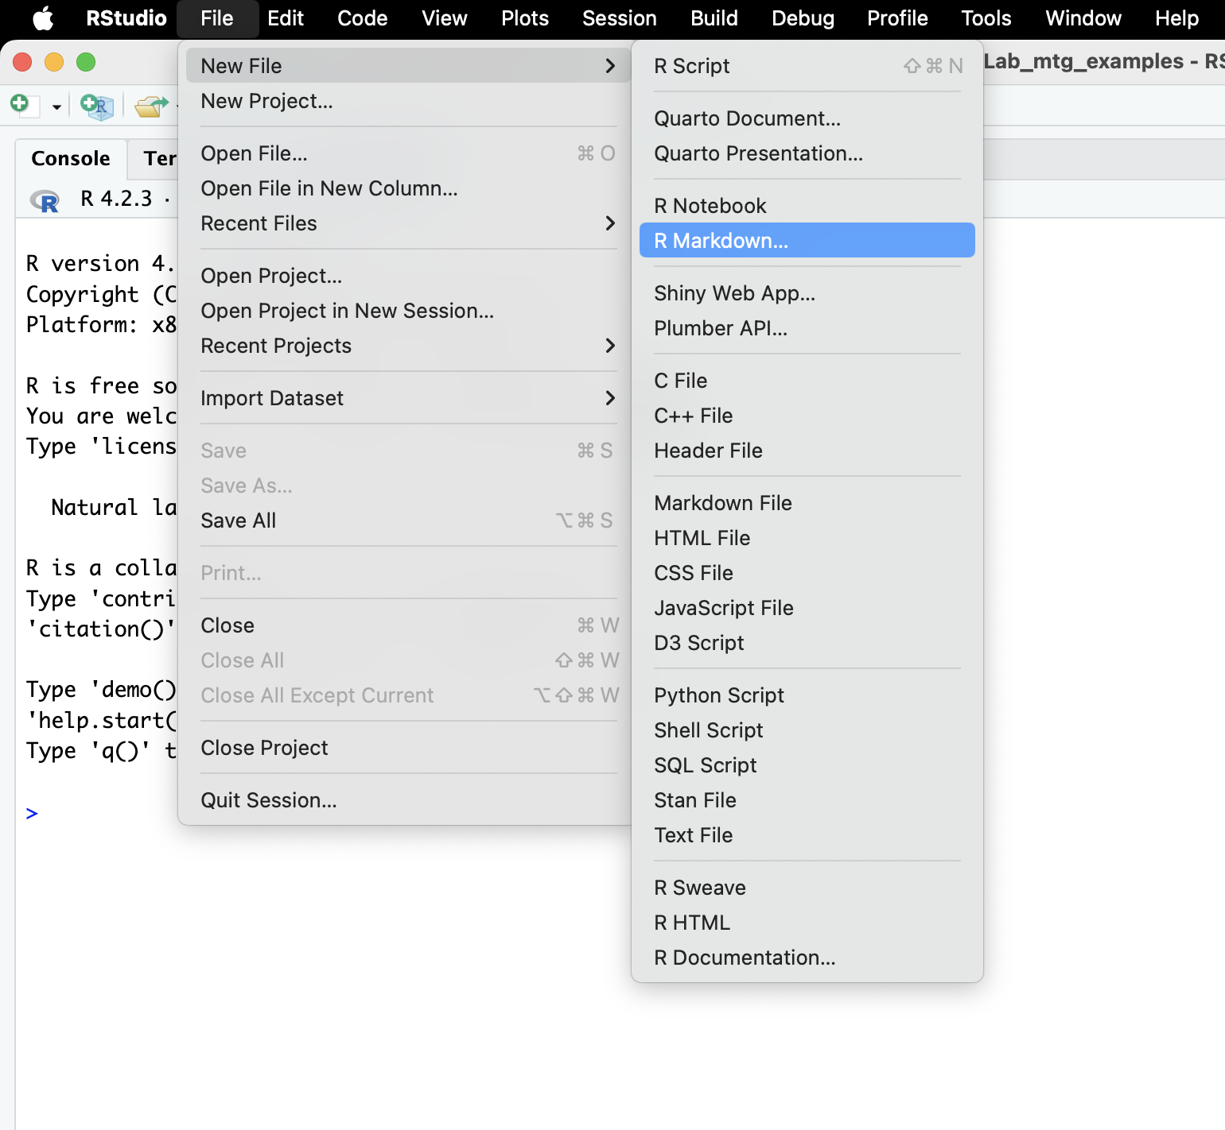
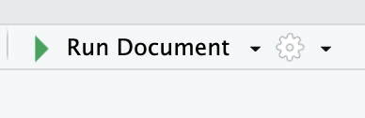

Shiny
1
4
Starting is super easy:
Make a new R project
Save to new or existing directory
Create a new .Rmd file
Make this a shiny document
Save your .Rmd file
Run and Publish
You already have an interactive plot!
2
5
3
6

Slide 3
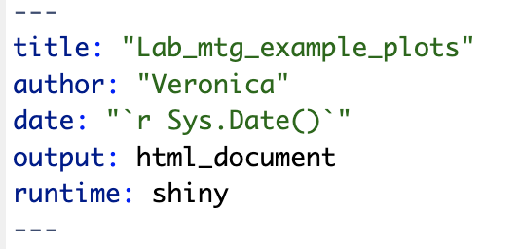

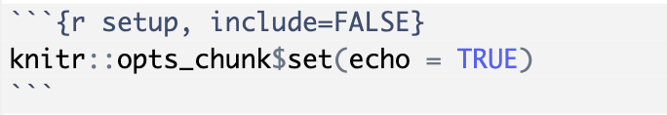
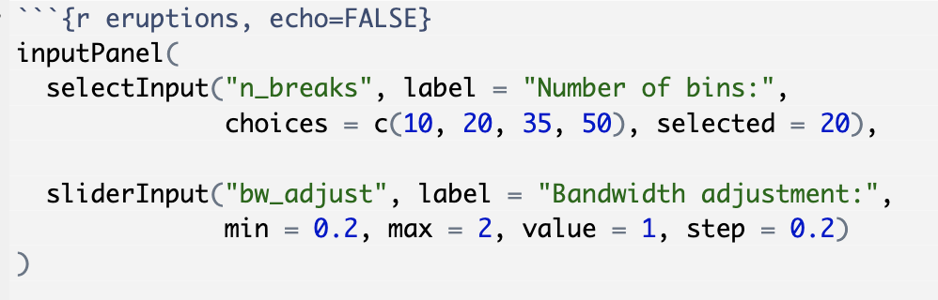


Anatomy of your script
Header
Your header and formatting info
That’s it!
Rmd formatting options
R code
End of R code with Rmd format options

Slide 4
Make an interactive chord diagram
Header
Your header and formatting info
That’s it!
Rmd formatting options
R code
End of R code with Rmd format options

