Slide 1
Making Interactive Graphics
With Github and Shiny

Slide 2
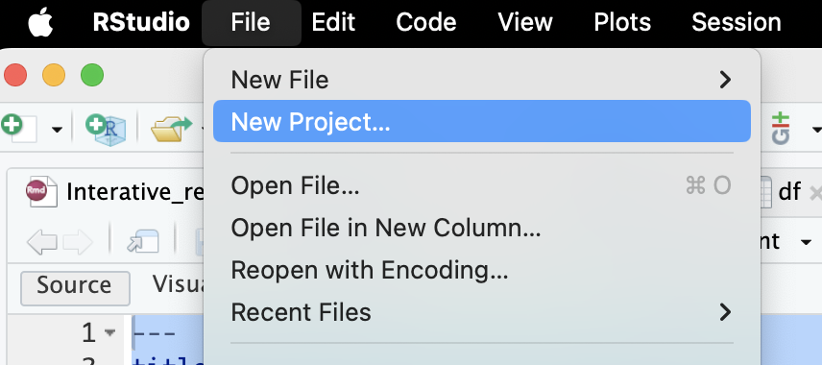
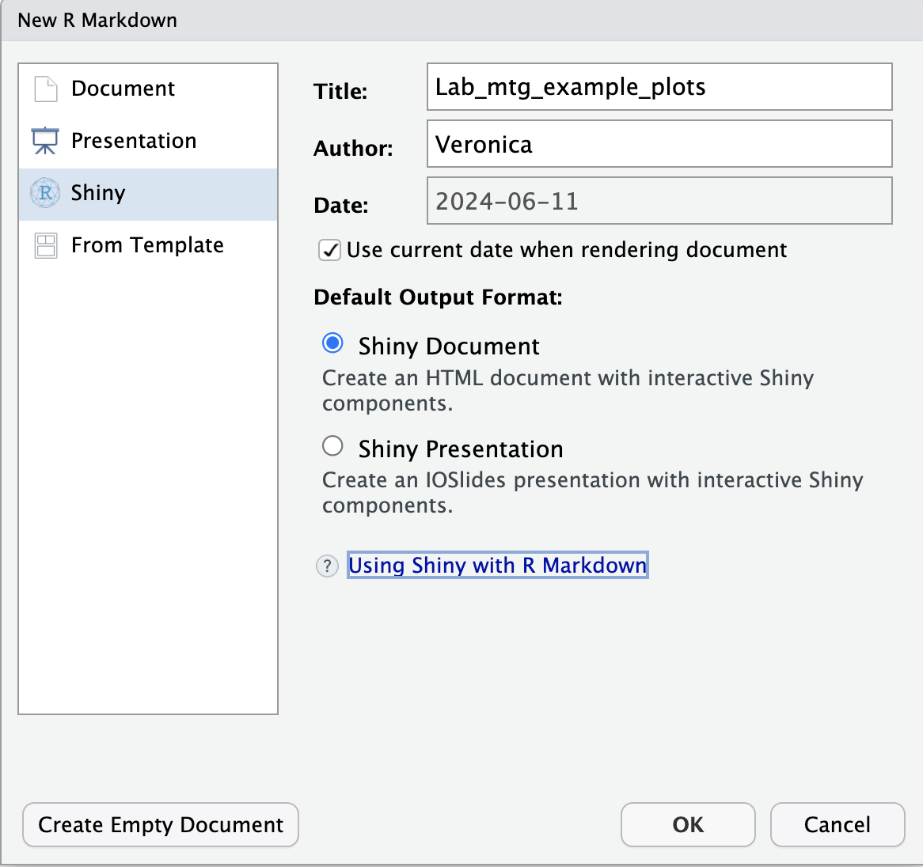
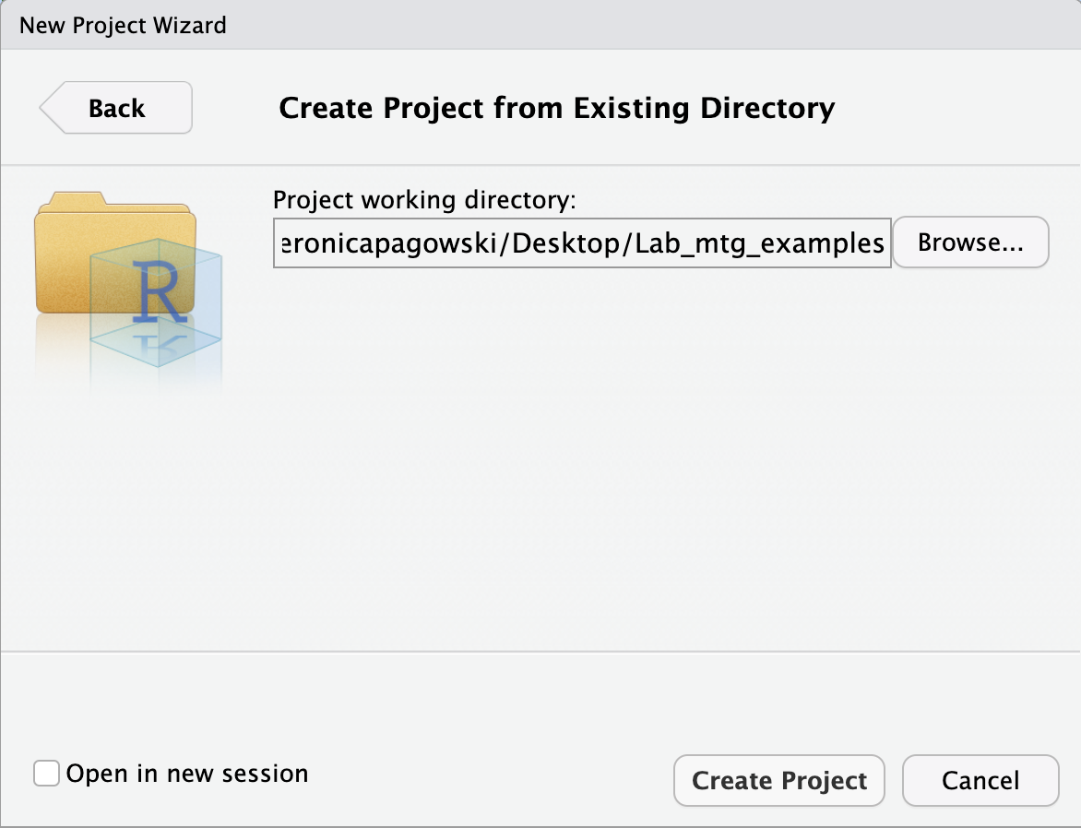
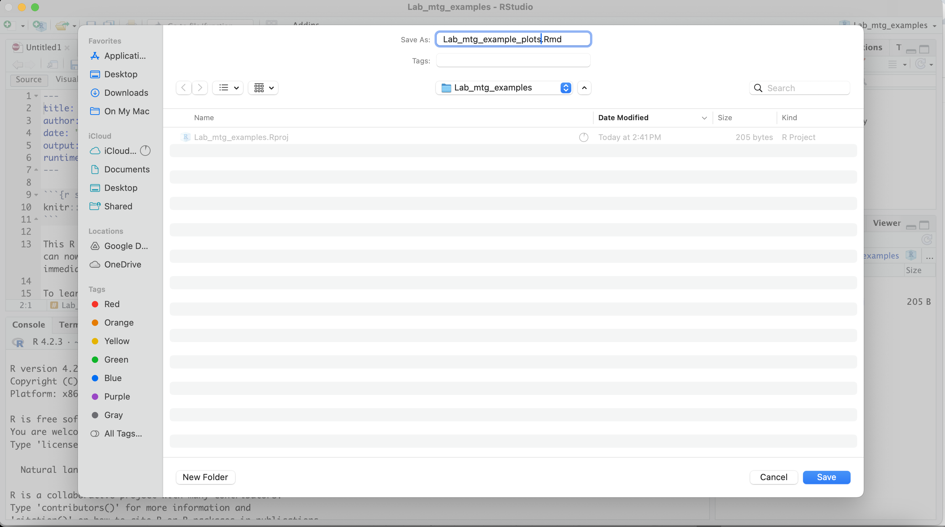
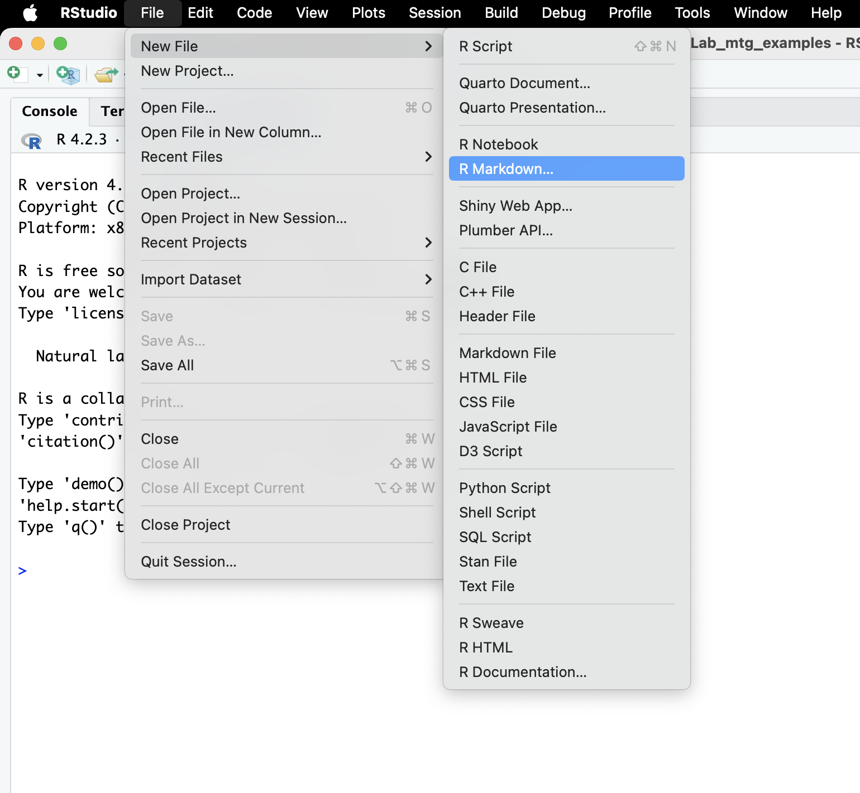
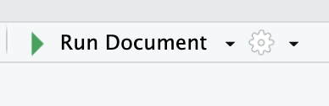

Shiny
1
4
Starting is super easy:
Make a new R project
Save to new or existing directory
Create a new .Rmd file
Make this a shiny document
Save your .Rmd file
Run and Publish
You already have an interactive plot!
2
5
3
6

Slide 3
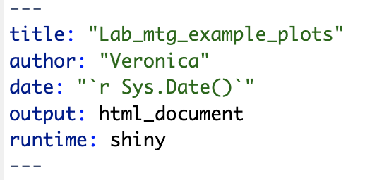

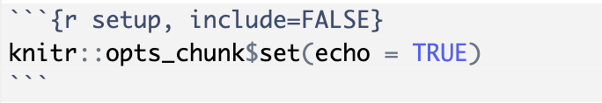
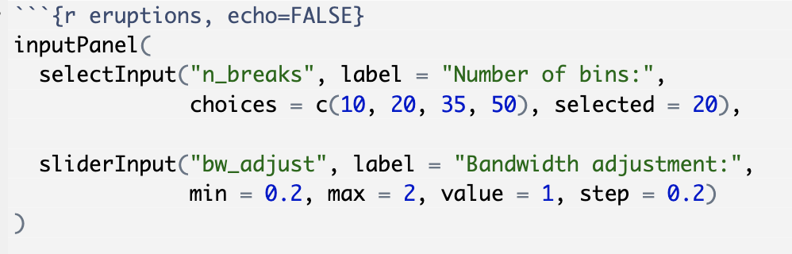


Anatomy of your script
Header
Your header and formatting info
Rmd formatting options
R code
End of R code with Rmd format options

Slide 4
Helpful Websites
https://bookdown.org/yihui/rmarkdown/interactive-documents.html
https://shiny.posit.co/r/getstarted/shiny-basics/lesson1/index.html
https://programminghistorian.org/en/lessons/shiny-leaflet-newspaper-map-tutorial
Examples
https://r-graph-gallery.com/interactive-charts.html
https://www.r-statistics.com/2017/03/shinyheatmaply-a-shiny-app-for-creating-interactive-cluster-heatmaps/

Slide 5
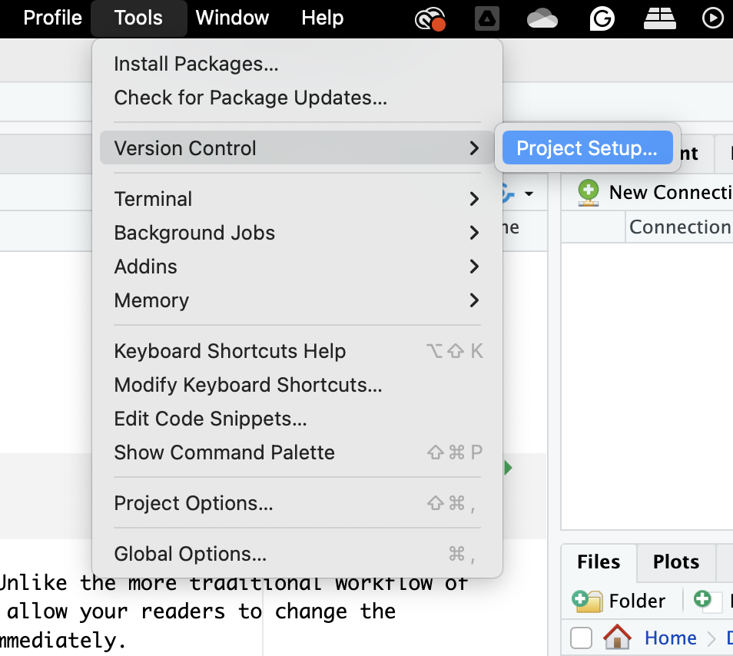
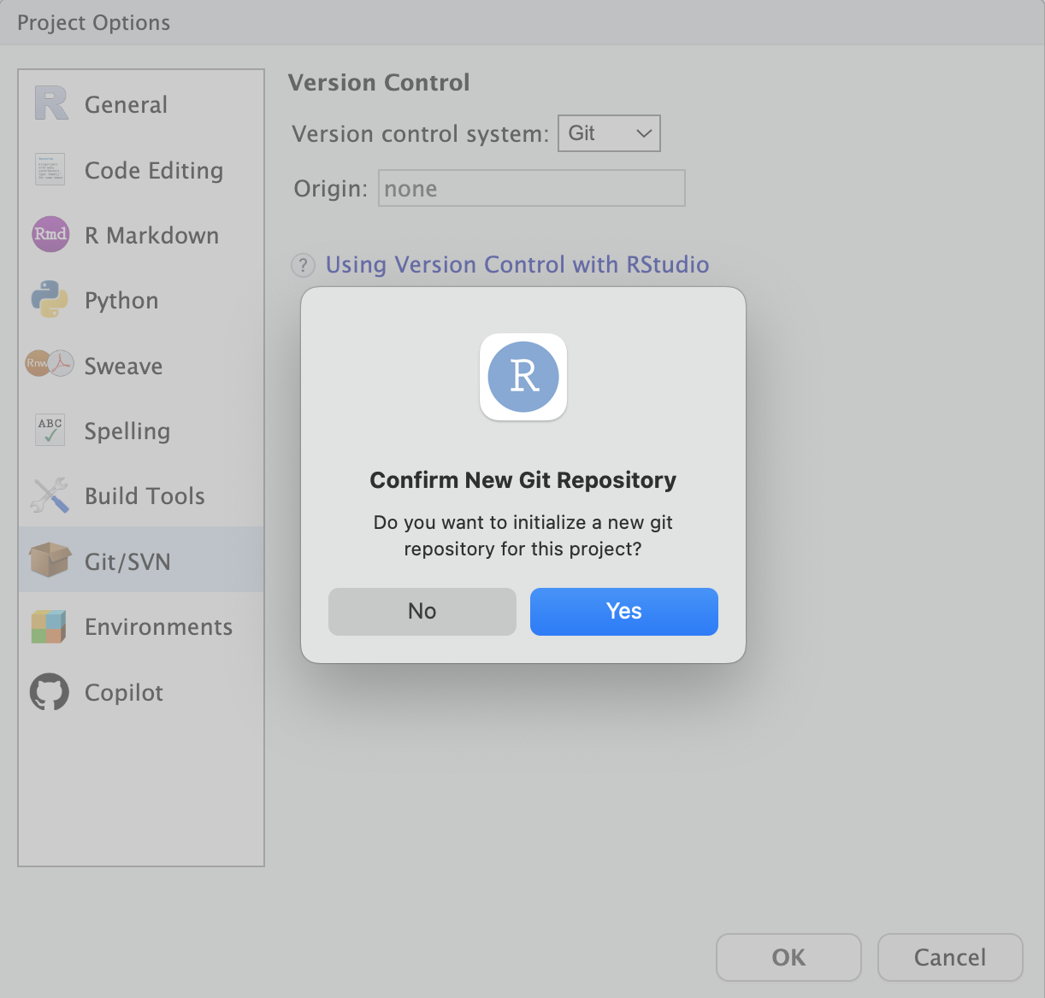
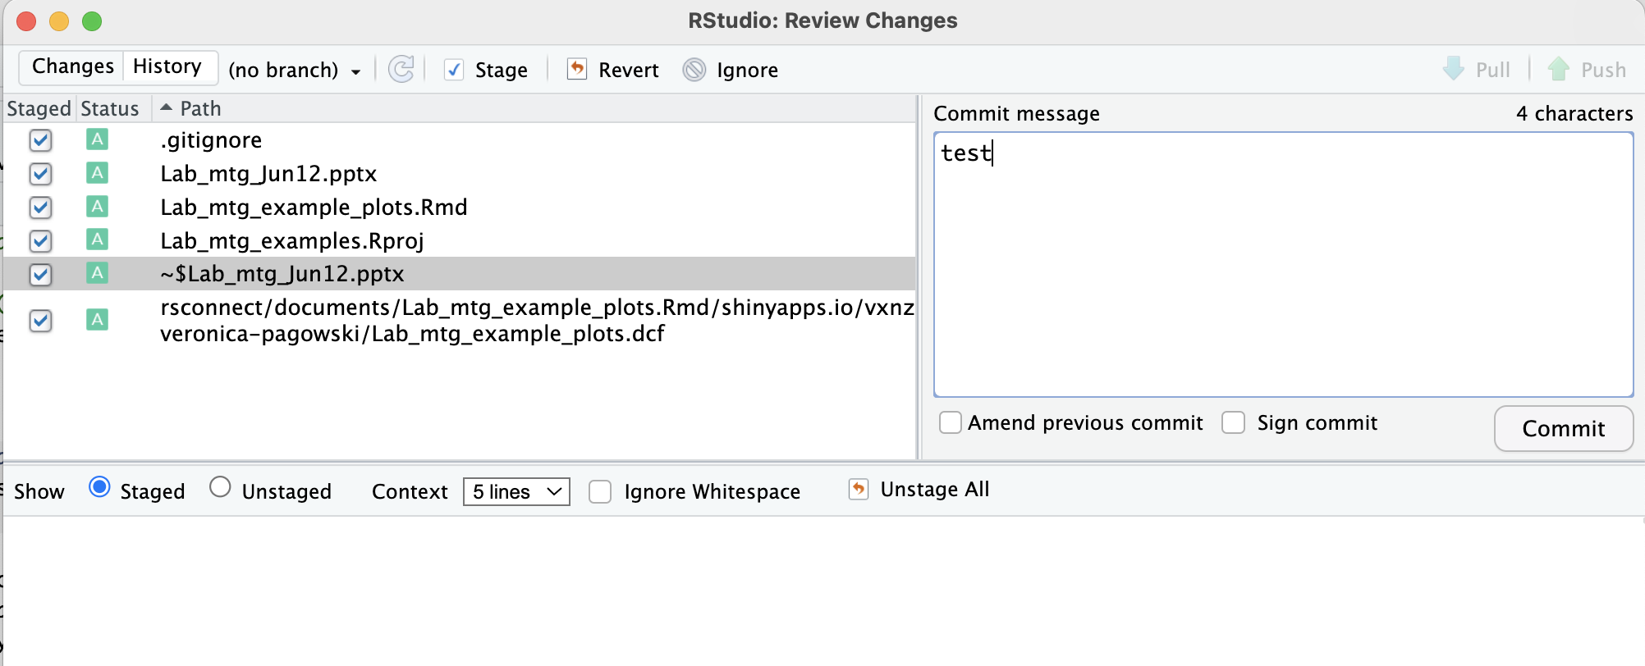
Track with GitHub
If you already have github installed:
Edit project setup
Make this project a git tracked project
Push, pull, and commit changes
2
1
3

Slide 6
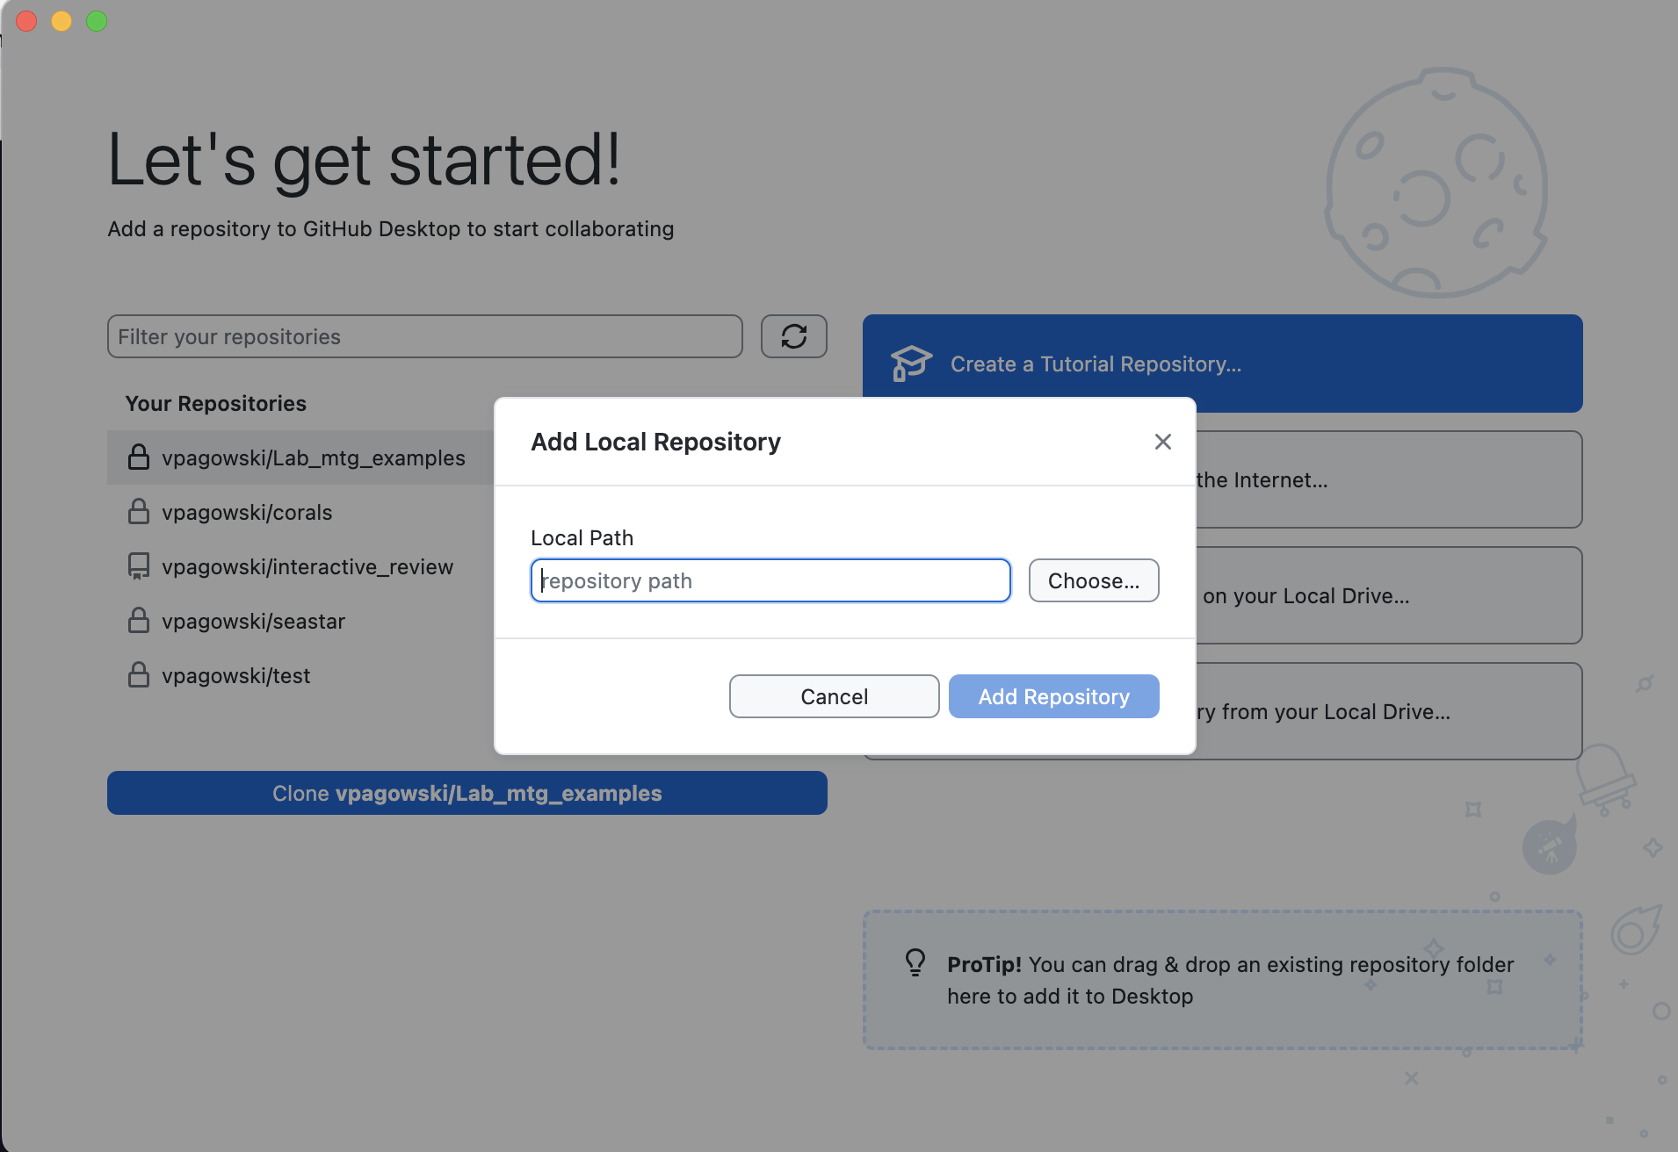
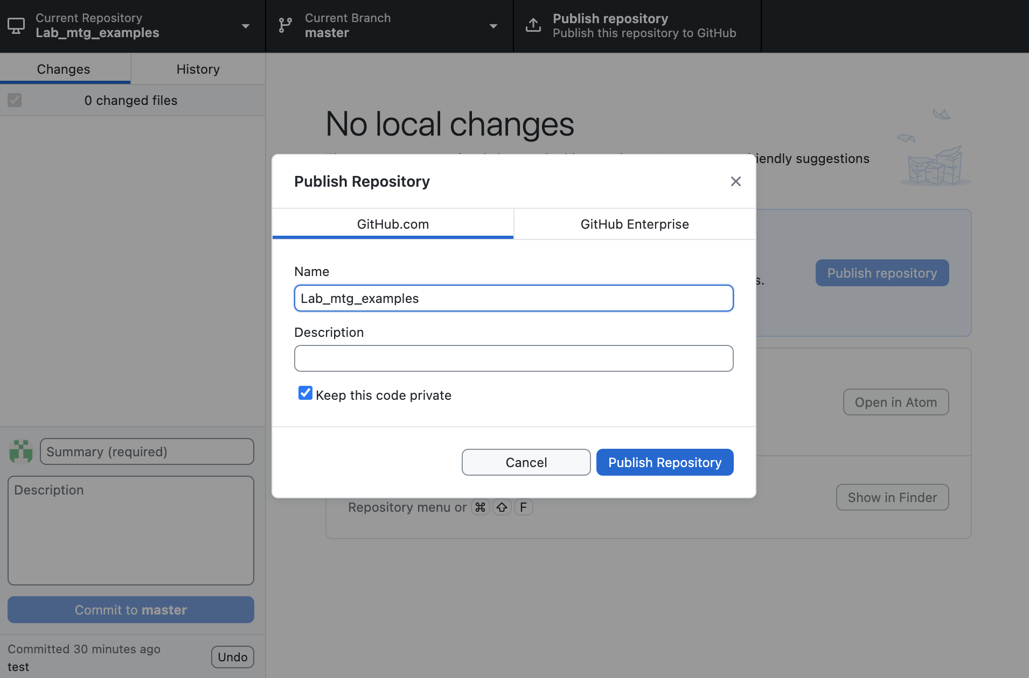
Track with GitHub
Match up repositories:
In your Github editor add your repository to your github account
Publish to the web (publicly or privately)
1
2

Slide 7
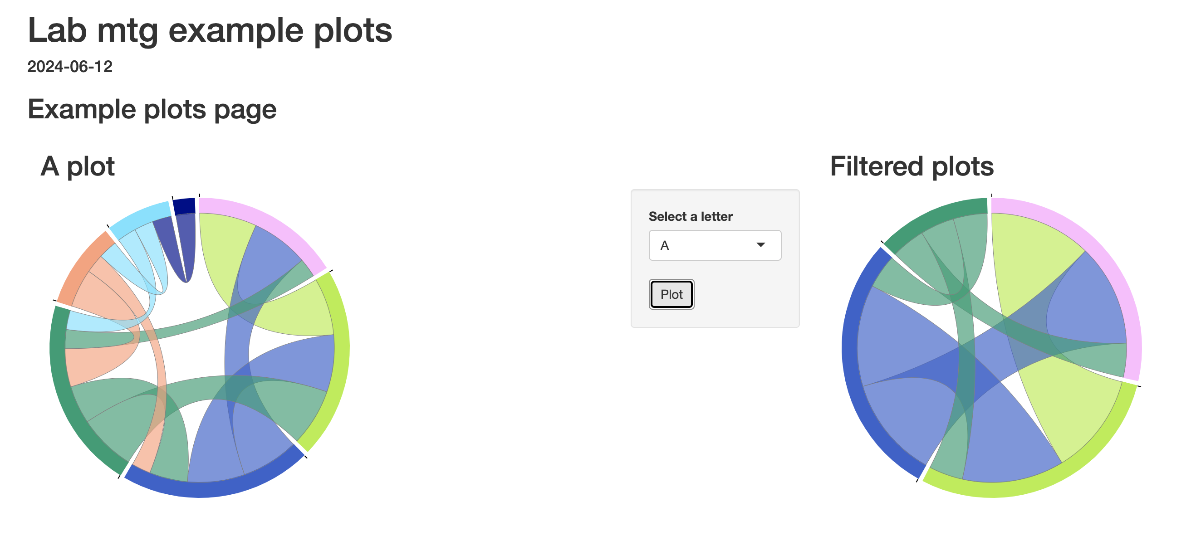
Make an interactive chord diagram
Download stuff from GitHub: git clone https://github.com/vpagowski/Lab_mtg_examples.git
Edit code in the .Rmd file and run your document to make plots!
You should see the same thing as on: https://vxnzru-veronica-pagowski.shinyapps.io/Lab_mtg_example_plots/

Slide 8


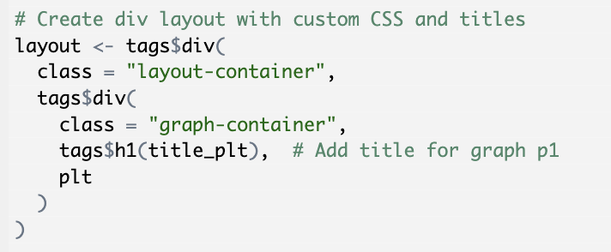
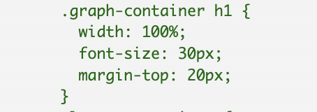
Formatting
*the most annoying part
Style the whole code block
Modify layout for specific plots
Apply layout
https://www.w3schools.com/html/html_css.asp

Slide 9
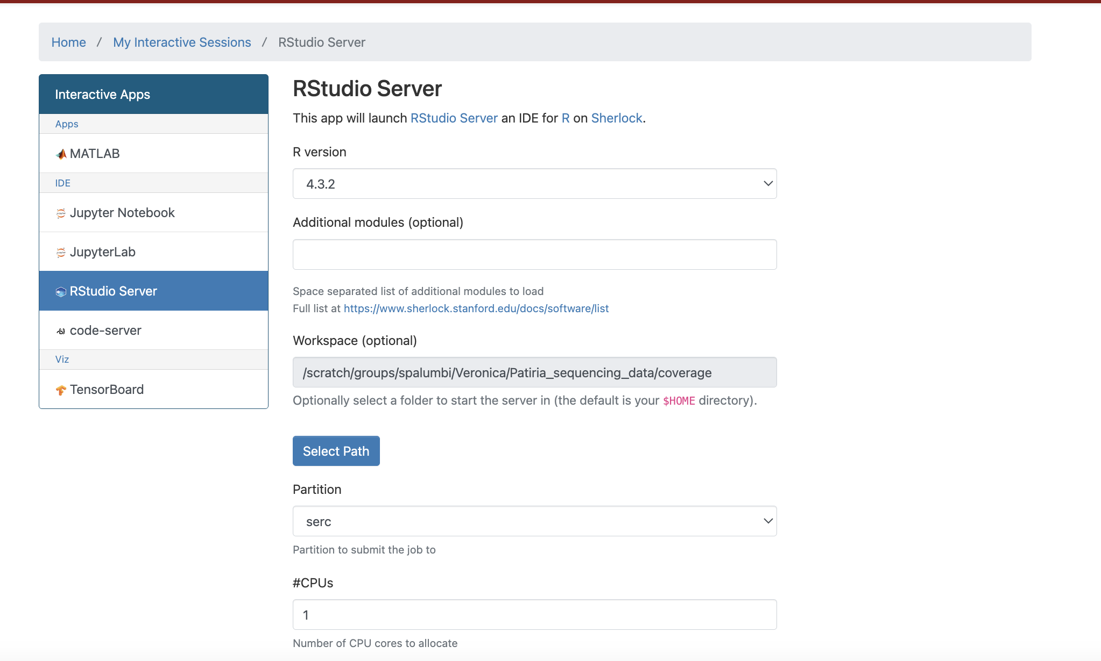
Other useful data visualization tools?
https://docs.google.com/document/d/1cli9PaDoTQa9lryh5hKTTQz5-FxO5y0Z6cvhD_1goKc/edit

