Slide 1
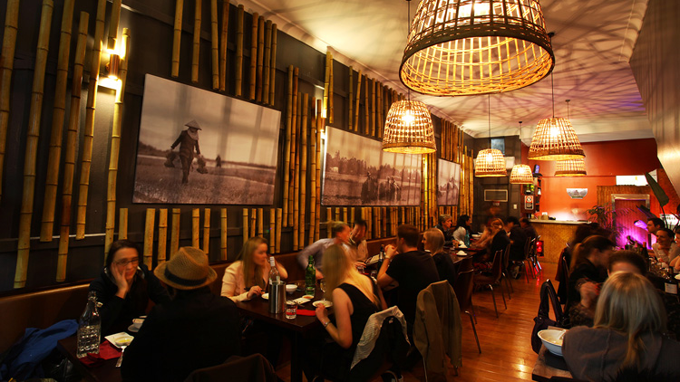
Predicting the best location for a new restaurant

Slide 2
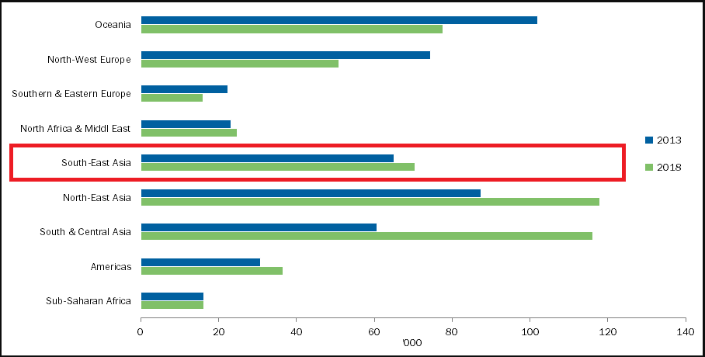
INTRODUCTION
There has been a great increase in the demand for Vietnamese food in Australia partly due to the increase in the popularity of Vietnamese food but also an increase in the overall Vietnamese population.
According to the Australian Bureau of Statistics, there has been a 20% increase in the total migrants coming from South East Asia between the year 2013 and 2018.
The objective of this project is to analyse and select the most suitable location for a Vietnamese restaurant in the city of Melbourne. The goal is to come up with the most suitable location using data science and machine learning for the target business audience
The place should be in close vicinity of CBD. i.e. within 5 km range.
The place should have no or very few existing Vietnamese restaurants

Slide 3
Data Acquisition & Cleaning
The number of restaurants and their type and location will be sourced from the Foursquare API. Since there is no exact address of the CBD as it is an area expanding about 6.2 Square kilometres, we have relied on google maps for the address of the CBD which is going to be used as the starting point.
Coordinates of the Melbourne CBD will be obtained through the Nominatim API.
Data obtained from Corra of the suburbs in Australia along with the latitude and longitude. Data cleaned and filtered for the state of Victoria. The original raw data contains 16,080 rows and 7 columns.
Due to constraints in the foursquare API and Folium. The data is further filtered by the closest suburbs within a 10 km range from the Melbourne CBD..
Size of the CBD area used for plotting the CBD is obtained from Wikipedia.
My Master data is saved in my GitHub Repository.

Slide 4


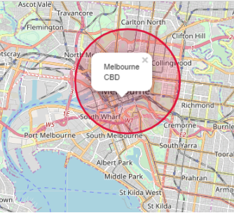
Methodology
Nominatim is used to get the latitude and longitude of the CBD.
Result is then plotted on a map using python’s folium library
The red circle represents the CBD which is 6.2 Square kilometres

Slide 5
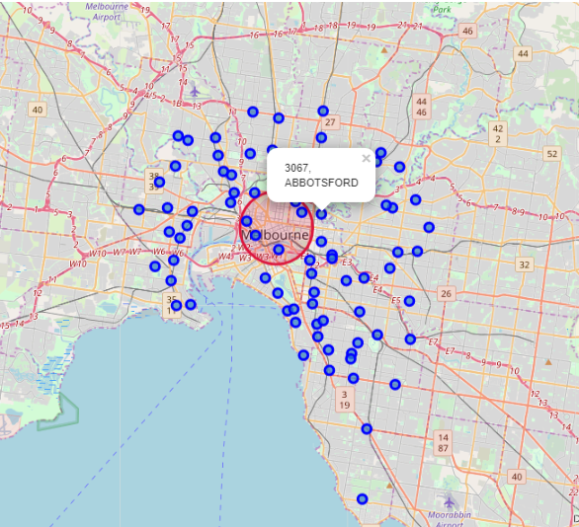
Adding Suburbs
Map of Melbourne with Suburb and Postcode superimposed on top. Using the latitude and longitude values to get the visual.

Slide 6
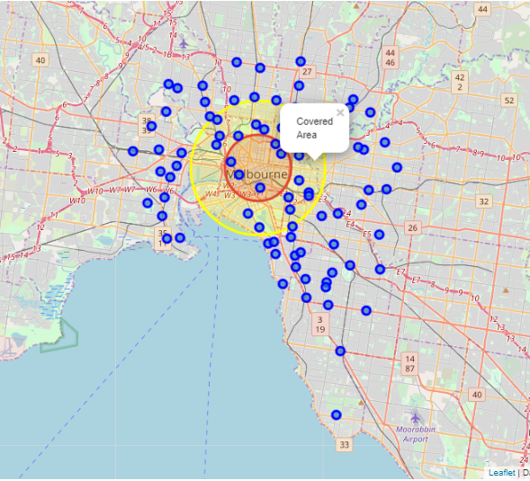
Vicinity Range
Now the locations closest to the CBD (Within 5 Kilometres) are taken into consideration.
Folium is used gain to show the “covered area”. or the area with suburbs that meet the requirements.

Slide 7
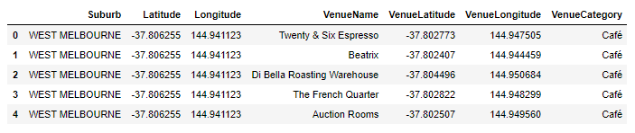
Foursquare API
I have utilized the Foursquare API to explore the boroughs and segment them. I designed the limit as 100 venues and the radius 5000 meters for each suburb from their given latitude and longitude information
A head of List of Venues name, category, latitude and longitude along with the Suburb, Latitude and Longitude from Foursquare API.

Slide 8
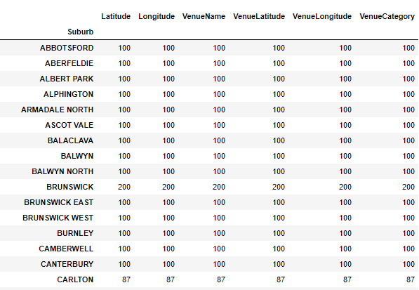
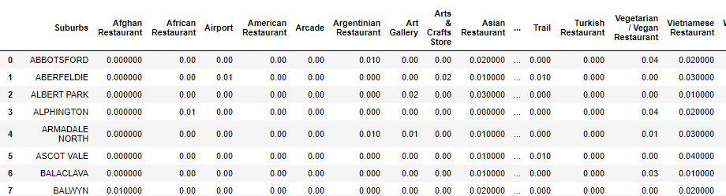
Unique Categories
The venues are further grouped according to suburbs. Here we can see that most of the Suburbs have reached the 100 limits of venues.
A list of 213 unique categories is curated from all the returned venues. We have then analyzed each suburb by grouping the row by Suburb and taking the mean of the frequency of occurrence of each venue category. By doing so, we have also prepared the date for use in clustering

Slide 9
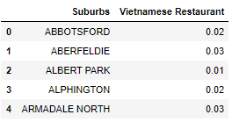
Filtering for Vietnamese Restaurant
Filtering the data for “Vietnamese Restaurant”.

Slide 10
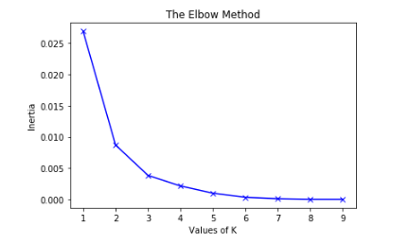
Kmeans Classification Model
Since we have a common venue category in Suburbs. Unsupervised learning K-means Algorithm is used to cluster the Suburbs. It is the most common algorithm used for common cluster method of unsupervised learning.
Elbow Method used to produce the optimum degree of K for the K-Means
To determine the optimal number of clusters, we must select the value of k at the “elbow” i.e. the point after which the inertia start decreasing linearly. Thus, for the given data, we conclude that the optimal number of clusters for the data is three

Slide 11
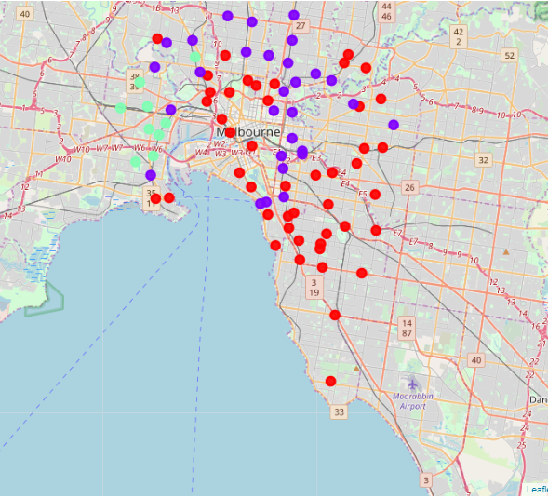
Clustering & Results
The results from the K-means clustering show that we can categories the Suburbs into 3 clusters based on the frequency of occurrence of the “Vietnamese Restaurant”.
Cluster 0 (RED)– Suburbs with no to low number of Vietnamese Restaurant.
Cluster 1(VIOLET)- Suburbs with low to moderate number of Vietnamese Restaurant.
Cluster 2(GREEN)– Suburbs with high concentration of Vietnamese Restaurant.

Slide 12
Conclusion and Future Research
Purpose of this project was to identify areas in Melbourne close to CBD (within 5km) with low to no Vietnamese restaurants to aid stakeholders in narrowing down the search for optimal location for a new Vietnamese restaurant.
The filtering of clusters has helped us narrows our search from 88 suburbs down to the 3 suburbs which we believe might be the best location for opening a new Vietnamese restaurant taking all other factors constant and considering the data limitation
Future research could make use of a larger database and more complex algorithm and methods such as deep learning. They could use of paid foursquare API or Google API account where there are no constraints to the number of API calls and results to obtain a more accurate result

