Slide 1
Best Pizzas NA Website Requirements
Victor Ng

Slide 2
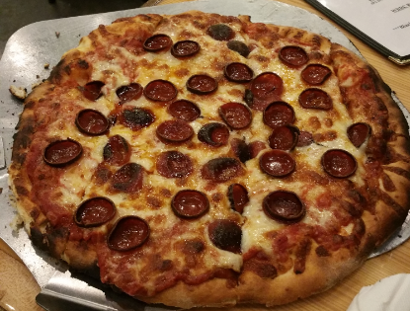
Project Statement
Building a website for a local restaurant that serves pizzas and other foods as another advertising platform

Slide 3
Brief History of the Restaurant
The restaurant was built by two brothers that loved pizza and wanted to share their love of food with the rest of the world.
The original restaurant, called Monster Pizzas, was built in 2000 in Boston, MA. It was burned down in 2004 due to a nearby apartment fire. After struggling a few years to reopen, they rebuilt the restaurant in Seattle, WA and called it Best Pizzas NA to signify that their pizzas are the best in North America.

Slide 4
Information Architecture
The website will consist of an about us, location, home, and menu web page.
Visitors who go to the website will hit the home page first. From there, he or she has the choice of navigating to the menu, location, or about us pages using the navigation bar.
To get back to the home page, he or she will need to click on the logo.

Slide 5
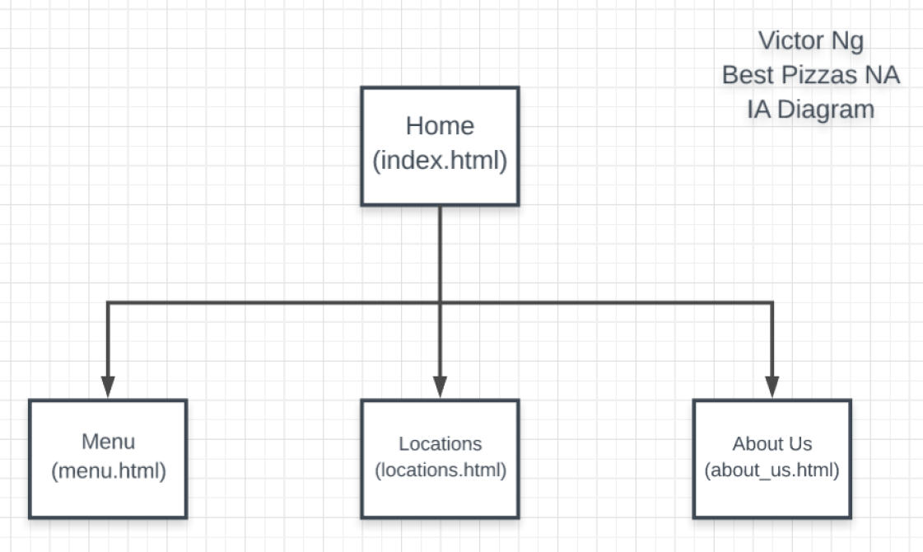
Information Architecture

Slide 6
Website Design & Concept
The website is going for a design that looks and feels local. We want the website to look legitimate, but not too simple like the pizza chains (Pizza hut, Dominos, etc.)
Every web page, including mobile, will have the hours and contact information listed on the left hand side. This ensures the information is always available when the visitor decides to contact the restaurant.
In the case of mobile, this information will be displayed at the bottom of the web page in the same order (hours, contact, share).

Slide 7
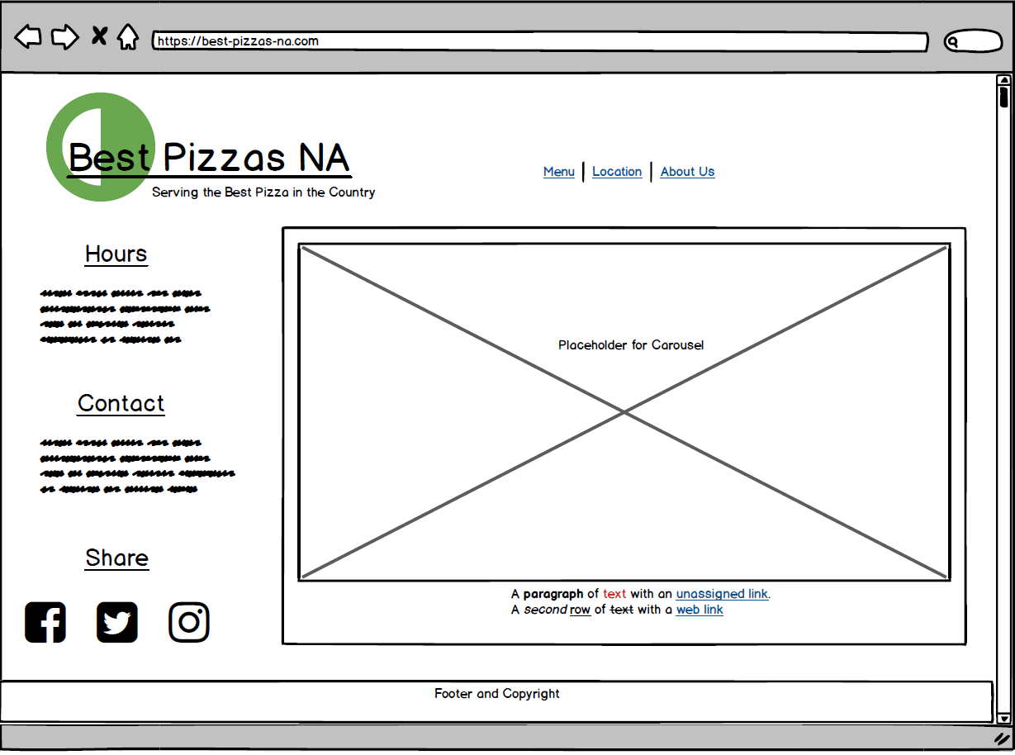
Website Design & Concept (Desktop)

Slide 8
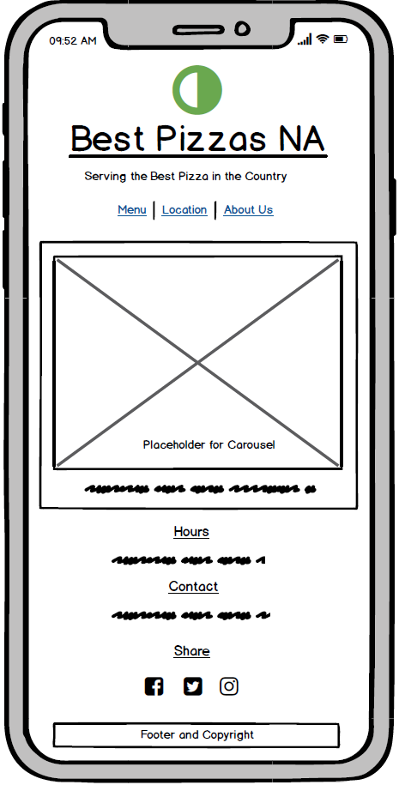
Website Design & Concept (Mobile)

Slide 9
Target Audience
New and returning customers – primary source of revenue
Foodies and journalists – increase exposure of the restaurant and further promote restaurant business

Slide 10
Best Practices and/or Recommendations
Since we are designing a website to allow customers to view our website from any device, we will need to follow mobile-first guidelines: https://abookapart.com/products/mobile-first
We will employ best practices set by W3C (https://www.w3.org/standards/webdesign/mobilweb) to make our website mobile compliant

Slide 11
Additional Thoughts
We will use the Bootstrap framework primarily to make the website mobile compliant.
We will conduct surveys to get peoples’ feedback on the website.

