Slide 1
Crawling HTML

Slide 2
Class Overview
Other Cool Stuff
Query processing
Content Analysis
Indexing
Crawling
Document Layer
Network Layer

Slide 3
Today
Crawlers
Server Architecture

Slide 4
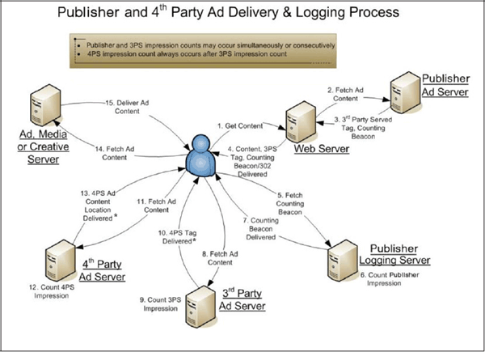
Graphic by Stephen Combs (HowStuffWorks.com) &
Kari Meoller(Turner Broadcasting)

Slide 5
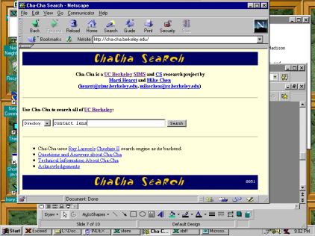
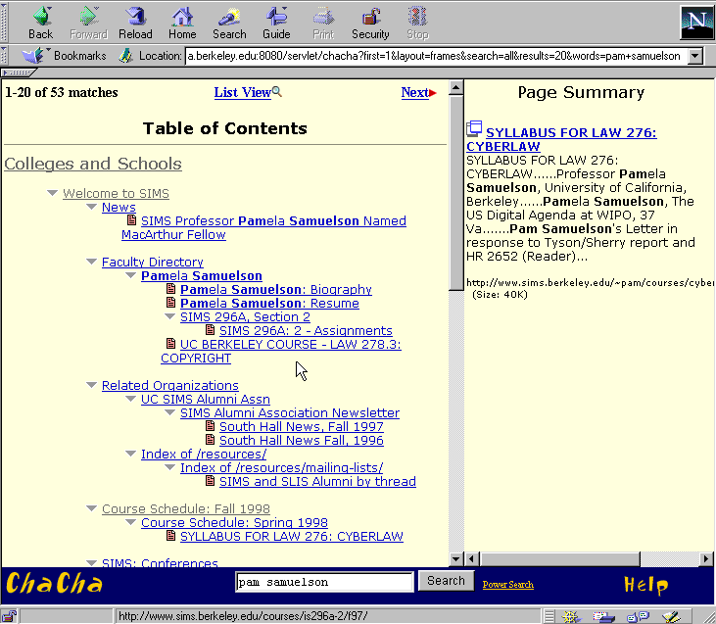
Standard Web Search Engine Architecture
store documents,
check for duplicates,
extract links
DocIds
crawl the
web
create an
inverted
index
user
query
inverted
index
Search
engine
servers
show results
To user
Slide adapted from Marti Hearst / UC Berkeley]

Slide 6
CRAWLERS…

Slide 7
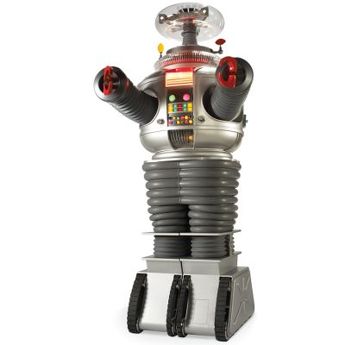
Danger Will Robinson!!
Consequences of a bug
Max 6 hits/server/minute
plus….
http://www.cs.washington.edu/lab/policies/crawlers.html

Slide 8
Open-Source Crawlers
GNU Wget
  Utility for downloading files from the Web.
  Fine if you just need to fetch files from 2-3 sites.
Heritix
  Open-source, extensible, Web-scale crawler
  Easy to get running.
  Web-based UI
Nutch
  Featureful, industrial strength, Web search package.
  Includes Lucene information retrieval part
    TF/IDF and other document ranking
    Optimized, inverted-index data store
  You get complete control thru easy programming.

Slide 9
Search Engine Architecture
Crawler (Spider)
  Searches the web to find pages. Follows hyperlinks.
  Never stops
Indexer
  Produces data structures for fast searching of all words in the pages
Retriever
  Query interface
  Database lookup to find hits
    300 million documents
    300 GB RAM, terabytes of disk
  Ranking, summaries
Front End

Slide 10
Thinking about Efficiency
Clock cycle: 2 GHz
  Typically completes 2 instructions / cycle
    ~10 cycles / instruction, but pipelining & parallel execution
  Thus: 4 billion instructions / sec
Disk access: 1-10ms
  Depends on seek distance, published average is 5ms
  Thus perform 200 seeks / sec
  (And we are ignoring rotation and transfer times)
Disk is 20 Million times slower !!!
Store index in Oracle database?
Store index using files and unix filesystem?

Slide 11
Spiders = Crawlers
1000s of spiders
Various purposes:
  Search engines
  Digital rights management
  Advertising
  Spam
  Link checking – site validation

Slide 12
Spiders (Crawlers, Bots)
Queue := initial page URL₀
Do forever
  Dequeue URL
  Fetch P
  Parse P for more URLs; add them to queue
  Pass P to (specialized?) indexing program
Issues…
  Which page to look at next?
    keywords, recency, focus, ???
  Avoid overloading a site
  How deep within a site to go?
  How frequently to visit pages?
  Traps!

Slide 13
Crawling Issues
Storage efficiency
Search strategy
  Where to start
  Link ordering
  Circularities
  Duplicates
  Checking for changes
Politeness
  Forbidden zones: robots.txt
  CGI & scripts
  Load on remote servers
  Bandwidth (download what need)
Parsing pages for links
Scalability
Malicious servers: SEOs

Slide 14
Robot Exclusion
Person may not want certain pages indexed.
Crawlers should obey Robot Exclusion Protocol.
  But some don’t
Look for file robots.txt at highest directory level
  If domain is www.ecom.cmu.edu, robots.txt goes in www.ecom.cmu.edu/robots.txt
Specific document can be shielded from a crawler by adding the line:
  <META NAME="ROBOTS” CONTENT="NOINDEX">

Slide 15
Robots Exclusion Protocol
Format of robots.txt
  Two fields. User-agent to specify a robot
  Disallow to tell the agent what to ignore
To exclude all robots from a server:
User-agent: *
Disallow: /
To exclude one robot from two directories:
User-agent: WebCrawler
Disallow: /news/
Disallow: /tmp/
View the robots.txt specification at http://info.webcrawler.com/mak/projects/robots/norobots.html

Slide 16
Danger, Danger
Ensure that your crawler obeys robots.txt
Don’t make any of these typical mistakes:
  Provide contact info in user-agent field.
  Monitor the email address
  Notify the CS Lab Staff
  Honor all Do Not Scan requests
  Post any "stop-scanning" requests
  “The scanee is always right."
  Max 6 hits/server/minute

Slide 17
Outgoing Links?
Parse HTML…
Looking for…what?
?
anns html foos
Bar baz hhh www
A href = www.cs
Frame font zzz
,li> bar bbb anns
html foos
Bar baz hhh www
A href = ffff zcfg
www.cs bbbbb z
Frame font zzz
,li> bar bbb

Slide 18
Which tags / attributes hold URLs?
  Anchor tag: <a href=“URL” … > … </a>
  Option tag: <option value=“URL”…> … </option>
  Map: <area href=“URL” …>
  Frame: <frame src=“URL” …>
  Link to an image: <img src=“URL” …>
  Relative path vs. absolute path: <base href= …>
  Bonus problem: Javascript
  In our favor: Search Engine Optimization

Slide 19
Web Crawling Strategy
Starting location(s)
Traversal order
  Depth first (LIFO)
  Breadth first (FIFO)
  Or ???
Politeness
Cycles?
Coverage?

Slide 20
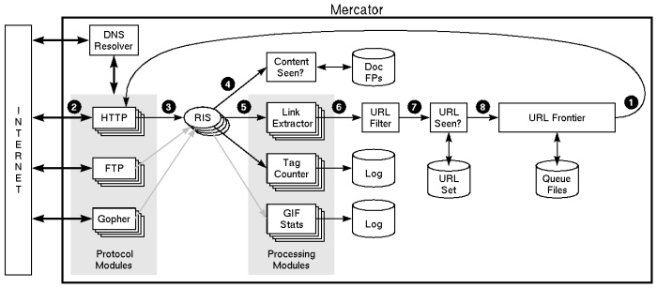
Structure of Mercator Spider
Document fingerprints
1. Remove URL from queue
2. Simulate network protocols & REP
3. Read w/ RewindInputStream (RIS)
4. Has document been seen before?
(checksums and fingerprints)
5. Extract links
6. Download new URL?
7. Has URL been seen before?
8. Add URL to frontier

Slide 21
URL Frontier (priority queue)
Most crawlers do breadth-first search from seeds.
Politeness constraint: don’t hammer servers!
  Obvious implementation: “live host table”
  Will it fit in memory?
  Is this efficient?
Mercator’s politeness:
  One FIFO subqueue per thread.
  Choose subqueue by hashing host’s name.
  Dequeue first URL whose host has NO outstanding requests.
Notes:
Live host table = hosts that have outstanding requests to them.
It should fit in memory, but the problem is locality. Alta vista had this implementation and because of URL locality, it spent a lot of time repeatedly checking the table, only to find out that it couldn’t make the query.

Slide 22
Fetching Pages
Need to support http, ftp, gopher, ....
  Extensible!
Need to fetch multiple pages at once.
Need to cache as much as possible
  DNS
  robots.txt
  Documents themselves (for later processing)
Need to be defensive!
  Need to time out http connections.
  Watch for “crawler traps” (e.g., infinite URL names.)
  See section 5 of Mercator paper.
  Use URL filter module
  Checkpointing!

Slide 23
Duplicate Detection
URL-seen test: has URL been seen before?
  To save space, store a hash
Content-seen test: different URL, same doc.
  Supress link extraction from mirrored pages.
What to save for each doc?
  64 bit “document fingerprint”
  Minimize number of disk reads upon retrieval.

Slide 24
Nutch: A simple architecture
Seed set
Crawl
Remove duplicates
Extract URLs (minus those we’ve been to)
  new frontier
Crawl again
Can do this with Map/Reduce architecture

Slide 25
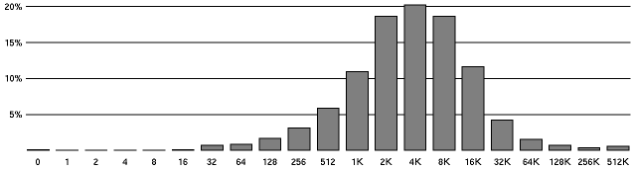
Mercator Statistics
PAGE TYPE PERCENT
text/html 69.2%
image/gif 17.9%
image/jpeg 8.1%
text/plain 1.5
pdf 0.9%
audio 0.4%
zip 0.4%
postscript 0.3%
other 1.4%
Exponentially increasing size
Outdated

Slide 26
Advanced Crawling Issues
Limited resources
  Fetch most important pages first
Topic specific search engines
  Only care about pages which are relevant to topic
“Focused crawling”
Minimize stale pages
  Efficient re-fetch to keep index timely
  How track the rate of change for pages?

Slide 27
Focused Crawling
Priority queue instead of FIFO.
How to determine priority?
  Similarity of page to driving query
    Use traditional IR measures
    Exploration / exploitation problem
  Backlink
    How many links point to this page?
  PageRank (Google)
    Some links to this page count more than others
  Forward link of a page
  Location Heuristics
    E.g., Is site in .edu?
    E.g., Does URL contain ‘home’ in it?
  Linear combination of above

Slide 28
Outline
Search Engine Overview
HTTP
Crawlers
Server Architecture

Slide 29
Server Architecture

Slide 30
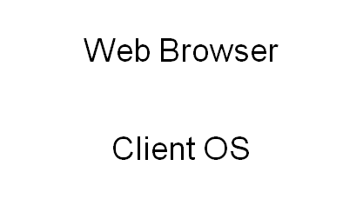
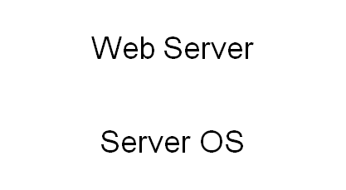
Connecting on the WWW
Internet

Slide 31
Client-Side View
Content rendering engine
  Tags, positioning, movement
Scripting language interpreter
  Document object model
  Events
  Programming language itself
Link to custom Java VM
Security access mechanisms
Plugin architecture + plugins
Internet
Web Sites

Slide 32
Server-Side View
Database-driven content
Lots of Users
Scalability
Load balancing
Often implemented with cluster of PCs
24x7 Reliability
Transparent upgrades
Internet
Clients

Slide 33
Trade-offs in Client/Server Arch.
Compute on clients?
  Complexity: Many different browsers
    {Firefox, IE, Safari, …} × Version × OS
Compute on servers?
  Peak load, reliability, capital investment.
  + Access anywhere, anytime, any device
  + Groupware support (shared calendar, …)
  + Lower overall cost (utilization & debugging)
  + Simpler to update service

Slide 34
Dynamic Content
We want to do more via an http request
  E.g. we’d like to invoke code to run on the server.
Initial solution: Common Gateway Interface (CGI) programs.
Example: web page contains form that needs to be processed on server.

Slide 35
CGI Code
CGI scripts can be in any language.
A new process is started (and terminated) with each script invocation (overhead!).
Improvement I:
  Run some code on the client’s machine
  E.g., catch missing fields in the form.
Improvement II:
  Server APIs (but these are server-specific).

Slide 36
Java Servlets
Servlets : applets that run on the server.
  Java VM stays, servlets run as threads.
Accept data from client + perform computation
Platform-independent alternative to CGI.
Can handle multiple requests concurrently
  Synchronize requests - use for online conferencing
Can forward requests to other servers
  Use for load balancing

Slide 37
Java Server Pages (JSP)
Active Server Pages (ASP)
Allows mixing static HTML w/ dynamically generated content
JSP is more convenient than servlets for the above purpose
More recently PHP & Ruby on Rails
<html>
<head>
<title>Example #3</title>
</head>
<? print(Date("m/j/y")); ?>
<body>
</body>
</html>

Slide 38
AJAX
Getting the browser to behave like your applications (caveat: Asynchronous)
Client → Rendering library (Javascript)
  Widgets
Talks to Server (XML)
How do we keep state?
Over the wire protocol: SOAP/XML-RPC/etc.

Slide 39
Interlude: HTML 5

Slide 40
Why HTML 5?
‘The websites of today are built with languages largely conceived during the mid to late1990’s, when the web was still in its infancy.’*
* Work on HTML 4 started in early 1997
CSS 2 was published in 1998
Slide from David Penny, EMCDDA 11/09
Notes:
These are sweeping statements to be taken with a grain of salt. HMTL 4.01 was issued as a recommendation in May 2001 and XHTML (essentially HTML 4.01 in XML syntax) in January 2000. The announcement in May of 2009 that work would cease on XHTML 2.0 effec

Slide 41
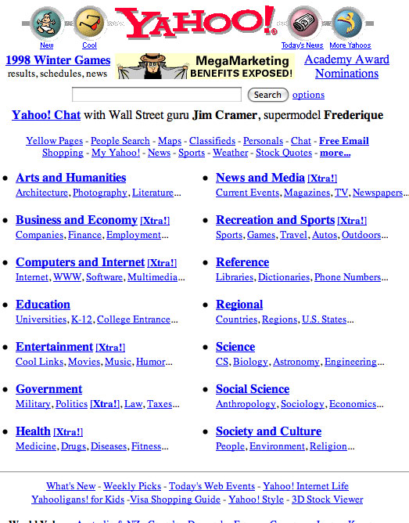
The website circa 1998
Simple layout
No frills design
Text, text, text
Slide from David Penny, EMCDDA 11/09
Notes:
These are sweeping statements to be taken with a grain of salt. HMTL 4.01 was issued as a recommendation in May 2001 and XHTML (essentially HTML 4.01 in XML syntax) in January 2000. The announcement in May of 2009 that work would cease on XHTML 2.0 effec

Slide 42
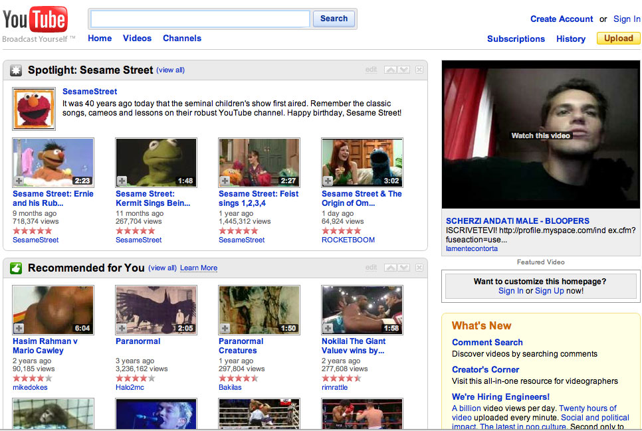
The website circa 2009
Complex layout
Fancy designs
User-interactivity
The modern web page is sometimes like a book,
sometimes like an application,
sometimes like an extension of your TV.
Current web languages were never designed to do this.
Slide from David Penny, EMCDDA 11/09
Notes:
These are sweeping statements to be taken with a grain of salt. HMTL 4.01 was issued as a recommendation in May 2001 and XHTML (essentially HTML 4.01 in XML syntax) in January 2000. The announcement in May of 2009 that work would cease on XHTML 2.0 effec

Slide 43
HTML 5 & CSS 3
HTML 5
Specifically designed for web applications
Nice to search engines and screen readers
HTML 5 will update HTML 4.01, DOM Level 2
CSS level 3
Will make it easier to do complex designs
Will look the same across all browsers
CSS 3 will update CSS level 2 (CSS 2.1)
Slide from David Penny, EMCDDA 11/09
Notes:
These are sweeping statements to be taken with a grain of salt. HMTL 4.01 was issued as a recommendation in May 2001 and XHTML (essentially HTML 4.01 in XML syntax) in January 2000. The announcement in May of 2009 that work would cease on XHTML 2.0 effec

Slide 44
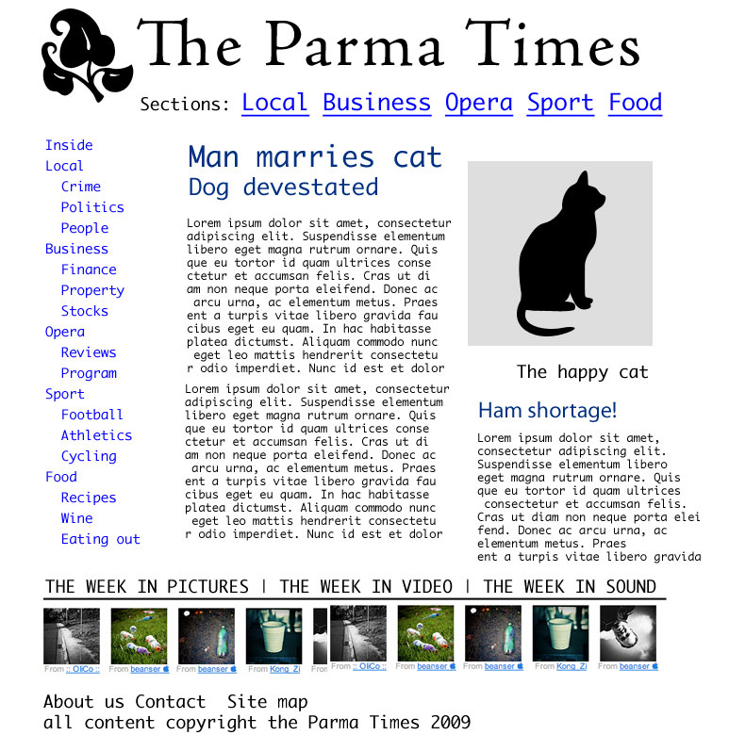
HTML 5: today’s markup
Today, if we wanted to markup this page we would use a lot of <div> tags, and classes.
Semantic value of <div> and ‘class’ = 0
Can lead to ‘divitis’ and ‘classitis’.
Slide from David Penny, EMCDDA 11/09

Slide 45
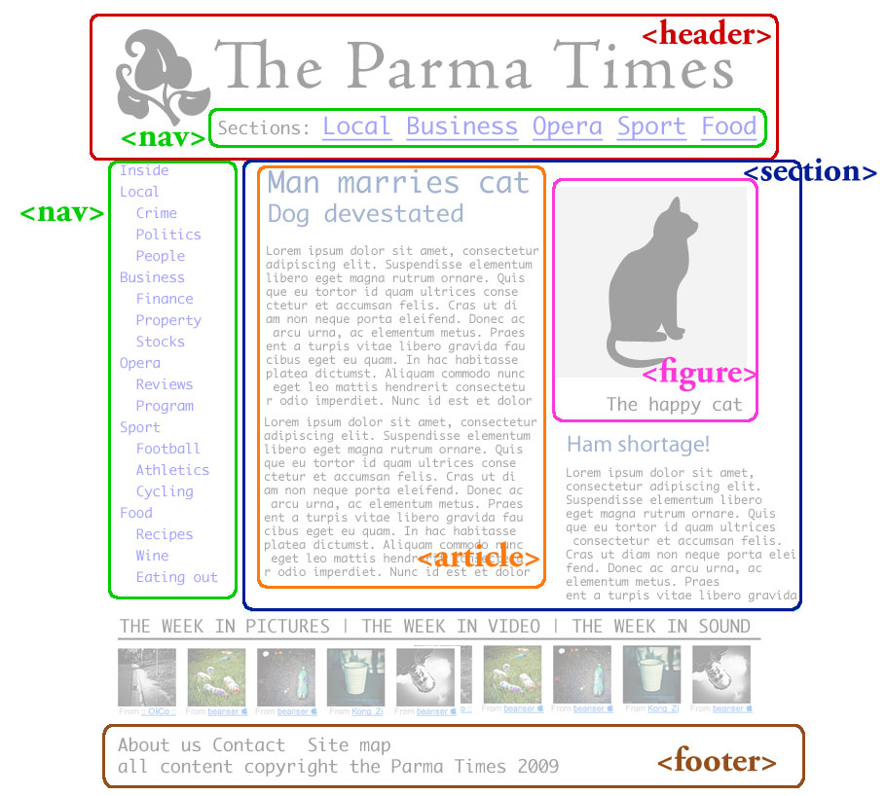
HTML 5: new tags to the rescue
Hello ,<header>, <nav>, <article>, <section>, and other new tags.
It’s good for search engines, screen readers, information architects, and the web in general.
Slide from David Penny, EMCDDA 11/09

Slide 46
HTML 5: at last, video + audio
Currently Video and audio handled by plugins (Flash, ReatTime, etc.)
New <video> and <audio> and associated APIs tags will be used as <img> tag is today
Browsers will need to define how video and audio should be played (controls, interface, etc.)
Slide from David Penny, EMCDDA 11/09

Slide 47
HTML 5: Web applications 1.0
Web applications a huge part of HTML 5.
Some APIs include:
  drag and drop,
  canvas (drawing),
  offline storage,
  geo-location,
Slide from David Penny, EMCDDA 11/09

Slide 48
HTML 5: Form handling
required attribute:
  browser checks for you that the data has been entered
email input type:
  a valid email must be entered
url input type:
  requires a valid web address
Slide from David Penny, EMCDDA 11/09

Slide 49
Roadmap
First W3C Working Draft in October 2007.
Last Call Working Draft in October 2009.
Candidate Recommendation in 2012.
First and second draft of test suite in 2012, 2015.
Reissued Last Call Working Draft in 2020.
Proposed Recommendation in 2022 (!)
Current browsers have already started implementing HTML 5.
Note: today’s candidate recommendation status = yesterday’s recommendation status
Slide from David Penny, EMCDDA 11/09

Slide 50
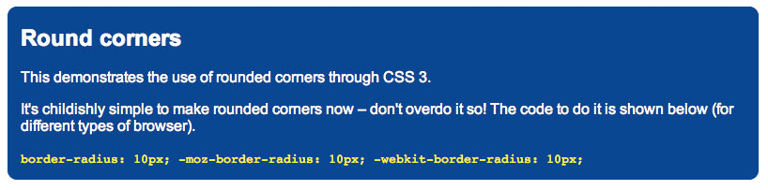
CSS-3: round corners
border-radius (or variant depending on browser) is used to make rounded corners
Example:
border-radius: 3px
The bigger the value or the radius, the more curvy and larger are the rounded corners
Much simpler than using CSS 2 (no background images etc. needed)
Slide from David Penny, EMCDDA 11/09

Slide 51
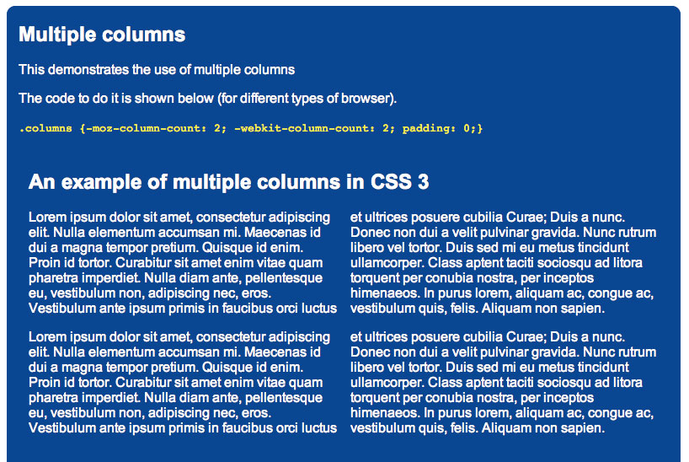
CSS-3: Multi-column layout
Allows you to split text newspaper-like across multiple columns
Express in terms of number of columns or width.
Example 1:
column-width: 45%; column-gap 5%;
Example 2:
column-count: 3;
Slide from David Penny, EMCDDA 11/09

Slide 52
CSS-3: Other new stuff
Multiple backgrounds
Border images
Transitions
New selectors:
‘… the power to describe Web 2.0 designs in CSS is insignificant compared with the power to select every third table row starting with the fifth one.’
Eric Meyer
Slide from David Penny, EMCDDA 11/09

Slide 53
CSS 3 timeline
Unlike CSS 2, CSS 3 consists of modules
Each module is recommended separately
Several modules are already considered stable and will probably not change in the future
Many are already implemented in current browsers
www.w3.org/Style/CSS/current-work gives the state of each module
Slide from David Penny, EMCDDA 11/09

Slide 54
Server Architecture

Slide 55

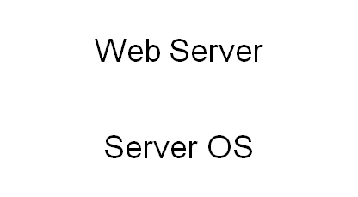
Connecting on the WWW
Internet

Slide 56
Tiered Architectures
1-tier = dumb terminal → smart server.
2-tier = client/server.
3-tier = client/application server/database.
  Why decompose the server?

Slide 57
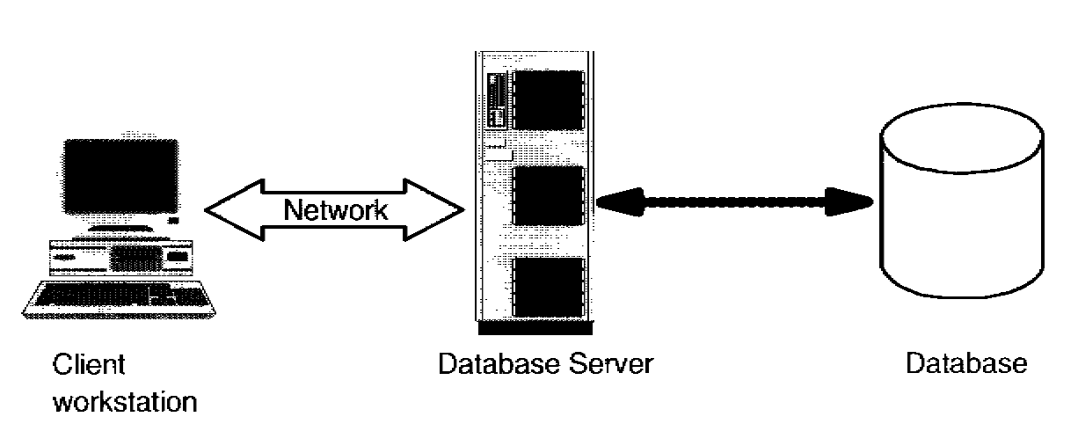
Two-Tier Architecture
TIER 2:
SERVER
Server performs
all processing
TIER 1:
CLIENT
Web Server
Application Server
Database Server
Server does too much work. Weak Modularity.
Notes:
52

Slide 58
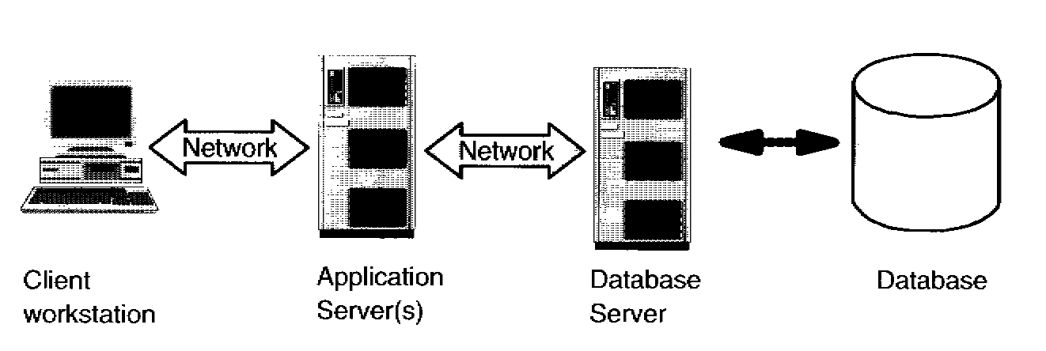
Three-Tier Architecture
TIER 2:
SERVER
TIER 3:
BACKEND
Application server
offloads processing
to tier 3
TIER 1:
CLIENT
Web Server +
Application Server
Using 2 computers instead of 1 can result in a huge increase in simultaneous clients.
Depends on % of CPU time spent on database access.
While DB server waits on DB, Web server is busy!
Notes:
52

Slide 59
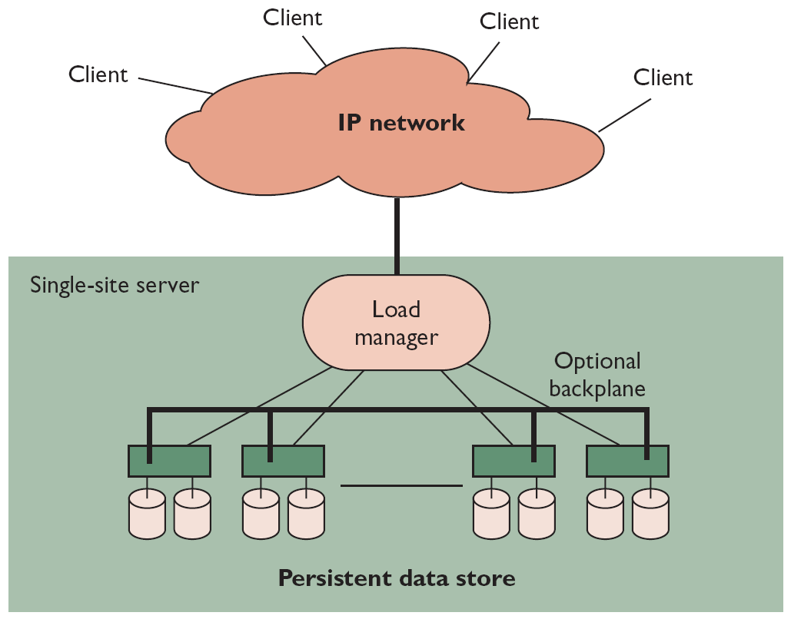
Getting to ‘Giant Scale’
Only real option is cluster computing
Optional Backplane:
System-wide network for intra-server traffic:
Query redirect, coherence traffic for store, updates, …
From: Brewer Lessons from Giant-Scale Services

Slide 60
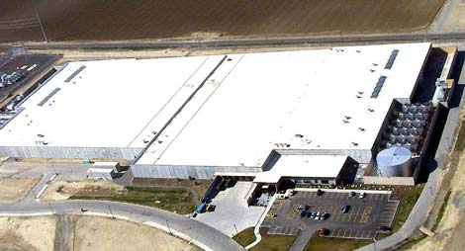
Microsoft Server Farm
Quincy, WA
9th largest in US (as of May 2010)

Slide 61
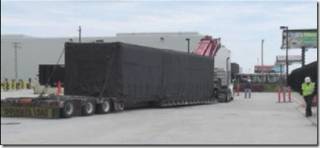
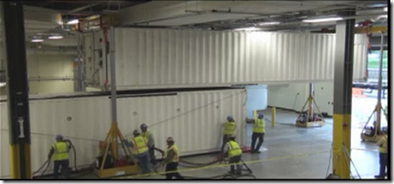
Containerized Data Centers
Factory built in shipping container
Trucked to loc; forklift stacks in warehouse
Connected to:
  chilled water supply,
  fiber-optic connection,
  electrical plugs
Self-provisioning +self-managed.

Slide 62
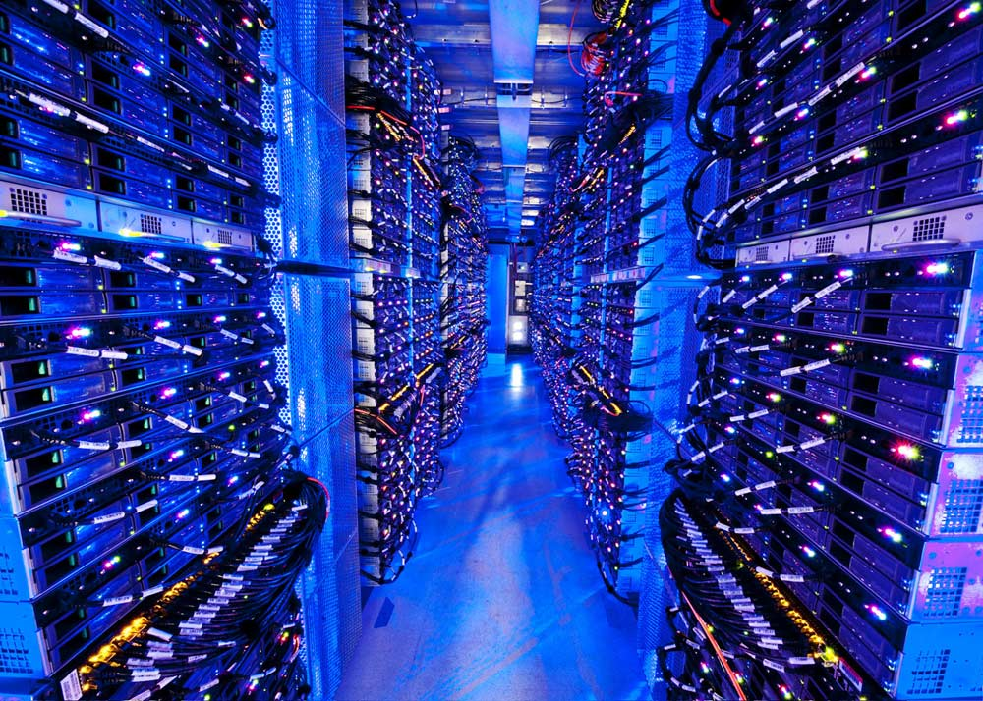
Inside the Container
Extreme symmetry
Internal disks
No monitors
No visible cables
No people!
Offsite management
Contracts limit
  Δ Power
  Δ Temperature
From: Brewer Lessons from Giant-Scale Services
Image: Microsoft Chicago data center

Slide 63
High Availability
Essential Objective
Phone network, railways, water system
Challenges
  Component failures
  Constantly evolving features
  Unpredictable growth
From: Brewer Lessons from Giant-Scale Services

Slide 64
Architecture
What do faults impact? Yield? Harvest?
Replicated systems
  Faults → reduced capacity (hence, yield @ high util)
Partitioned systems
  Faults → reduced harvest
  Capacity (queries / sec) unchanged
DQ Principle ∃ physical bottleneck
  Data/Query × Queries/Sec = Constant
From: Brewer Lessons from Giant-Scale Services

Slide 65
Graceful Degradation
Too expensive to avoid saturation
Peak/average ratio
  1.6x - 6x or more
  Moviefone: 10x capacity for Phantom Menace
    Not enough…
Dependent faults (temperature, power)
  Overall DQ drops way down
Cutting harvest by 2 doubles capacity…
From: Brewer Lessons from Giant-Scale Services

Slide 66
Admission Control (AC) Techniques
Cost-Based AC
  Denying an expensive query allows 2 cheap ones
  Inktomi
Priority-Based (Value-Based) AC
  Stock trades vs. quotes
  Datek
Reduced Data Freshness
From: Brewer Lessons from Giant-Scale Services

