Slide 1

Facebook Open Graph

Slide 2
History of the Open Graph
August 2006: First Version of the Facebook API is Introduced
-This enabled users to share their information with third-party applications and websites they choose.
May 2008: Facebook Launches Facebook Connect
-This allowed users to ‘connect’ their Facebook identity, friends and privacy settings to any site.
April 2010: Facebook Launches its ‘Open Graph’ API
-This allowed developers to do more than just connect their site to Facebook. It introduced a new set of programming tools that allows developers to get information in and out of Facebook. New plugins came with the ‘Open Graph,’ including the like button, activity feed, recommendations, like box, login button, facepile, comments and live stream.
September 2011: Facebook Introduced the New Open Graph
- The new Open Graph is different from the old in many ways, most distinctively: applications no longer have to ask permissions to post content to Facebook over and over, updates through the new graph appear in the ticker automatically, but do not appear in the news feed unless it’s an important event, and users can share experiences, such as listening to music, through the new Open Graph and the ticker.

Slide 3
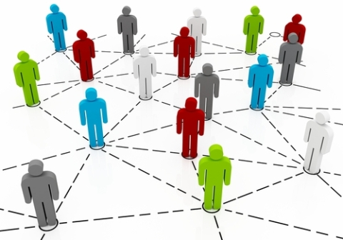
Social Graph
"The global mapping of everybody and how they're related" in Social Network.

Slide 4




The old social graph contained relationships
between people
(and some groups and brands)
is friends with
is a Fan of
Larry
is a member of
Local Pizza Co
People Who Love Cheese
Notes:
The old social graph focused on friendship relationships. Facebook next added group relationships, and finally brand relationships.
However this still limited the types of connections that could be made.

Slide 5


The Open Graph shows relationships
between objects
uses
is sister to
loves to eat
Larry
is a member of
Local Pizza Co
likes to watch
People Who Love Cheese
Notes:
The Open Graph now enables relationships between people and what they like – people, products, places, ideas. Anything a person can connect to can be linked now in Facebook.
Facebook has established some basic categories of objects to start with, but these will increase over time.

Slide 6

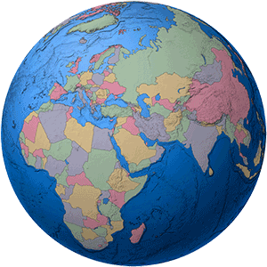
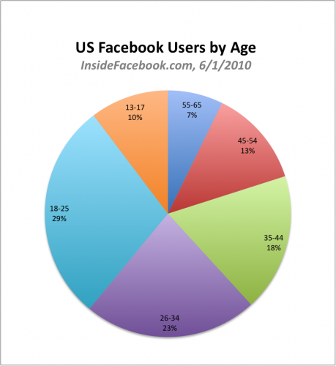
500 Million Users = 3rd Largest Country
Notes:
Facebook is where your customers are
500 million current users, up from 400 million just 5 months ago
Has deep penetration into international markets, approaching 50% saturation in some countries like the UK
The “Over 35” demographic is now close to half of the overall user base

Slide 7
Anything can now be
part of the graph
Your company
Your brand
Your product
Your content
Your idea
Your service
Notes:
Using the categories specified, Facebook can now group and display relationships with context. This can make it much easier for brands to spread their messages and grow their business.

Slide 8








The Social Plugins
Just like Connect, but lighter
Recommendations
Activity Feed
Login with Faces
Like Button
Comments
Like Box
FacePile
Live Stream
Notes:
Facebook’s social plugins have evolved from the Facebook Connect widgets. They offer lightweight interactions, often not requiring the user to log into the hosting website.
There are 3 layers of integration, each offering a little more for doing more work:
Generate a simple line of HTML that hosts the appropriate control and paste it onto your site. (Sometimes a little metadata must be added as well)
Use the Facebook JavaScript SDK and XFBML to add the plugins, modify and interact with them
Create a Facebook web application and use the JavaScript SDK/Open Graph API to create rich integrations

Slide 9
The Open Graph
What is Open Graph and How do we use it?
Implementation for Developers.
Notes:
These widgets show what a user’s friends have done on the site and which items were interacted with the most. This can be a great way to drive views of other content that is likely to be relevant to the viewing users. Facebook takes care of matching the items users have commented on, liked or shared – your site doesn’t have to do anything but add this box.
Note: these plugins do not require a user to be logged into your site, only to be logged into Facebook. They will prompt users to log into Facebook if they aren’t already.

Slide 10
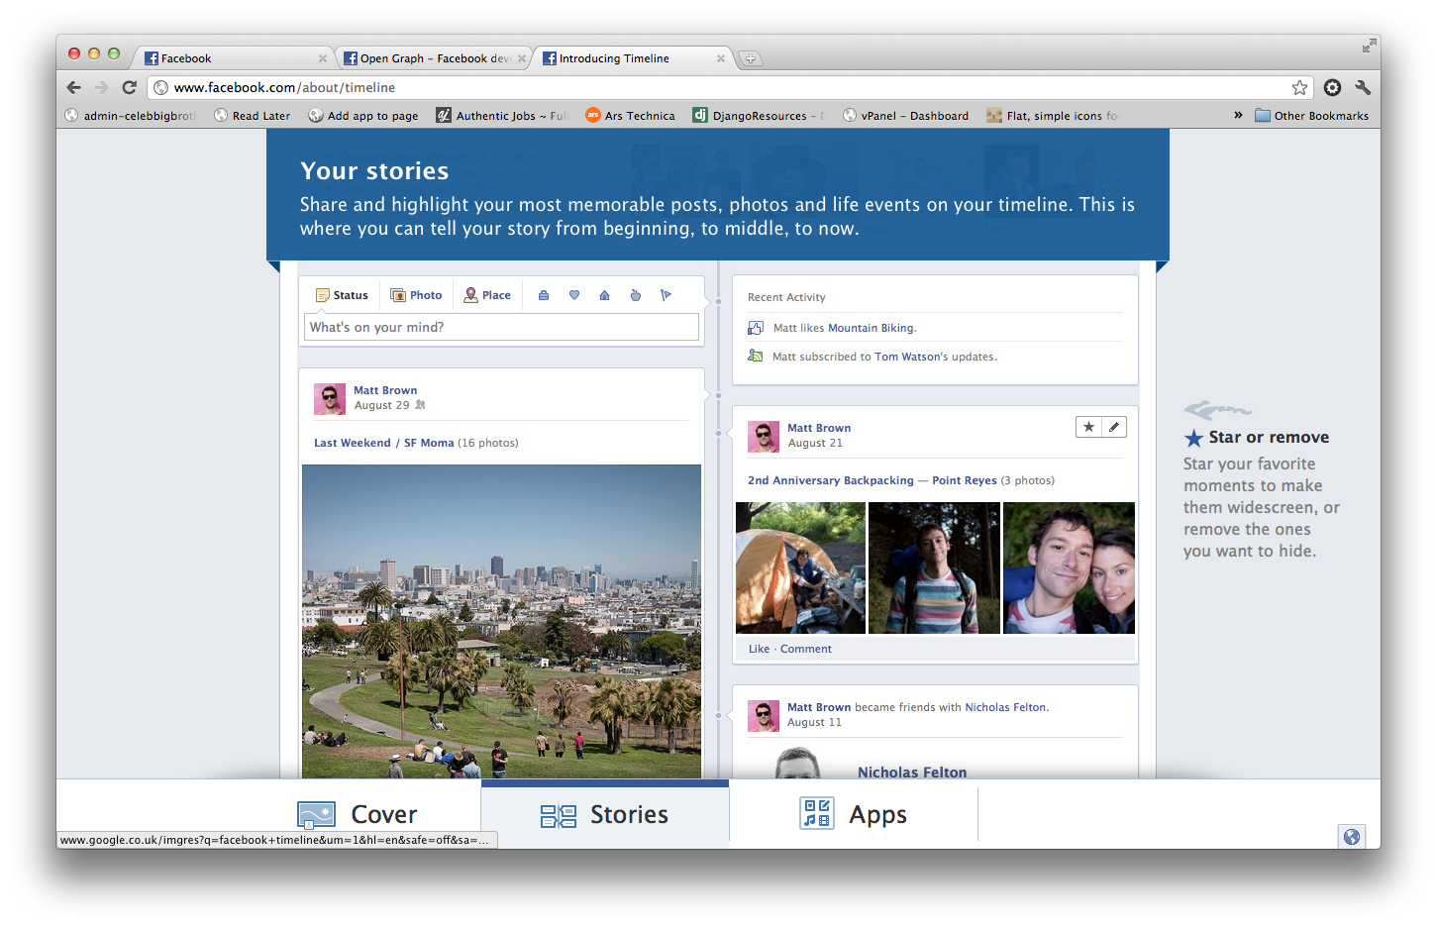
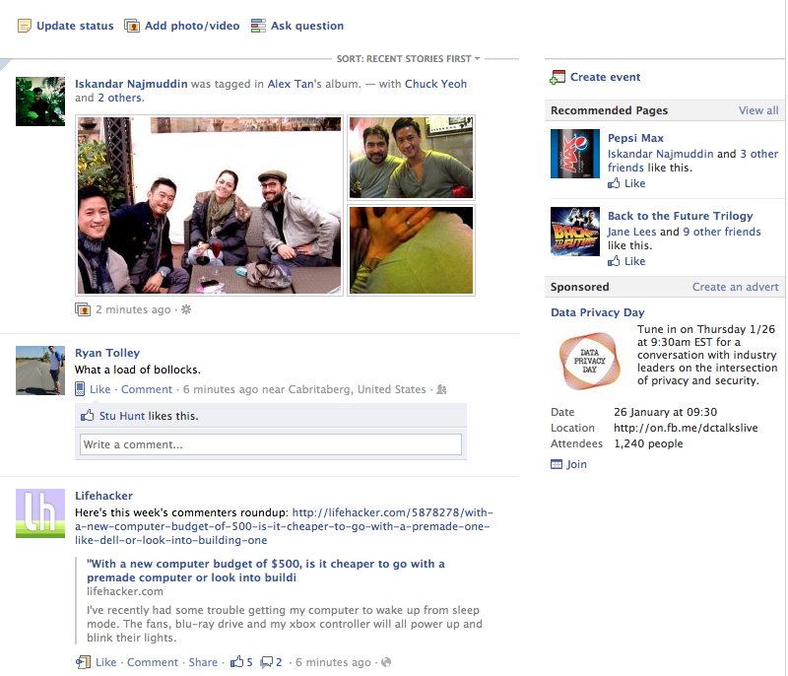
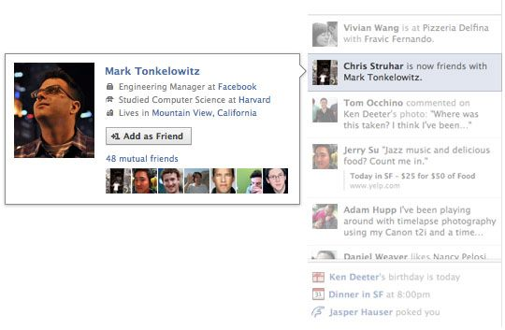
What is Open Graph?
User Interaction
Notes:
The Like Box is a quick way to drive users to a Facebook Public Profile (Fan Page) that you have created for your brand or company. It lets people become a Fan, shows the latest updates and pictures of friends that have also become Fans.
Note: this plugin does not require a user to be logged into your site, only to be logged into Facebook. It will prompt users to log into Facebook if they aren’t already.

Slide 11
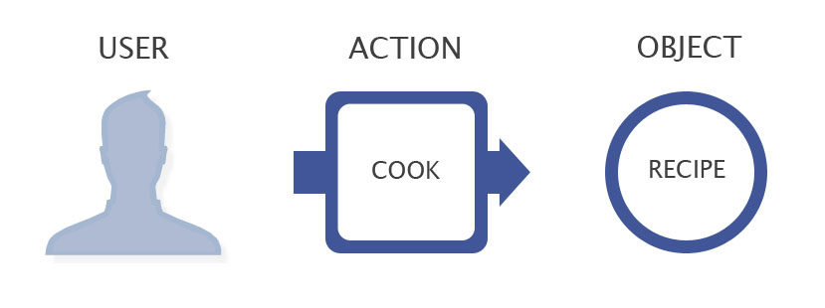
What is Open Graph?
Rajesh purchased a Mobile
Notes:
Enabling Facebook users to log into your site with their Facebook credentials can drastically increase sign ups and retention. It can be a little tricky to integrate with an existing user management system, but Facebook provides some tools to help migrate users, as well as to gather needed information like email addresses. You can position the Login button anywhere on your page, and it will show friends of the user who have already signed up as an enticement. This plugin actually does require users to log into your site.
The Facepile plugin just shows friends that have connected their Facebook account to your site. It is similar to the faces in the Login plugin. You can place this anywhere again as social pressure to sign in. Note: this plugin does not require a user to be logged into your site, only to be logged into Facebook. It will prompt users to log into Facebook if they aren’t already.

Slide 12
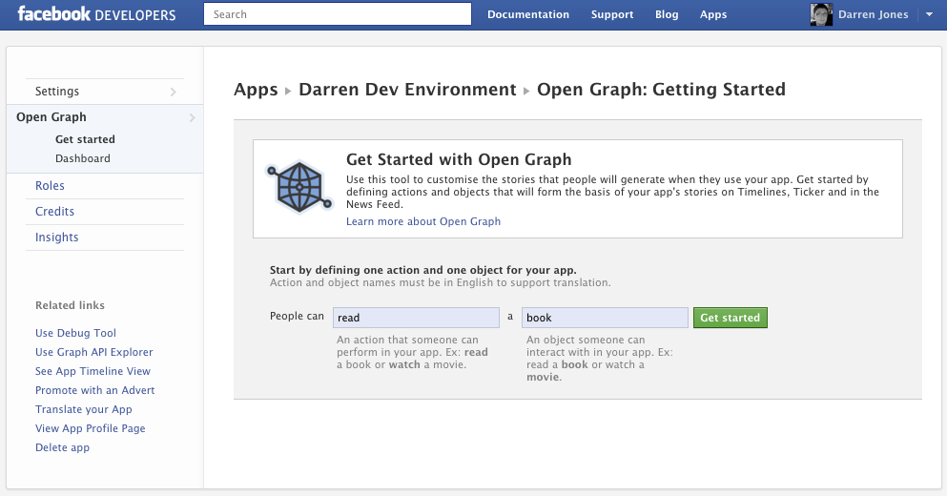
Implementation for Developers
Setting up actions and objects in the Facebook Developer Panel
Notes:
The Comments Box is an easy way to add discussions to a product page or site. Comments from users can be sent directly to their profiles as updates and therefore out to their friends. You can have full moderation capabilities to handle bad content. You need to be prepared to deal with international users, so get your Google Translate ready.
The Live Stream adds a real time discussion to a page. Again comments go to the users profile. This plugin is quite scalable and would work well for events, launches, etc.
Note: these plugins do not require a user to be logged into your site, only to be logged into Facebook. They will prompt users to log into Facebook if they aren’t already.

Slide 13
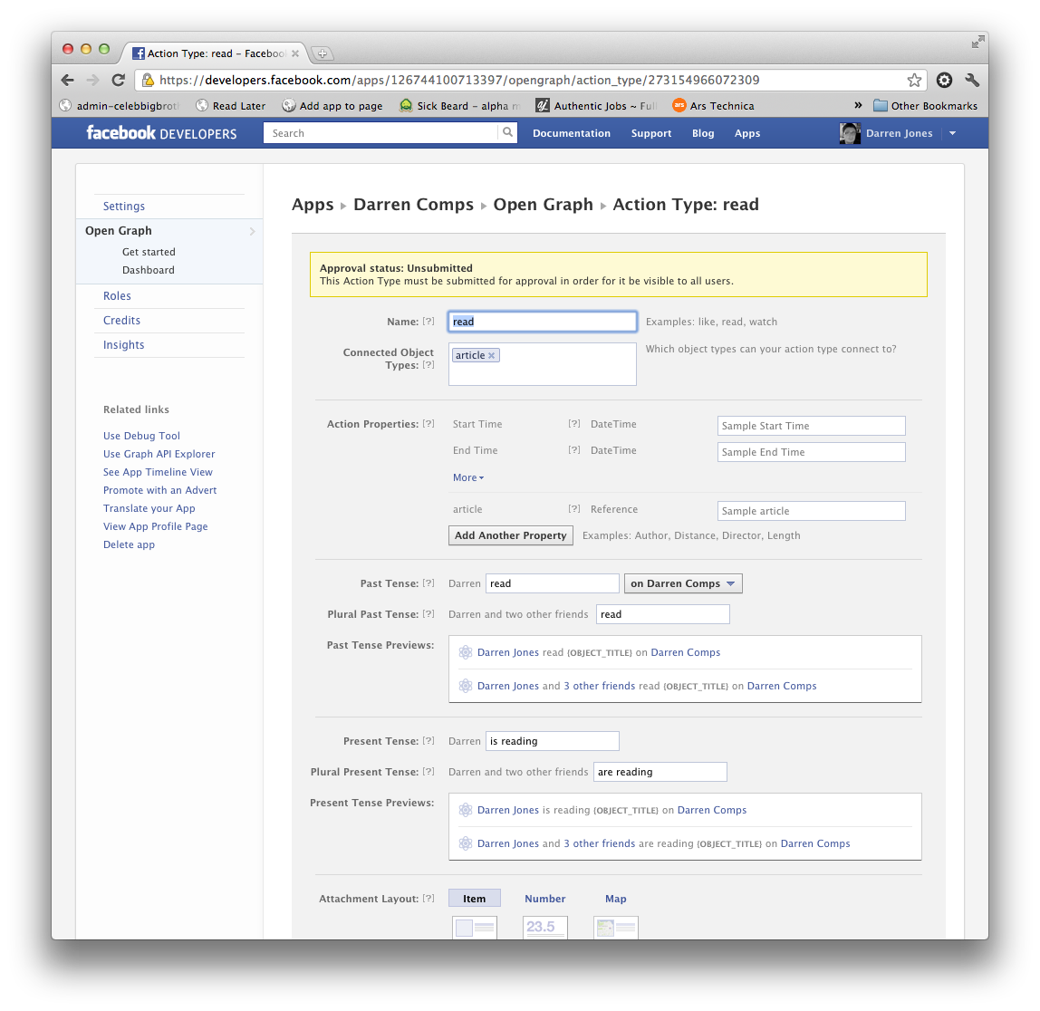
Implementation for Developers
Notes:
Instant Personalization is a feature that allows select sites (currently Docs.com, Pandora and Yelp) access to the viewing user’s public information without them having to log into the site. This lets them automatically show content based on the user’s interests or friend activity. Non-select sites would have to create an application and get the user to give permission in order to access the information.
There was some controversy about this, but Facebook has created a privacy setting to allow users to disable it.

Slide 14
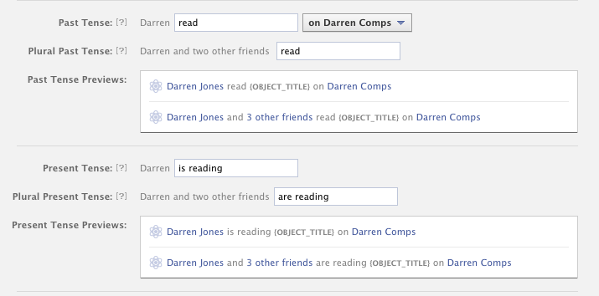
Implementation for Developers
Notes:
The Open Graph is like the Wild West. There is a lot of opportunity to grow quickly and establish dominance by claiming first-order objects on the graph.

Slide 15
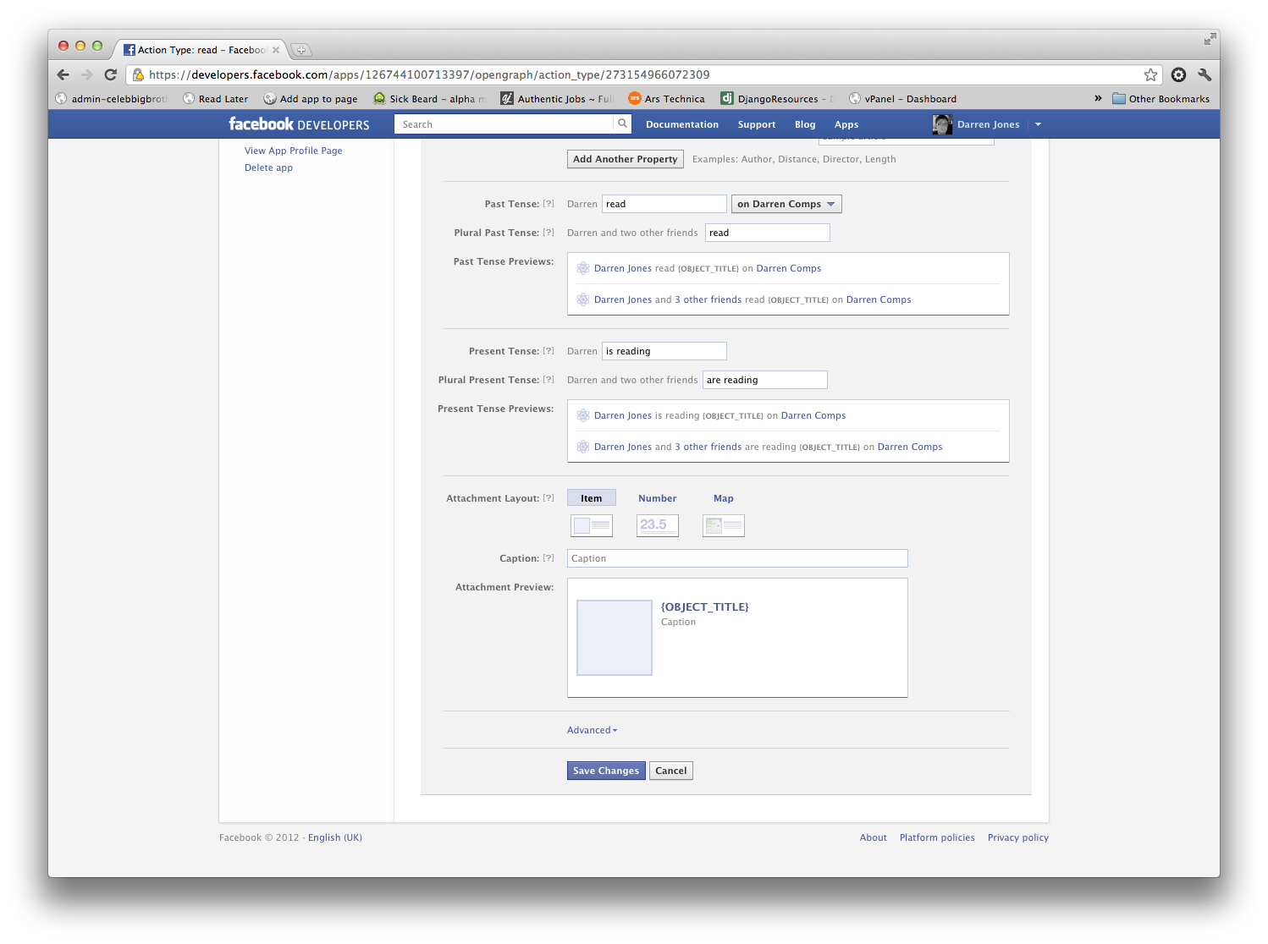
Implementation for Developers
Notes:
Each item that is “liked” can be a first-order-object, meaning that it has a name and identity. An example would be an object named “Boston Celtics” on a page at the Boston Globe. Anyone that sees the item will see it only as “Boston Celtics”. Since anyone can create an object named “Boston Celtics”, the goal is to be the one that owns the one that has the most Fans.

Slide 16
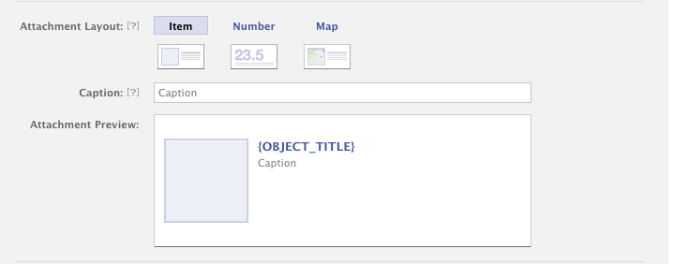
Implementation for Developers
Notes:
Pandora used the Like button to enable users to Like all the artists on the site. This creates a news story on the user’s profile that is also sent to his/her friends. The news story links back to Pandora. They also show what music a user’s friends have listened to and which artists they like. This adds a lot of value for a user in return for being a Facebook user.

Slide 17
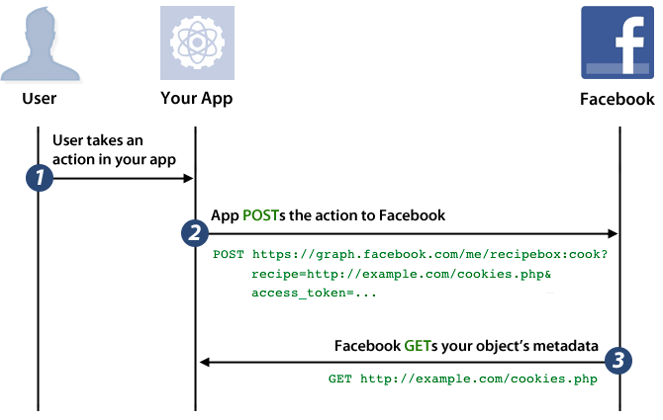
Implementation for Developers
Open Graph mechanics
Notes:
Kayak enables users to “like” hotels and other destinations. In this case, Jamie has liked the Hilton Pearl River hotel. If enough people interact with this object on Facebook, Kayak will have a valuable property, since it now “owns” it. If the Hilton Pearl River wants to reach its customers, it will likely have to interact with Kayak.

Slide 18
Publishing to the Open Graph
Facebook must be able to access the site.
Application must have logo and Unique App-namespace.
OG tags must be in place namespace:action
Once the Application got approved we can publish the action at any time.
Notes:
Enabling Facebook users to log into your site with their Facebook credentials can drastically increase sign ups and retention. It can be a little tricky to integrate with an existing user management system, but Facebook provides some tools to help migrate users, as well as to gather needed information like email addresses. You can position the Login button anywhere on your page, and it will show friends of the user who have already signed up as an enticement. This plugin actually does require users to log into your site.
The Facepile plugin just shows friends that have connected their Facebook account to your site. It is similar to the faces in the Login plugin. You can place this anywhere again as social pressure to sign in. Note: this plugin does not require a user to be logged into your site, only to be logged into Facebook. It will prompt users to log into Facebook if they aren’t already.

Slide 19
Publishing to the Open Graph
curl -F 'access_token=' \
-F 'article=http://example.com/article-slug/' \
'https://graph.facebook.com/me/lastampa:read'
FB.api(
'/me/[YOUR_APP_NAMESPACE]:cook?recipe=http://fbwerks.com:8000/zhen/cookie.html',
'post',
function(response) {
if (!response || response.error) {
alert('Error occured');
} else {
alert('Cook was successful! Action ID: ' + response.id);
}
});
Notes:
Levi’s lets users like individual products, not just the brand as a whole. Users who click it will go right to this specific pair of jeans. Wouldn’t something like this help your products sell more?

Slide 20
Reading from the OpenGraph
GET
https://graph.facebook.com/me/namespace:action
Notes:
Users always have concerns as Facebook tries to balance privacy with the benefits of public information. The more public information, the more Facebook can spread and the more successful it is. Younger generations also feel more comfortable sharing publicly.
Facebook recently release privacy updates to enable users to better control how information is shared with their friends. They can also now globally shut off information access for all applications and for Instant Personalization.
Businesses that need access to a user’s information should ask only for the pieces that they need in response to a user’s direct action. Users will feel better about giving permission in those cases.

Slide 21
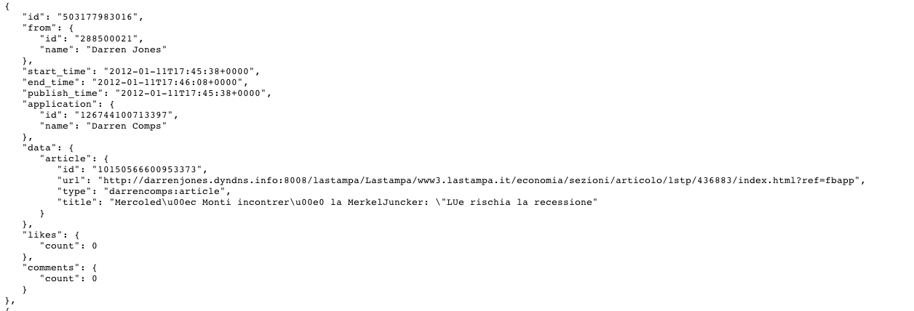
Reading from the OpenGraph

Slide 22
E-commerce
Buying and Selling of products or services
Over electronic system such as the Internet and other computer networks.

Slide 23
But it is More than Buying and selling products Online!

Slide 24
Various aspects of E-commerce
* Inspiration
* Investigation
* Transaction
* End Of Life

Slide 25
Social Commerce
A subset of electronic commerce that involves using social media, on line media that supports social interaction and user contributions, to assist in the on line buying and selling of products and services.

Slide 26
Questions?

