Slide 1

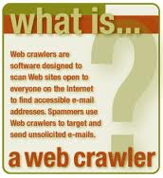
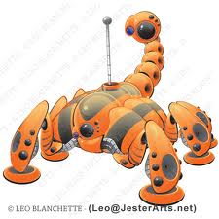
WEB CRAWLING
Santosh Kumar Mohanty
Sedin Technologies/RailsFactory
santosh@railsfactroy.org

Slide 2
WEB CRAWLING
Web scraping (also called web harvesting or web data extraction) is a computer software technique of extracting information from websites.
Web-scraping software: There are many software tools available that can be used to customize web-scraping solutions.
e.g NOKOGIRI, MECHANIZE, HPRICOT and Many More

Slide 3
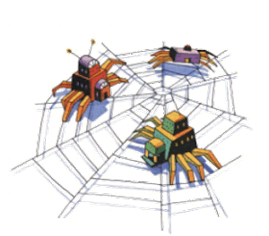
Why Do We Use Crawlers
Web Crawlers, sometimes called scrapers, automatically scan the Internet attempting to glean context and meaning of the content they find. The web wouldn’t function without them. Crawlers are the backbone of search engines which, combined with clever algorithms, work out the relevance of your page to a given keyword set.
To make a simple crawler, we’ll be using the most common programming language of the internet – RUBY

Slide 4
Objectives
To give some knowledge about core technologies used in Nokogiri
This lecture covers:
  XPath/Css path

Slide 5
Outline
XPath basics
XPath axes
XPath examples

Slide 6
Useful links
Useful links:
  http://www.w3schools.com/xpath/default.asp
  http://nokogiri.org/
  http://mechanize.org

Slide 7
XPath Basics (1)
XPath is a language for specifying parts of an XML document
XPath uses path expressions to identify XML document parts. When evaluated, the expression returns an object that can be of type node-set (a group of nodes of the XML document tree structure), boolean, number, or string. Expressions are evaluated within a context.

Slide 8
XPath Basics (2)
A path expression is typically constructed from steps, which include:
  an axis, specifying the tree relationships between the nodes
  a node test, specifying the name of the selected nodes and
  zero or more predicates, which refine the set of nodes selected.
For example, in the expression:
child::pet[attribute::Type="dog"]
child specifies the axis,
pet the node test
and [... ] the predicate.
Abbreviated syntax is also used, for instance "@Type" instead of "attribute::Type", "/pet" instead of "child::pet" (and others).

Slide 9
XPath Basics (3)
XPath also inludes a library of standard functions for node-sets, strings, boolean and numbers.
Nokogiri provides an, extension to XPath, set of functions, for performing various operations. For instance:
var=Nokogiri::HTML(open('http://www.google.co.in'))
var.xpath('//div') OR
var.css('div')

Slide 10
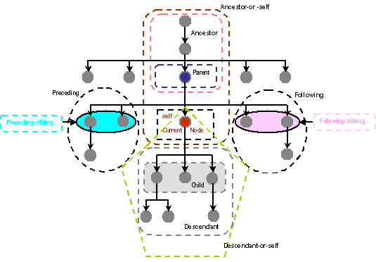
XPath axes
The axes in XPath are shown in the picture below (attributes and namespaces are not shown).

Slide 11
XPath examples (1)
The following XML document example is the one used on the introduction to XML.
  <?xml version="1.0" encoding="iso-8859-1"?> <pets>
  <pet type="dog" color="brown">Max</pet>
  <pet type="cat" color="white">Toula</pet> </pets>
We will now demonstrate some very simple XPath examples using that document.

Slide 12
XPath examples (2)
Select all pet elements
//pet or alternatively /pets/pet or /pets/child::*
Select the first pet
/pets/pet[1]
Select all pets of type dog
//pet[@type ="dog"]
Select all pets of white color
//pet[@color="white"]
Select the color of all dogs
//pet[@type ="dog"]/@color
Get the types of pets with the name Max
/pets/pet[text()="Max"]/@type

Slide 13
Key Points
XPath is an efective and powerful way of query XML documents.
At this point you should have a basic idea about what XML and XPath is all about.
It is VERY IMPORTANT that BEFORE Moving to write a Web Crawler you must be expertised in Xpath and Css path.

Slide 14
ANY QUERIES
THANKING ALL OF YOU
        Santosh Kumar Mohanty
        RailsFactory | 9445808957

