Slide 1
class WsOnRailsTutorial < Tutorial
Web Services on Rails
Using Ruby on Rails for Web Services Development and Mashups
E. Michael Maximilien
http://maximilien.org
Research Staff Member
IBM Almaden Research Center
Almaden Services Research
San Jose, CA USA
date “12 September 2006”
last_modified “3 April 2007”
version “0.9.7”
copyright “© IBM and E. Michael Maximilien, 2007”
Notes:
Tutorial presented at:
ICWS/SCC 2006 on 12 September 2006 in Chicago, IL, USA
IBM Guadalajara on 28 October 2006 in Guadalajara, Jalisco, Mexico, USA
IBM ARC on 1 November 2006 and 8 November 2006 in San Jose, CA, USA
UC Santa Cruz on 30 January 2007 and 5 February 2007 in Mountain View, CA, USA
Fujitsu Labs on 3 April 2007 in Sunnyvale, CA, USA
Mention about the DSL for tutorial in the pages of the tutorial
Define DSL == Domain Specific Language
Guess how to create DSLs?

Slide 2

Why programming is a good medium for
expressing poorly understood and sloppily
formulated ideas
Programming provides us with new tools to express ourselves. We now have intellectual tools to describe “how to” as well as “what is.” This is a profound transformation: it is a revolution in the way we think and the way we express what we think.
[…] one often hears a student or teacher complain that the student knows “the theory” of some subject but cannot effectively solve problems. We should not be surprised […] The student is never given any instructions on how to abstract from examples, nor is the student given any language for expressing what has been learned. It is hard to learn what one cannot express.
[…] expressing methodology in a computer language forces it to be unambiguous and computationally effective. […] The programmer expresses his/her poorly or sloppily formulated idea in a precise way, so that it (can) become clearer […]
G. Jay Sussman, MIT Professor
Keynote talk at OOPSLA 2005
Title “stolen” from a paper by Marvin Minsky (circa 1960’s)

Slide 3


About the speaker
def turorial.about_the_speaker
  Research Staff Member
  IBM Almaden Research Center
  Almaden Services Research group
  13 years experience in software research, architecture, design, and engineering
  Research interests in SOA, Web services, service mashups, service ecosystems, OOD/P, SE, and Agile methods and practices
  Ph.D. in computer science from NC State University, Raleigh
end

Slide 4

Agenda
def tutorial.agenda
Tutorial at a glance and objectives
Setting up Ruby and Rails
Ruby language overview
RoR overview
RoR Web services or APIs (REST, RSS, and SOAP)
  Consuming Web services
  Mashing up Web services
Example
Closing remarks and references
end

Slide 5
At a glance
def tutorial.at_a_glance
Ruby and RoR setup (15 min)
Intro to Ruby (25 min)
Break (10 min)
Intro to RoR (10 min)
MVC in RoR (15 min)
RoR exercise and break (20 min)
Intro to RoR Web services (10 min)
Exposing an API (REST, RSS, and SOAP) (10 min)
Consuming APIs exercise and break (15 min)
Example Web service (or API) mashup (15 min)
Final exercise (15 min)
end

Slide 6
Objectives
def tutorial.objectives
Get a quick overview of the Ruby language
Get a quick overview of RoR
  Setup RoR
  Create basic RoR application
  Learn basics of ActiveRecord
Learn basics of Web services support in RoR
  Expose RoR application Web APIs
  Consume Web APIs
  Compose or mashup Web APIs
end

Slide 7
Agenda
def tutorial.agenda
Tutorial at a glance and objectives
Setting up Ruby and RoR
Ruby language overview
RoR overview
RoR Web services or APIs (REST, RSS, and SOAP)
  Consuming Web services
  Mashing up Web services
Example
Closing remarks and references
end

Slide 8
Ruby setup
def Ruby.setup
Use tutorial CD
  Copy folder appropriate to your operating system (Windows, Mac, or Linux)
Windows
  InstantRails - provides Ruby, Rails, Apache, and MySQL
  RadRails - Eclipse-based RoR IDE (need to install the rest)
Mac OS X
  Locomotive - provides Ruby, Rails, Apache, and MySQL
  Manual install (Google “install ruby on rails on Mac OS X”)
Linux
  Most distros come with Ruby, check: $ruby -v
  Manual install (Google “install ruby on rails on [your bistro]”)
Notes:
Examples of this tutorial are created with Ruby v1.8.4, Rails 1.2.1, and MySQL v5.0.27-standard running on Mac OS X 10.4 (Tiger)
Particular OS should not matter. In particular, these examples are also running on a Thinkpad running Ubuntu 6.06 (DapperDrake) release.

Slide 9
Ruby setup
Mac
  Ruby 1.8.4
    $tar xvf ruby-1.8.4.tar
    $cd ruby-1.8.4
    $make
    $sudo make install
  MySQL setup
  RoR
    $gem install rails --include-dependencies
  See http://developer.appler.com/tools/rubyonrails.html
Linux
  Ubuntu 6.06 (Dapper Drake)
    $sudo apt-get ruby
    $sudo apt-get mysql
    $sudo gem install rails --include-dependencies
  RPM or manual install for others
  Google “install ruby and rails for [distro]”
end
Notes:
[distro] == Ubuntu, SuSe, Red Hat or Fedora Core, and so on
On Linux the various distro distribution do not vary if you use the source. They vary if you use the distro’s binary distribution packaging system, e.g., Fedora’s RPMs

Slide 10
Agenda
def tutorial.agenda
Tutorial at a glance and objectives
Setting up Ruby and Rails
Ruby language overview
RoR overview
RoR Web services or APIs (REST, RSS, and SOAP)
  Consuming Web services
  Mashing up Web services
Example
Closing remarks and references
end

Slide 11
Ruby language overview
def Ruby.language_overview
  Modern “pure” object-oriented language
  Created by Yukihiro Matsumoto (aka “Matz”) circa 1993
  “Everything” is an object (including numbers)
  Features at a glance
    Interpreted
    Dynamic typing (duck typing)
    Single inheritance
    Supports mixins
    Supports blocks or Procs (e.g., for iterators)
    Rich class libraries (growing)
    DSL == domain specific languages
  Open source with fast growing community
    http://ruby-language.org and http://rubycentral.org
    http://rubyonrails.org
end

Slide 12
Ruby tools
def Ruby.tools
  ruby – Ruby interpreter
  gem – jar-like packager and installer
  gem_server – local API documentation at http://localhost:8088/
  irb – interactive Ruby
  ri – command line documentation viewer
  rdoc – JavaDOC-like document generator
  rake – make-like tool though more like Apache ant
end

Slide 13
Ruby language basics
irb = “Interactive Ruby”
def Ruby.language_basics
Variables, console printing, and assignments
  irb>name = “scc/icws”
  =>scc/icsws #irb and ruby statements return last object
  irb>a_string = “Hello #{name.swapcase} from ruby”
  irb>puts a_string
Looping
  irb>10.times { puts a_string }
  irb>an_array = [1,2,3,4,5]
  irb>for i in an_array #for i in 1..5
  irb> puts “we are at iteration #{i}”
  irb>end
  irb>index = 0
  irb>while index < 10; puts “we are at iteration #{index}”; index += 1; end
Conditional
  irb>ruby_is_cool = 1 #You can also use objects true and false
  irb>if ruby_is_cool
  irb> puts “Ruby is cool”
  irb>end
  irb>puts “Ruby is cool” if ruby_is_cool #if, unless, and while modifiers
  irb>puts name if a_string #Do you expect scc/icws or SCC/ICWS?
Notes:
irb is Ruby’s interactive console #can type pretty much any ruby code at prompt
#{statement} inside a string is executed when String object is used
puts is a method on Object (root of all Ruby classes) to print a String to console
Numbers are object and times is a method in Ruby {puts a_string} is a proc or block passed to the times method (more later)
if some_value … end #executed if some_value == 1 or is not nil
statement if condition #Ruby shorthand for if condition; statement; end
Separate Ruby statement with ; if you want to put in same line otherwise use new line
Ruby indentation uses two spaces
Ruby statements return last value
String#swapcase method changes a string from lowercase to uppercase (and vice versa). Does not modify String. Contrast with String#swapcase!

Slide 14
Ruby language basics
alias RDoc JavaDOC_tool_like_for_Ruby
ri = “Ruby interactive documentation or RDoc”
Classes
  irb>class Tutorial
  irb> def initialize name
  irb> @name = name
  irb> end
  irb> def name
  irb> @name
  irb> end
  irb> def length
  irb> @length
  irb> end
  irb> def length= num_hours
  irb> @length = num_hours
  irb> end
  irb>end
  irb>t=Tutorial.new “WS on Rails”
  irb>t.name #=> “WS on Rails”
  irb>t.length=3
More about classes
  irb>class Tutorial
  irb> attr_accessor :description
  irb> def objectives
  irb> @objectives ||= []
  irb> end
  irb>end
  irb>t.description=“Why Ruby and RoR are best platform for Web services”
  irb>t.objectives<<“learn Ruby basics”
  irb>t.objectives<<“learn RoR basics”
  irb>t.objectives<<“learn AWS basics”
  irb>puts “Tutorial #{t.name} has #{t.objectives.size} objectives”
  irb>for o in t.objectives
  irb> o.capitalize!
  irb>end
  irb>t.objectives
tip “Use ri class|method|class#method|’some text’ to get documentation”
Notes:
initialize is special method in Ruby for constructor #Ruby methods are lower case and use underscore “_” to_separate_words
ClassName.new to create new instances #Ruby classes are capitalized and use camel case
@name is an instance variable called name
Ruby getter use the name of attribute
Ruby setter use the name= of attribute
:name is a Ruby symbol
Methods are defined with def name … end
Method invocation and definition can omit parenthesis (if unambiguous)
attr :symbol, boolean #adds attribute symbolized by :symbol to class and if boolean is true adds both getter and setter
attr_reader adds only a getter
attr_writer adds only a setter
Ruby methods with ! (e.g., String.capitalize!) indicate side-effect on objects receiving message
a_var ||= a_value is a Ruby idiom for conditionally assigning a value to a variable if not nil #all uninitialized objects are nil
Can redefine a class in Ruby by just defining it again… This adds to the previous class and does not create a new class (old objects can now be send new messages---in most cases)
Method << is defined in class Array to append values to an array #for details do $ri “Array#<<”

Slide 15
Ruby language basics
Inheritance and overriding methods
  irb>class WsOnRailsTutorial < Tutorial
  irb> def initialize
  irb> super “Ws on Rails” #calls super class version
  irb> @description = “SCC/ICWS 2006 tutorial #4”
  irb> @objectives = [“Learn ruby”, “Learn RoR”, “Learn AWS”]
  irb> end
  irb>end
Private and protected methods
  irb>class WsOnRailsTutorial < Tutorial
  irb> def attendees
  irb> @attendees ||= {} #creates a hash (map or dictionary) – ruby idiom
  irb> end
  irb> private
  irb> def attendees_grades
  irb> @grades ||= {}
  irb> @attendees.each_key {|key| @grades[key]=“A” if @grades.empty? }
  irb> @grades
  irb> end
  irb>end
  irb>t = WsOnRailsTutorial.new
  irb>t.attendees = {:max => “Michael Maximilien”, :john => “John Doe”}
  irb>t.attendees_grades #Causes a NoMethodError exception
Notes:
Single inheritance
Subclass can override any method except xxx
super calls super class method
private or protected makes all methods define after private or protected
private :method_1, :method_2 make methods method_1 and method_2 private

Slide 16
Ruby language basics
Variable method arguments
  irb>class WsOnRailsTutorial < Tutorial
  irb> def initialize *args
  irb> super “Ws on Rails” #calls super class version
  irb> @description = “SCC/ICWS 2006 tutorial #4”
  irb> @objectives = [“Learn ruby”, “Learn RoR”, “Learn AWS”]
  irb> @attendees = args.first if args.first
  irb> end
  irb>end
  irb>t=WsOnRailsTutorial.new :max => “Michael Maximilien”, :john => “John Doe”
  irb>t.attendees #prints hash {:max => ..., :john => ...}
Class variables and class methods
  irb>class WsOnRailsTutorial < Tutorial
  irb> def initialize
  irb> super “Ws on Rails” #calls super class version
  irb> end
  irb> def material; @@material ||= “http://maximilien.org”; end
  irb> def material= material
  irb> @@material = material
  irb> end
  irb>end
  irb>t1, t2 = WsOnRailsTutorial.new, WsOnRailsTutorial.new
  irb>t1.material=“http://maximilien.org/turorials/2006/ws_on_rails”
  irb>t2.material
end
Notes:
method_name param1, *param allows for variable number of argument
If last arguments to a variable argument method is a hash, no need to use {} #this idiom (syntactic sugar) is used a lot in RoR
Array#first and Array#last return first and last element of array
Note that array[n] is nil when array.size < n
@@class_variable defines a new class variable
var1, var2 = value1, value2 #for multiple variable assignments
var1, var2, …, varN = [value1, value2, …, valueN] #multi assignment, last return is [value1, value2, …, valueN]
Class methods
class SomeClass
def self.method
puts “I am a class method”
end
end
SomeClass.method
Also def SomeClass.method; #body; end is another way to define a class method. The def self.method; #body; end is useful for defining class methods in modules. Why?

Slide 17
Ruby language modules
def Ruby.language_modules
Used as namespace mechanism
Can be included (mixed in) to classes
Similar to classes but cannot be instantiated
Ruby’s library makes heavy use of modules, e.g., Enumerable
irb>module MyModule
irb> def check_positive value
irb> raise “Value #{value} is not positive!” if value < 0
irb> end
irb> def to_s
irb> “MyModule#to_s”
irb> end
irb>end
irb>class MyClass
irb> alias old_to_s to_s
irb> include MyModule
irb>end
irb>MyClass.new.check_positive -3 #exception raised
irb>MyClass.new.to_s #=>MyModule#to_s
end

Slide 18
Ruby language procs
def Ruby.language_procs
Used for iterators and extending methods – very powerful
  irb>[‘H’,‘A’,‘L’].collect {|l| l.succ} #=>[‘I’,‘B’,‘M’]
  irb>[1,2,3].inject {|sum, i| sum += i } #=>6
  irb>File.open(“file_name.txt”, “r”) do |file|
  irb> while line = file.gets
  irb> puts line
  irb> end
  irb>end #file is closed and released
Make your methods accept proc
  irb>def fibonacci max
  irb> i1, i2 = 1, 1
  irb> while i1 <= max
  irb> yield i1
  irb> i1, i2 = i2, i1 + i2
  irb> end
  irb> i2
  irb>end
  irb>fibonacci(30) {|i| print “#{i} ”} #1 1 2 3 5 8 13 21 => 55
credit “Two examples from PickAxe book”
end
Notes:
Use the yield statement to pass values to proc passed to methods
self is like the this implicit variable in Java
Kernel module includes various IO methods

Slide 19
Ruby language arrays and hashes
def Ruby.language_arrays_and_hashes
More about arrays and lists
  Similar to Java List
  Includes Enumerable module
  For list of supported methods $ri Array
    [], []=, clear, empty?, include?, reverse, reverse!, sort, sort!, size, slice, and so on
More about hashes
  Collection of { key => value} pairs – keys are usually symbols
  Access value via: irb>some_hash[:key]
  Non existing keys return nil – useful for conditional tests
  Similar to Java Map
  Includes Enumerable module
  Used widely in RoR
  For list of supported methods do $ri Hash
    key?, keys, has_key?, has_value?, each_pair, each_key, merge, merge!, size, sort, values, and so on
end

Slide 20
Ruby conventions and idioms
def Ruby.conventions_and_idioms do |convention, idiom|
Conventions
  Some enforced (by interpreter) and some are not enforced
  Generally accepted in community (Ruby and Rails)
Variables use _ instead of camel case
  E.g., this_is_a_variable vs. thisIsNotAVariable
Methods
  Instance or class
  Start with lower case
  Use “_” to separate words
  Last statement value is returned
  E.g., String class has methods capitalize and also sort_by
Method names can end in:
  ? for query methods, e.g., [“a”, “b”, 1].include? 1 => true
  ! for methods with side effects, e.g., “ibm”.upcase! => “IBM”
  = for assignment methods, e.g., tutorial.name = “Web APIs on Rails”
Operators are supported as method names
Constants start with upper case, e.g., Math::PI and Math::E

Slide 21
Ruby conventions and idioms
Use nil for false and true or also other values in conditional expressions
Parenthesis are “optional” for some method calls
  E.g., -123.abs is same as -123.abs()
  E.g., “some string”.sub “s”, “S” => “Some string” and “some string”.gsub “s”, “S” => “Some String”
  When last parameter is a Hash, may omit {}, e.g., Location.create :name => “Silicon Valley”, :city => “Mountain View”
  Must use parenthesis when call is ambiguous, e.g., [“u”, “c”, “s”, “c”].join(“.”).upcase! = > “U.C.S.C”
  No space before (), e.g., %w{this is an array}.length()
Classes
  Name start with upper case, e.g., Hash, String, and Array
  Use camel case, e.g., IO, TrueClass, NilClass, and ObjectSpace
  Instance variables are lower case with _ and start with @, e.g., @name
  Class variables are lower case with _ and start with @@, e.g., @@count
Modules have similar conventions as classes
Global variables are named with $ prefix
  E.g., $&, $’, and $` globals for regular expressions matching (as in Perl)
end

Slide 22
Ruby summary
def Ruby.summary
What we covered?
  Basic Ruby: conditional, looping, printing on console
  Classes, methods, instance variables, class variables
  Hash, arrays, iterators, multiple assignments
  Usage of irb, and ri
  Some Ruby conventions and idioms
Other features
  More about IO, modules, and exceptions
  Reflection and metaprogramming (e.g., method_missing, define_class, eval, module_eval, class_eval, and undef_method, and so on)
  Regular expressions, e.g., /[aeiou]/
  yield expression and more about iterators and generators
  More Ruby libraries, e.g., Web, Socket, CGI, REXML, Tk, Thread
  Creating your own DSLs
  More Ruby idioms
end

Slide 23
Break
def tutorial.break
  10 minutes
  Optional exercises (use irb)
    Experiment with arrays and hashes
    Execute a .rb script file
    Browse Ruby library with ri
    Implement Array#search using iterator
    Learn about basic metaprogramming – ri Kernel#method_missing
    Lean about basic regular expressions – ri Regexp
end

Slide 24
Agenda
def tutorial.agenda
Tutorial at a glance and objectives
Setting up Ruby and Rails
Ruby language overview
RoR overview
RoR Web services or APIs (REST, RSS, and SOAP)
  Consuming Web services
  Mashing up Web services
Example
Closing remarks and references
end

Slide 25
Ruby on Rails
alias RoR Ruby_on_Rails
def tutorial.RoR_overview
Brief overview
  Created by David Heinemeier Hanson (aka DHH) at 37 Signals
  Abstracted from experience building real-world Web applications
  Open source (MIT liscense), MVC-based framework, and toolset
Philosophy
  Convention over configuration
  DRY == Don’t Repeat Yourself
  Do it in Ruby
  Small tools
end

Slide 26
RoR features
def RoR.features
  Metaprogramming, generators, and scaffolding
  Built-in ORM (object relational mapping) via ActiveRecord
  Built-in testing via Test::Unit (JUnit-like framework)
  ActiveSupport which “enhances” Ruby and its libraries
  ActionPack framework
    Mailer – ActionMailer
    Web services and APIs – via XML builder and ActionWebService
    and others, e.g., views with RHTML
  Support for AJAX, YAML, and JSON
  Support for various Web servers
    Apache, Lighttpd, WEBrick, Mongres, and so on
  Support for various relational databases
    DB2, MySQL, MS SQL, Postgres, and so on
  Built-in supports for three environments
    production, development, and test
end

Slide 27
RoR tools and scripts
def RoR.tools_and_scripts
  Mac and Linux do $./script/<name>
  Windows do $ruby ./script/<name>
  Use -h for usage information (mostly)
  Available automatically for any RoR applications
    rails – create a new RoR application skeleton
    script/console – runs a Ruby console with RoR libs loaded
    script/server – runs the RoR server
    script/breakpointer – starts the breakpoint server
    script/generate xyz – invoke the xyz generator
    script/destroy – removes generated code
    script/about – prints version of RoR components
    script/performance/benchmarker
    script/performance/profiler
end

Slide 28
RoR up and running
def RoR.up_and_running
  Create a new RoR Web application
    $rails <application_name>
  Creates basic application structure
  Start the WEBrick server
    $cd <application_name>
    $./script/server webrick
  Default server is WEBrick (unless another server is setup)
  Default application port is 3000 – use –p 80 option to change
  Point browser to http://localhost:3000/
end

Slide 29
RoR application structure
def RoR.application_structure
app
app/apis #Web services
app/controllers #All controller .rb
app/helpers #Application modules (helpers)
app/models #All models (active record)
app/views #.rhtml templates
app/views/<controller> #.rthml controller templates
app/views/layouts #Common layout templates
config #Config scripts, e.g., routes.rb
config/environments #DB YAML file for each environment
db #Any DB .sql and schema.rb
db/migrate #DB migration .rb files

Slide 30
RoR application structure
doc #Generated RDoc .html
log #Log files: production.log, test.log, and
#development.log
public #All static Web application files
public/images #All images
script #generator, server, console, breakpointer, ...
script/performance #benchmarker and profiler
script/process #spawner and reaper
test #Root dir for tests also for helpers
test/fixtures #.yaml for setting up test fixtures
test/unit #.rb unit tests
test/functional #.rb functional tests
tmp #Temporary working dir (default session caches)
end

Slide 31
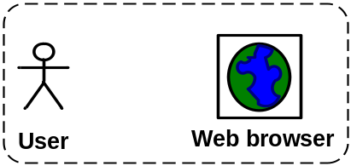

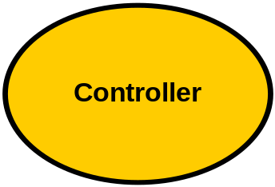
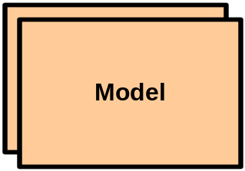
RoR ideal MVC architecture
def RoR.ideal_mvc
1
7
2
5, 6
3, 4
end

Slide 32
RoR ActiveRecords basics
def RoR.active_records_basic
  Object-relational mapping
  Used for RoR models
  Simple conventions
    RoR model class maps to a DB table
      Employee => employees
      Person => people
    Camel case singular class names map to tables with “_” name in plural
    ActiveRecord class instances maps to table rows
  Use ActiveRecord DSL methods calls to define relationships between models
  Use ActiveMigration to create tables in a DB-independent fashion
end

Slide 33
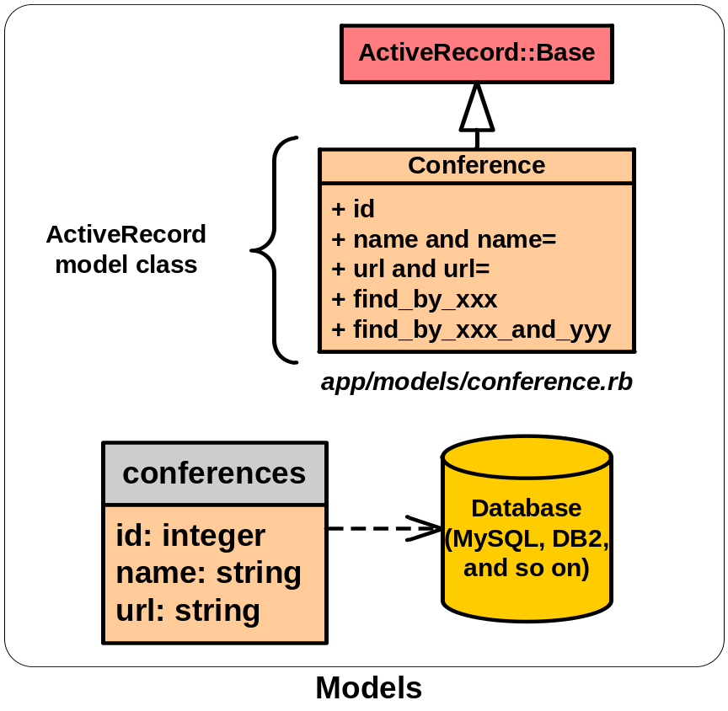
RoR ActiveRecords mapping
def RoR.active_records_mapping
Extend ActiveRecord::Base
Located in app/models/ directory
Attributes added from associated DB table (same name as class but lower case and plural)
id attribute is primary key
All attributes added via metaprogramming
Finder methods, e.g, find_by_id, find_by_name, and find_by_sql
Complex classes
  Inheritance by mapping attributes into one table
  Composition using one table and special composed_of DSL call
end

Slide 34
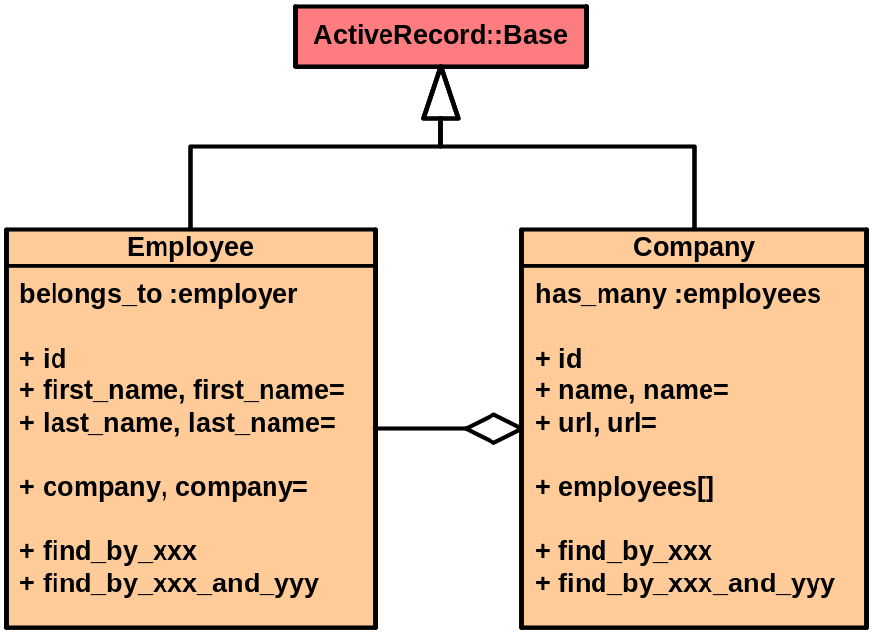
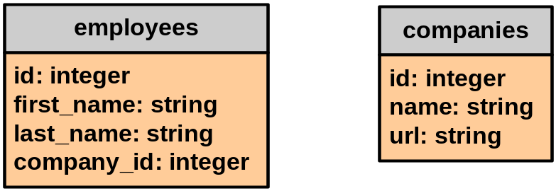
RoR ActiveRecords relationships
def RoR.active_records_relationships
One-to-one
  has_one :office
  belongs_to :employee
One-to-many
  has_many :employees
  belongs_to :company
Many-to-many
  has_and_belongs_to_many :projects
List
  act_as_list :scope => “company_id”
Tree
  act_as_tree
note “Foreign key added to table for model with belongs_to DSL call”
note “Many-to-many requires one additional association mapping table”
end

Slide 35
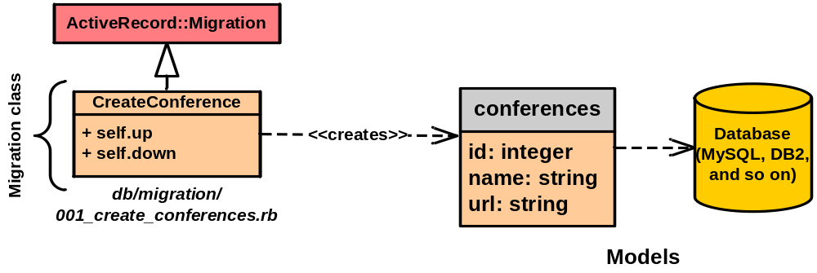
RoR ActiveRecords migrations
def RoR.active_records_migrations
Programmatically define DB tables
Portable across ActiveRecord compatible DBs
Allows for gradual definition of table’s schema and easy migration across versions

Slide 36
RoR ActiveRecords migrations
class CreateEmployee < ActiveRecord::Migration
def self.up
create_table “employees” do |table|
table.column :first_name, :string
table.column “last_name”, :string
table.column :employee_id, :integer
end
end
def self.down
drop_table “employees”
end
end
Migration class into db/migration/<version>_<names>.rb, e.g, 001_create_employees.rb
Issue command $rake db:migrate VERSION=<version>
Can also initialize instances in migration class self.up method
end

Slide 37
RoR ActiveRecords advanced
def RoR.active_records_advanced
Transactions
  def transfer from_account, to_account, amount
  Account.transaction do
  from_account.debit amount
  to_account.credit amount
  end
  end
act_as_list comes with many methods
  first?, last?, insert_at_position, remove_from_list, ...
act_as_tree defines
  parent_id, children[]
Association methods (added for each association)
  <association_name>.create, <association_name>.build, <association_name><<, <association_name>.delete, <association_name>.find, <association_name>.size, <association_name>.empty?, <association_name>.clear, ...
Nested sets for trees, versioning, count caching for faster SQL
end

Slide 38
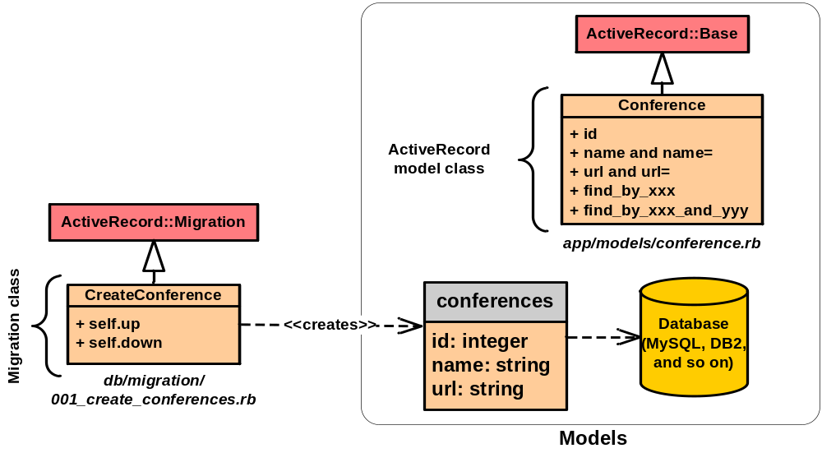
RoR models
def RoR.models_overview
end

Slide 39
RoR ActionController basics
def RoR.action_controller_basics
  Manages interactions between models and views
  Generator
    ./script/generate controller Welcome index logout
    WelcomeController < ApplicationController
    ApplicationController < ActiveController::Base
  Controller
    public methods corresponds to actions (no parameters)
    method names match view templates names
  RoR applications can have many controllers
  Unlike other MVC frameworks, controllers are instantiated per HTTP request (no need to worry about threading)
  Supports basic aspect-oriented programming with
    invoke_before and invoke_after DSL calls
end

Slide 40
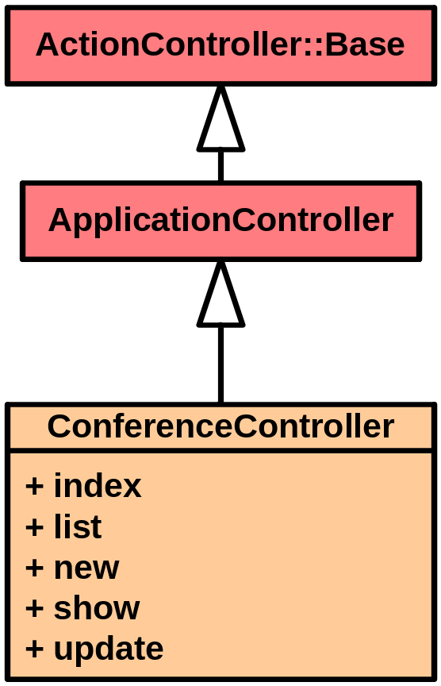
RoR controllers
def RoR.controllers
class ConferenceController < ApplicationController
def index
render_text “Welcome to ConfApp”
end
def list
@conference_page, @conferences = paginate :conferences, :per_page => 10
end
def new
@conference = Conference.new
end
def show
@conference = Conference.find params[:id]
end
#...
end
end

Slide 41
RoR views
def RoR.views
  View template corresponds to a controller action
  Views are implemented using RHTML (similar to JSP and ASP)
  ERb to embed Ruby in HTML
    <%= link_to( image_tag “image_file.gif”, :size => “50x50”,
    url_for( :action => “show”,
    :id => conference.id ) ) %>
  Use controller layout for common view parts, i.e., header and footer
  Partial views (starts with _, e.g., _form.rhtml)
  Full support for CSS, JavaScript, and AJAX
end

Slide 42
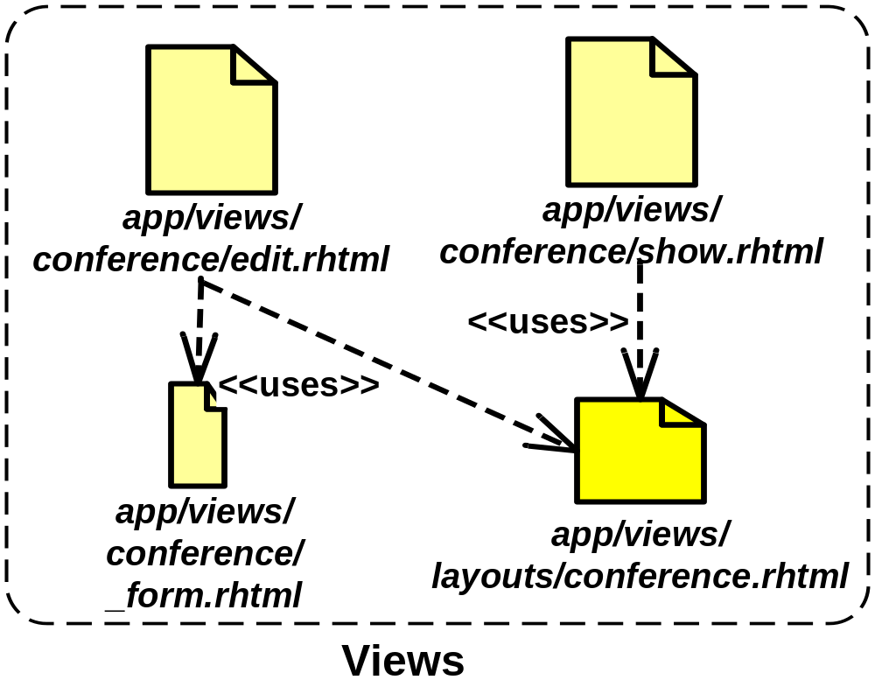
RoR views
def RoR.views_overview
Each controller have subdirectory for its views
Layouts directory with controller common view layout with name of controller
Partial views with names starting with “_”
app\
…
controllers\conference_controller.rb
…
views\layouts\conference.rhtml
\conferences\
\edit.rhtml
\show.rhtml
\_form.rhtml
\…
end

Slide 43
RoR RHTML basics
def RoR.rhtml_basics
  Access to all instance and class variables of controller
  Access to all classes visible to controller
  h() for converting strings safely to HTML
  Use -%> to remove “\n” in HTML output when needed
  Various methods (inherited from ApplicationController) to generate HTML tags, e.g., link_to, image_tag, …
app/views/conferences/list.rhtml
<% for column in Conference.content_columns %>
<p>
<b><%= column.human_name %>: </b> <%=h @conference.send column.name %>
</p>
<% end -%>
<%= link_to “Edit”, :action => “edit”, :id => @conference.id %>
<%= link_to “Back”, :action => “list” %>
end

Slide 44
RoR views scaffoldings
def RoR.views_scaffoldings
  Use scaffolding to automatically generate default views
  Generate scaffold for a model and a controller
    ./script/generate scaffold <model> <controller> [<action> ...]
    E.g., $./script/generate scaffold Conference conferences index list edit show
  If no actions are specified then scaffold generates CRUD actions (create, read, update, destroy) using create, show, update, and destroy methods in controller
  Gradually replace scaffold by editing generated views and methods
  Scaffold metaprogramming by adding scaffold DSL call to controller (no RHTML generated thus cannot edit)
    class ConferenceController < ApplicationController
    scaffold :model_name
    #...
    end
end

Slide 45
RoR partial views
def RoR.partial_views
  Allows decomposition of views
  Enables reuse of views parts
  Great for reusing headers, footers, and forms
  Name of file starts with _, e.g., _form.rhtml
app/views/conferences/_form.rhtml
<% errors_messages_for “conference” %>
<!--[form:conference]-->
<% form_tag :action => “update”, :id => @conference.id do %>
<p><label for=“conference_title”>Title</label><br/>
<%= text_field “conference”, “title”, :size => 20 %></p>
<% end -%>
<!--[eoform:conference]-->
#Use partials in other RHTML with render :partial => “name” call
render :partial => “form”
end

Slide 46

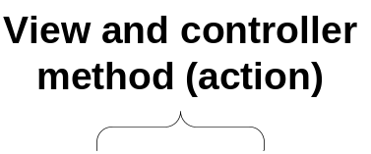



RoR URL parsing and flow
def RoR.url_parsing_and_flow
  Controller name is conference_controller class is ConferenceController
  View name is show.rhtml also matches ConferenceController#show method
  Parameters passed as a hash to controller method
    params hash for request parameters
    session hash for session data
    request and response objects
end

Slide 47
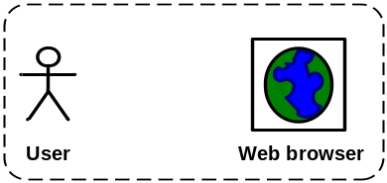
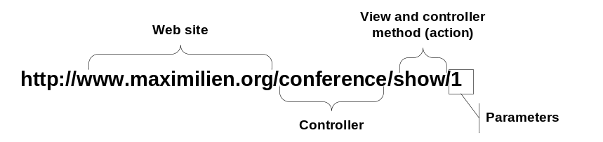
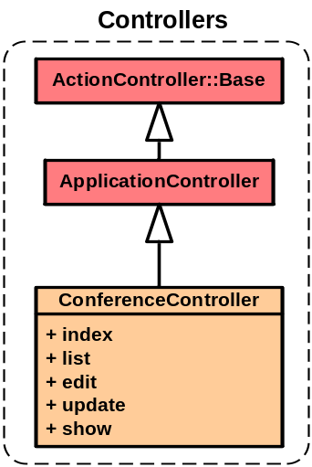
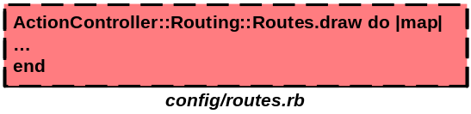
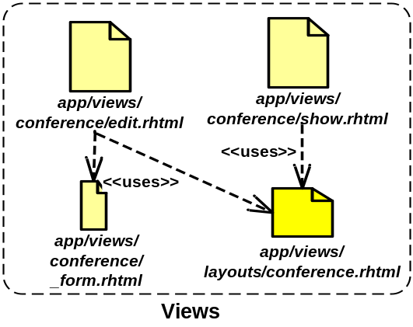

RoR MVC overview
def RoR.mvc
1
2
3
10
4
9
5, 8
6, 7
end

Slide 48
Ruby on Rails
What we covered?
  Rails philosophy, features, and MVC architecture
  ActiveRecords basics
    Models
    Migrations
    Relationships
  ActionController
  RHTML basics
Other features
  AJAX via prototype and effect library integration into Rails
  CSS support
  More details about act_as_list and act_as_tree
  RJS, RXML, and ROXML
  YAML and JSON support
end

Slide 49
Break 2
def tutorial.break_2
  25 minutes
  Optional exercises
    Create confapp application
    Add Conference, Attendee, Address, and Paper models
    Add Conference controller
    Add basic scaffolding views
    Edit list.html view to make more usable
end

Slide 50
Agenda
def tutorial.agenda
Tutorial at a glance and objectives
Setting up Ruby and Rails
Ruby language overview
RoR overview
RoR Web services (SOAP, REST, and RSS)
  Consuming Web services
  Mashing up Web services
Example
Closing remarks and references
end

Slide 51
What are Web services or APIs?
def tutorial.what_are_web_services_or_apis?
  Basic idea is to make the Web, it’s resources, and applications accessible to software agents, i.e., make it programmable
  Web services
    Root in distributed computing, i.e., CORBA, DCOM, messaging systems, etc.
    Intended to facilitate interoperation across systems and languages
    Industry definition and support and wide-range of standards, i.e., WS-*
  REST – representational state transfer (Web applications as “virtual state machine”)
    Roy Fielding’s Ph.D. thesis at UC Irvine, 2000
    Simple; uses the Web’s architecture to expose services
    Use HTTP protocol and GET, POST, PUT, and DELETE method for CRUD (create, read, update, and destroy) actions
  RSS – really simple syndication
    Syndication for data
    Feed for Web data on the Web which can be viewed by modern browsers
    Simple XML format for delivering data with historical context
    RSS 0.9, 1.0, 1.1, 2.0, and now Atom
end

Slide 52
REST
def REST.what_is_it?
  Architectural style
    Conceptualize a Web application as a virtual state machine
    User moves around states by invoking HTTP methods (GET, POST, PUT, and DELETE)
    Each state transition results in “new page” (stylized XML content) or application state transfer to user’s browser
  In practice
    GET and POST are mostly used (use Accept: application/xml header)
    URI as “operation” names, e.g., http://api.evdb.com/rest/events/search?app_key=test_key&q=mashup
    Pass operation’s parameters as URL parameters
    Return response as XML
  Easily supported by any language with HTTP support
  Can be invoked directly from browser via JavaScript
  Limitations
    Security and privacy (encode data using XML security?)
    Transactions and recovery
    Bound to HTTP so cannot use other TCP/IP protocols for large, reliable, or asynchronous transmission, i.e., SMTP, FTP, and so on
end

Slide 53
REST serving
def REST.serving
  Add a controller, e.g., rest_controller.rb
  Add REST actions, e.g., RestController#conferences
  Implement responses using RXML templates using the XML builder library
app/views/rest/conferences.rxml
#@conferences is an array of all Conferences setup in action
xml.conferences
@conferences.each do |conf|
xml.conference(:name => conf.name, :title => conf.title) do
xml.description conf.description
xml.attendees
conf.attendees.each do |attendee|
#add attendee XML represenation using XML builder
end
end
end; end; end
end

Slide 54
REST consuming
def REST.consuming
  Use Ruby library to make HTTP request formatted according to API documentation
    Typically use open-uri, rexml, and cgi
  Parse resulting XML using REXML or ROXML into Ruby objects
#Calling the Yahoo! Flickr REST API
require “open-uri”; require “rexml/document”; require “cgi”
API_KEY = “<string_key_here>”
def flickr_call method_name, args_hash={}
args = args_hash.collect do |key, value|
CGI.escape(key) + ‘=‘ + CGI.escape(value)
end
args.join ‘&’
url = “http://www.flickr.com/services/rest/?api_key=%s&method=%s&%s”
% [API_KEY, method_name, args]
doc = REXML::Document.new open(url).read #Returns results as XML doc
end
credit “Inspired from Ruby Cookbook book”
end

Slide 55

RSS and Atom
def RSS.what_is_it?
  Web data (content) syndication XML format
  Includes historical log of data over time
  Includes metadata, e.g., date, author, title, and updated dates
  Examples
    Text data, e.g., news, blogs, and so on
    Multimedia, e.g., pictures and video
  Can also be used to syndicate data from a Web service, e.g., calendar entries from Google Calendar
  RSS has gone through various iterations; version 2.0 is latest
  Atom is “standard” version
    Precise definitions of parts, e.g., date format
    Official namespace
    Includes official MIME type: application/atom+xml
  Specialized readers and direct browser support to read RSS/Atom feeds directly
end

Slide 56
RSS and Atom Example
def RSS_and_Atom.example
<?xml version="1.0" ?>
<rss version="2.0">
<channel>
<title>Conferences RSS Feed</title>
<link>http://localhost:3000/conferences/rss</link>
<description>Conference RSS feed.</description>
<language>en-us</language>
<pubDate>Tue, 03 Apr 2007 04:00:00 GMT</pubDate>
<lastBuildDate>Tue, 03 Apr 2007 09:41:01 GMT</lastBuildDate>
<docs>http://blogs.law.harvard.edu/tech/rss</docs>
<generator>Ruby on Rails</generator>
<managingEditor>maximilien@acm.org</managingEditor>
<webMaster>maximilien@acm.org</webMaster>
<item>
<title>RoR Mashup talk at Fujitsu Labs</title>
<link>http://localhost:3000/conferences/1</link>
<description>
Ruby on Rails Mashup talk at Fujitsu Labs in Sunnyvale, CA <a href=“http://maximilien.org/tutorials/2007/ws_om_rails/WS-on_Rails.ppt">PPT slides</a>.
</description>
<pubDate>Tue, 03 Apr 2007 09:39:21 GMT</pubDate>
<guid>
http://localhost:3000/conferences/1
</guid>
</item>
<!-- other items -->
</channel>
</rss>
<?xml version="1.0" encoding="utf-8"?>
<feed xmlns="http://www.w3.org/2005/Atom">
<title>Conferences Atom Feed</title>
<subtitle>An Atom feed of Conference data.</subtitle>
<link href="http://localhost:3000/conferences/atom"/>
<updated>2007-04-03T18:30:02Z</updated>
<author>
<name>E. M. Maximilien</name>
<email>maximilien@acm.org</email>
</author>
<id>
urn:uuid:60a76c80-d399-11d9-b91C-0003939e0af6
</id>
<entry>
<title>RoR Mashup talk at Fujitsu Labs</title>
<link href="http://localhost:3000/conferences/1"/>
<id>urn:uuid:1225c695-cfb8-4ebb-aaaa-80da344efa6a</id>
<updated>2007-04-03T18:30:02Z</updated>
<summary>
Ruby on Rails Mashup talk at Fujitsu Labs in Sunnyvale, CA <a href=“http://maximilien.org/tutorials/2007/ws_om_rails/WS-on_Rails.ppt">PPT slides</a>.
</summary>
</entry>
<!-- other entries -->
</feed>
end

Slide 57
Atom feeding
def Atom.feeding
  Create AtomController
  Add conference_feed action and RXML view
  app/views/conference_atom/conferences.rxml
xml.instruct!
xml.feed "xmlns" => "http://www.w3.org/2005/Atom" do
xml.title “Conferences Atom feed"
xml.link "rel" => "self", "href" => url_for(:only_path => false, :controller => 'atom', :action => ‘conferences_feed')
xml.id url_for(:only_path => false, :controller => ‘conferences')
xml.updated @conferences.first.updated_on.strftime("%Y-%m-%dT%H:%M:%SZ") if @conferences.any?
xml.author { xml.name "#{@user.formatted_name if @user}" }
@conferences.each do |conference|
xml.entry do
xml.title conference.title
xml.link "rel" => "alternate", "href" => url_for(:only_path => false, :controller => 'conferences',
:action => 'show', :id => conference.id)
xml.id url_for(:only_path => false, :controller => 'conferences',
:action => 'show', :id => conference.id)
xml.updated conference.updated_on.strftime("%Y-%m-%dT%H:%M:%SZ")
xml.author { xml.name "#{@user.formatted_name if @user}" }
xml.summary “Conference summary"
xml.content "type" => "html" do
xml.text! render(:partial => "conferences/show", :locals =>{:conference => conference})
end; end; end; end
end

Slide 58
Action Web Services
include RoR::ActionWebServices
alias AWS Action_Web_Services
def AWS.overview
  Originally created by Leon Breedt of Cape Town, South Africa
  Server-side support for SOAP and XML-RPC Web services
  Supports WSDL (but not complete)
  Defines a DSL to define Web service types
  Supports
    Nested types
    Arrays
    Exceptions
  Library to create SOAP/WSDL clients
end

Slide 59
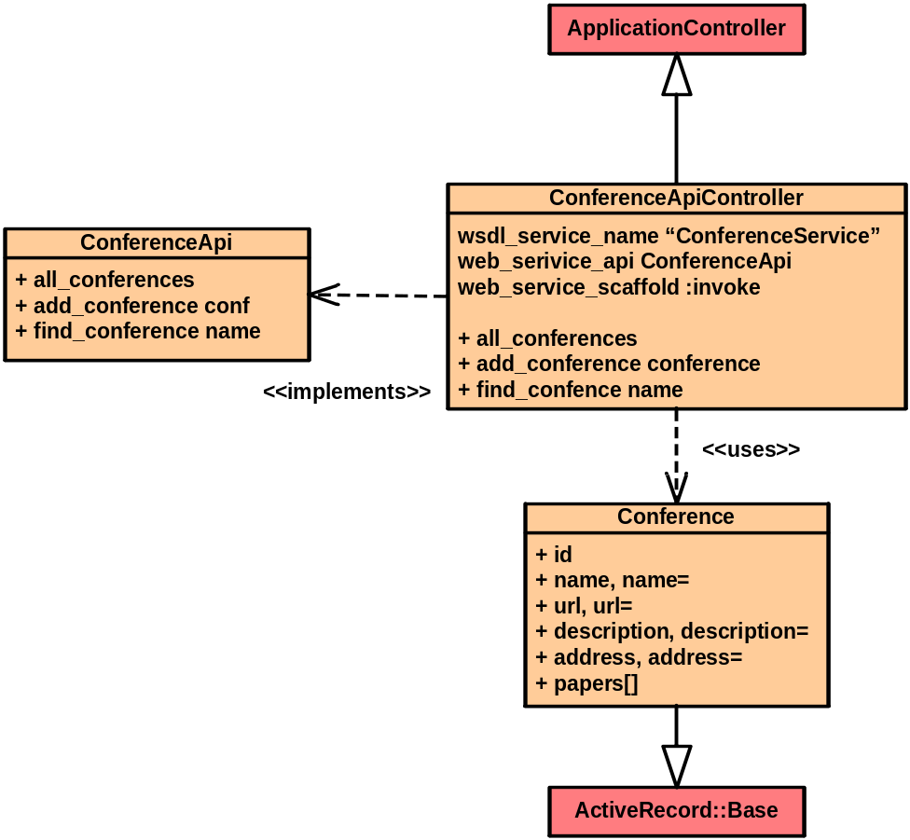
AWS basics
def AWS.basics
Define an API class
  api_method for each operation
  Specify parameters and return types
Parameter types can be
  Simple types
  ActiveRecord models
  ActionWebService::Struct subclasses
Define dispatching mode
Supports invocation interceptions
  before_invocation
  after_invocation
Supports scaffolding
end

Slide 60
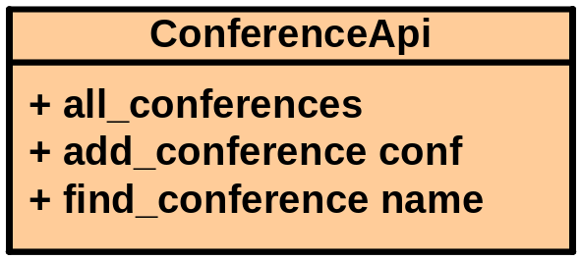
AWS API interface
def AWS.api_interface
app/apis/conference_api.rb
class ConferenceApi < ActionWebService::API::Base
api_method :all_conferences,
:expects => [],
:returns => [[Conference]]
api_method :add_conference,
:expects => [Conference],
:returns => []
api_method :find_conference,
:expects => [{:name => :string}],
:returns => [{:conference => Conference}]
#...
end
end

Slide 61
AWS dispatching mode
def AWS.dispatching_mode
  Direct
    API definition attached to controller
    API methods as controller public methods
  Layered
    Multiple APIs per controller
    One endpoint URL for all APIs
  Delegated
    Like layered but results in a different endpoint for each API (or service)
  web_service_dispatching_mode DSL call to specify dispatching mode (default is :direct)
end

Slide 62
AWS scaffolding
def AWS.scaffold_invoke
  Add web_service_scaffold :invoke (or name of method to use) to controller
  Automatically generates views for services
    Simple pages to invoke each service operations
    Pass and submit parameters to auto-generated forms
    Supports SOAP and XML-RPC
  Does not support complex types
  Uses names in API definition for parameter names
  http://localhost:3000/conference_api/invoke
  http://localhost:3000/conference_api/service.wsdl
end

Slide 63
AWS unit test as client
def AWS.unit_test_client
Using web_service generator
  ./script/generate web_service <name> [action, …]
Automatically generates stub unit tests
Additional Test::Unit methods to invoke and invoke_layered services
test/functional/conference_api_test.rb
#...
class ConferenceApiTest < Test::Unit::TestCase
fixtures :conferences
def setup
@controller = ConferenceApiController.new
@request = ActionController::TestRequest.new
@response = ActionController::TestResponse.new
end
def all_conferences
confs = invoke :all_conferences
assert_equal conferences.size, confs.size
end
end
end

Slide 64
Consume Web services
client.consume(web_service) do |ws|
  Java using Axis wsdl2java
    Generate JAX-RPC stubs pointing to WSDL
      http://site-url.com:3000/controller_api/service.wsdl
    Use Locator API to create instance of service port
    Use port to make API calls
  Ruby
    class SomeController < ApplicationController
    web_client_api :conference_api,
    :soap,
    “http:://../conference_api/api” # service’s EPR
    def some_method
    confs = @conference_api.all_conferences
    end
    end
    #...
    conference_api = ActionWebService::Client::Soap.new
    ConferenceApi,
    “http:://../conference_api/api”
end

Slide 65
What are service mashups?
def tutorial.what_are_service_mashups?
  Repurposing and remixing Web data and services
  Examples
    Combining data from multiple sources (search and pictures and music)
    Combining services, e.g., Eventful event management and Google Calendar and Flickr pictures
  Conceptually can be seen as expanded MVC Web applications
  Data mediation
    Transforming, converting, and manipulating data
    Create new mixed content
    Create necessary input to get more data from a service
  Protocol mediation
    Passing correct parameters
    Correct sequencing of service operation calls
    Sync and asynchronous service calls
  UI customization
    Create new UI for remixed content and service
    Deal with service access latency using AJAX
end

Slide 66
Web services mashup with RoR
web_services.each_mashup(other_web_services) do |ws|
  Composition of multiple Web services
  Composition of UI – using RHTML
  AJAX user interface
  Apply same principles of service consumption before
    Expose parts of Web application as REST, RSS, or SOAP API
    Create proxy clients for remote services
    Generate composed service using Ruby
  With composed service
    Expose API for composed service (if necessary)
    Generate UI views
end

Slide 67
Break 3
def tutorial.break_3
  15 minutes
  Optional exercises
    Create Conference API
    Use scaffolding to test API
    Finish unit tests
    Add a Ruby client for API
end

Slide 68
Agenda
def tutorial.agenda
Tutorial at a glance and objectives
Setting up Ruby and Rails
Ruby language overview
RoR overview
RoR Web services (SOAP, REST, and RSS)
  Consuming Web services
  Mashing up Web services
Example
Closing remarks and references
end

Slide 69
Example
def tutorial.example
  Mashup
    ConferenceApi Web service
    Map conference addresses
    Use Yahoo! Flickr and Eventful’s REST services
    Use Google Map service
  Generate RHTML views for location photo and Eventful event data
  Generate views using Google Map JavaScript
  Get key for Google Map
  Setup Google Map with default marker
  Create some conference instances in DB or via edit.rhtml scaffold
  Pass address parts to Flickr, Eventful, and Google Map to search and map address
end

Slide 70
Example code
def tutorial.example_code
end

Slide 71
Agenda
def tutorial.agenda
Tutorial at a glance and objectives
Setting up Ruby and Rails
Ruby language overview
RoR overview
RoR Web services action pack
  Consuming Web services
  Mashing up Web services
Example
Closing remarks and references
end

Slide 72
Closing remarks
def tutorial.closing_remarks
  Scratched surface of RoR
  Support for other WS-* standards?
  REST vs. RSS vs. SOAP vs. XML-RPC vs. …
  Various other generators, e.g., login
  Lots more information and documentation online
    Active community
    Blogs, videos, articles, and so on
  Scalability
    Mainly via hardware
    May be an issue for big sites
    Next version of Ruby will likely help
  RJS, RXML, ROXML, and other DSLs
end

Slide 73
References
def tutorial.references
http://rubyonrails.org and http://api.rubyonrails.org and http://ruby-doc.org
http://railshelp.com and http://rails.outertrack.com
ZenTest at http://www.zenspider.com/ZSS/Products/ZenTest
RubyCentral, http://rubycentral.org
Thomas, D. et al. “Programming Ruby” The Pragmatic Bookshelf, 2005 (aka PickAxe book)
Thomas, D. and Hansson, D. “Agile Web Development with Rails”, The Pragmatic Bookshelf, 2005
Tate, B. and Hibbs, C. “Ruby on Rails: Up and Running”, O’Reilley, 2006
Fowler, C. “Rails Recipes”, The Pragmatic Bookshelf, 2006
Carlson, L. and Richardson, L. “Ruby Cookbook”, O’Reilly, 2006
InstantRails for Windows
Locomotive for Mac
RadRails Eclipse-based IDE, http://radrails.org
Editors see http://wiki.rubyonrails.org/rails/pages/Editors
end

Slide 74




Acknowledgments
def tutorial.acknowledgements
http://rubyonrails.org
The
Pragmatic
Programmers
http://www.pragmaticprogrammer.com
http://eclipse.org
end

Slide 75








def tutorial.thank_you
Hindi
Traditional Chinese
Thai
Gracias
Russian
Spanish
Thank You
Obrigado
English
Brazilian Portuguese
Arabic
Danke
Grazie
German
Merci
Italian
French
Simplified Chinese
Tamil
Japanese
Korean
end; end

