Slide 2
Application of AI in Warehouse Scheduling Optimization Problems
Vangel Paronov, K11938626

Slide 3
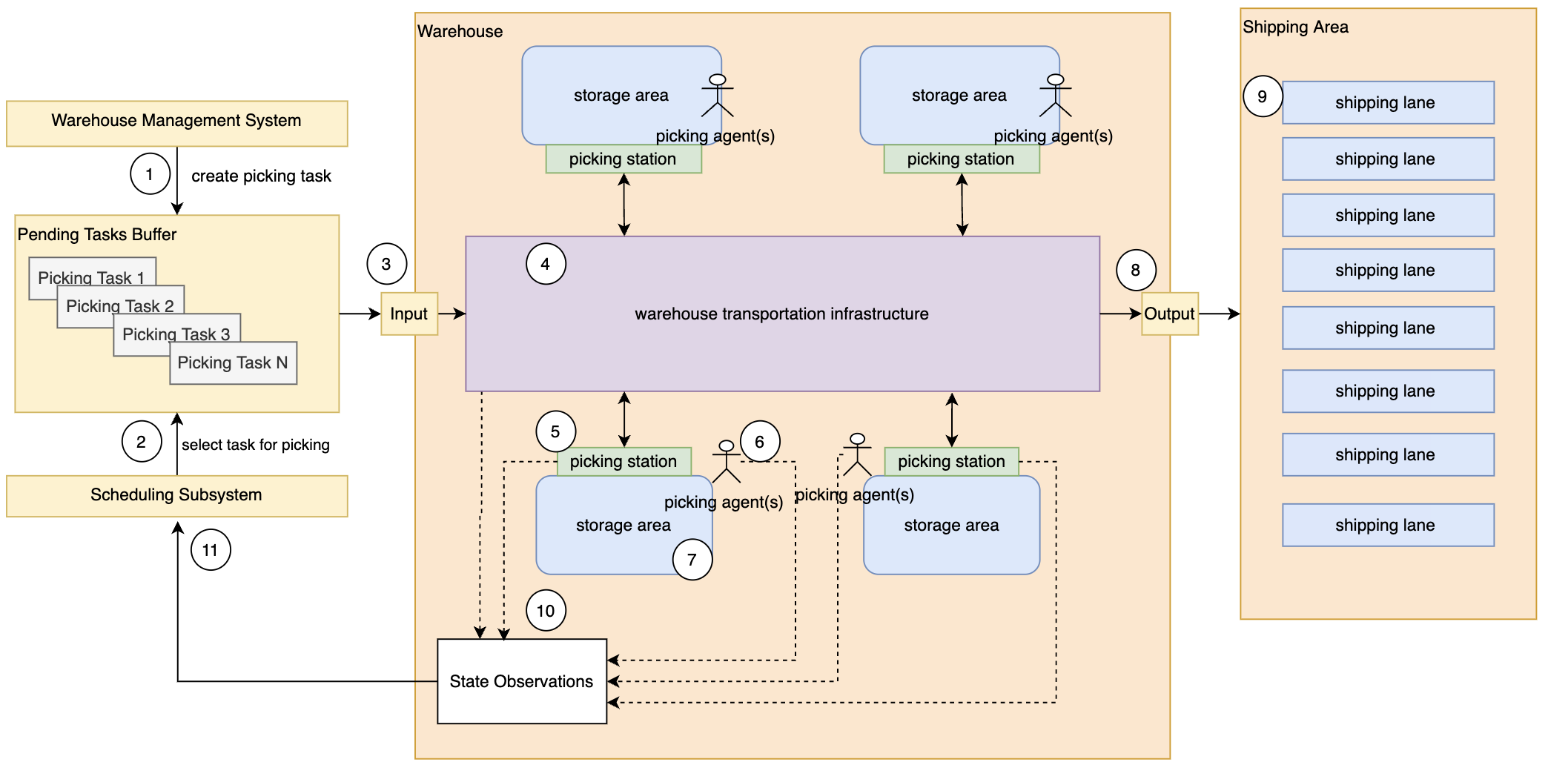
Problem definition

Slide 4
Problem definition
The WMS creates picking tasks and puts them in th the picking tasks buffer

Slide 5
Problem definition
The Scheduling Subsystem (2) decides which picking task start (3).

Slide 6
Problem definition
The box for the task is transported to the designed picking stations using
the warehouse transportation infrastructure WTI (4)
Notes:
The transportation infrastructure in the warehouse is fixed and can not be reconfigured dynamically.
Every component of the warehouse has performance (speed / picks per hour / etc.)
- capacity (max number of boxes on a conveyer / max number of boxes on a picking station / etc.

Slide 7
Problem definition
When the task arrives to the picking station (5) it is processed by the picking agent (6) and the items (SKUs) are picked from the storage area (7).
Notes:
The agents can be two types – human beings or machines (robots).
The number of the active agents could be different depending on the demand.
The performance of the agents can vary.
The automated agents are more performant than the human agents.

Slide 8
Problem definition
When the picking for a certain picking station is finished, the agent (6) returns the box to the WTI and is transported to the next picking station or to the output of the warehouse (8) and then to some of the shipping lanes in the shipping area (9).

Slide 9
Problem definition
The state of the system is collected by the messages (10) sent from the WTI (4), picking stations (5) and agents (6). The observed state is used by the Scheduling Subsystem to decide which picking task to select next (11).
Notes:
The state of the whole system is collected asynchronously
The system is partially observable

Slide 10
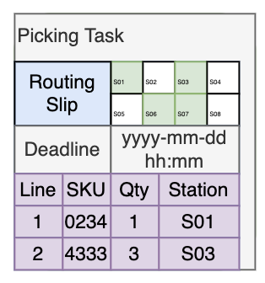
Picking task structure
Picking task structure
The routing slip defines at which picking stations the box should be processed.
The deadline is the latest moment in time when the box should be in the shipping area.
A list of all SKUs (stock keeping unit) that should be picked at every station from the routing slip.

Slide 11
Scheduling Subsystem Objectives
Given:
A set of picking tasks.
A scheduling interval (e.g. 1s, 10s, 1m).
Fixed warehouse infrastructure.
Fixed number and type of picking agents.
Should:
Meet the deadlines for all picking tasks.
Maximize warehouse utilization.
Avoid deadlocks / stalls in any of the warehouse subsystems (transportation / picking).

Slide 12
Scheduling Subsystem Challenges
Finding an optimal schedule is NP complete problem.
All components of the system are nondeterministic.
The state of the system is collected asynchronously and is generated from many independent components.

Slide 13
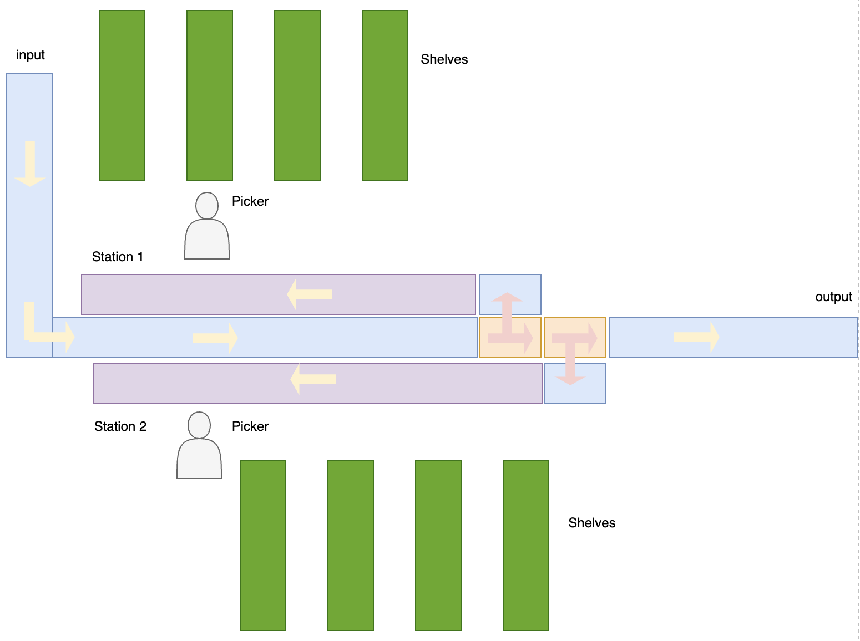
Scheduling Example
T = 0s
1
2
3
4
5
6
7
8
9
10
11
12
13
14
15
16
17
18
19
Naïve scheduling:
“Start a new task, whenever there you can put it on the input conveyer”

Slide 14
Scheduling Example
T = 0s
2
3
4
5
6
1
7
8
9
10
11
12
13
14
15
16
17
18
19
Naïve scheduling:
“Start a new task, whenever there you can put it on the input conveyer”

Slide 15
Scheduling Example
T = 5s
3
4
5
6
2
7
8
9
10
11
12
1
13
14
15
16
17
18
19
Naïve scheduling:
“Start a new task, whenever there you can put it on the input conveyer”

Slide 16
Scheduling Example
T = 50s
11
12
10
13
14
15
16
17
18
9
19
8
7
6
5
4
3
2
1
Naïve scheduling:
“Start a new task, whenever there you can put it on the input conveyer”

Slide 17
Scheduling Example
T = 55s
11
12
10
13
14
15
16
17
18
9
1
19
8
7
6
5
4
3
2
Naïve scheduling:
“Start a new task, whenever there you can put it on the input conveyer”

Slide 18
Scheduling Example
T = 60s
12
11
13
14
15
16
17
18
10
1
19
9
8
7
6
5
4
3
2
Naïve scheduling:
“Start a new task, whenever there you can put it on the input conveyer”

Slide 19
Scheduling Example
T = 70s
14
13
15
16
17
18
1
12
1
2
3
19
11
10
9
8
7
6
5
4
Naïve scheduling:
“Start a new task, whenever there you can put it on the input conveyer”

Slide 20
Scheduling Example
T = 90s
18
17
1
16
1
2
3
4
5
6
7
19
15
14
13
12
11
10
9
8
Naïve scheduling:
“Start a new task, whenever there you can put it on the input conveyer”

Slide 21
Scheduling Example
T = 310s
18
Deadlock
17
1
16
1
2
3
4
5
6
7
19
15
14
13
12
11
10
9
8
Naïve scheduling:
“Start a new task, whenever there you can put it on the input conveyer”

Slide 22
Scheduling Example
T = 310s
9
10
11
12
13
14
15
16
17
18
1
1
2
3
4
5
6
7
19
Non optimal heuristic:
“Don’t put new boxes,
when station 1 or station 2 are full”

Slide 23
Scheduling Example
T = 315s
9
10
11
12
13
14
15
16
17
18
2
3
4
5
6
7
19
1
Non optimal heuristic:
“Don’t put new boxes,
when station 1 or station 2 are full”

Slide 24
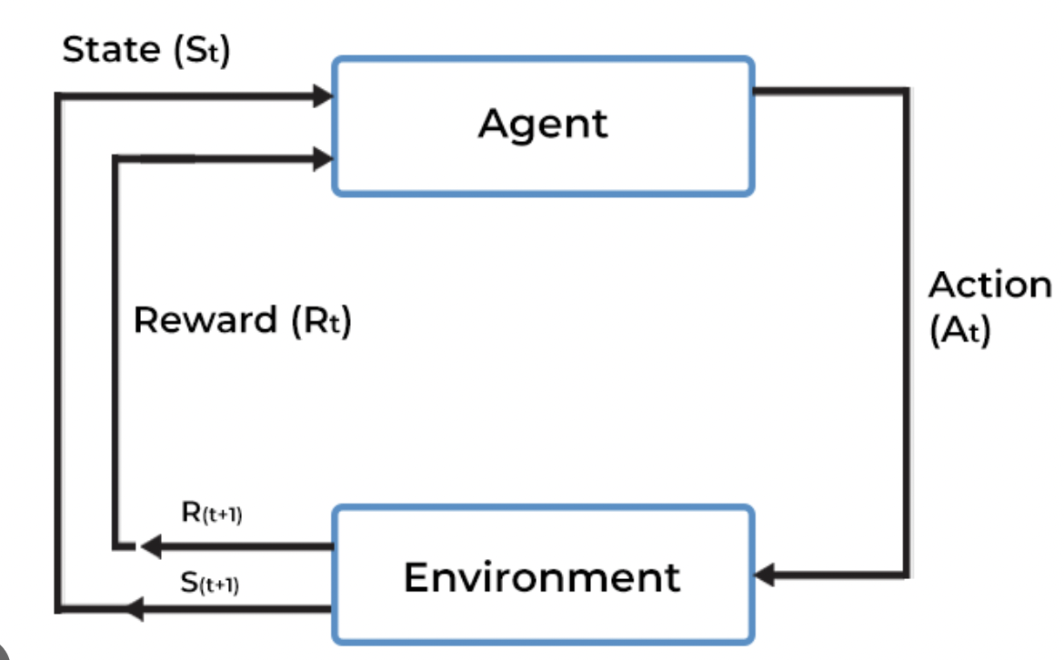
AI Hypothesis
The optimal policy for the Scheduling Subsystem (SS) could be learned using the Reinforcement Learning (RL) approach.
The elements of the RL could be mapped to the problem as follows:
RL | Problem
Agent | The Scheduling Subsystem
Action | The selection of a specific picking task from the task pool.
Environment | The warehouse (transportation / picking stations / picking agents).
Reward | A function that maps all SS goals to a number.
State | The number and location of all picking tasks in the warehouse at a certain moment in time. Approximated with the collected observations (messages) sent from the warehouse components

Slide 25
RL mapping - Actions
At every scheduling time step, the agent should apply an action to the environment. The action should lead to maximization of the reward.
There are two classes of actions.
Do nothing.
Choose picking task with certain characteristics – Routing Slip / Deadline / SKUs to be picked.
The list of all available actions depends on the tasks, that are in the Picking Tasks Buffer.
Example: If there are 9 picking stations the tasks could be arranged into 2⁹-1 slots. The tasks in every slot are sorted in ascending order by their deadline property. Then the action is to pick the earliest (first) task with specific routing slip.
In this case there are 512 actions – {do nothing, pick earliest with picking slip P}.

Slide 26
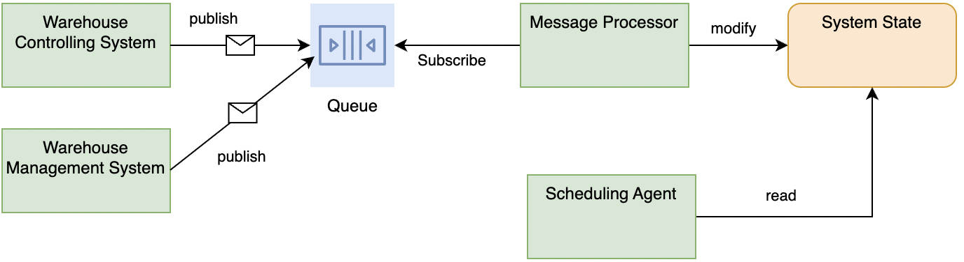
RL mapping - State
The state should encode the number and location of all picking tasks that are in the warehouse.
The environment is is partially observable, and it is not possible to have the full state.
The state is aggregated from messages that are sent from the warehouse components and the picking agents.

Slide 27
RL mapping – Reward Function
The reward function maps all Scheduling Subsystem objectives to a number
Two different approaches are possible:
Reward is zero for all intermediate steps and it is calculated after the last step of the scheduling episode (i.e., when all tasks are completed). A special negative value is calculated when a deadlock or task deadline overdue is detected.
An intermediate reward value is generated at every step, based on the current state of the system.
The proposal for a proper reward function is one of the goals of this project.

Slide 28
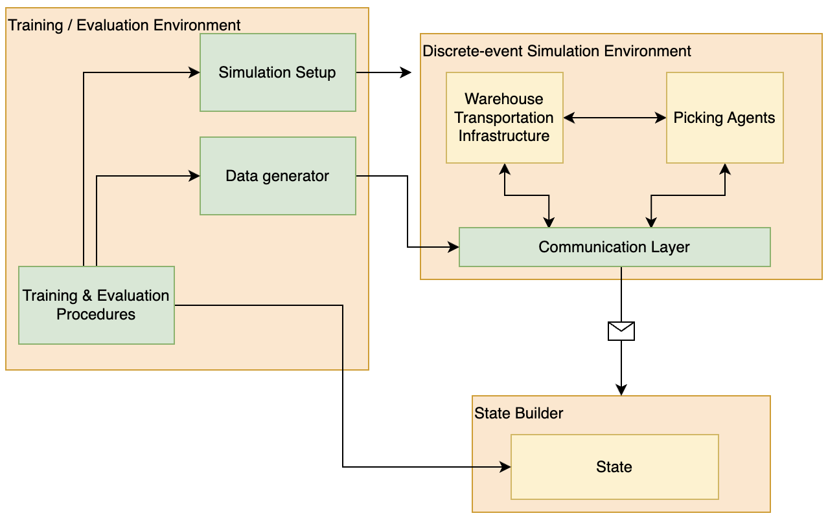
Simulation Environment
The model of the warehouse will be implemented using a Discrete-event Simulator.
For the initial experiments, a simple Python implementation will be used.
Standalone simulation environments like 4diac / Forte will be tested during the following stages of the project.

Slide 29
Warehouse structure for evaluation
Design Parameters
The conveyers move with speed C cm/s. Every segment has fixed length of Cx cm.
The diverters move with speed D cm/s. Every diverter has fixed length of Dx cm.
Every picking agent works with speed P tasks/h. The number of agents at stations are A1n and A2n.
All tasks are picked in equally sized boxes with length B cm.
Conveyers C1 .. C7
Diverters D1 .. D2
Picking Agents A1 .. A2
C1
A1
C4
C3
C2
D1
D2
C7
C6
C5
A2

Slide 30
Thank You For Your Attention

