Slide 1
CS 513 Homework 3 Satellite/Aerial Image Retrieval
Submitted by:
Bharatiben Kyada (A20353636)
Sharul Saxena (A20380920)
Tanmay Pradhan (A20376280)
Vickyben Patel (A20370450)

Slide 2
Aim:
Write a program using Bing maps tile system to automatically download aerial imagery (maximum resolution available) given a lat/lon bounding box
Input: lat1, lat2, lat3, lat4
Output: An aerial imagery within the bounding box defined above

Slide 3
Understanding of the problem:
Given input is latitude and longitude of two points using this image is obtained which has these values with highest possible zoom level.

Slide 4
Approach
From given lat/lon values maximum zoom level calculated that can be attained by all images.
Bing Map Tile Systems is used as reference.

Slide 5
Approach
Given lat/log (Geo) points converted into pixels.
Pixels are used to get tileX and tileY for given Geo Points.
Values of tiles for given geo points used as starting and ending tile. Using those tile tuples intermediate tileX and tileY values are calculated.
From tileX and tileY quadkeys calculated.
From quadkey tile images are downloaded using rest api.
Finally, All tiles are stitched together to get final output image.

Slide 6
Code Input
Point 1- (Cloud Gate)
Lat1: 41.8757944
Lon1: -87.621137
Point 2 - Buckingham Fountain
Lat2: 41.8826013
Lon2: -87.6245621

Slide 7
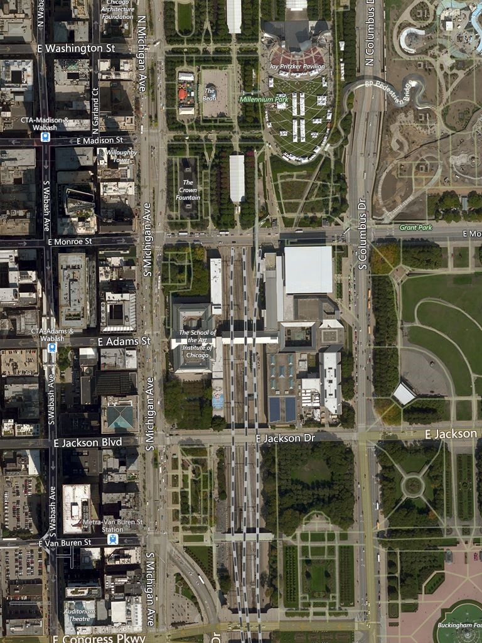
Code Output

Slide 8
Thank you!

