Slide 1

SALES ANALYSIS DASHBOARD
Power BI project: sales performance, profitability and discount analysis (2016 to 2019)
CoachX | Data Analytics Project | October 2026

Slide 2

Introduction
Why this project and what data was used
Objective
Dataset
Evaluate sales and profit trends over time
Find top products, customers, regions
Study shipping modes and their impact
Understand how discounts affect profit
9,994 order lines, 21 columns
Orders from Jan 2016 to Dec 2019
793 customers, 1,850 products, 531 cities
Tool: Power BI (Power Query + DAX)
2

Slide 3
Methodology
End-to-end workflow followed in Power BI
1
2
3
Load Excel data
Clean in Power Query
Calendar table + model
4
5
6
DAX measures
Build 6 report pages
Interactivity + insights
3

Slide 4
Approach: Data Cleaning
Done in Power Query before any analysis
Order Date and Ship Date converted from text to Date type
Postal Code set to Text; 11 blank values (Burlington, VT) filled with 05401
Discount and Sales kept as Decimal (Whole Number rounded Avg Discount to 8.6% instead of 15.6%)
Row ID removed; unused sheets (Sheet2, 3, 4) not loaded
Added: Sales Tax (10%), Sales Category (High/Low), Discount Flag, First and Last Name
Separate queries: Sales_NoDup (unique Order ID) and Sales_Discounted
4

Slide 5
Key Findings: KPI Overview
Headline numbers across 2016 to 2019
2.30M
286K
12.5%
37,873
15.6%
Total Sales
Total Profit
Profit Margin
Quantity
Avg Discount
Healthy overall margin, but unevenly distributed across categories and regions
Average discount of 15.6% hides a loss problem at higher discount levels
5

Slide 6
Key Findings: Sales Trend and Growth
Monthly sales, 2016 to 2019
Year-over-Year
2017: -2.8%
2018: +29.5%
2019: +20.4%
Nov and Dec are the strongest months; Feb is the weakest
6

Slide 7
Insights: Category Performance
Technology leads; Furniture earns very little profit
Technology: 836K sales, 145K profit
Office Supplies: 719K sales, 122K profit
Furniture: 742K sales but only 18K profit (about 2.5% margin)
7

Slide 8
Insights: Sub-Category Profit
Three sub-categories lose money
Tables: -17.7K
Bookcases and Supplies are also negative
Copiers and Phones earn the most profit
8

Slide 9
Insights: Region Analysis
West and East lead; Central has weak margins
West: 725K sales, 108K profit
East: 679K sales, 92K profit
Central: 501K sales but only 40K profit
West and East give 61% of total sales
9

Slide 10
Key Findings: Customers and Products
Top 5 by sales
Sean Miller is the top customer (25K). Canon imageCLASS 2200 is the top product (61.6K sales, 25K profit). Consumer segment gives 1.16M sales.
10

Slide 11
Insights: Ship Mode and Segment
Standard Class dominates shipping
11

Slide 12
Insights: Discount vs Profit
The most important finding of the project
Up to 20% discount: profit stays positive
30% and above: average loss
Orders with discount: profit -34.6K
Orders without discount: profit +321K
12

Slide 13
Approach: Power Query Analysis
Task 4 results
733K
1.20M
Sales in 2019 (3,312 lines)
Sales after removing duplicate Order IDs (was 2.30M)
243 to 221
1.21M
Average sales per order line, 2016 to 2019
Sales on discounted orders (5,196 lines)
13

Slide 14
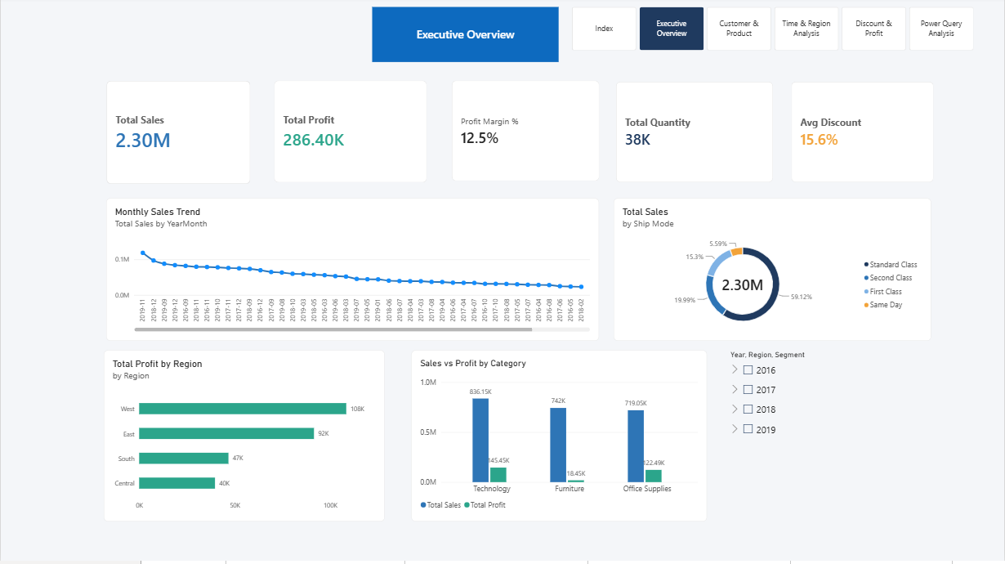
Dashboard: Executive Overview
Power BI report page
What this page shows
KPIs: Sales 2.30M, Profit 286K, Margin 12.5%
Standard Class gives about 59% of sales
Technology leads; Furniture profit is very low
14

Slide 15
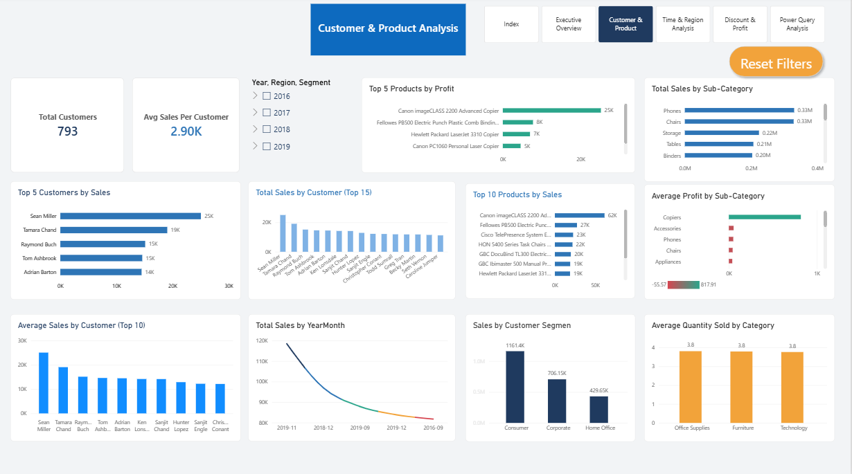
Dashboard: Customer and Product
Power BI report page
What this page shows
793 customers; average sales per customer 2.90K
Top customer: Sean Miller (25K)
Consumer segment gives 1.16M sales
15

Slide 16
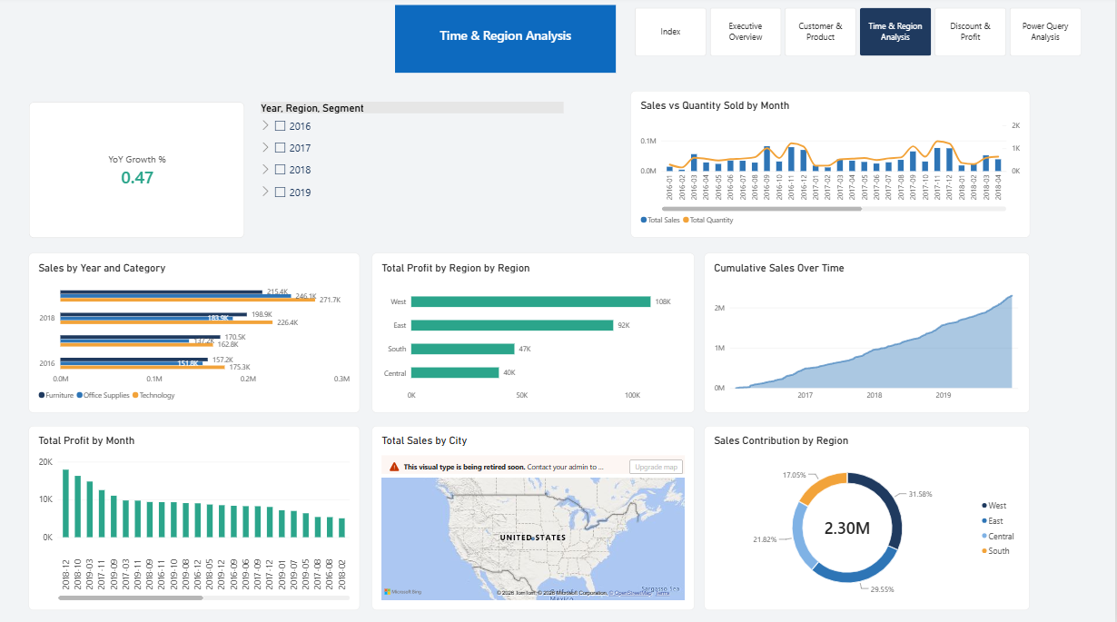
Dashboard: Time and Region
Power BI report page
What this page shows
Sales and quantity rise together over months
Cumulative sales reach 2.30M by end of 2019
West: 108K profit; West and East give 61% of sales
16

Slide 17
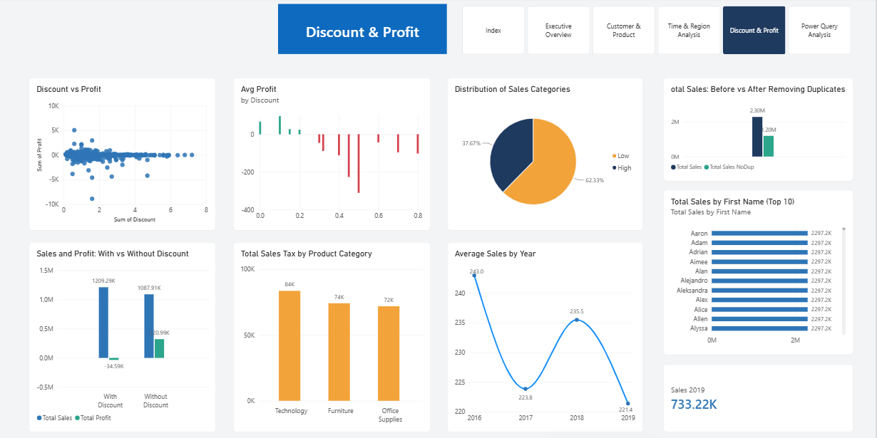
Dashboard: Discount and Profit
Power BI report page
What this page shows
With discount: sales 1.21M, profit -34.6K
Without discount: profit +321K
Losses begin at 30% discount
17

Slide 18
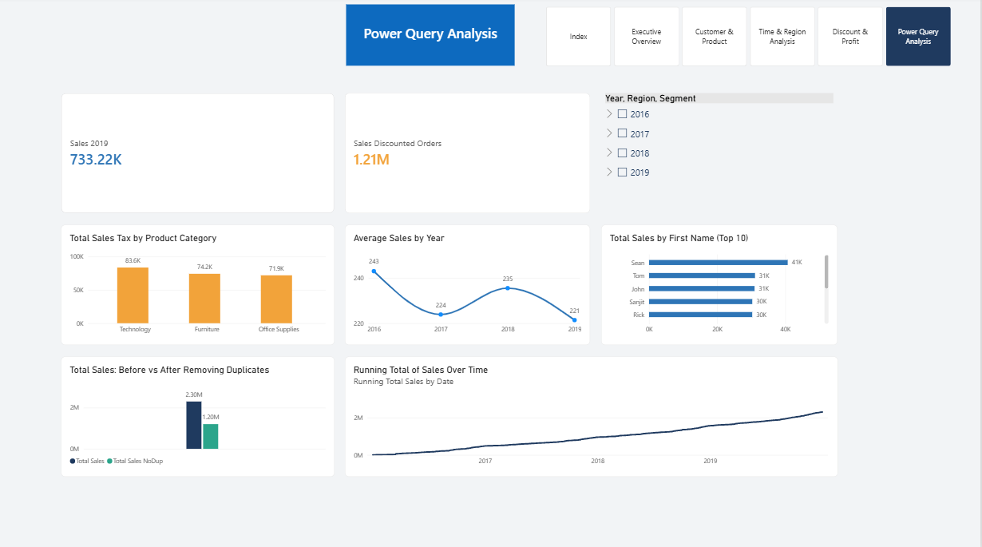
Dashboard: Power Query Analysis
Power BI report page
What this page shows
2019 sales: 733K
Duplicate removal: 2.30M falls to 1.20M
Average sales per order line: 243 to 221
18

Slide 19
Actionable Recommendations
Based on the data
Cap discounts at 20 to 25%; losses begin at 30% and peak at 50%
Review pricing and sourcing for Tables, Bookcases and Supplies
Improve Furniture margin (sales 742K, profit only 18K)
Fix Central region cost and discount strategy (profit only 40K on 501K sales)
Focus growth on Technology and the Consumer segment
Launch a loyalty program for the top customers
19

Slide 20
Conclusions
Sales grew from 484K (2016) to 733K (2019) with a 12.5% overall margin.
Discounts above 20% turn profitable orders into losses.
Furniture and three sub-categories hold back profit.
Controlling discounts and fixing pricing can raise profitability.
Thank you

