Slide 1
Problem No. 3
Drehu / Cemuhi

Slide 2
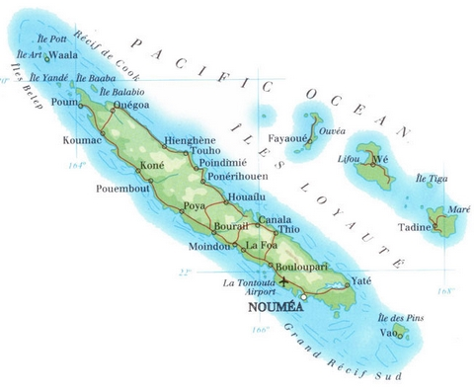
The Islands of New Caledonia

Slide 3
Drehu

Slide 4
i-wahnawa, i-drai, i-jun, jun
drai-hmitrötr, gaa-hmitrötr,
uma-hmitrötr, ngöne-uma

Slide 5
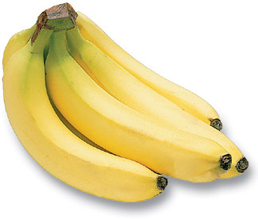
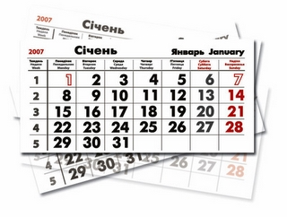
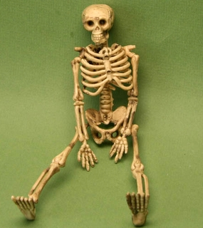

What do these objects have in common?

Slide 6
Multitude
multitude of bananas
multitude of days
multitude of bones

Slide 7
HOLY (in Christian religion)
church = ‘holy house’
Sunday = ‘holy day’
sanctuary = ‘holy place (or part)’
wall = ‘house X?’

Slide 8
Multitude
i-wahnawa
i-drai
i-jun

Slide 9
i-wahnawa = bunch of bananas
i-drai = calendar
jun = bone
i-jun = skeleton
drai-hmitrötr = Sunday
uma-hmitrötz = church
ngöne-uma = wall
gaa-hmitrötr = sanctuary

Slide 10
ngöne-gejë (Drehu)= ba-jié (Cemuhi) = coast = ‘water border’
ngöne-uma = wall = ‘house border’
nyine-thin = awl

Slide 11
Cemuhi

Slide 12
nyine (Drehu) = bé (Cemuhi)
thin (Drehu) = wöli (Cemuhi)
nyine-thin (Drehu) = awl
bé-wöli, bé-wöli-wöta, wöta

Slide 13
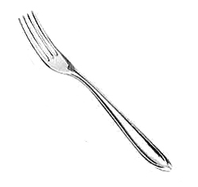
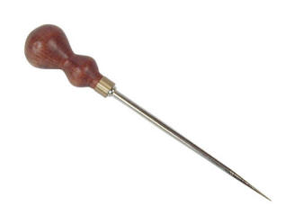
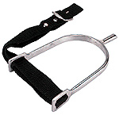
What do these objects have in common?

Slide 14
They are sharp, pointed objects

Slide 15
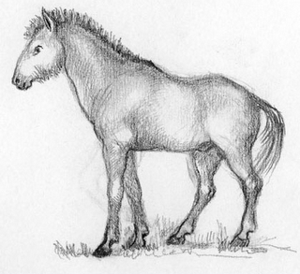
wöli = nyine (Drehu) = to poke
bé-wöli
nyine-thin (Drehu)
wöta
bé-wöli-wöta

Slide 16
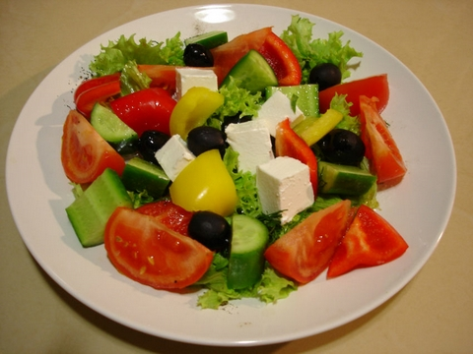
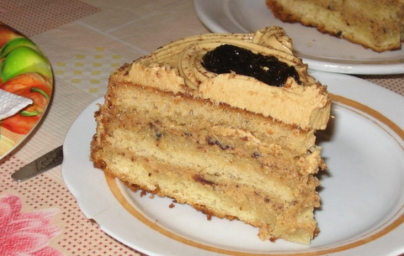
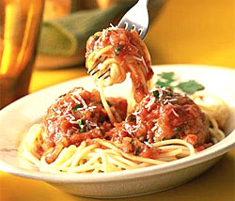
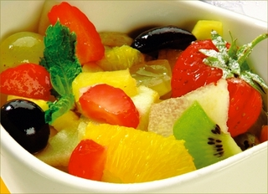
What else can we eat with the fork?

Slide 17
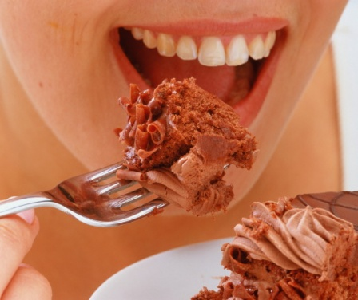
What else can we eat with the fork?

Slide 18
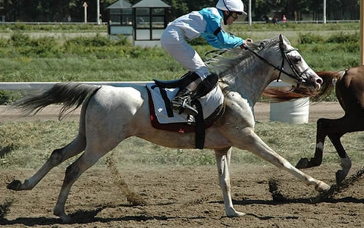
A spur is a tool to urge a horse

Slide 19
ba = border
ba-jié = coast = ‘sea border’
ba-bwén = twilight =‘night border’

Slide 20
tii = to write
bé-tii = pencil

Slide 21
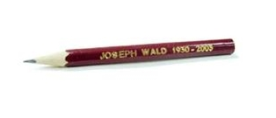
What do these objects have in common?
bé-wöli
nyine-thin (Drehu)
bé-tii
bé-wöli-wöta

Slide 22
All these objects are tools
bé-wöli
nyine-thin (Drehu)
bé-tii
bé-wöli-wöta

Slide 23
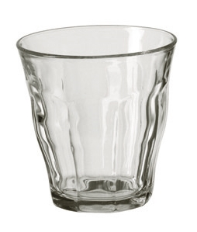
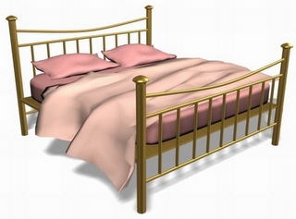
What does bé-ôdu mean?
OR

Slide 24
gaa (Drehu) = a (Cemuhi) = place a-pulut = ‘place for something’

Slide 25
bé-ôdu
a-pulut

Slide 26
NB The modifier follows its head in both languages
i-wahnawa (multitude of bananas)
drai-hmitrötr (holy day)
bé-tii (tool to write)
ba-jié (water border)
etc.

Slide 27
Assignment 1. Drehu
jun = bone
i-jun = skeleton (multitude of bones)
i-wahnawa = bunch of bananas (multitude of bananas)
i-drai = calendar (multitude of days)
drai-hmitrötr = Sunday (holy day)
gaa-hmitrötr = sanctuary (holy place)
uma-hmitrötr = church (holy house)
ngöne-uma = wall (house border)
ngöne-gejë = coast (water border)
nyine-thin = awl (tool to poke)

Slide 28
Assignment 1. Cemuhi
tii = to write
bé-tii = pencil (tool to write)
bé-wöli = fork (tool to poke)
wöta = animal
bé-wöli-wöta = spur (tool to poke animal)
bé-ôdu = cup (tool to drink)
ba-jié = coast (water border)
ba-bwén = twilight (night border)
a-pulut = bed (place to sleep)

Slide 29
Assignment 2.
wahnawa = ‘banana’
drai = ‘day’
wöli = ‘to poke’
pulut = ‘to sleep’

Slide 30
Assignment 3.
uma-hmitrötr = ‘holy house’ = church
drai-hmitrötr = ‘holy day’ = Sunday
gaa-hmitrötr = ‘holy place’ = sanctuary
tusi-hmitrötr = holy book (in Christian religion) = the Bible.

Slide 31
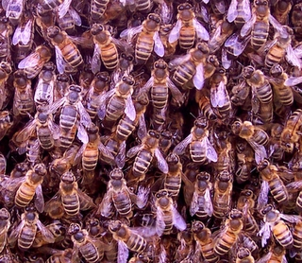
Assignment 3.
i-drai
i-wahnawa
i-jun
i-bii

Slide 32
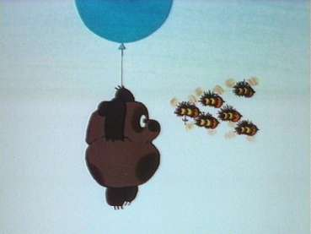
i-bii = swarm of bees

