Slide 1

Employee Data 1-100 Project
https://datasquirrel.ai/

Slide 2
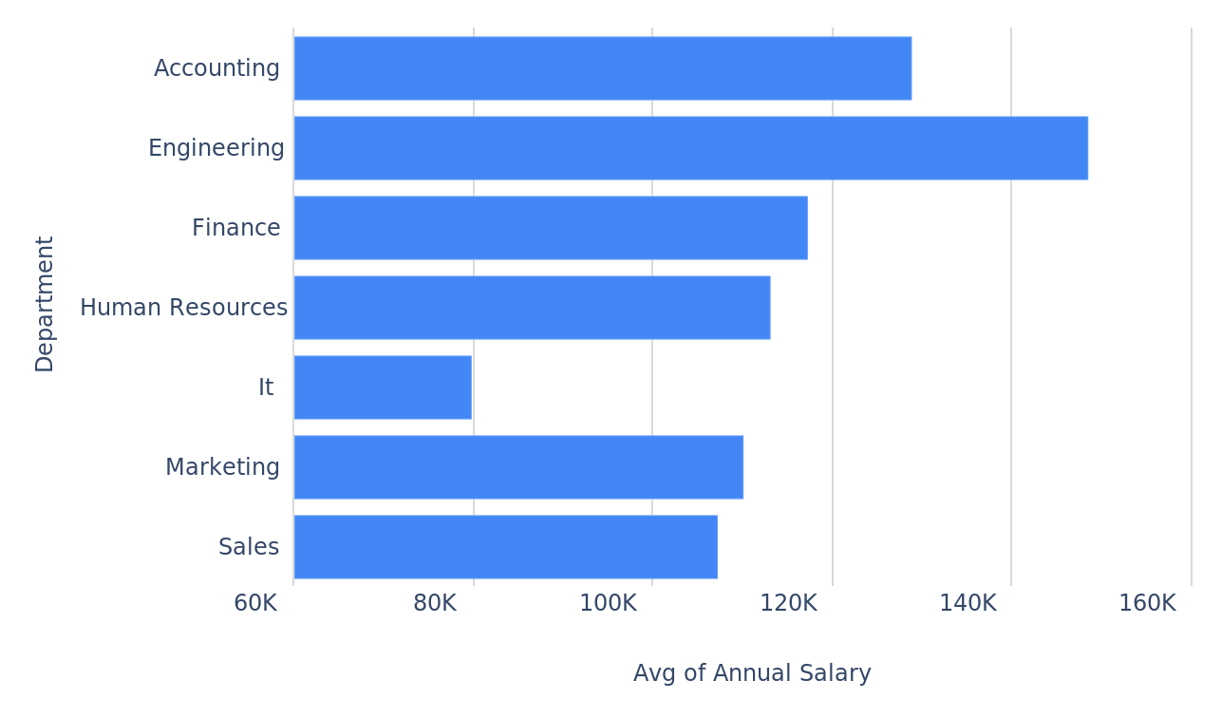
Calculating average salary across different departments.
Annual Salary per Department
Employee_Data_1-100_Project_20250509_053322.pptx
2

Slide 3
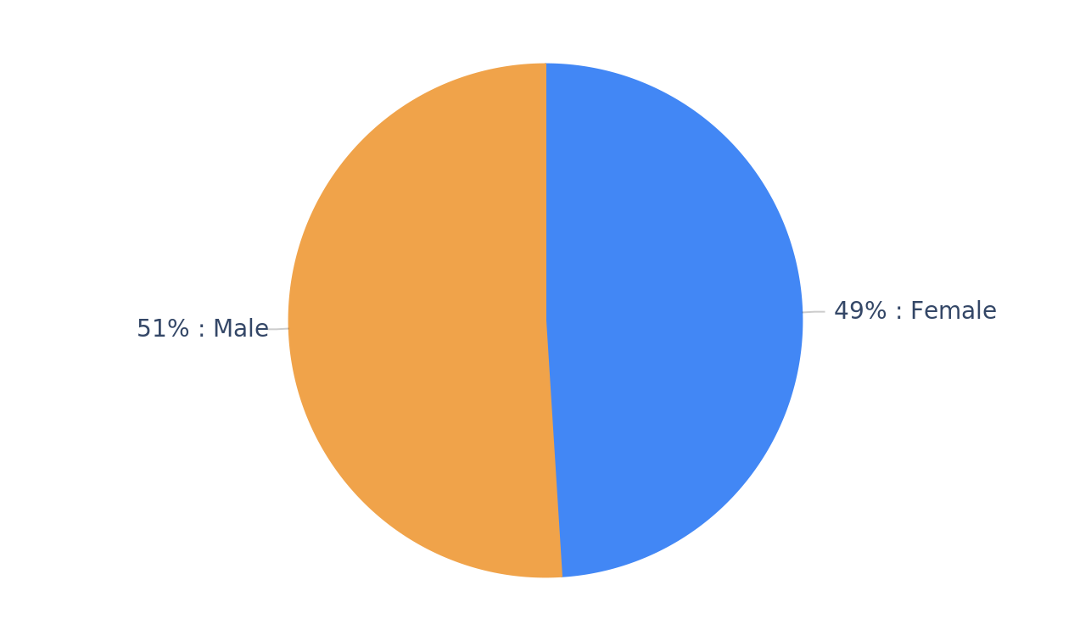
Showing the distribution of employees by gender.
Genders
Employee_Data_1-100_Project_20250509_053322.pptx
3

Slide 4
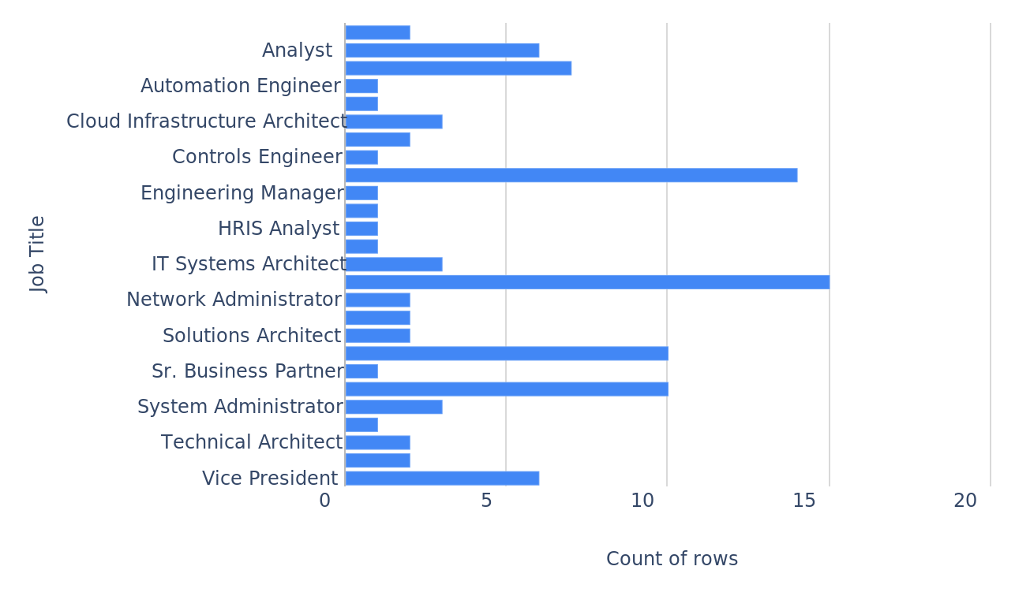
Displaying the number of employees in each job title.
Job Titles
Employee_Data_1-100_Project_20250509_053322.pptx
4

Slide 5
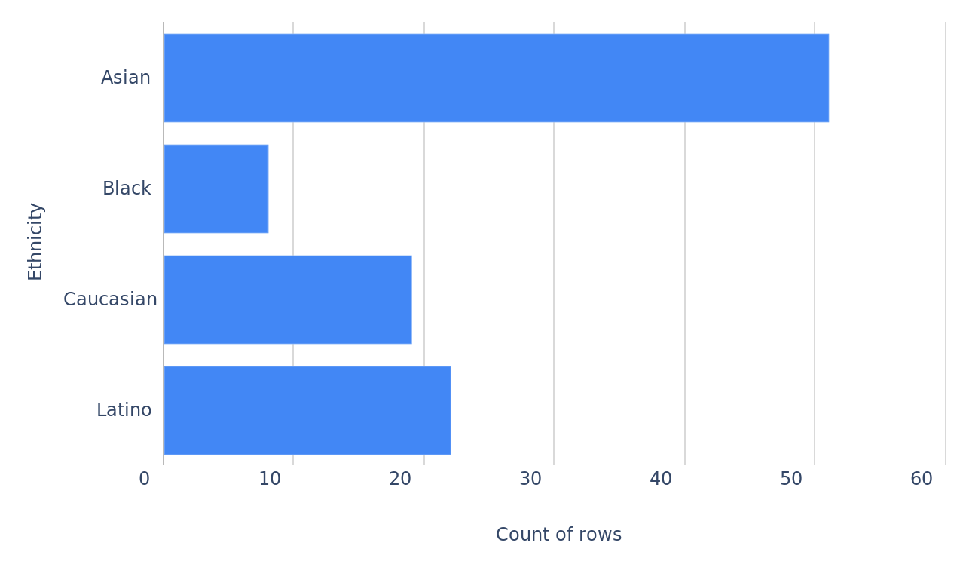
Illustrating the composition of the workforce by ethnicity.
Ethnicities
Employee_Data_1-100_Project_20250509_053322.pptx
5

Slide 6
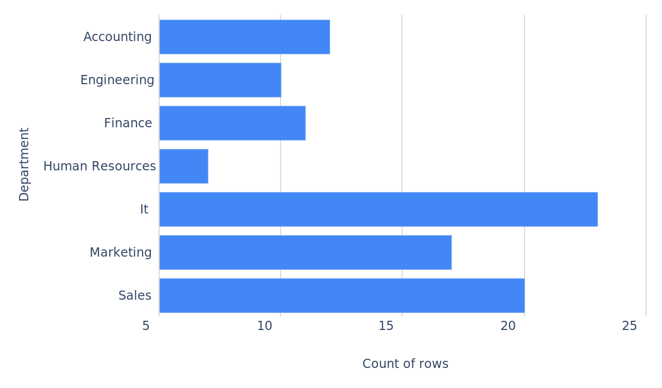
Indicating the number of employees in each department.
Departments
Employee_Data_1-100_Project_20250509_053322.pptx
6

Slide 7
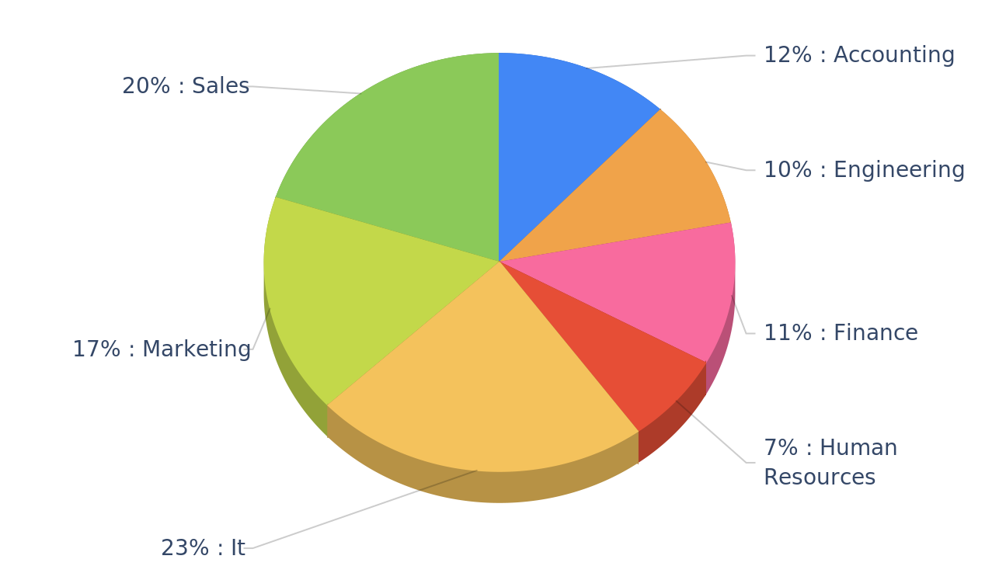
Business Unit per Department
Business Units
Employee_Data_1-100_Project_20250509_053322.pptx
7

Slide 8
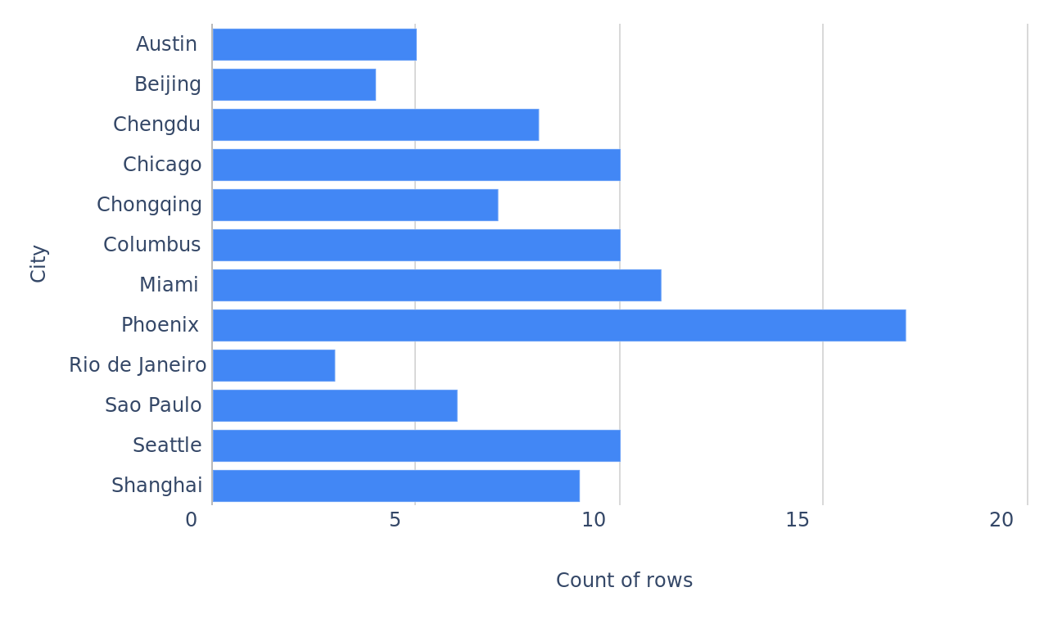
Presenting the number of employees located in each city.
Cities
Employee_Data_1-100_Project_20250509_053322.pptx
8

Slide 9
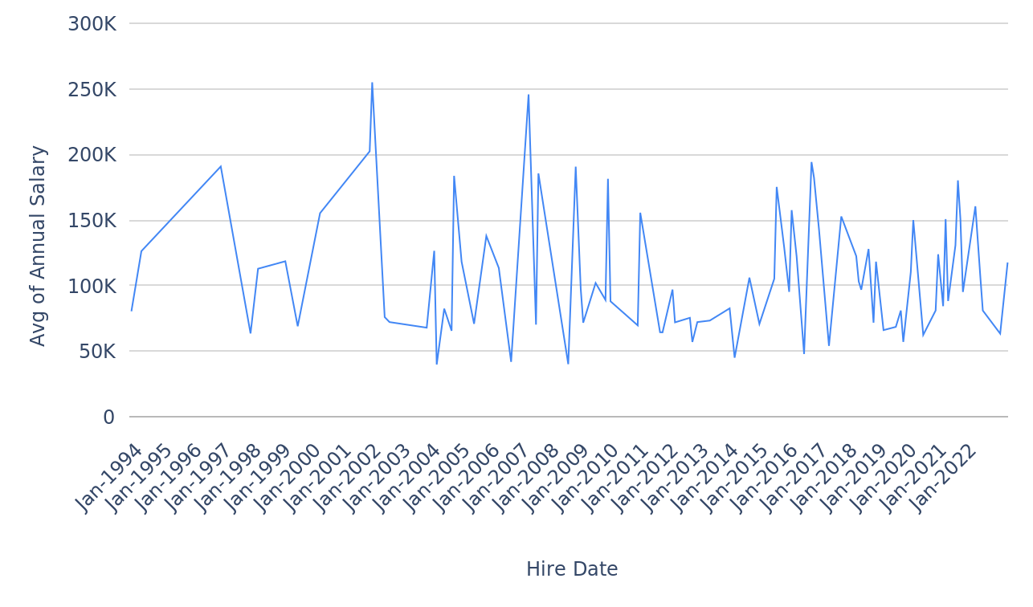
Examining the trend of average salary over the hire dates.
Annual Salary per Hire Date
Employee_Data_1-100_Project_20250509_053322.pptx
9

Slide 10
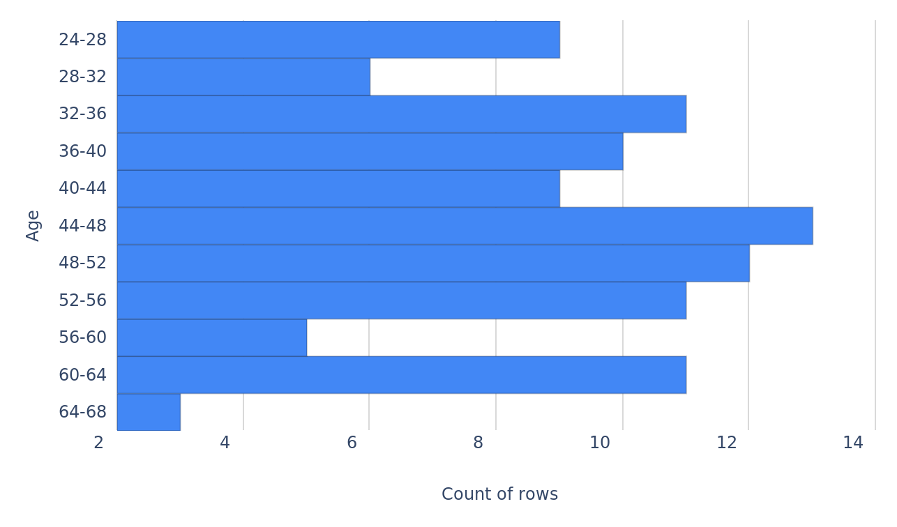
Revealing the age distribution of the employees.
Ages
Employee_Data_1-100_Project_20250509_053322.pptx
10

Slide 11
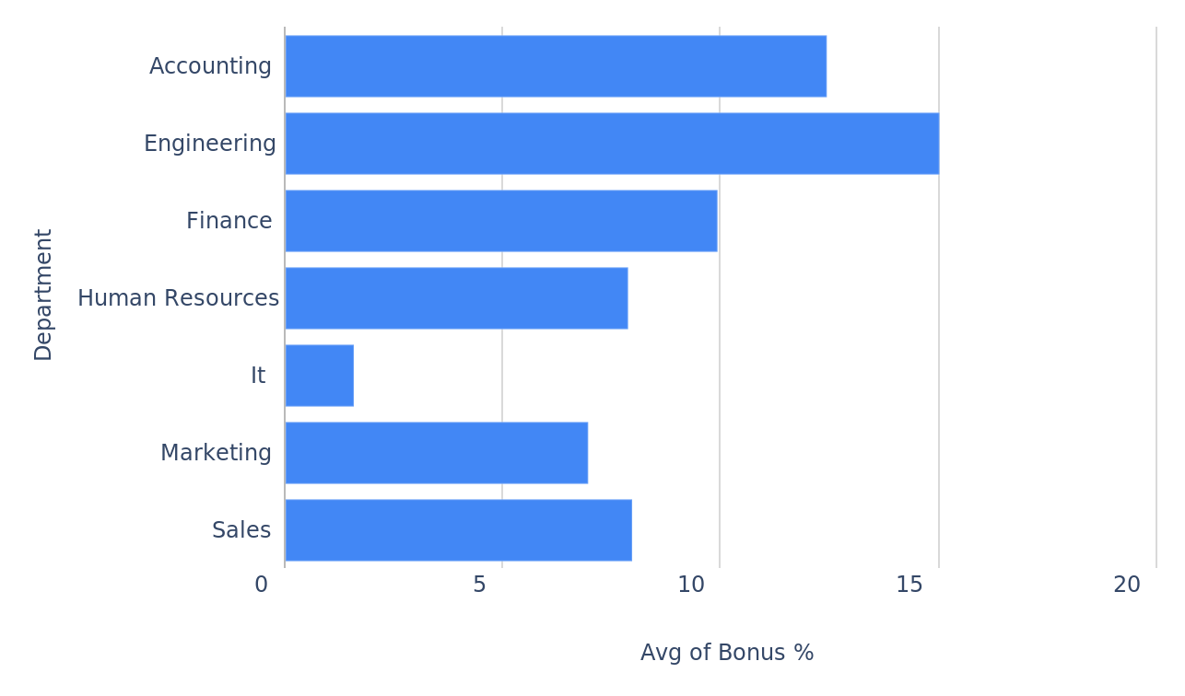
Determining the average bonus percentage for each department.
Bonus % per Department
Employee_Data_1-100_Project_20250509_053322.pptx
11

Slide 12
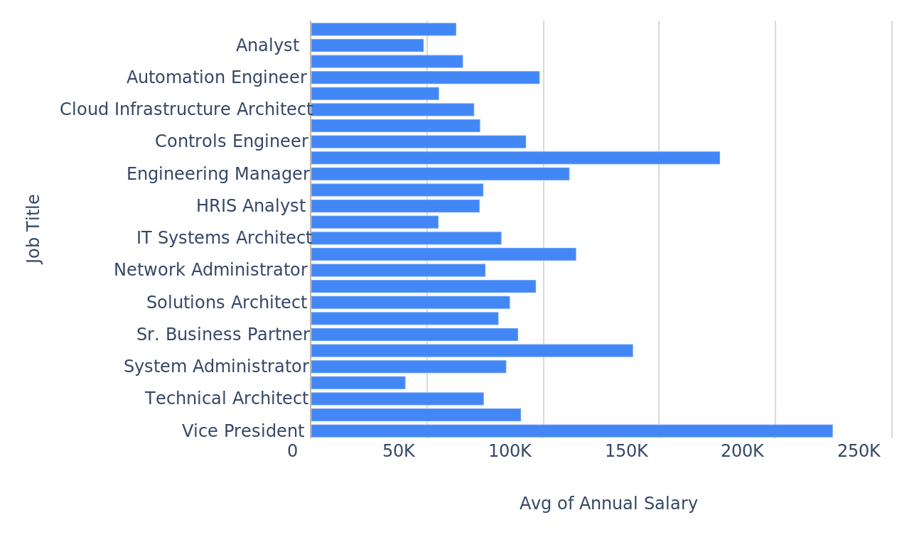
Evaluating the average salary for each job title.
Annual Salary per Job Title
Employee_Data_1-100_Project_20250509_053322.pptx
12

Slide 13
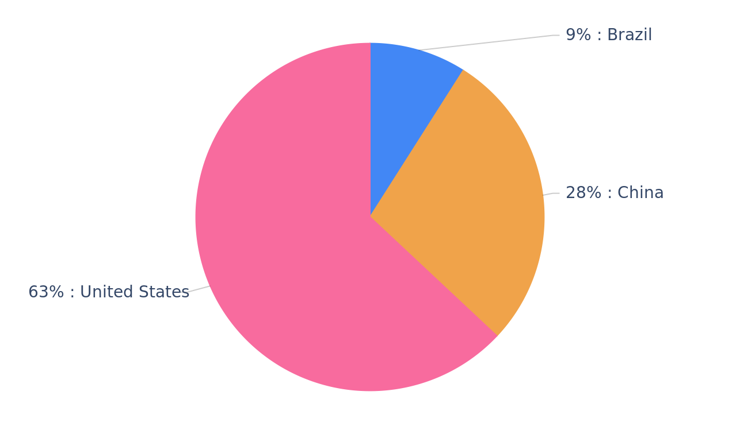
Showing the proportion of employees in each country.
Countries
Employee_Data_1-100_Project_20250509_053322.pptx
13

Slide 14
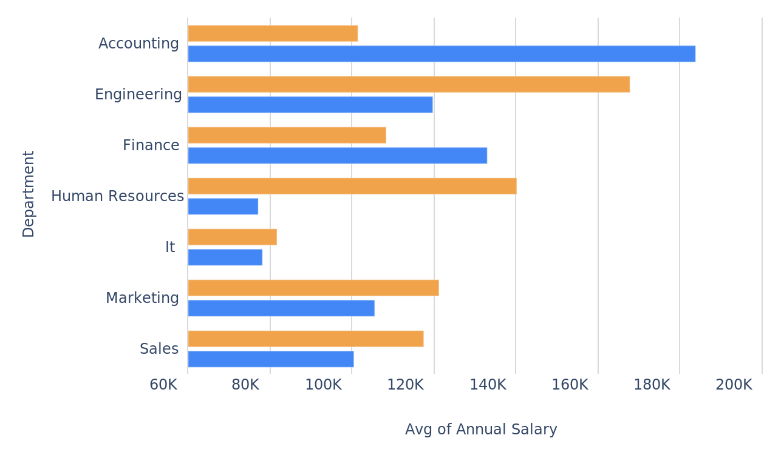
Comparing average salaries across departments by gender.
Annual Salary per Department, grouped by Gender
Employee_Data_1-100_Project_20250509_053322.pptx
14

Slide 15
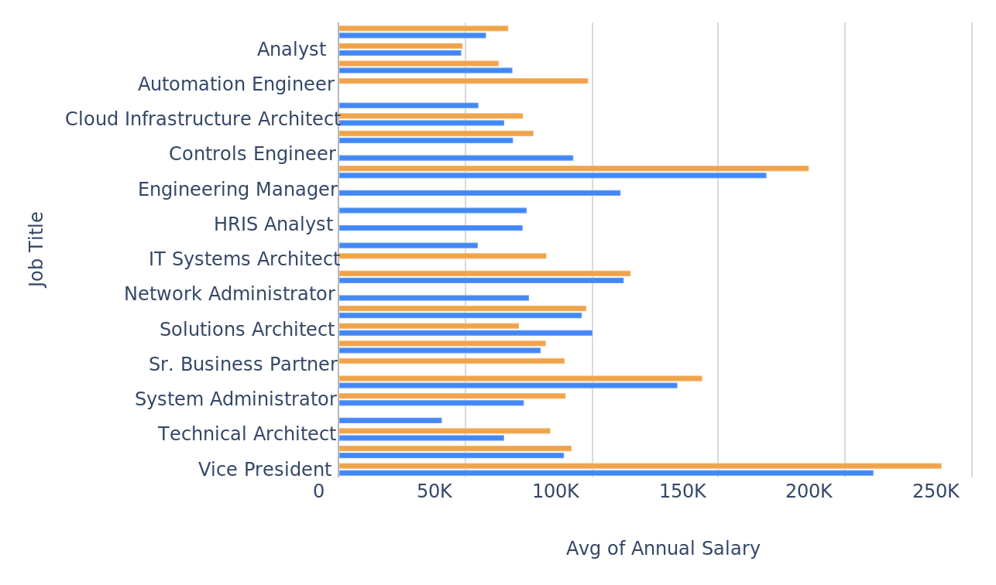
Analyzing average salaries for each job title by gender.
Annual Salary per Job Title, grouped by Gender
Employee_Data_1-100_Project_20250509_053322.pptx
15

Slide 16
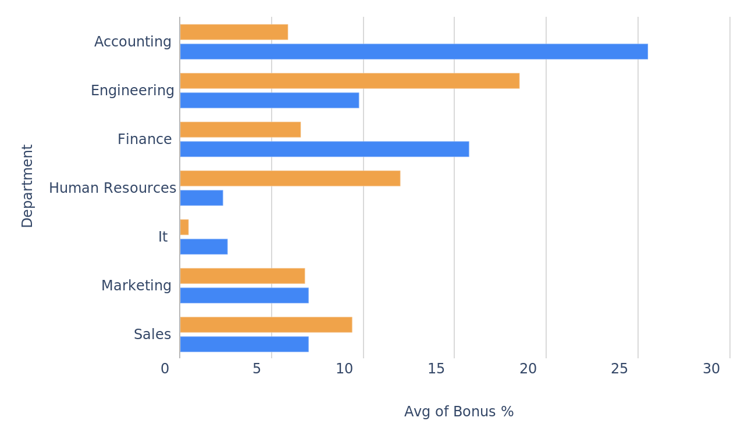
Investigating average bonus percentages across departments by gender.
Bonus % per Department, grouped by Gender
Employee_Data_1-100_Project_20250509_053322.pptx
16

Slide 17
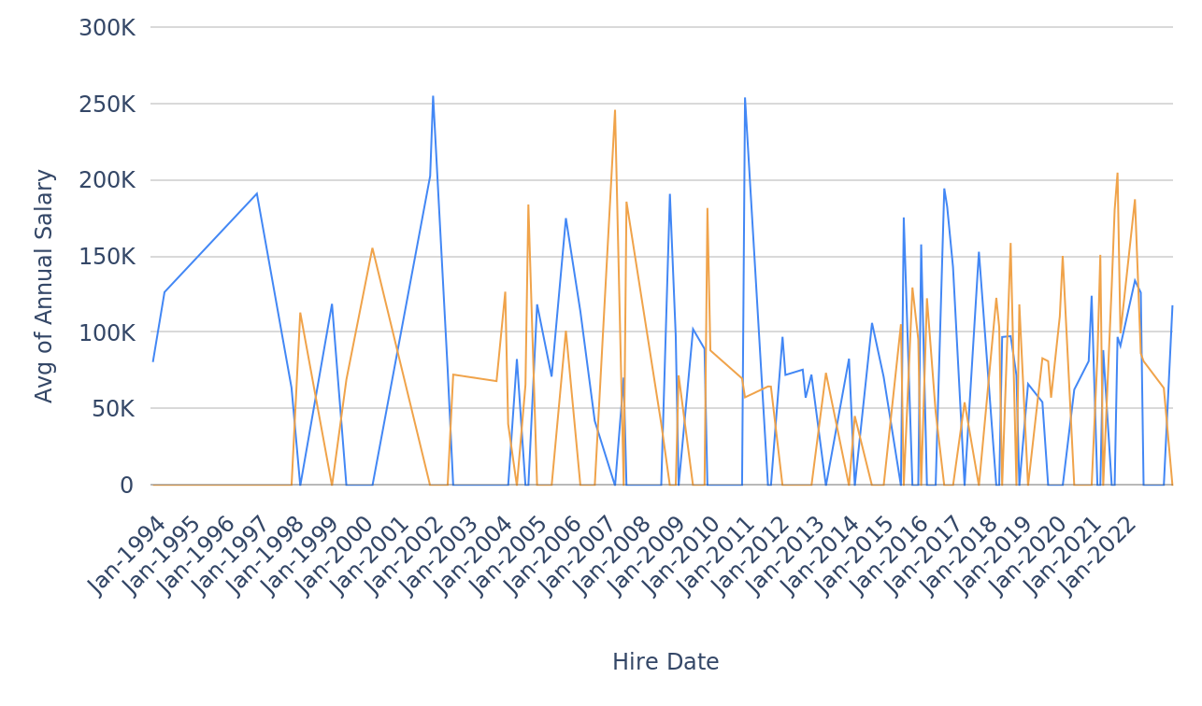
Studying the average salary trend over hire dates, segmented by gender.
Annual Salary per Hire Date, grouped by Gender
Employee_Data_1-100_Project_20250509_053322.pptx
17

Slide 18
Created By: parijat.chakraborty@gmail.com
Created At: Fri 09 May 2025 05:33 AM UTC
https://datasquirrel.ai/

