Slide 1

Excel Pivot Tables
Discover how to transform your data analysis with Excel's powerful pivot table feature. Learn to create interactive reports without formulas.
by Parijat Chakraborty

Slide 2

What is a Pivot Table?
A pivot table is an interactive report that lets you explore data from many perspectives.
Interactive View
Multiple Perspectives
Examine your data dynamically without static reports or formulas.
Group data into categories, break down by time periods, and filter results.
Visual Analysis
Build charts and explore data relationships with just a few clicks.

Slide 3
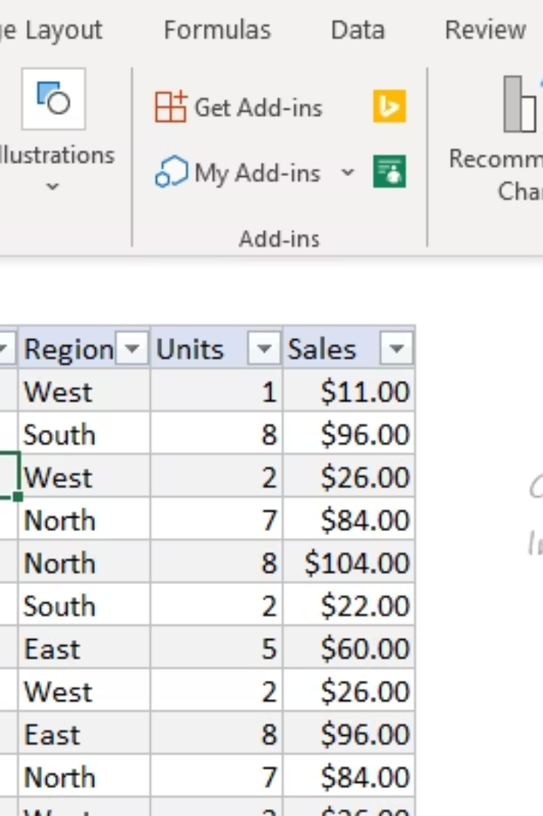
Creating Your First Pivot Table
Select Any Cell in Your Data
Click Pivot Table on the Insert tab of the ribbon.
Choose Location
Override the default and enter H4 to place on current worksheet.
Build Your Table
Drag fields into Columns, Rows, or Values areas in the PivotTable Fields pane.

Slide 4
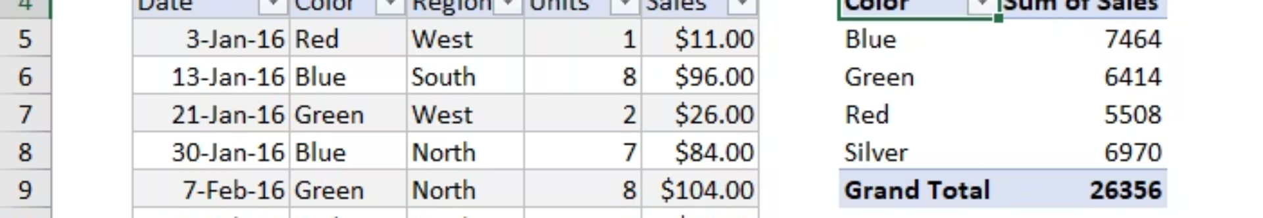



Adding Fields to Your Pivot Table
Add Values
Drag Sales field to Values area to calculate grand total.
Add Row Fields
Drag Color field to Rows area to break out sales by category.
Review Results
See which colors are top sellers while maintaining the grand total.

Slide 5
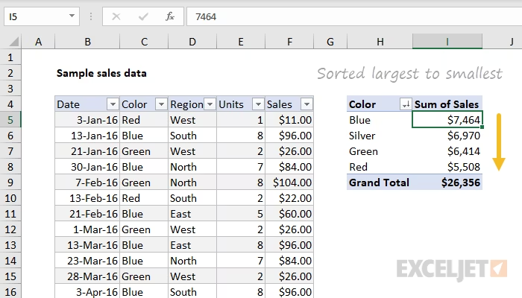
Formatting and Sorting
Number Formatting
Value Sorting
Refreshing Data
Right-click any Sales number and choose Number Format. Apply Currency with zero decimal places.
Right-click any Sales value and choose Sort > Largest to Smallest.
Right-click anywhere in the pivot table and select "Refresh" to update with new data.
Top-selling items appear first. This order updates automatically when data changes.
Formatting stays applied even when data changes or the pivot table is reconfigured.
The pivot table maintains formatting and sorting rules after refreshing.

Slide 6
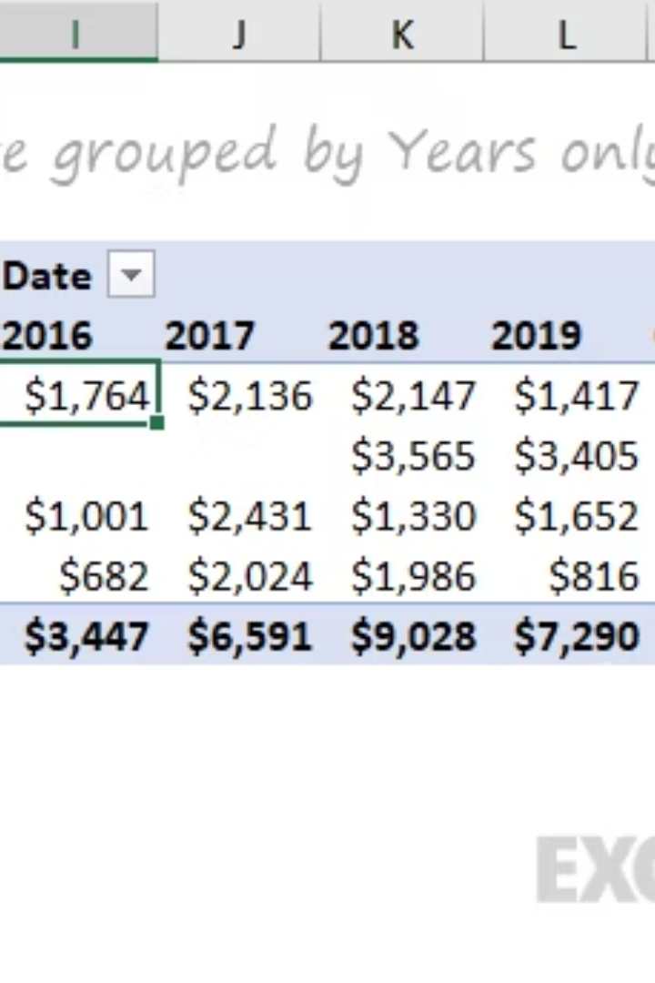



Advanced Value Display Options
Add Multiple Value Fields
Drag Units to the Value area to see Sales and Units together.
Show Percent of Total
Add Sales field twice. Right-click the second instance and choose "% of grand total".
Group by Date
* Remove Sales From Values
Drag Date field to Columns. Right-click a date and choose "Group" by Years.

Slide 7








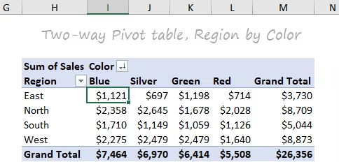
Creating Two-Way Pivot Tables
Start with Base Table
Add Column Dimension
Begin with your existing pivot table showing Color in Rows.
Drag Region into the Columns area to create a two-way table.
Analyze Patterns
Swap Dimensions
Identify relationships between dimensions while maintaining the same total.
Drag Region to Rows and Color to Columns for a different view.

Slide 8





Key Pivot Table Benefits
Simplicity & Speed
Create useful reports in minutes without complex formulas.
Flexibility & Accuracy
Rearrange views quickly while maintaining calculation accuracy.
Formatting & Updates
Apply consistent formatting that persists through data refreshes.
Filtering & Charts
Filter data easily and create pivot charts with a few clicks.

