Slide 1
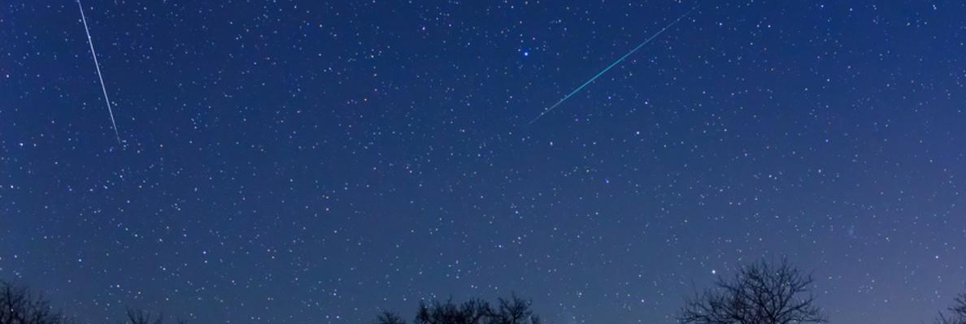




Improving meteor shower characterization from radio meteor counts in a multi-observer network
S. Calders, J. De Keyser, H. Lamy, K. Kolenberg
ROYAL BELGIAN INSTITUTE FOR SPACE AERONOMY
Notes:
12 minutes, incl. 2 minutes questions
This talk focuses on improving meteor shower modeling using radio meteor count data from multiple stations.
Mention that the work builds on Steyaert (2006) but generalizes and improves it.
Agenda:
Explain the problem
Solution proposed by Chris Steyaert
Limitations of this solutions, and how we generalized it
An example

Slide 2

Outline
Explain the problem
Solution proposed by Chris Steyaert
Limitations of this solutions, and how we generalized it
An example
Notes:
Uncertainty on the results: OF, the sporadic profile and the stream parameters
>Skip this slide

Slide 3
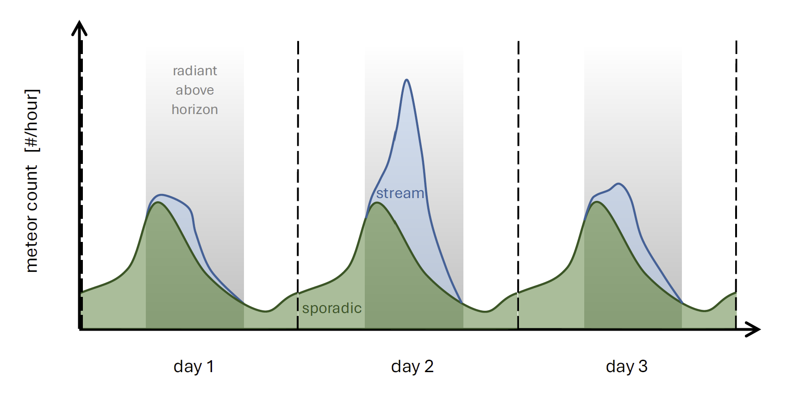
Problem statement
Notes:
How can we statistically distinguish which meteors belong to a specific shower, given that single-station radio forward scatter data alone cannot reliably separate shower meteors from sporadic background activity?
Forward scatter radio data from a single or a small number of stations are not enough to say whether a detected meteor belongs to a shower or is part of the sporadic background.
This means that any separation between shower activity and background must be done statistically.

Slide 4
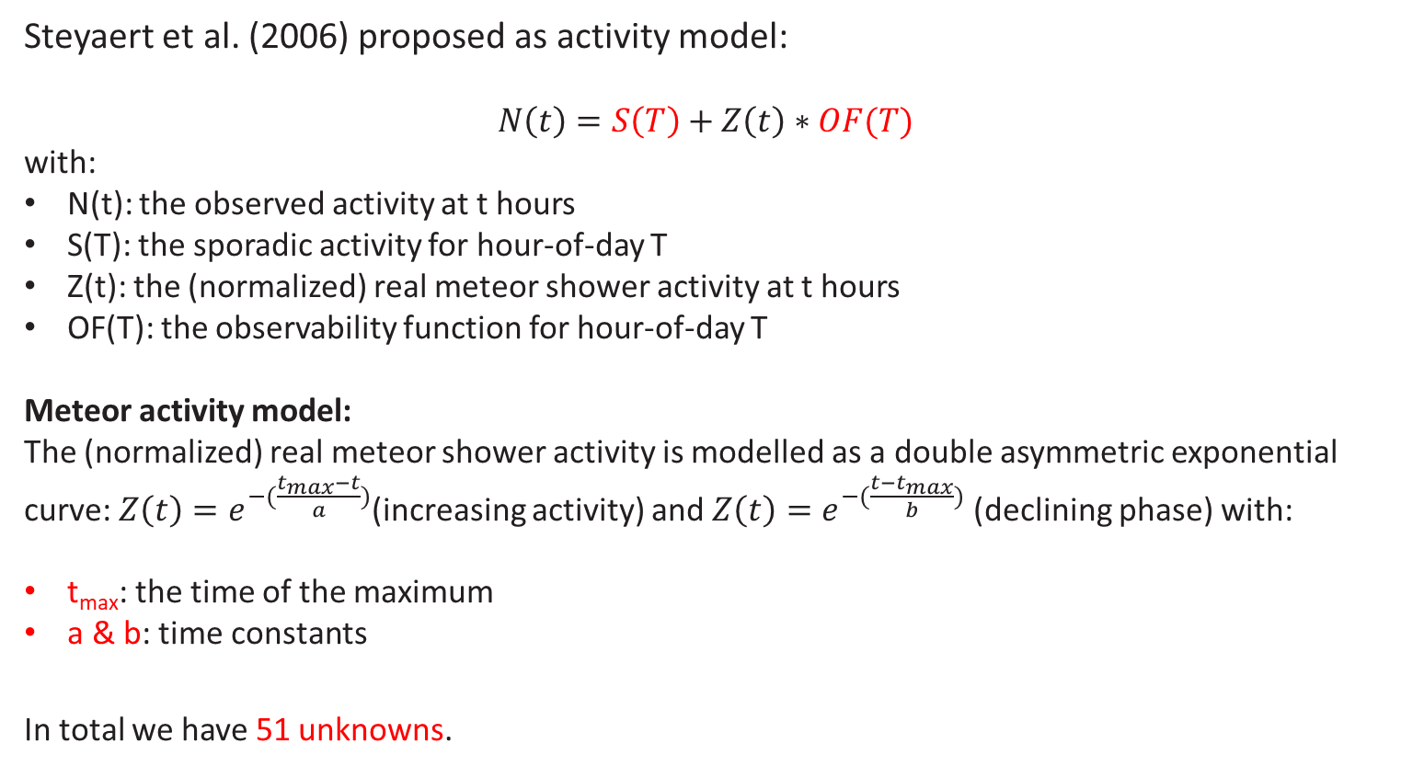
Solution proposed by Steyaert (2006)
Steyaert et al. (2006) proposed as activity model:
$$N\left(t\right)=S\left(T\right)+Z\left(t\right)∗OF(T)$$
with:
N(t): the observed activity at t hours
S(T): the sporadic activity for hour-of-day T
Z(t): the (normalized) real meteor shower activity at t hours
OF(T): the observability function for hour-of-day T
Meteor activity model:
The (normalized) real meteor shower activity is modelled as a double asymmetric exponential curve: $Z\left(t\right)=e^{−(\frac{t_{max}−t}{a})}$(increasing activity) and $Z\left(t\right)=e^{−(\frac{t−t_{max}}{b})}$ (declining phase) with:
t_{max}: the time of the maximum
a & b: time constants
In total we have 51 unknowns.
Notes:
Briefly summarize Steyaert’s original approach:
The number of observed meteors is the sum of the number of sporadic meteors and the number of observed shower meteors.
Uses a double-exponential profile for shower activity.
But not all shower meteors can be observed, e.g. when the radiant is below the horizon. The OF captures the fraction of shower meteors that can be observed.
Fits count-rate profiles per local time independently.
The unknowns are in red.

Slide 5
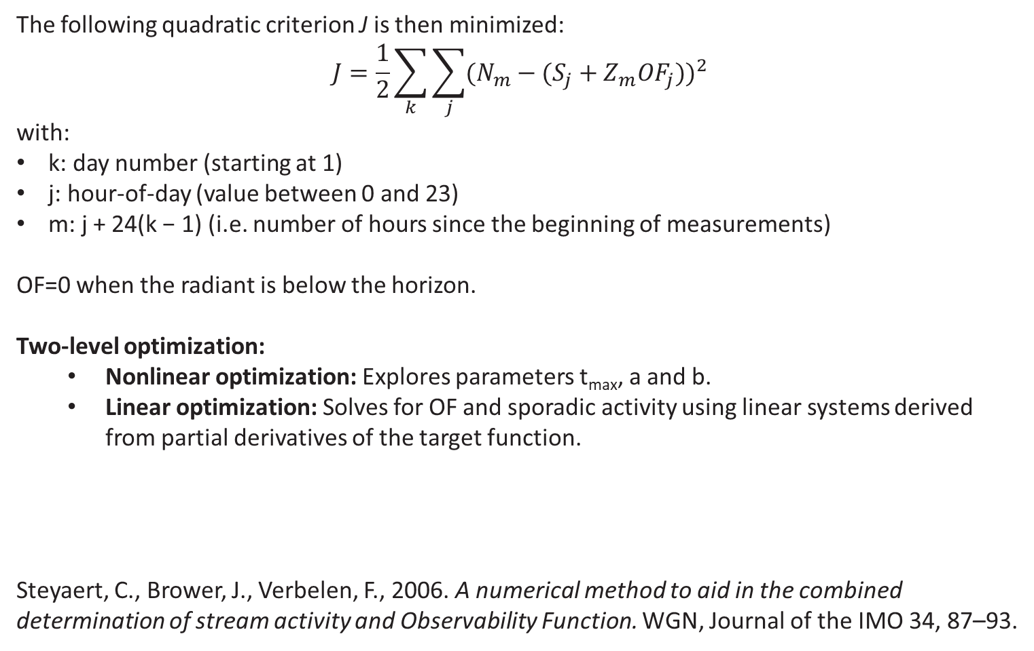
Solution proposed by Steyaert (2006)
The following quadratic criterion J is then minimized:
$$J=\frac{1}{2}\sum_{k}{\sum_{j}{{(N_{m}−(S_{j}+Z_{m}{OF}_{j}))}^{2}}}$$
with:
k: day number (starting at 1)
j: hour-of-day (value between 0 and 23)
m: j + 24(k − 1) (i.e. number of hours since the beginning of measurements)
OF=0 when the radiant is below the horizon.
Two-level optimization:
Nonlinear optimization: Explores parameters t_{max}, a and b.
Linear optimization: Solves for OF and sporadic activity using linear systems derived from partial derivatives of the target function.
Steyaert, C., Brower, J., Verbelen, F., 2006. A numerical method to aid in the combined determination of stream activity and Observability Function. WGN, Journal of the IMO 34, 87–93.
Notes:
J = cost function that you try to minimize

Slide 6
Limitations → generalization
Steyaert already mentioned some limitations, that we tried to solve:
Randomness in the observations
Limited to a single dataset
Many unknowns
Uncertainty on the results
Notes:
Uncertainty on the results: OF, the sporadic profile and the stream parameters
>Skip this slide

Slide 7
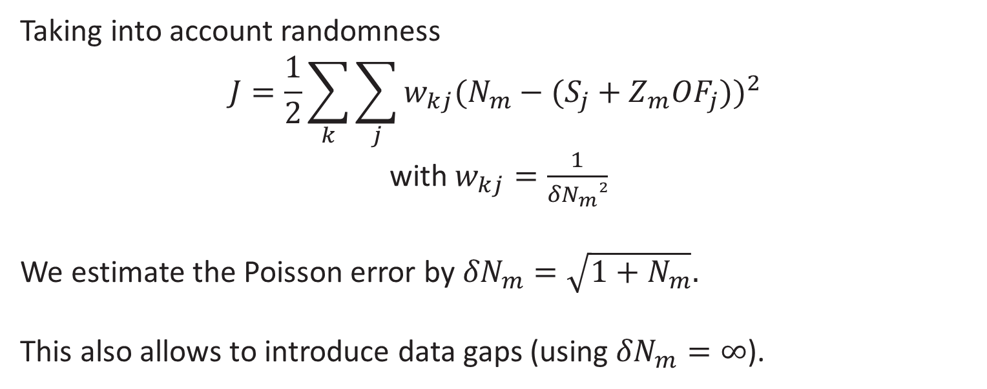
Randomness in the observations
Taking into account randomness
$$J=\frac{1}{2}\sum_{k}{\sum_{j}{{w_{kj}(N_{m}−(S_{j}+Z_{m}{OF}_{j}))}^{2}}}$$
with $w_{kj}=\frac{1}{{δN}_{m}²}$
We estimate the Poisson error by ${δN}_{m}=\sqrt{1+N_{m}}.$
This also allows to introduce data gaps (using ${δN}_{m}=∞$).
Notes:
The number of observed meteors follows a Poisson distribution. The uncertainty on the measurement is the square root of the number of observations.
This also allows to introduce data gaps: there we set the uncertainty on the measurement to infinite, so the measurement has no impact on the cost function.

Slide 8
Multiple data sets
We can also add multiple data sets by considering the sum of the cost function for each individual data set.
It increases the number of data, but it proportionally increases the number of unknowns. By itself, it is not very useful yet.

Slide 9
Reducing #unknowns/#data
One way is by increasing the amount of data.
Another way is by imposing constraints or a priori information:
Assuming that the stream parameters for all data sets are the same.
Assuming that the OF and sporadic background profile are the same for subsets of the datasets (“stations”).
Imposing smoothness conditions on the sporadic background.
Using an analytical model for the sporadic background.
It improves the problem conditioning.
Notes:
changing the ratio of the number of unknowns to the number of data points

Slide 10
Uncertainty on the results
Monte Carlo simulations: Repeats optimization with input data drawn from Poisson distributions.
Outlier removal: Discards solutions trapped in local minima far from the global optimum.
Provides average parameter values and their standard deviations as uncertainty estimates.
Notes:
We run the fitting algorithm multiple times, each time with slightly perturbed input following a Poisson process (which could be considered a form of Monte Carlo simulation).
Outlier solutions (local minima far from the expected global minimum) are filtered out based on their higher cost function.
From the accepted fits, we compute the mean and standard deviation, yielding results that are less precise but more robust. Given the nature of the observational data, we consider this trade-off acceptable.

Slide 11
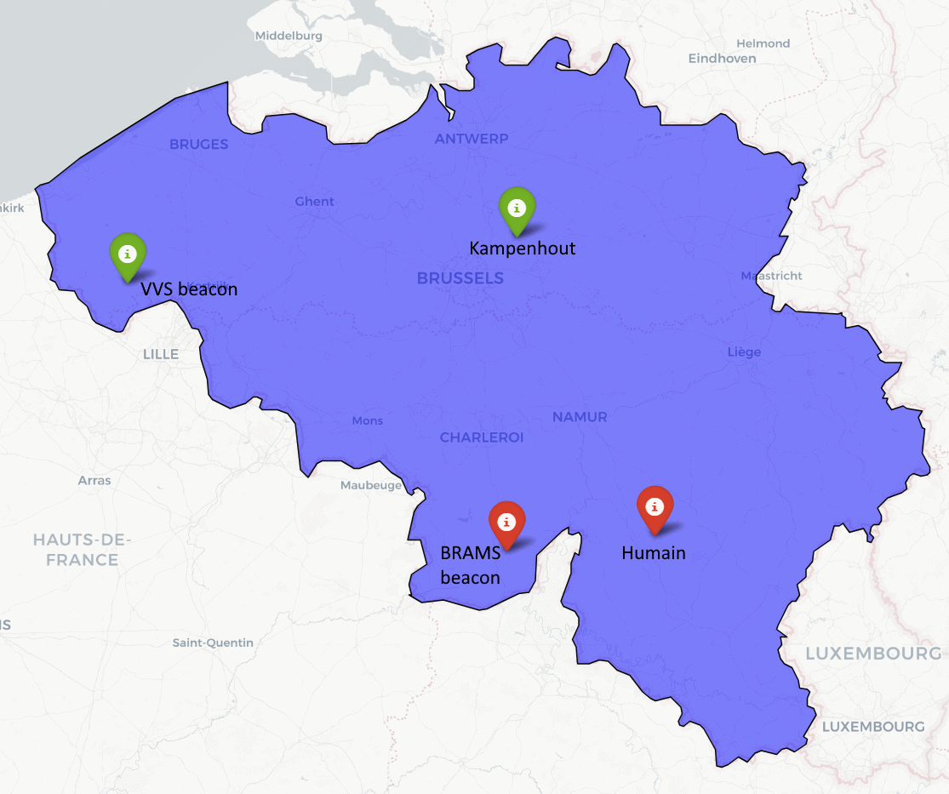
Example
Notes:
Both are forward scatter, but using different transmitter/receiver. One station observing the VVS beacon, one the BRAMS beacon.
Mention RMZ

Slide 12
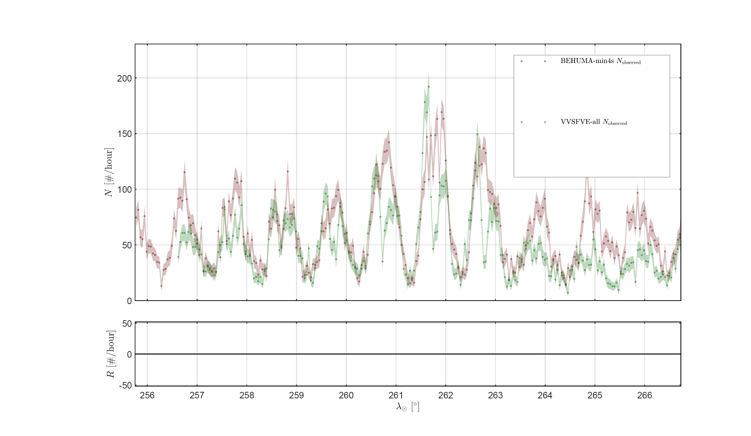
2019 Geminids forward scatter radio data from BEHUMA and VVSFVE
Observed meteors
Humain >4 sec
Kampenhout (all)
Notes:
We will fit the meteor shower, assuming shared shower parameters.
9-19 December 2019
Geminids

Slide 13
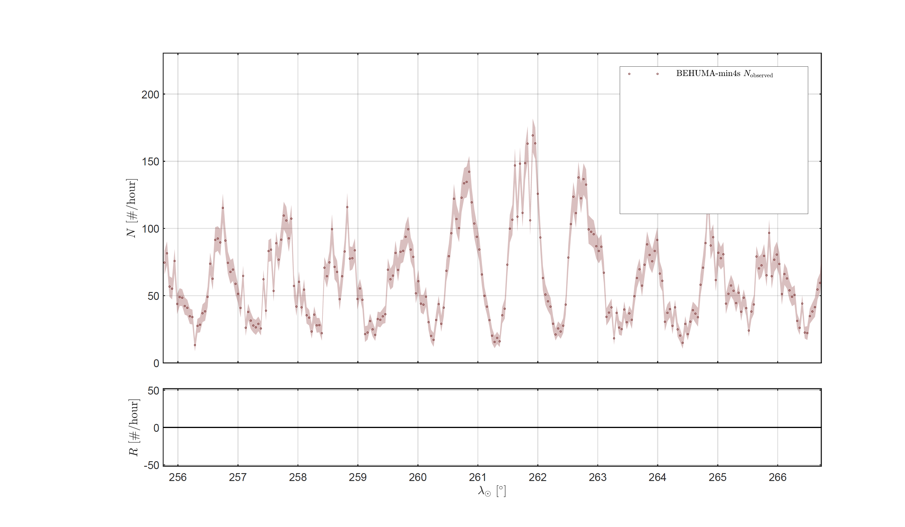
2019 Geminids data from BEHUMA alone
Observed meteors
Humain >4 sec

Slide 14
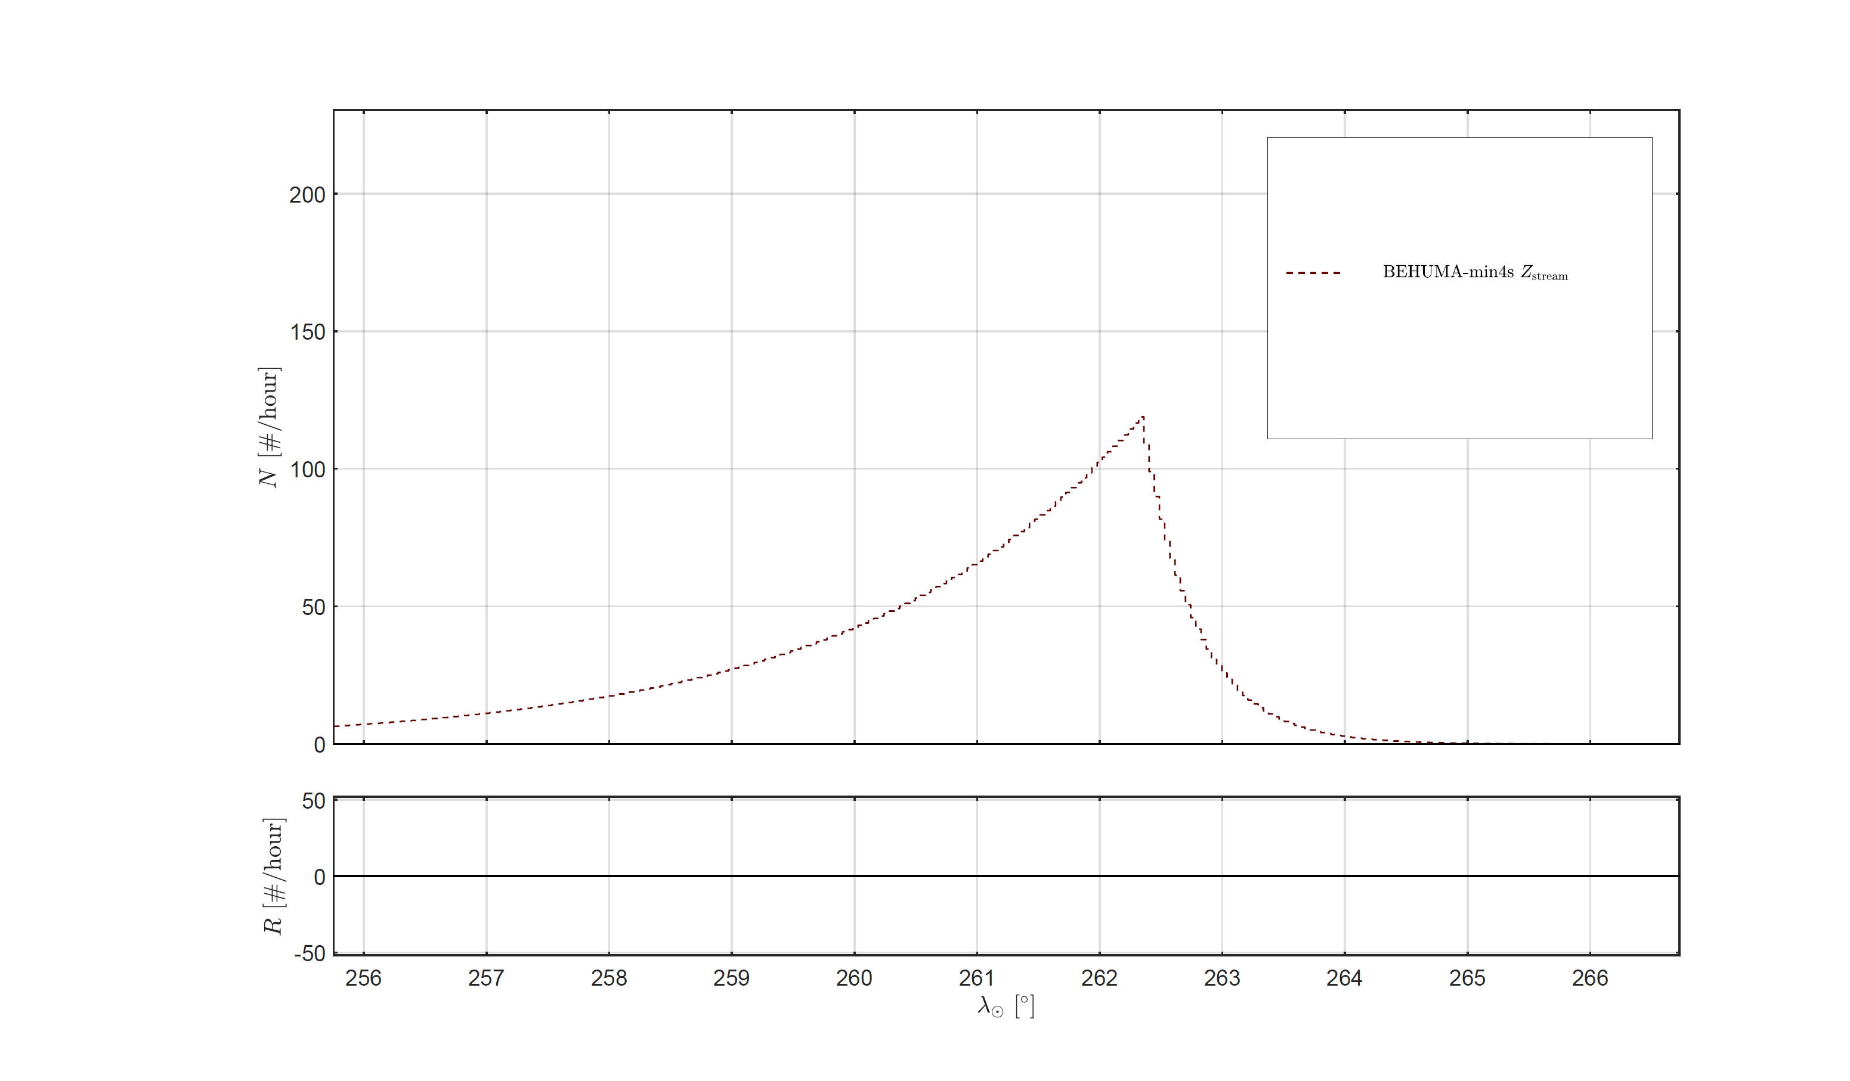
2019 Geminids flux model using a double-exponential profile
Notes:
This would be the number of observed meteors if the OF=1

Slide 15
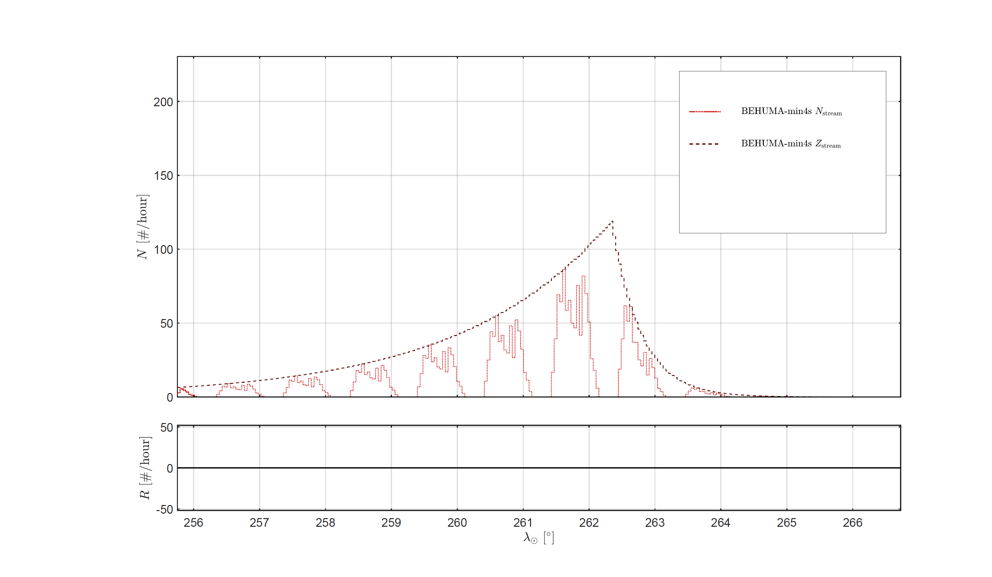
2019 Geminids flux observable at BEHUMA accounting for observability function
Notes:
These are the real observed shower meteors

Slide 16
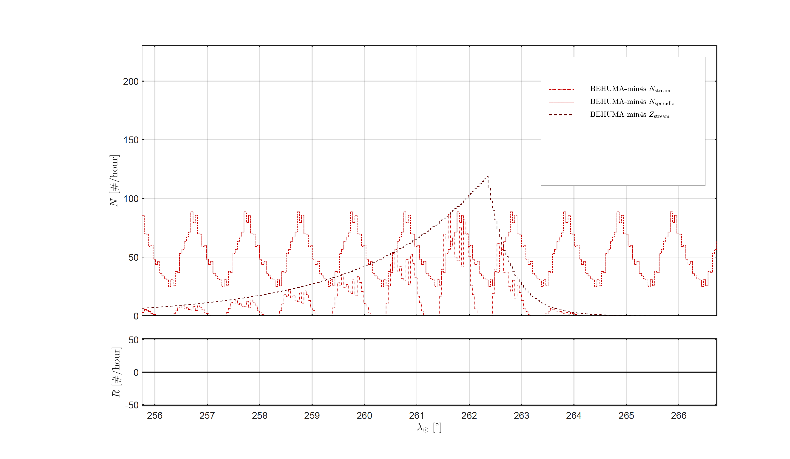
2019 Geminids flux – showing also the sporadic flux
Notes:
The sporadic has a daily variation.

Slide 17
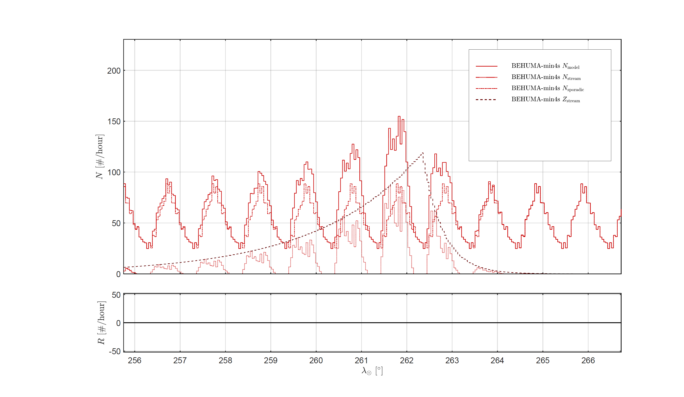
2019 Geminids flux model – sum of stream meteors and sporadics
Notes:
Together they make the total expected meteor activity.

Slide 18
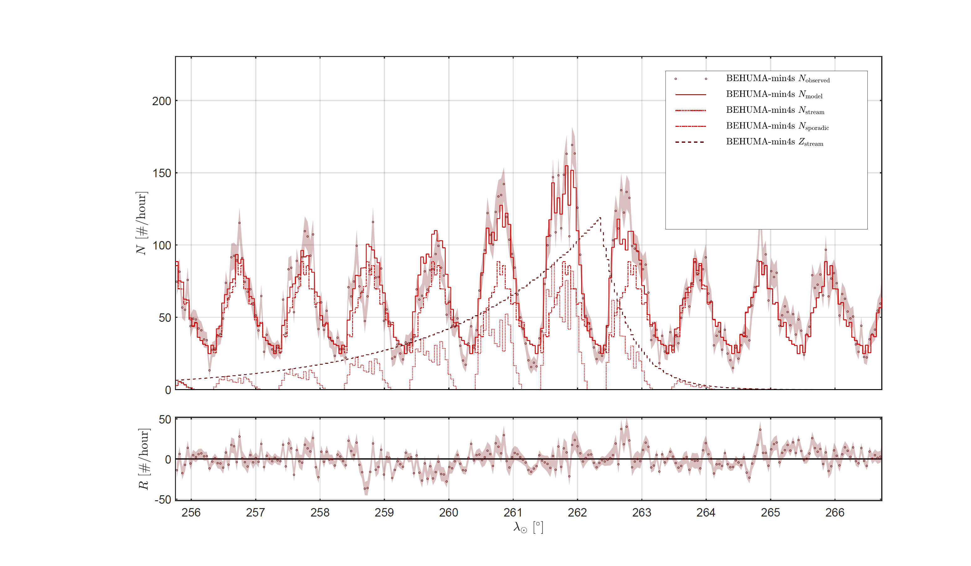
2019 Geminids flux model – comparison with the observations
Notes:
This is close to the observed meteor activity.

Slide 19
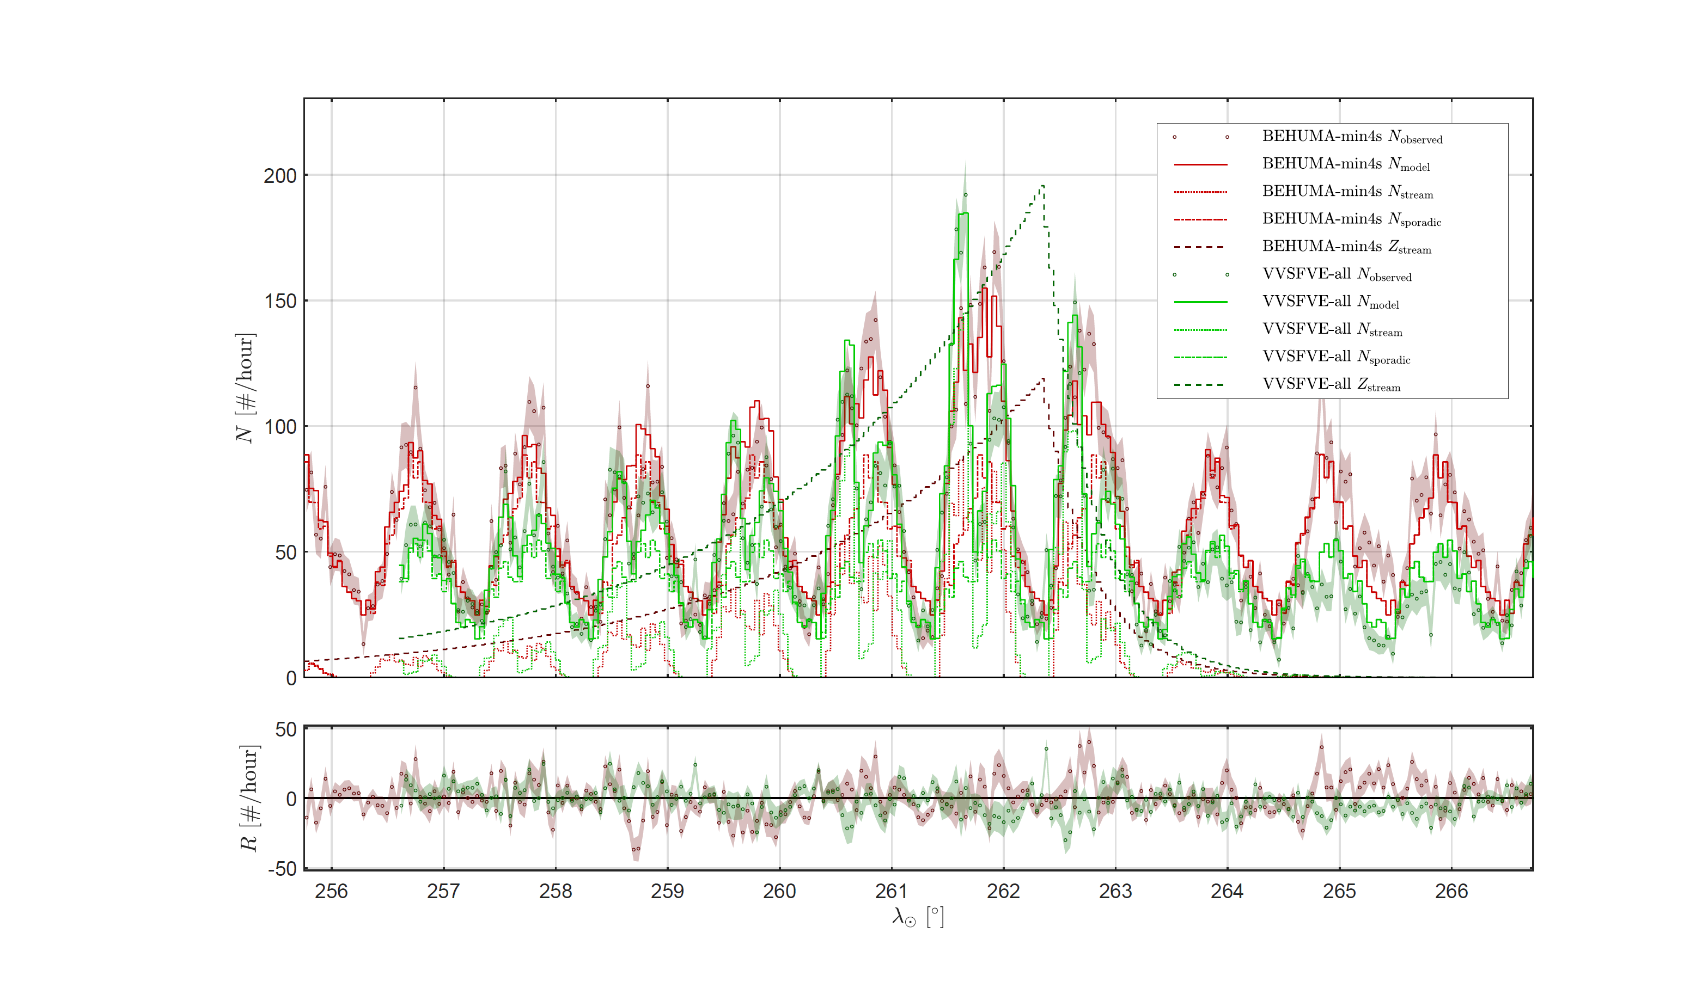
2019 Geminids flux model and observations for both stations
Notes:
The stream parameters are shared.
Mention residuals as a diagnostic for fit quality.

Slide 20
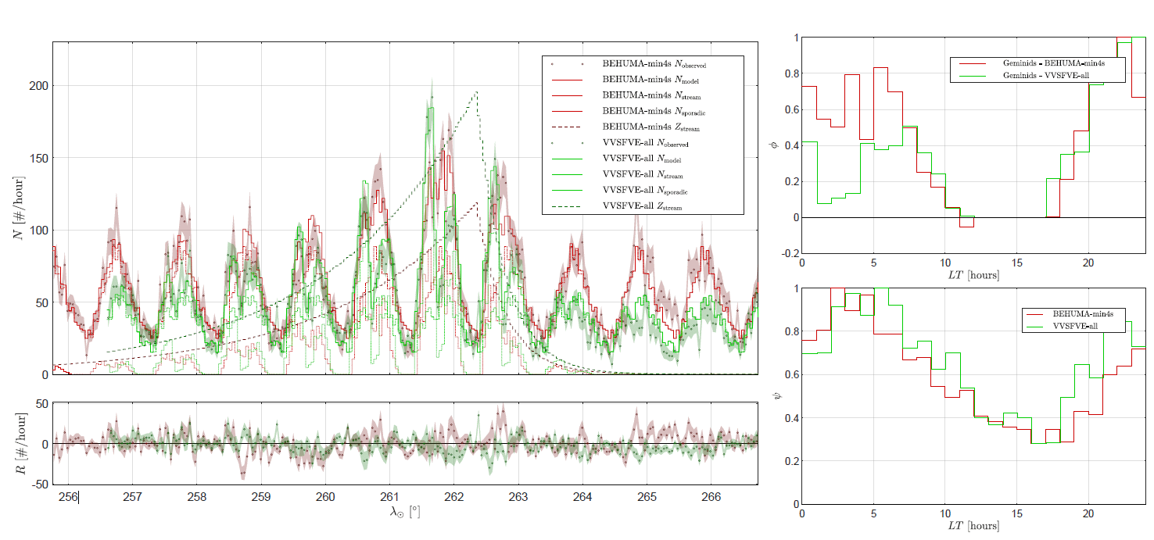
Example fit
OF
Fit
Residuals
Sporadics
Notes:
The normalized sporadic curve is similar between the two stations.

Slide 21
Example fit
OF
Fit
Residuals
Sporadics
Notes:
The OF has a similar shape, although the dip at high radiant elevations for Kampenhout is striking. This is due to the antenna configuration.

Slide 22
Conclusions
You can derive the shower activity from time series.
Key improvements:
Errors estimates on the outputs
Multi-station data
Adding constraints and a priori information
Challenges & solutions:
Overfitting risk: Mitigated by progressive optimization (e.g. starting with simple models and adding complexity).
Note: RMZ volunteer data is reliable and usable in scientific analysis.
De Keyser et al. (2025) Deriving meteor stream properties from meteor count rate time series in a multi-observer network (submitted to Planetary & Space Science)
Notes:
Key improvements:
Multi-Station Data: Combines observations from multiple stations to better separate sporadic and stream contributions.
Smoothness & Models: Imposes smoothness on sporadic profiles and uses latitude-dependent models to reduce unknowns and improve robustness.
Constraints: Ensures non-negativity of observability functions (OFs) and sets OFs to zero when radiants are below the horizon.
Generalized, more robust method.
Proper error handling and global fitting.
Ready for operational use in multi-station networks.
Mention upcoming paper submission and planned applications.

Slide 23
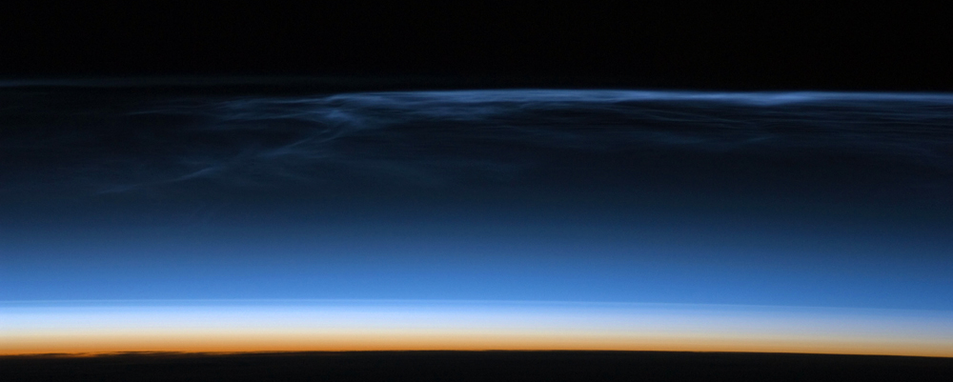

thank you! Questions?
http://www.radiometeorzoo.org
Stijn.Calders@aeronomie.be

Slide 24

Adding a priori information
Assumption:
Meteoroids detected by data sources at the same station have similar properties. So they share the same normalized observability function (OF) and sporadic background profile.
Activity model:
Advantages:
Reduces the number of unknowns compared to individual data source methods.
Improves problem conditioning by leveraging multiple data sources.
Notes:
Assumption: multiple data sources at the same station share observability and sporadic profiles.
Advantage:
Reduces unknowns.
Makes fitting more stable and accurate.

Slide 25
Adding a priori information
Smooth sporadic background
Adds a smoothness condition to the sporadic background profile
Ensures physically meaningful, smooth periodic curves.
Couples equations for all time bins, improving problem stability.
Sporadic background model
Uses a latitude-dependent sinusoidal model for sporadic activity based on Younger et al. (2009).
Reduces unknowns, simplifies optimization, and improves robustness.
Both methods enhance the reliability of meteor stream analysis by better handling sporadic background variations.

Slide 26

Multiple streams
We can work with multiple streams s:
Of course it will add more stream parameters and increases the number of unknowns.
$$N_{m}=S_{j}+\sum_{s}{Z_{sm}{OF}_{sj}}$$
Notes:
→ This slide could be skipped if necessary.
Generalisation on suggestions that Steyaert gave in his paper.
Explain that the new method generalizes Steyaert’s approach:
- Introduce weights to correct for low counts
Several stations and data sets
More than one meteor shower
Allows simultaneous fitting across stations.
Better constraints of the problem and more robust results.
We introduce also a soft way to avoid OF and S to become negative.

