Slide 1

Why Geminids are a comet stream
Galina O. Ryabova
Tomsk State University
19 September 2025; online
IMC 2025
September 18th – 21st Soest, the Netherlands

Slide 2
In this talk I'll try to explain what structural parameters of the meteor shower indicate its cometary origin and what observational data we need to confirm (or deny) this.

Slide 3
Geminid’s orbit
a = 1.4 AU
q = 0.14 AU
e = 0.9
i = 23º
Dec. 7 – 15

Slide 4
Model
3 – 10 mln of test particles
Masses: m₃ ≈10⁻³ g и m₄ ≈ 10⁻⁴ g
Age: 2000 years
Cometary model
Evolution — polynomial approximation
Ryabova G.O. Mathematical modelling of meteoroid streams. Springer Internat. Pub., 2020. 76 p.

Slide 5
Cometary scenario
Dust production around the orbit, increasing towards perihelion, and
from the sunlit hemisphere.
The ejection speed is larger for smaller particles.
Let us consider this point by point …

Slide 6
The ejection speed is larger for smaller particles

Slide 7
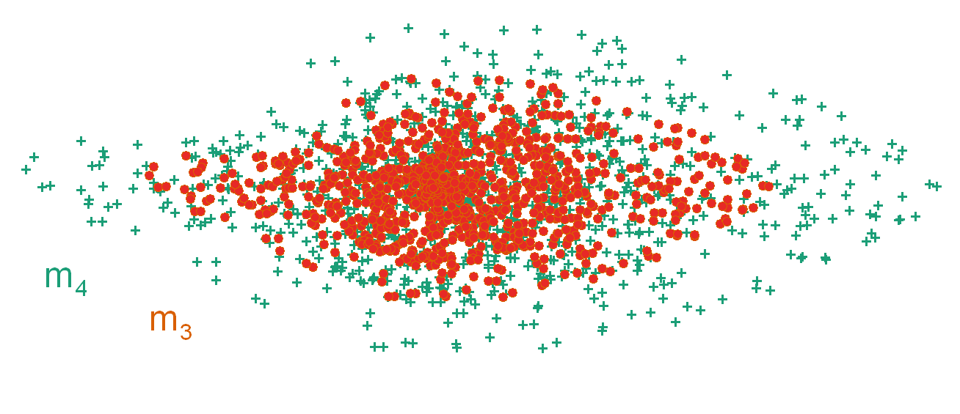
3. The ejection speed is larger for smaller particles
m₃ = 10⁻³ g
m₄ = 10⁻⁴ g
Cross-section at the descending node, at time t₀ (initial time).

Slide 8
Evolution of the cross-section
For mass m₃
NB: not to scale!
The model Geminid cross-sections in a plane perpendicular to the reference orbit’s velocity vector at the descending node. The time in years from the moment of the stream generation is indicated in the top right-hand corner of every panel. The densest part of the stream is designated by white colour. The numbers in the bottom left-hand corners are the length (in au) of the sides of the corresponding rectangle enclosing the cross-section. The mass of particles is m₃.
Ryabova (2020, fig. 5.4) [modified after Ryabova (2006, Fig. 8)]

Slide 9
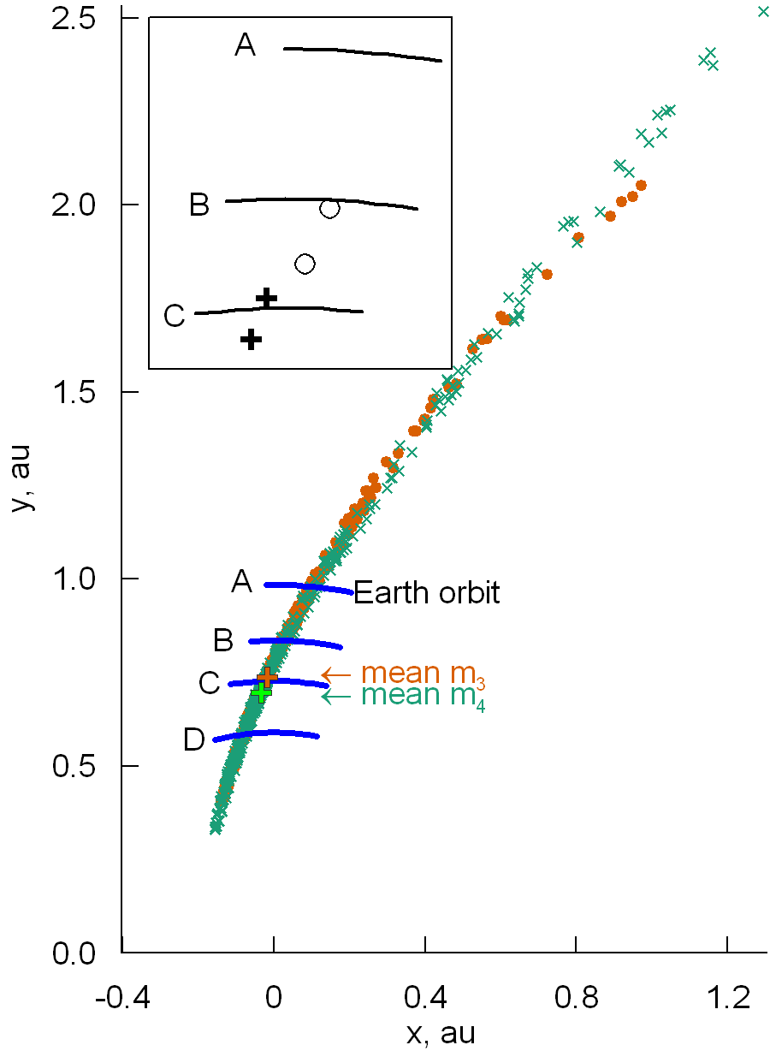
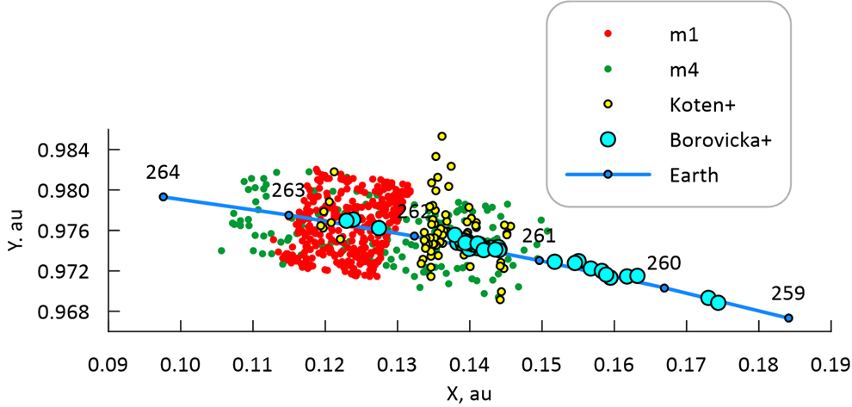
Geminid model cross-section in the ecliptic plane is more convenient to show what we can observe at the Earth.
(Ryabova, 2021; Fig.1)
(Ryabova, 2024; Fig. 1)
m1 = 10⁻¹ g
m4 = 10⁻⁴ g

Slide 10
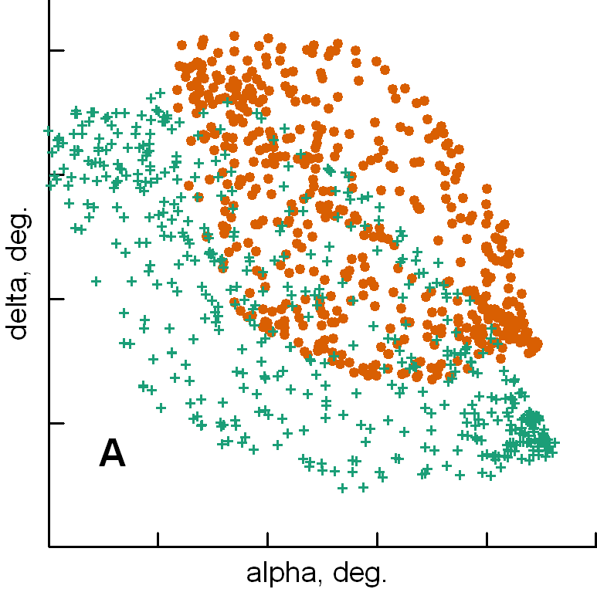
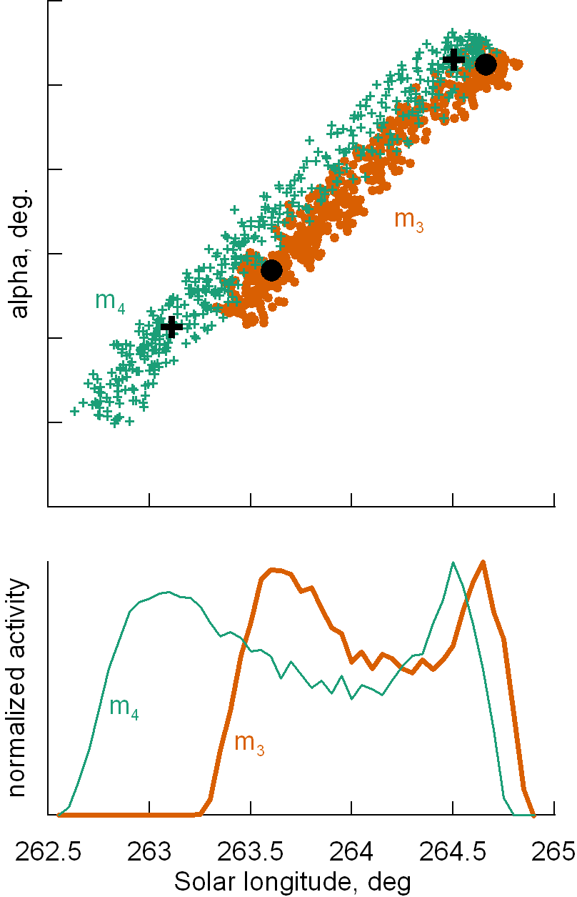
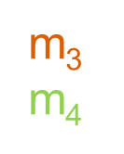
Radiation area
Shower activity curves
(Ryabova, 2021; Fig.2)
(Ryabova, 2021; Fig.3)
From my talk at IMC2022.

Slide 11
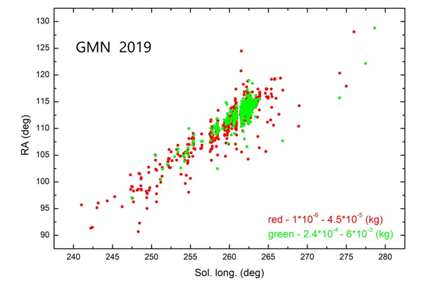
In observations this feature (smaller particles — larger ejection speed) should manifest itself in the fact that the shower of small particles is wider and the radiation area is also wider.
In observations?
Meteors: small and large
(Ryabova, 2023; Fig.2) = Proc. IMC 2022

Slide 12
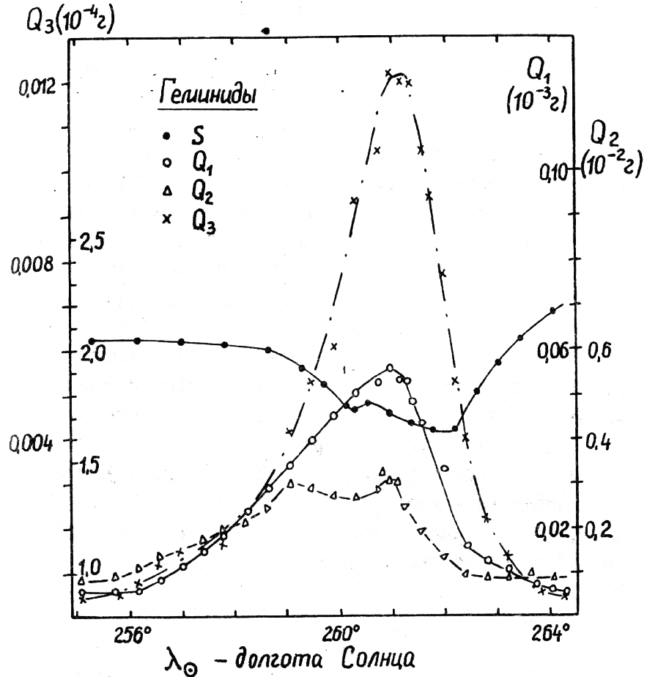
More observations…
Flux density versus Solar Longitude (1950.0)
Q1 (m > 10⁻³ g)
Q2 (m > 10⁻² g)
Q3 (m > 10⁻⁴ g)
10⁻⁴
S
10⁻³
10⁻²
Radar Geminids (1964–1971)
(Belkovich+, 1975; p. 93–99)

Slide 13
Sublimaition around the orbit

Slide 14
Evolution of the cross-section
Ryabova (2007, fig. 7)
For mass m₃
NB: not to scale!
The enlarged fragment is shown on the next slide.
The model Geminid cross-sections in a plane perpendicular to the reference orbit’s velocity vector at the descending node. The time in years from the moment of the stream generation is indicated in the top right-hand corner of every panel. The densest part of the stream is designated by white colour. The numbers in the bottom left-hand corners are the length (in au) of the sides of the corresponding rectangle enclosing the cross-section. The mass of particles is m₃.

Slide 15
t = 0
Left:
Three equidensities and the densest part of the stream (white) are shown.
Right:
The same sections. Colour code: ejections pre-perihelion, post-perihelion, and both.
t = 2000
Modified after (Ryabova, 2006; RMS2005).

Slide 16
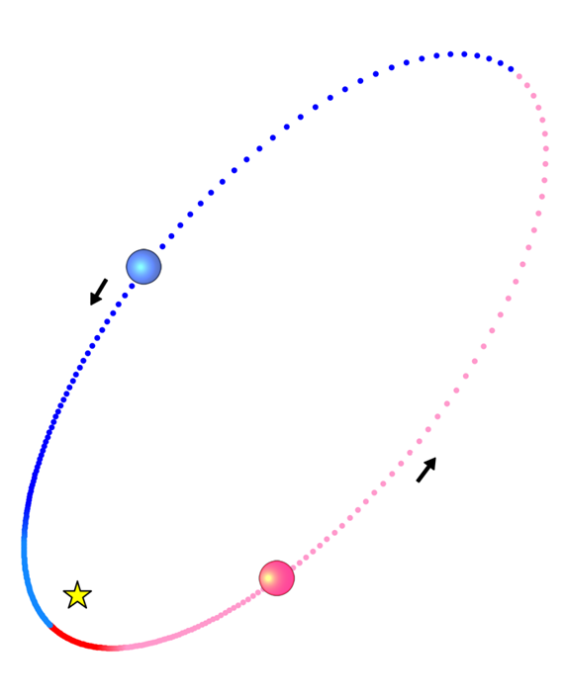
Nodes in the ecliptic plane for m₃-particles only.
Pre-perihelion layer. Post-perihelion layer.

Slide 17
We do not know where the Earth intersects the real stream. But: we can use observations to calibrate the model.
Nodes in the ecliptic plane for m3-particles and m4-particles. In the small panels: flux density profiles, and a profile for mass index s. Modified after (Ryabova, 2008; fig. 1).

Slide 18
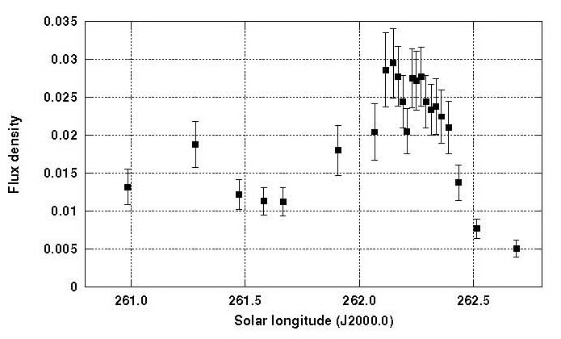
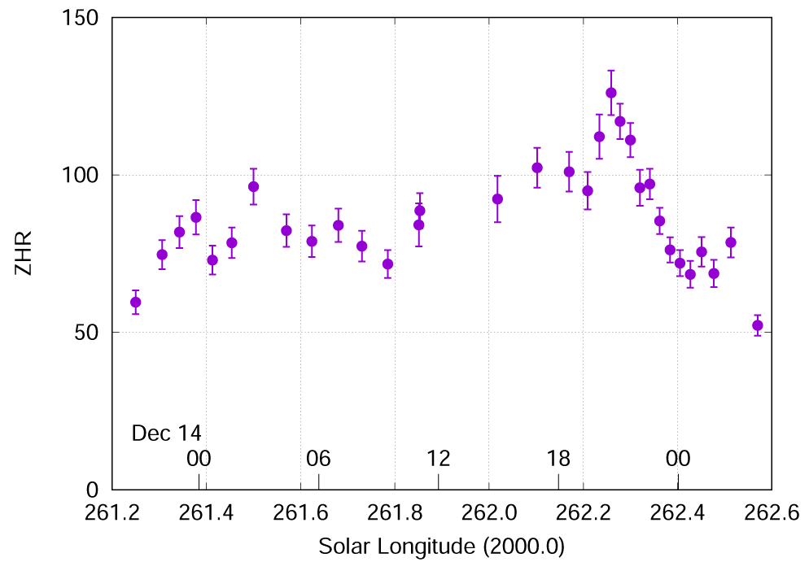
In observations?
Visual Geminids 2004.
(Arlt & Rendtel, MNRAS, 2006, 367, 1721–1726)
Visual Geminids 2023. (Rendtel, 2024, WGN, 52, 4–5)

Slide 19
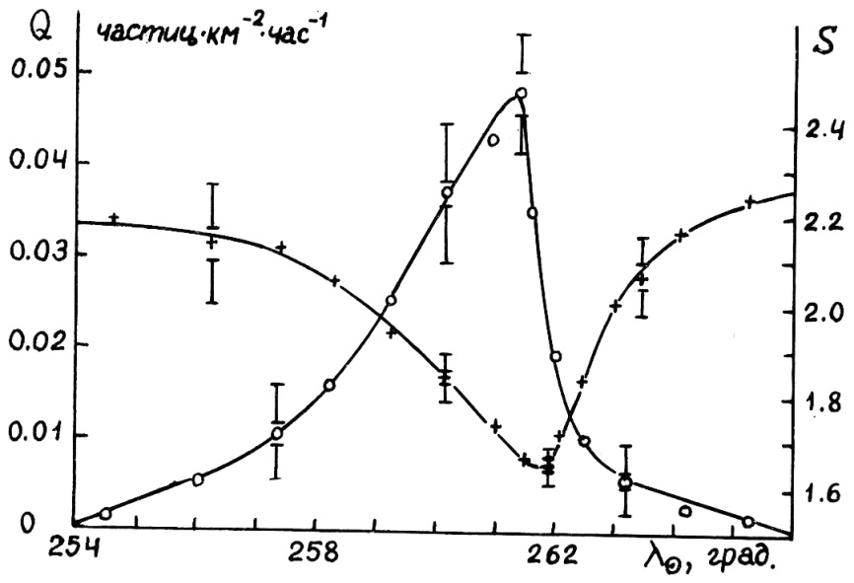
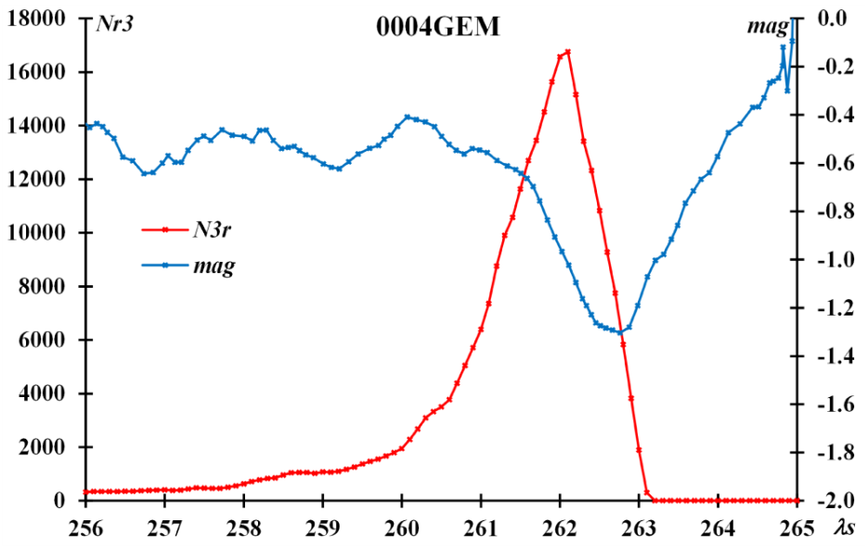
Also in observations
Radar Geminids (1964-1971)
(Belkovich+, 1982; p. 88–101 )
Video Geminids (2007–2022), SonotaCo
(Koseki, 2025, WGN, 53,3)

Slide 20
Observational selection

Slide 21
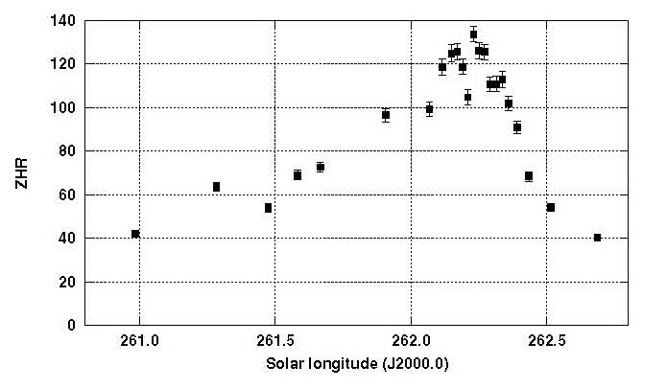
Flux
ZHR
Visual Geminids 2004. (Arlt & Rendtel, MNRAS, 2006 , 367, 1721–1726)

Slide 22
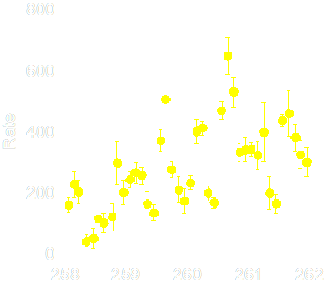
Flux
Rate
Radar observations in Kazan. 1964–71.
(Bel’kovich 2005; private communication; reproduced in (Ryabova, 2007)); Resolution 0.1º

Slide 23
Astronomical selection

Slide 24
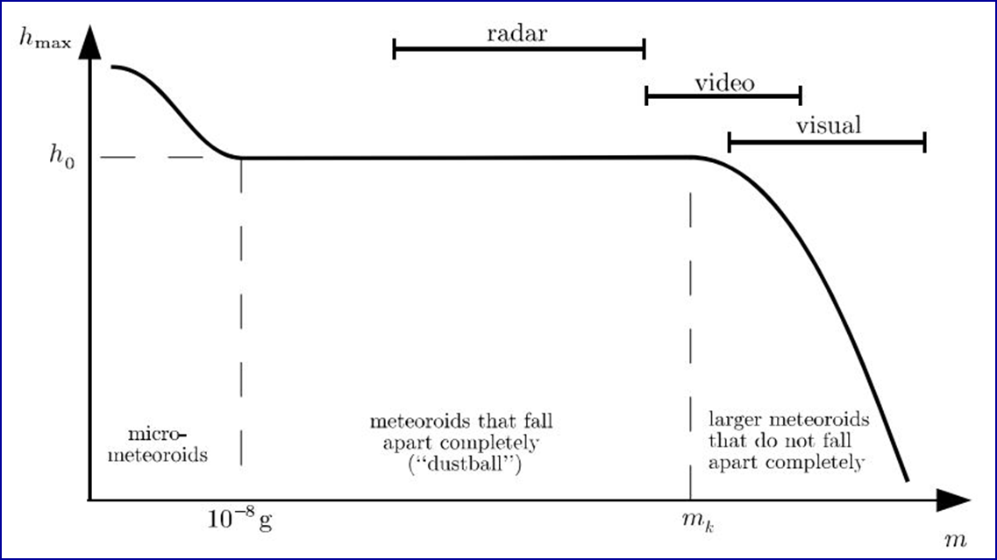
Physical selection
(Belkovich, 2006, Fig. 3; RMS2005)

Slide 25
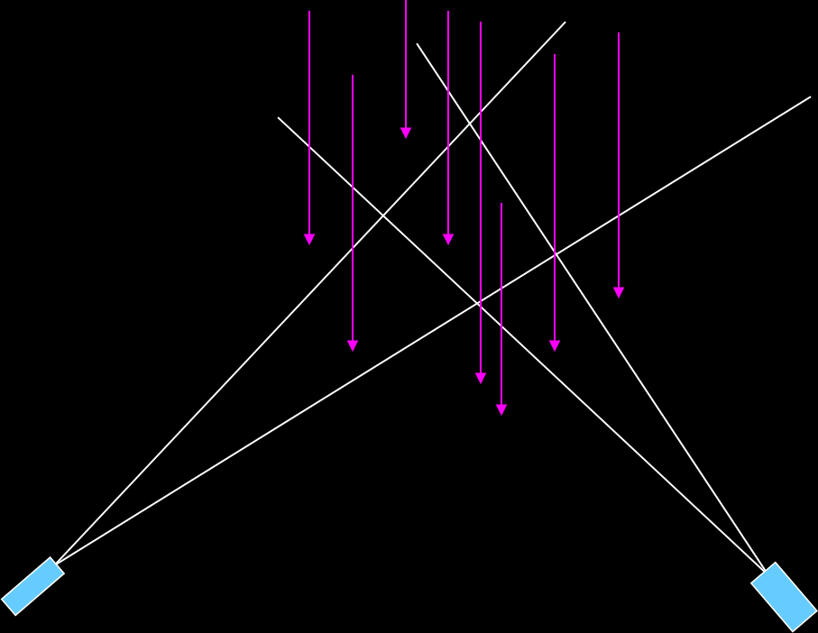
Geometrical selection
It is possible, that in observations we obtain not a random sample, but a sample with some bias

Slide 26
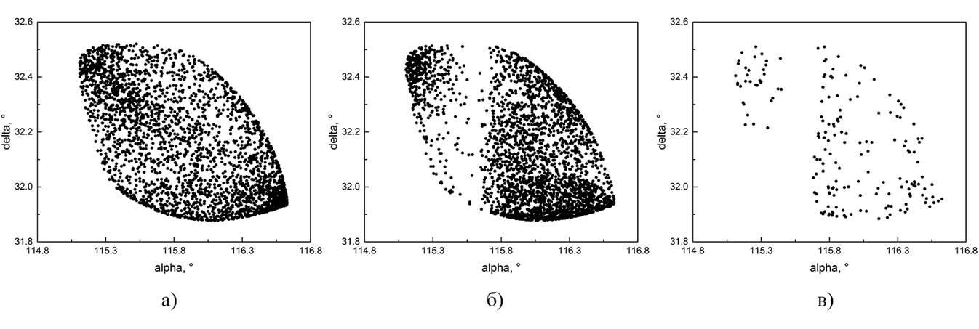
Radiant modelling for three-station observations
All meteors
From any camera
From 2 or 3 cameras
(Khudyashev, Ryabova, 2015)

Slide 27
Summary
If the shower width is greater for small meteoroids than for large ones…
if the radiation area is larger for small meteoroids that for large ones…
this is a characteristic of a comet stream.
If there are two maxima in the Geminid shower activity curve this is a characteristic of a comet stream.

Slide 28
References:
Ryabova G.O. (2006). RMS2005 Proceedings. 67
Ryabova G.O. (2007). MNRAS. 375. 1371
Ryabova G.O. (2020). Mathematical modelling of meteoroid streams. Springer Internat. Pub., 2020. 76 p.
Ryabova G.O. (2021). MNRAS. 507. 4481
Ryabova G.O. (2023). IMC2022 Proceedings. 7.
Ryabova G.O. (2024). WGN. 52. 4–5. 127
The research was carried out within the state assignment of the Ministry of Science and Higher Education of the Russian Federation (theme No. FSWM-2024-0005)

Slide 29
This is all I wanted to say today…
questions?

