Slide 1

TEST Automation
Quality is free, but only to those who are willing to pay heavily for it

Slide 2

Do you like cinema?

Slide 3
And Where is the heart of cinema?

Slide 4

IN Hollywood

Slide 5
But where is Hollywood? In l.a.

Slide 6
Ok but today we will talk about another l.a.…

Slide 7
Let’s automate

Slide 8

Now let’s COMBINE cinema & test automation

Slide 9

And let’s follow tarantino’s pattern, by starting with the Quarterfinal scene

Slide 10
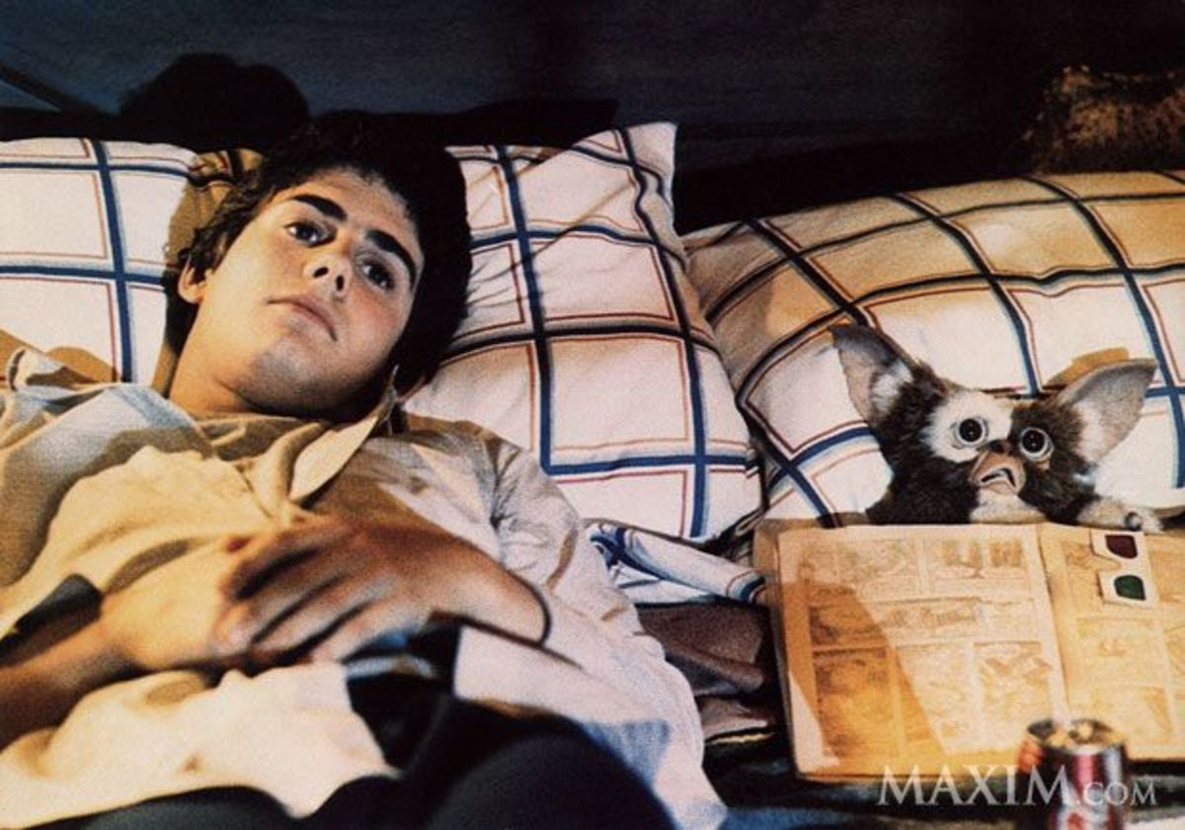
Test execution
QUARTERfinal
As you sleep, your luck works
Scene 7

Slide 11
…end of test execution

Slide 12

Results’ analysis – Script debugging - reporting
semifinal
Come and see what you did
Scene 8

Slide 13
…end of results’ analysis, debugging and reporting

Slide 14
About me
Are you talking to me
Scene 1

Slide 15
My name is Vasilis PETROU
&
I am Test Automation Leader in INTRASOFT International

Slide 16

Scene 1. are you talking to me Intrasoft international
One of the biggest IT companies in Greece
was established in 1996
Head Offices in Luxemburg
Branches and offices in 13 other countries. Athens, Thessaloniki, Patra for Greece
Our CEO is Mr. Alexandros Manos, our GM is Mr. George Manos
Employees more than 1800 highly-skilled professionals
Customers like European Commission, European Railways, Eurostat, Customs, Banks etc.

Slide 17


Scene 1. are you talking to me v for Vasilis petrou
Work for Intrasoft the last 4 years in Thessaloniki’s branch, managed by Mr. Tsakiris Zisis The first two as a test automation engineer, the last two as a test automation leader.
Worked as a full-stack developer for 10 years developing custom ERP and other custom applications.
Why to change from a software engineer to test automation engineer?
a piece of great interest to me, was always the quality of the software I delivered. I have read about testing, but never thought how deep you can get and how many parts there are.
What about test automation leading role?
Design & Implement Test Project Structures
Investigate and select tools, languages, frameworks etc.
Review test automation activities
Train people with internal workshops and consult other teams on test automation

Slide 18

About testing team
FOTINI’s eleven …and more
Scene 2

Slide 19
Scene 2. fotini’s eleven …and more software testing services center
Independent Testing Team
With more than 50 employees.
Manager is Charpidi Fotini who supports
the knowledge sharing
the visits to conferences in order to get latest news and trends
and many more…
Why to have an independent testing team?
Having an independent testing team, it gives an unbiased interference in the quality assurance. When someone else checks the project you developed it is more possible to think steps and find bugs you didn’t even think about.

Slide 20

Software testing
It’s not a bug, it’s a feature
Scene 3

Slide 21

Scene 3. it’s not a bug, it’s a feature software testinG
Software Testing is a process that take place throughout the Software Development Life Cycle (SDLC).
In Software Testing we check whether the actual results of a software match the expected results.
During software testing we find bugs or discrepancies with customer requirements before the customer receive the application, delivering the best possible quality.
Testing early has the grand benefit that costs are minimized. If we find a critical bug in production, months after we implemented our code, it is more difficult and more expensive to resolve it.
And the worst, if this keeps happening, again and again, we lose our customer’s trust and therefore our reputation is getting worse.

Slide 22

Test automation
Back to the test automation
Scene 4

Slide 23

Scene 4. back to the test automation 1. what is test automation?
In software testing, test automation is the use of another program or tool (separate from the software being tested) to execute automatically the tests and report the results.

Slide 24

Scene 4. back to the test automation 2. when do we need test automation?
Test automation is needed when the application demands many test executions either because the application will have many versions, or because it must be tested in different platforms (or browsers if it is a web UI application), or because there are many combinations of inserted data and rules that must be checked.
In few words, test automation is critical for continuous delivery and continuous testing.

Slide 25

Scene 4. back to the test automation 3. manual or automated or both?
Correct answer is Both.
Not everything can be automated. Not because we cannot do it, but it doesn’t worth it.
There are cases where it is quicker and easier to test them manually.
Additionally, each mode of test has its own value. There are things that even a well-structured test automation project couldn’t catch. There we need human eye and human hand.

Slide 26
Scene 4. back to the test automation 4. What are the benefits of Test Automation?
At least 5 x faster execution than manual tests
Minimal effort to re-execute during next cycle. The time that is saved, can be used to increase the size of test suite. Therefore, the coverage is expanded.
With no test automation, there is a possibility the testing period to be longer than the development period. Therefore, that would lead to the decision not to test certain things, putting the project to risk.

Slide 27
Scene 4. back to the test automation 5. why test automation rises?
In earlier days, for automation there were only expensive tools, with the ability to record the test steps and re-execute them.
The way that elements in UI screens were located was unstable, and the maintenance of test script was so difficult that in most cases it was better to run and record the test step again from scratch than aligning the test scripts for the next releases.
Now, there are open source test frameworks like Selenium, TestNG, Cucumber, Protractor etc. and patterns like Page Objects, Screenplay Pattern etc. that offer great potential for well-structured and easy maintainable test projects.

Slide 28
Scene 4. back to the test automation 6. what is the job title related to test automation?
According to ISTQB (international organization in software testing) the job title is Test Automation Engineer.
Alternatively, the job title can also be Software Engineer in Test but it is not correct. Companies select this name just because the title Test Automation Engineer is not clear sometimes to candidates.
QA Engineer or QA Automation Engineer is also a related job title.

Slide 29
Scene 4. back to the test automation 7. what is the role of a test automation engineer?
learning application’s business and rules
analyzing and writing test cases
designing and writing test automation scripts
using test automation frameworks
investigating problems in software as a result of testing
working with analysts and software developers to find solutions

Slide 30
Scene 4. back to the test automation 8. some NECESSARY SKILLS of a test automation engineer?
knows how to code
being able to decide if something is better not to be automated
being analytical thinker and willing to read and understand the business analysis of an application
willing to execute manual tests when it is required
being able to analyze issues and report them properly

Slide 31

meetup
School of test
Scene 6

Slide 32

Scene 6. school of test Thessaloniki s/w testing & QA Meetup
In Thessaloniki there is a meetup related with testing in which I am co-organizer.
This meetup is called Thessaloniki Software Testing & QA Meetup.
People that come to this meetup can learn, discuss and share knowledge and experiences regarding Quality Assurance and Software Testing.
What are the differences of Quality Assurance and Software Testing?
Both work in the same direction and focus on product quality. But:
Focus of QA is to control the quality, checking that requirements are met.
Focus of S/W Testing is the system inspection and bugs finding.
https://www.meetup.com/Thessaloniki-Software-Testing-and-QA

Slide 33

Test automation project
Show me the code
Scene 5

Slide 34
…end of source code demonstration

Slide 35
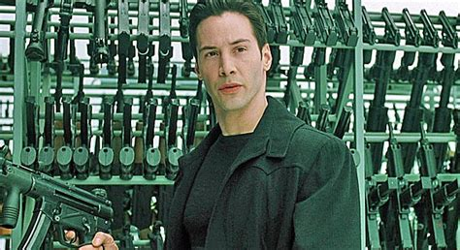
Useful links
final
We need links, lots of links
Scene 9

Slide 36
Scene 7. we need links, lots of links 1. useful links
Test Automation Frameworks/Tools:
JAVA JDK: https://www.oracle.com/
Maven: https://maven.apache.org/
GIT Bash for Windows: https://git-scm.com/
Selenium WebDriver: https://www.seleniumhq.org/
TestNG Framework: https://testng.org/doc/index.html
Cucumber BDD: https://cucumber.io/
SmartBear SoapUI: https://www.soapui.org/
Apache Jmeter: https://jmeter.apache.org/
Docker: https://www.docker.com/
Jenkins: https://jenkins.io/
Test Mentality:
ISTQB (International Software Testing Qualifications Board): https://www.istqb.org
ISTQB Foundation Level Syllabus: https://www.istqb.org/downloads/send/51-ctfl2018/208-ctfl-2018-syllabus.html
Other Tools:
IntelliJ IDEA Community Edition IDE: https://www.jetbrains.com/idea/download
Guru Links:
Angie Jones: http://angiejones.tech/

Slide 37
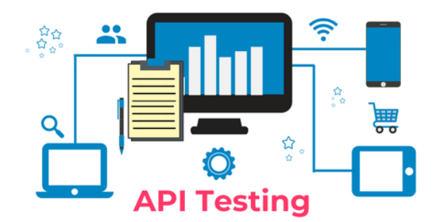

Scene 7. we need links, lots of links 2. OTHER TYPEs OF TEST that can be automated
Except UI Testing, there are also and other types of test that can be automated:
API TESTING: RESTfull or SOAP web services
Smartbear SoapUI (RESTfull & SOAP)
Rest Assured API (RESTfull)
PERFORMANCE TESTING
Apache Jmeter
Smartbear LoadUI
IBM RPT

Slide 38

Scene 7. we need links, lots of links 3. where to find me
My GitHub:
https://github.com/billpetrou
My LinkedIn Profile:
https://www.linkedin.com/in/vasilis-petrou-09a785a3/
My Emails:
vasilios.petrou@intrasoft-intl.com
petrou82@gmail.com

Slide 39

Thank You
Questions?

