Slide 2

What Are Web Services?
Web Services are a standardized way of enabling communication and data exchange between different applications or systems over the internet.
Key Characteristics:
Interoperability: Facilitates seamless communication between diverse systems.
Reusability: Encourages the development of modular and reusable code components.
Accessibility: Ensures easy access to data and functionalities over the web.

Slide 3
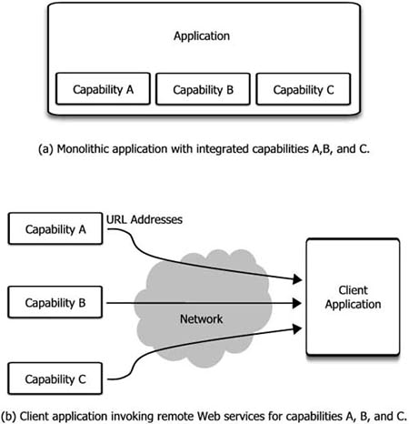
What are web services?
Web services represent a new architectural paradigm for applications.
An application can use the capabilities of a Web service by simply invoking it across a network without having to integrate it.

Slide 4
Example: Online Store Payments
You want to let customers pay on your online store with their credit cards.
Traditional Approach:
Work with banks and understand complex financial regulations.
Build secure systems to handle sensitive credit card information.
Implement fraud detection and security measures
Web Service Solution:
You use a payment gateway web service (like Stripe, PayPal, or Braintree).
When a customer wants to pay, your store redirects them to the payment gateway's secure page.
The customer enters their card details on the payment gateway.
The payment gateway handles the whole transaction and notifies you back on success or failure.

Slide 5
Benefits of Web Services
Dramatically cut application development costs
01
Reduce or eliminate many errors
02
Simplify application maintenance and customization
03
Significantly reduce time-to-market.
04

Slide 6

Characteristics of Web Services

Slide 7
Standardization
Serialisation Involves the use of established norms and protocols to ensure consistency and interoperability.
01
Use of standard protocols (e.g., SOAP, REST): leverage standardized communication protocols like SOAP (Simple Object Access Protocol) and REST (Representational State Transfer) to enable seamless data exchange between applications.
02
Role of W3C and other standards organizations: The World Wide Web Consortium (W3C) and other standards organizations play a vital role in defining and maintaining these protocols, ensuring a common language for web service communication.
03

Slide 8
How Does Serialization Work?
Serialization Mechanism:
Your chosen programming language or library will provide a serialization mechanism. This could be a built-in function, a library, or a framework-specific serialization tool.
Format: The serialization mechanism determines the format for the byte stream:
XML: Human-readable text format, good for cross-platform data.
JSON: More lightweight text format, ideal for web interactions.
Binary formats: More compact, faster to process, but often platform-specific.

Slide 9
Standardization
Imagine you're running a travel booking website and want to offer flight information from various airlines.
Each airline might have its own API for providing flight data, with different formats and protocols.
Question: What would be the problem?
By using protocols like SOAP or REST, airlines can expose their data in a consistent way, making it easier for your website to understand and interpret the information.
Additionally, standards for data formats like JSON or XML ensure the structure of the information is consistent, removing the need for complex parsing and adaptation.

Slide 10

Interoperability
Interoperability refers to the ability of diverse systems to communicate and work together.
Enabling communication between diverse systems: Web Services allow different applications, often built on different technologies, to communicate seamlessly.
Overcoming platform and language barriers: By using standard protocols like SOAP or REST, Web Services facilitate communication between applications developed on different platforms and in different programming languages.

Slide 11
Example - interoperability
E-commerce Order Processing
Imagine an online store that wants to streamline its order fulfillment process.
The Problem: The store's systems are a combination of older software and more recent additions:
Its inventory management system runs on a Java platform.
The shipping provider offers a .NET-based API for calculating rates and generating labels.
The payment processing is handled by a third-party SaaS platform with a RESTful API.
The Goal: Make all these systems communicate seamlessly for automated order processing, regardless of their underlying technologies.

Slide 12
Discoverability
Discoverability refers to the ability to find and locate web services efficiently.
Methods for discovering and locating services: Various methods, such as service directories, registries, and standardized protocols, are employed to discover and locate web services within a network.
Importance of service directories and registries: Centralized repositories, like service directories and registries, play a crucial role in facilitating the discovery process. They provide a structured way for services to be cataloged and accessed.

Slide 13
Let's consider a scenario where discoverability plays a crucial role in web services
Imagine you're building a website that compares flights from various airlines to find the best deals for users.
Here's how discoverability of relevant web services is essential:
Finding Airline Web Services
Solutions for Discoverability?

Slide 14
Solutions for discoverability
UDDI (Universal Description, Discovery, and Integration):
UDDI registries act like directories or yellow pages for web services.
Airlines that want to make their flight search functionality available to external partners can register their services.
You could search these registries based on relevant keywords.
Web Search and Industry Repositories:
Airlines with web services might promote these on their developer portals or within industry-specific online repositories related to travel and booking.

Slide 15
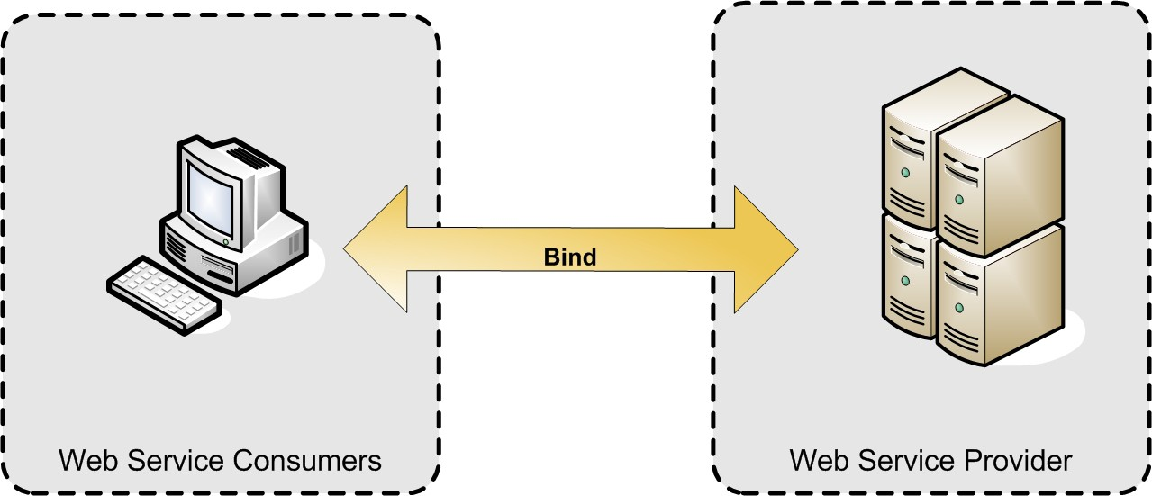
Web service architecture
The simplest Web service system has two participants:
A service producer (provider)
A service consumer (requester).
The provider presents the interface and implementation of the service, and the requester uses the Web service.

Slide 16
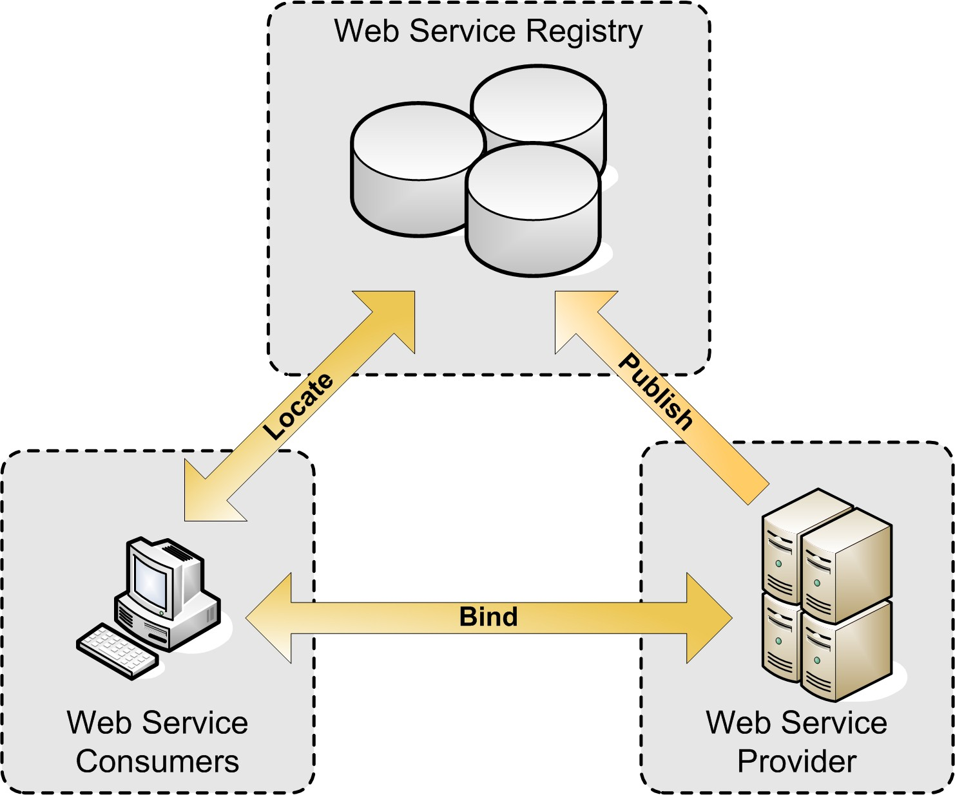
Web Service Architecture – Service Oriented
A registry, acts as a broker for Web services.
A provider, can publish services to the registry
A consumer, can then discover services in the registry

Slide 17
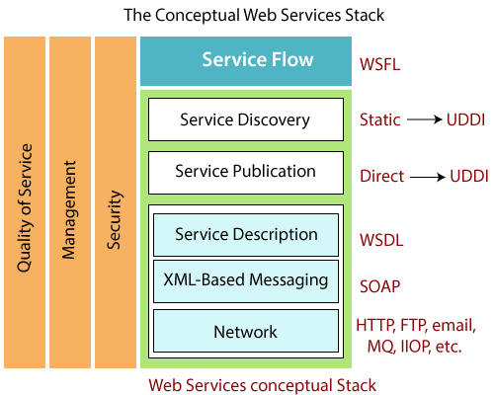
Web Service Stack

Slide 18
SOAP-based Web Services
SOAP (Simple Object Access Protocol) is a protocol for exchanging structured information in web services.
It is a messaging protocol that allows programs running on different operating systems to communicate with one another.
It is often employed in enterprise-level applications and scenarios where a strict and standardized communication protocol is required.

Slide 19

Protocol Specifications
Standards and Specifications
SOAP is governed by industry standards and specifications.
W3C (World Wide Web Consortium) defines the SOAP standard.
Versions
SOAP 1.1 and SOAP 1.2 are the widely used versions.
HTTP and Other Transport Protocols
SOAP messages can be transported over various protocols, including HTTP.

Slide 20
XML
<?xml version="1.0" encoding="UTF-8"?>
<note>
<to>Tove</to>
<from>Jani</from>
<heading>Reminder</heading>
<body>Don't forget me this weekend!</body>
</note>
XML-based: SOAP messages are structured XML documents. This makes them platform-independent and human-readable (though slightly verbose).
Envelope Structure: SOAP messages have a specific structure. They always include an 'Envelope' element which contains a 'Header' (optional) and a 'Body'.
Header: Can carry extra information like security metadata, routing, or transaction details.
Body: Contains the actual message payload (e.g., information about a function call and its parameters).

Slide 21
XML-Based Format for Message Structure
XML (eXtensible Markup Language)
Platform-independent and human-readable.
Used to define the structure of SOAP messages.
<soap:Envelope xmlns:soap="http://www.w3.org/2003/05/soap-envelope" xmlns:m="http://www.example.org">
<soap:Header>
<!-- Header content here -->
</soap:Header>
<soap:Body>
<!-- Body content here -->
</soap:Body>
</soap:Envelope>

Slide 22
SOAP
XML-based:
Envelope Structure: SOAP messages have a specific structure. They always include an 'Envelope' element which contains a 'Header' (optional) and a 'Body’.
Header: Can carry extra information like security metadata, routing, or transaction details.
Body: Contains the actual message payload (e.g., information about a function call and its parameters).
SOAP messages are structured XML documents. This makes them platform-independent and human-readable (though slightly verbose).

Slide 23
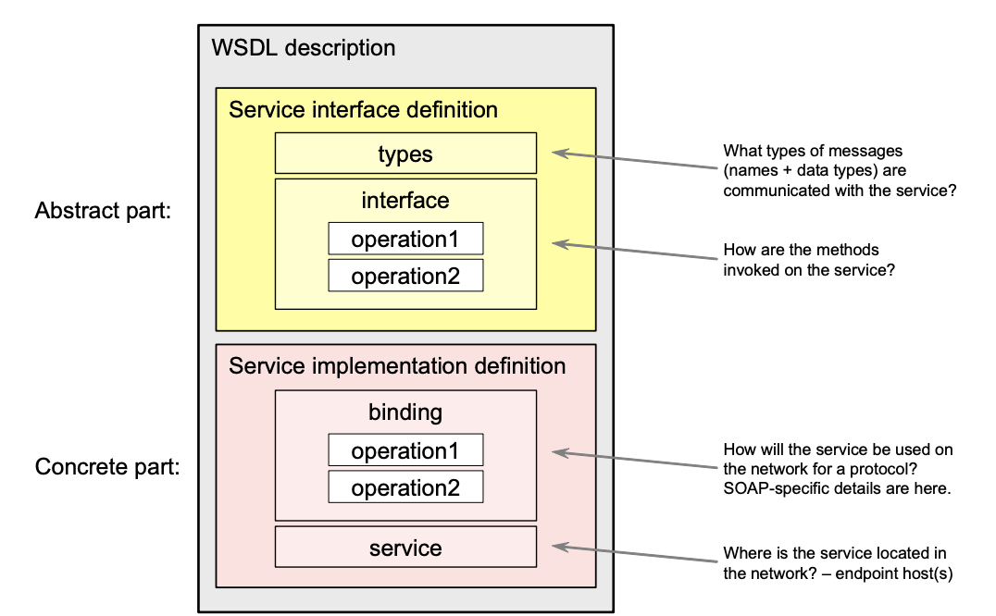
WSDL
Stands for: Web Services Description Language
Purpose: An XML-based language that describes the capabilities of a web service. Think of it as a 'contract' defining how a client application should interact with the web service.

Slide 24
WSDL
Operations: Lists the specific functions or actions the web service offers (e.g., calculateInterestRate, searchProducts).
Data Types: Describes the format of the input and output messages the web service expects and produces. This can be done using simple data types (string, integer) or more complex structures defined in XML Schema.
Binding: Specifies the communication protocol or mechanism (usually SOAP, but sometimes REST-like bindings are used) and the message format (e.g., how data is encoded within a SOAP message).
Endpoint: Provides the network address (URL) where the web service can be accessed.

Slide 25
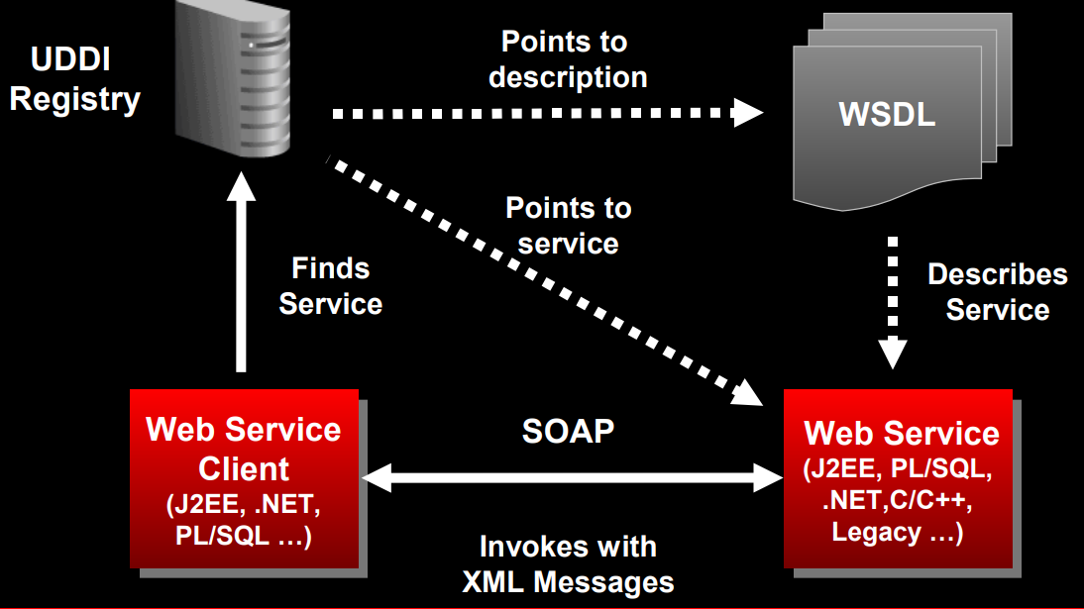

Slide 26
RESTful Web Services
REST (Representational State Transfer) is an architectural style for designing networked applications.
Introduction to REST: RESTful Web Services use the principles of REST, emphasizing simplicity, scalability, and statelessness.
Key principles and constraints: REST is based on principles such as stateless communication, resource identification, and uniform interfaces, contributing to its popularity for web service development.

Slide 27
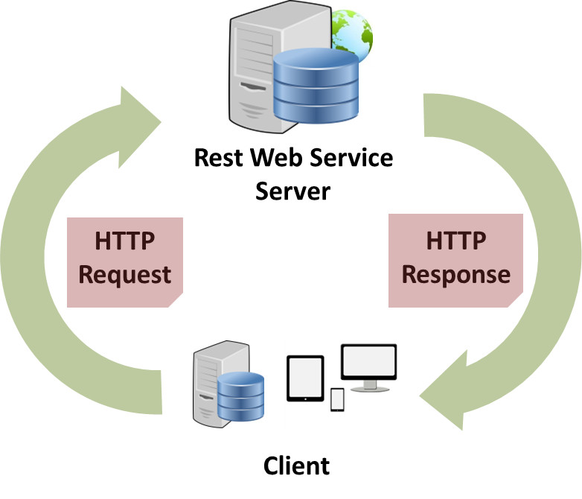
Introduction to RESTful Services
Representational State Transfer (REST) is an architectural style for designing networked applications.
It’s not a protocol or a standard, but a set of guiding principles and constraints.

Slide 28

Purpose of RESTful Services in Modern Web Development
RESTful APIs and web services have revolutionized the way modern web applications communicate and interact.
They provide a standardized, flexible, and scalable approach to enable seamless integration between diverse systems.

Slide 29
Principles of REST - Stateless Communication
In REST, statelessness refers to when the client is responsible for storing and handling the session-related information on its own side.
Each request from the client to the server must contain all the information needed to process that request.

Slide 30
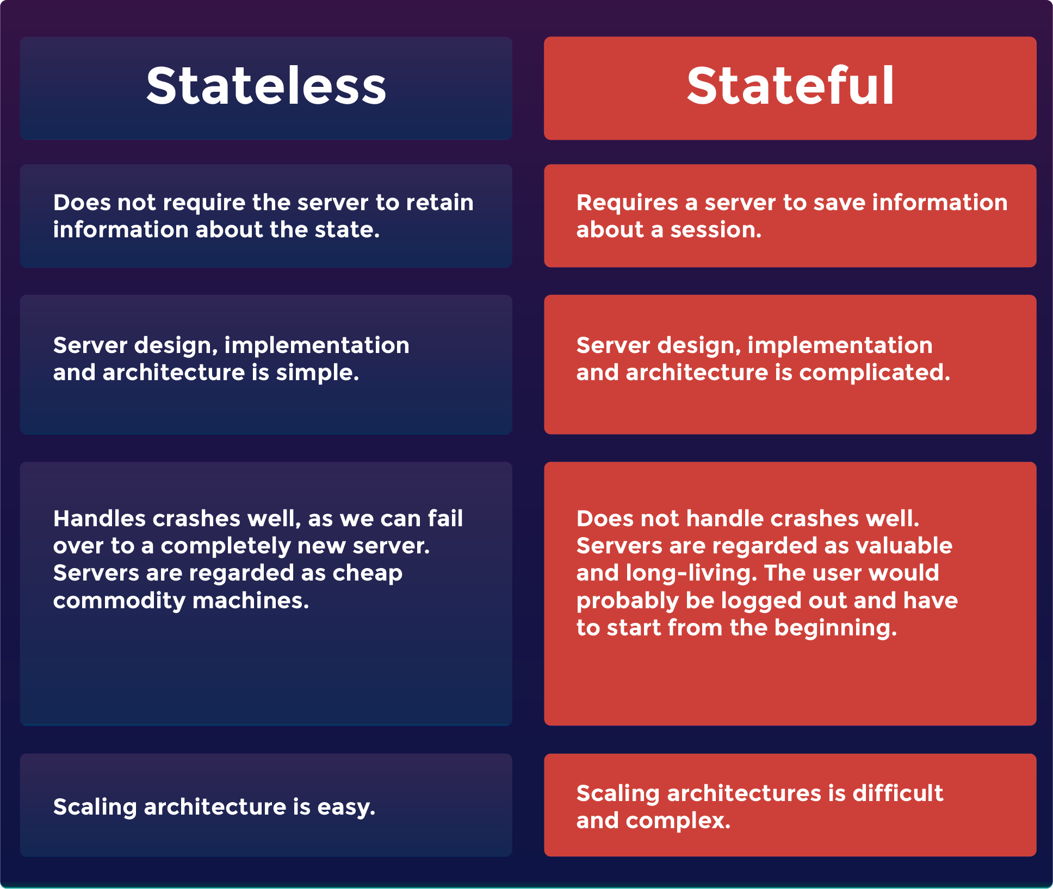

Slide 31
Principles of REST - Client-Server Architecture
In a RESTful architecture, the server and the client are clearly isolated from each other.
While the server doesn’t know the user interface, the client doesn’t know the application’s business logic or how the application persists data.

Slide 32
Principles of REST - Uniform Interface
REST defines a consistent and uniform interface for interactions between clients and servers.
For example, the HTTP-based REST APIs make use of the standard HTTP methods (GET, POST, PUT, DELETE, etc.) and the URIs (Uniform Resource Identifiers) to identify resources.

Slide 33
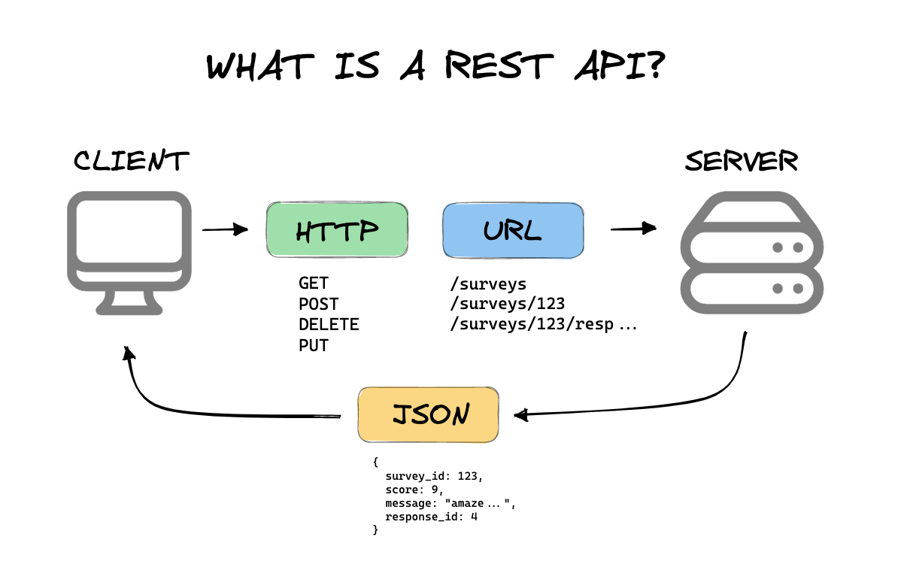
Principles of REST - Uniform Interface

Slide 34
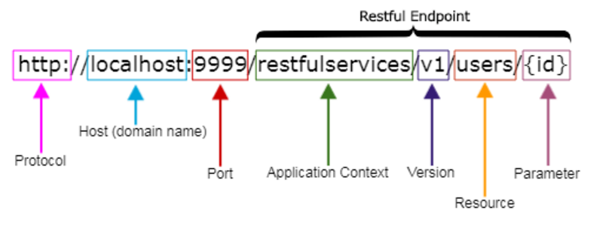
The core architectural elements of a RESTful system - URI
A URI is a string of characters used to identify a resource over the Web.
The client uses a URI to locate the resources over Web and then, sends a request to the server and reads the response.

Slide 35

Understanding the JSON data syntax
Lightweight data interchange format.
Enclosed in curly braces {}.
Consists of key-value pairs.

Slide 36
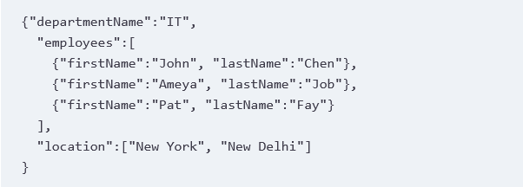
Understanding the JSON data syntax
Arrays are enclosed in square brackets ([ ]), and their values are separated by a comma (,).
Each value in an array may be of a different type, including another array or an object.

Slide 37
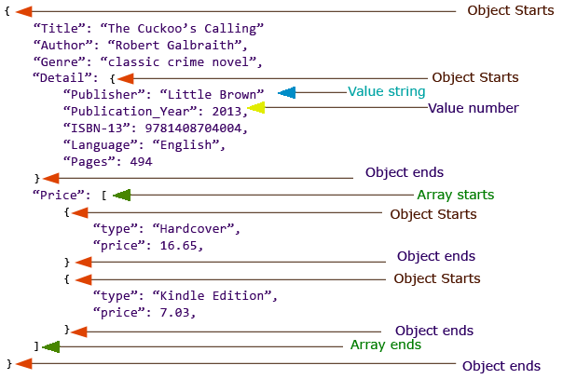
Basic data types available with JSON

Slide 38
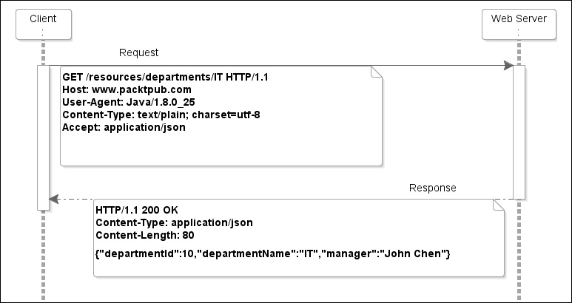
The HTTP GET method

Slide 39
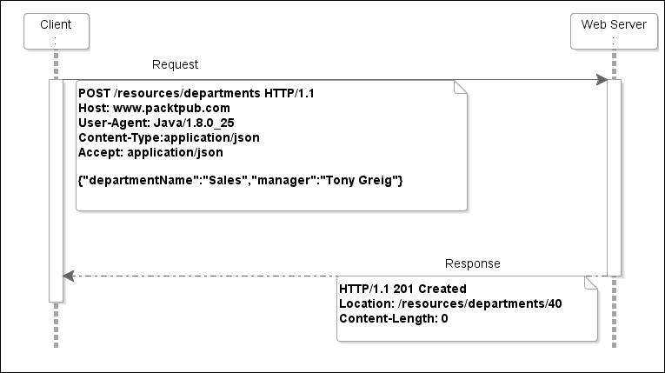
The HTTP POST method
The POST method is used to create resources.

Slide 40
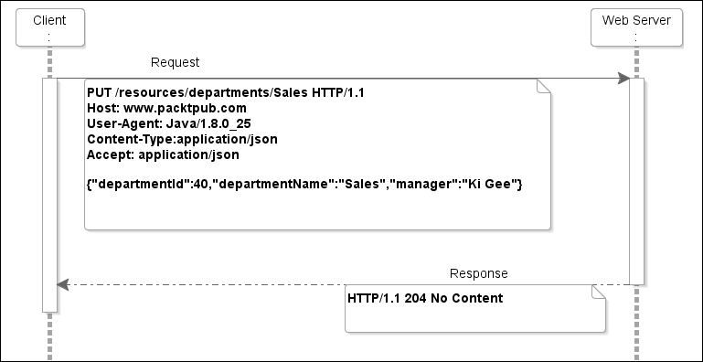
The HTTP PUT method
The PUT method is used to update resources.

Slide 41
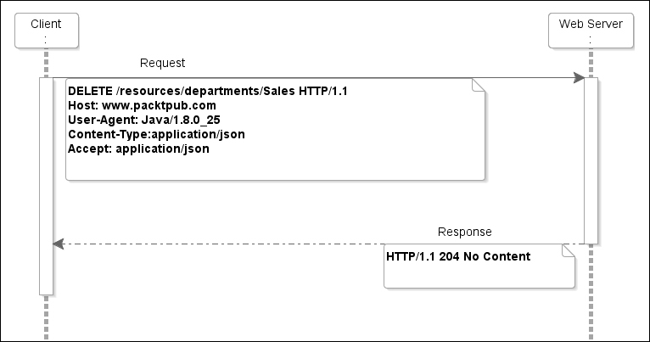
The HTTP DELETE method

Slide 42
The Travel Agency App
What is a monolith: It's like a giant castle where all the parts of your app (booking flights, reserving hotels, managing user accounts) live together inside the same walls.
Pros: Can be simpler to start with.
Cons: As your app grows, it can be hard to change or scale one part without affecting everything else.

Slide 43
Designing the Web Service
What does our travel app need to do? Let's list the features:
Search for flights (destination, dates, etc.)
View flight options and prices
Book flights
Search for hotels
Book hotels
Manage user accounts (login, profiles, trip history)

Slide 44
what kind of information the app needs from outside to work?
Flights: Needs data from airline systems (schedules, prices)
Hotels: Needs data from hotel booking services
User accounts: Our app will likely store this data itself

Slide 45
Web service endpoints
Each feature will have its own 'endpoint'. An endpoint is like a special web address your app uses to make a request:
/search-flights
/book-flight
/search-hotels
and so on...

