Slide 1







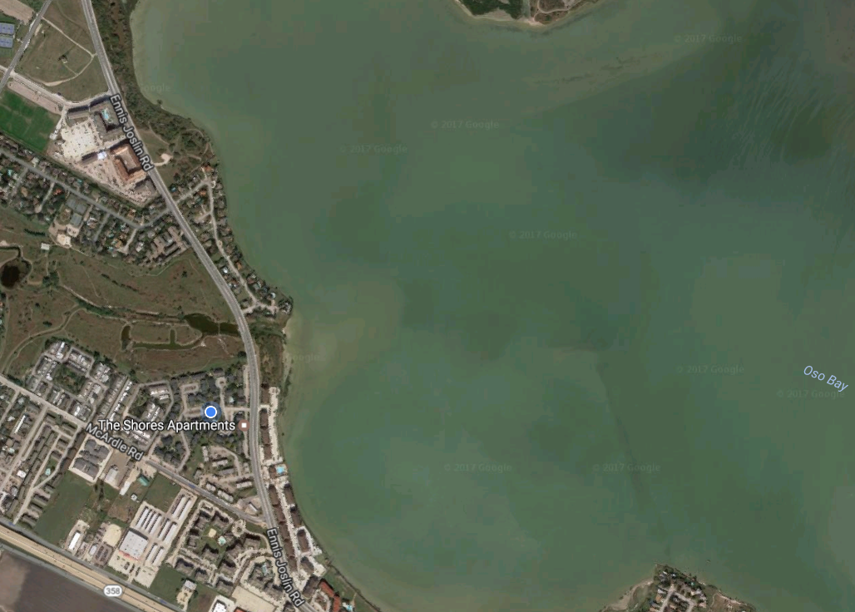





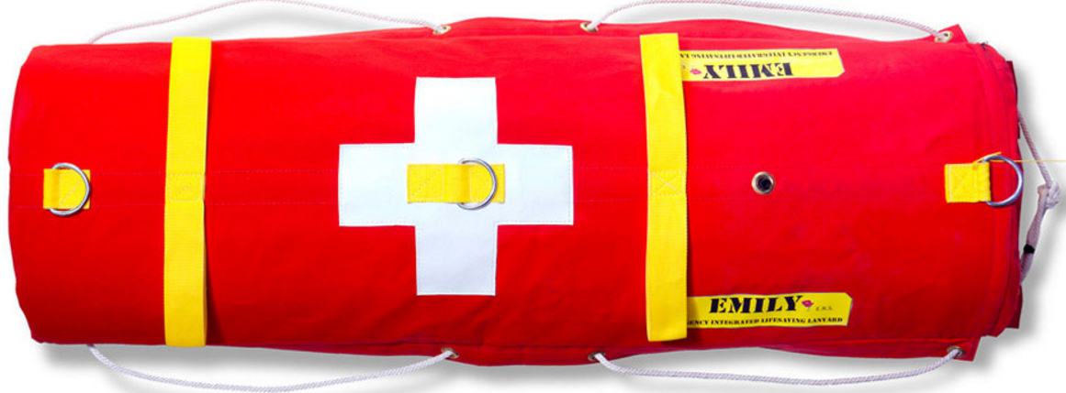

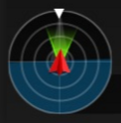


Connected
75%
60%
GPS
80%
15 mph
2 ft
200 ft
1:30 min

Slide 2
Camera view
Connected
Connect to Mission Planner
Battery status
75%
Setting battery & wireless thresholds
Wireless signal strength
EMILY status
60%
Map view
GPS signal strength
GPS
80%
Way points
EMILY speed
15 mph
Distance from home
2 ft
EMILY location
Distance to next waypoint
200 ft
Control button for immediate takeoff and return to home
Elapsed time from takeoff
1:30 min
EMILY
Compass

Slide 3



Approaching victim
75%
60%
GPS
80%
1 mph
402 ft
2 ft
1:30 min

