Slide 1
WebStrat Automated Scripts
HSS WebStrat UFT Automation Demo
An overview about each test script.
Delivered Venu Pittala

Slide 2
HSS WebStrat Overview
Web.Strat is a Web based application used for pricing a commercial claims that use APC, ASC & DRG methodology. Claims can be manually entered in Webstrat or can be sent electronically via GGMAP from TOPS, ppoONE & COSMOS so the claim can be paid. Web.Strat also contains the ability to price claims using DRG ,APC and ASC methodologies.
HSS comes into play for pricing when the claim is sent from the claim engine (ppoOne, TOPS and COSMOS etc) after eligibility is validated.
Mainly HSS WebStrat is working on commercial claims like APC*,ASC**,DRG*** methodology
At a high-level, The claim route is as followed:
A claim is submitted from a Provider (i.e Hospital) for services rendered on a eligible patient (insured).
ppoOne (claim is entered into the ppoOne system, claim policy eligibility is determined (i.e. policy effective date, policy limitation and exclusions, etc)) > Claim is sent to GGMAP (Go Get Me a Price - this is the gateway between ppoOne and HSS (Web.Strat)) > Web.Strat- This is where the claim is reprised> Claim is priced and sent back to GGMAP > GGMAP sends the claim back to ppoOne with a price

Slide 3
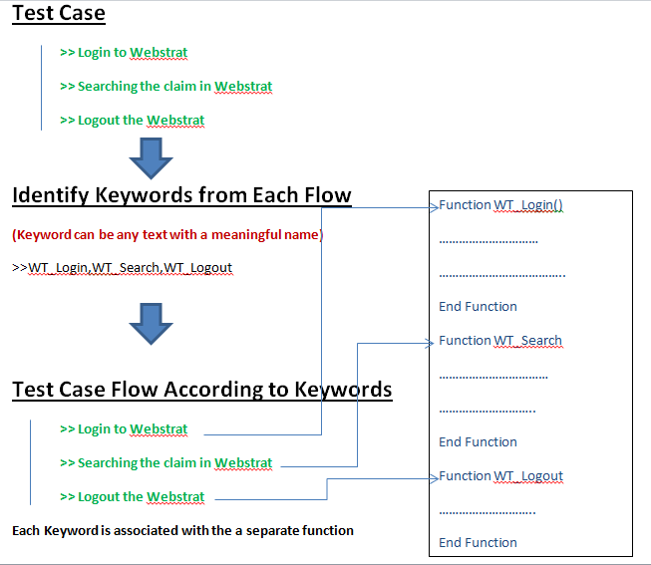
Introduction
Copyright © 2008 Accenture All Rights Reserved.

Slide 4
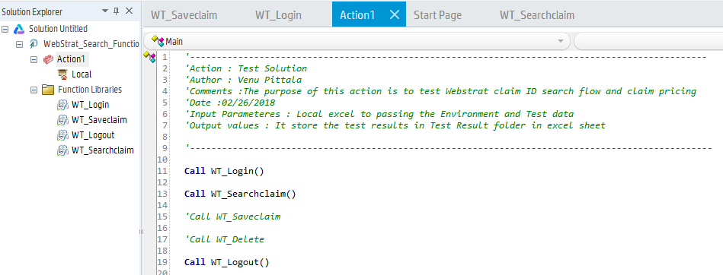
WT_ClaimSearch Functionality
Reusable Functions
WT_Login
WT_Logout
WT_Save
WT_Searchclaim
WT_Delete
Copyright © 2008 Accenture All Rights Reserved.

Slide 5
WT_ClaimSearch Functionality
Instructions:
In the following Reusable functions we have to reusable whenever it is required.
WT_Login
WT_Logout
WT_Searchclaim
WT_Delete
WT_SaveClaim
It is responsible to ensure that the parameter is working and that the same script will be identified properly in all the Reusable function. Considering that, when a new test case be added to the WT_ClaimSearch, the data of the new test case should be updated also in the Reusable Actions.
The WT_Delete and WT_Saveclaim, is optional, so we just need to add the TestCase in the datatable, for the TestCases which we want to delete. For the others, we do not need to do it.
Copyright © 2008 Accenture All Rights Reserved.

Slide 6
WT_Login
WT_Login
Copyright © 2008 Accenture All Rights Reserved.

Slide 7
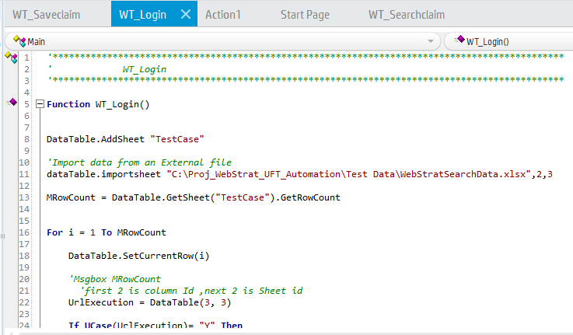
WT_Login
This Reusable Function is responsible to login in the Webstrat. It is used for all the descriptive scripts and in general we do not need to do any update in its Datatable.
Copyright © 2008 Accenture All Rights Reserved.

Slide 8
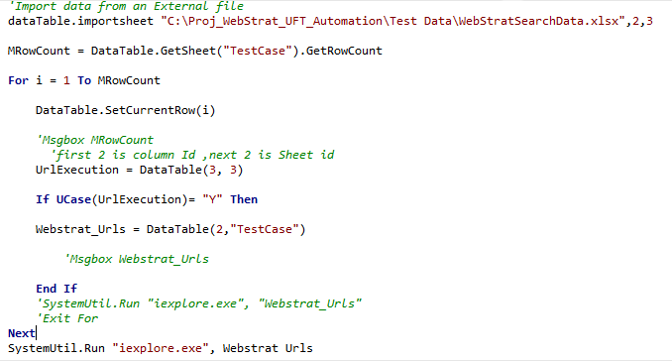
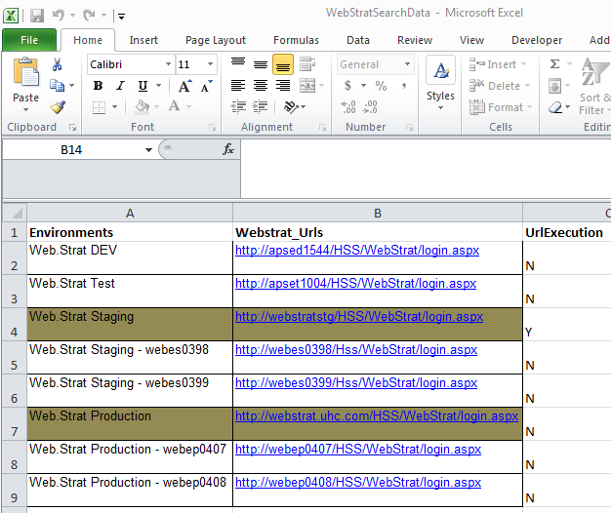
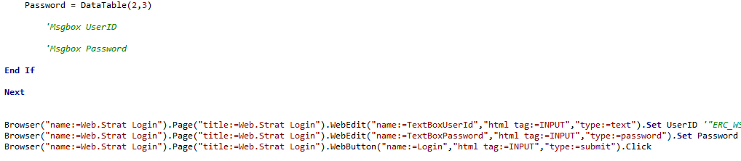
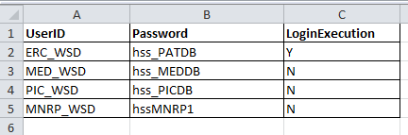
WT_Login
If you want to add a new User and new environment in the Script, you have to open the input excel sheet from Test Data folder and add the Username & Password and Url environment and no need to change in the script
Copyright © 2008 Accenture All Rights Reserved.

Slide 9
WT_Login
WT_Logout
Copyright © 2008 Accenture All Rights Reserved.

Slide 10
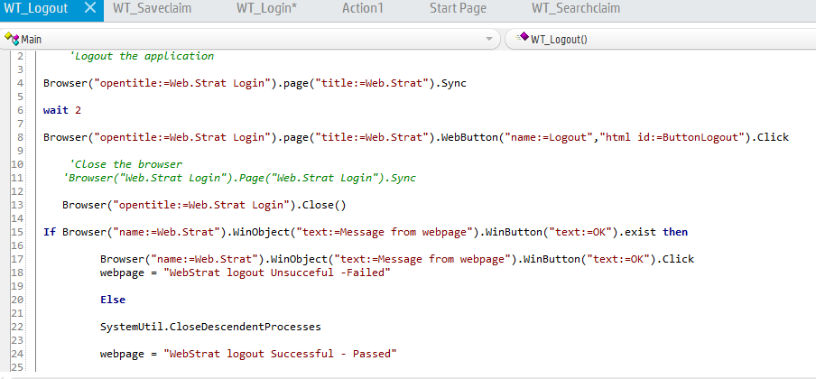
WT_Logout
The WT_Logout is responsible to logout from the Webstrat.
In this reusable function, the Datatable is not used. So there is nothing to change or even to update.
Copyright © 2008 Accenture All Rights Reserved.

Slide 11
WT_Searchclaim
WT_Searchclaim
Copyright © 2008 Accenture All Rights Reserved.

Slide 12
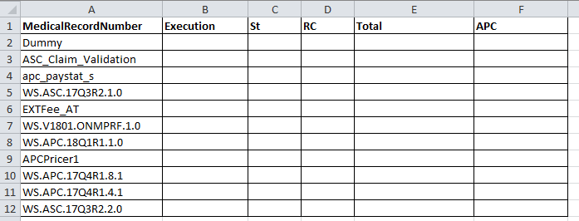
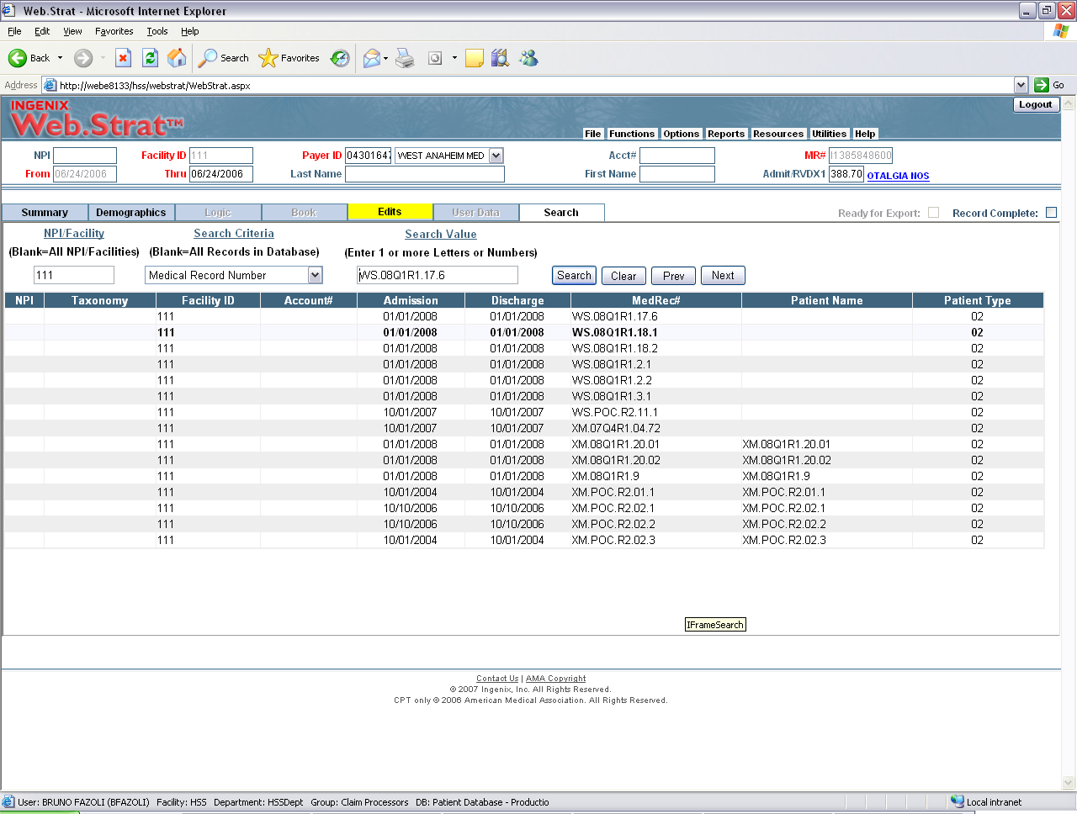
WT_Searchclaim
The purpose of this action is to price and save a claim and then search and select it.
> Claim Id will get from in excel sheet from Test Data folder and If you want to add any new claim ID to test, so we can add in excel sheet itslef and no any change anything in the script
Copyright © 2008 Accenture All Rights Reserved.

Slide 13
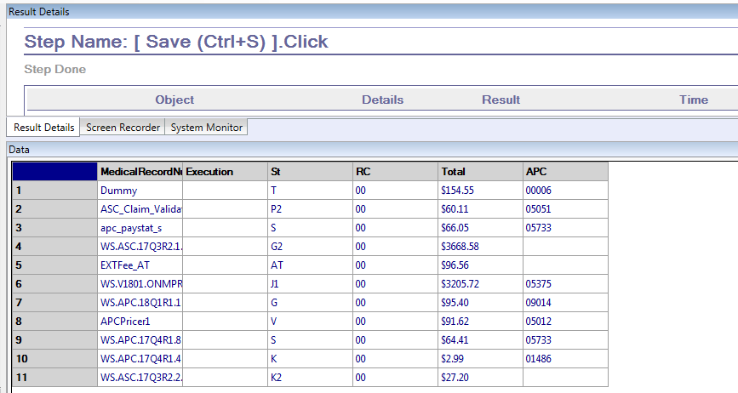
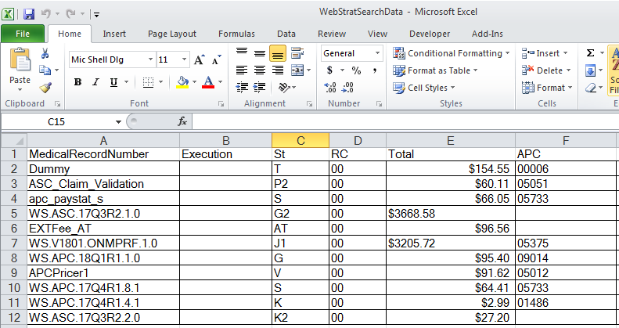
Test_Results
Finally the test results to store in excel sheet in test results folder in local drive.
Copyright © 2008 Accenture All Rights Reserved.

