Slide 1
Methods used in Big Data Analytics Graph Analysis
Christina Lerouge and Victoria Plange
ALY 6110- Spring 2018

Slide 2
Overview
Importance of Big Data
Intro to Graph Analysis
Types of Graph Analysis
Uses
Nashville Meetup Data

Slide 3
Importance of Big Data
Large volume of data – that has structured & unstructured data that inundates a business on a daily basis
It’s not the volume that is important – but the content and what organizations do with the data
Can be analyzed for insights-that lead to better decisions & strategic business moves
Volume Velocity Veracity Variety Variability

Slide 4
Graph Analysis
Graphs are one of the most popular computer science concepts
Used in real world applications: GPS on mobile phones, suggested friend notifications on social media, NYSE real-time data, transportation grids, etc.

Slide 5
Data can be translated into Graph Analytics
One of the many things that graphs can be used for is performing grid & network quality of service
identifying weakness in power/water grids, transportation networks, preventing cybercrime, etc.
Optimizing routes in the airlines and retail industries
Different types:
PATH ANALYSIS
CONNECTIVITY ANALYSIS
COMMUNITY
ANALYSIS
CENTRALITY ANALYSIS
Notes:
These are the different types of graph analysis below.

Slide 6
When Can Graph Analysis Be Used?
All the time.
To address relationship-based problems(travel, security, social media hierarchies)
To represent networks of communication and data organization within a company
To identify clusters of communities

Slide 7
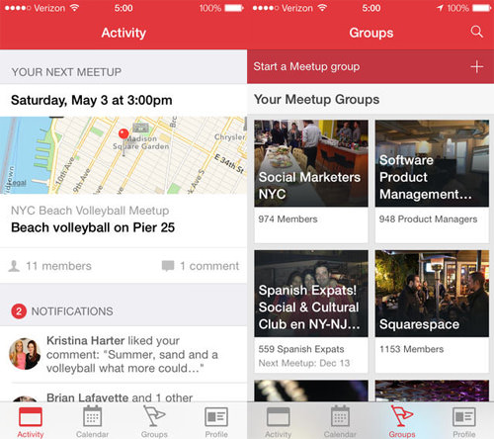
Nashville Meetup Network Data
Meet-Up is a social media platform that offers membership software to enable their users create events on a common platform.
The relationship derived from this platform are the members who attend or create meetups and is ideal for graphical analysis

Slide 8
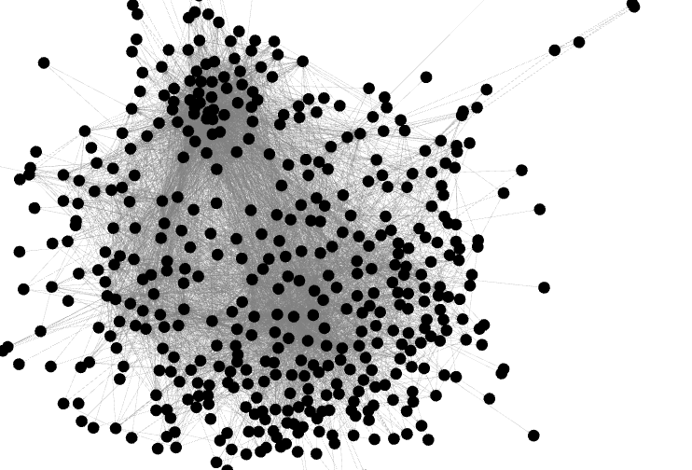
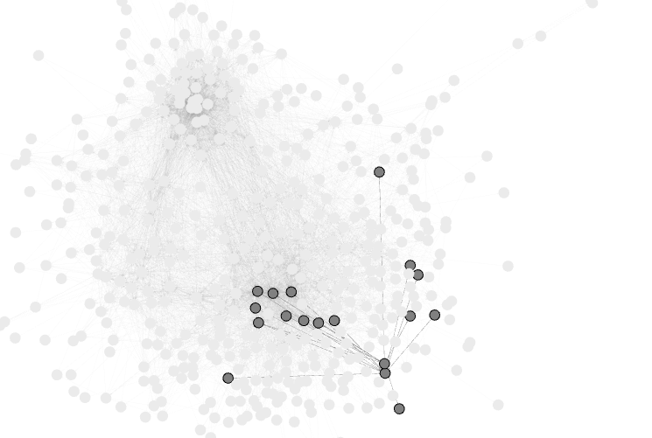
Nashville Meetup Network

Slide 9
References
What is Big Data and why it matters. (n.d.). Retrieved from https://www.sas.com/en_us/insights/big-data/what-is-big-data.html
· Bailey, S. (2018, February 09). Retrieved from https://www.kaggle.com/stkbailey/nashville-meetup
· Visualizing network data to illustrate airline delays. (n.d.). Retrieved from https://www.ibm.com/communities/analytics/watson-analytics-blog/visualizing-network-data-to-illustrate-airline-delays/

