Slide 1


Team Details
  Team name: AI Alchemists
  Team leader name: Sanika Salunke
  Problem Statement: Sustainability & Social Impact: cutting the carbon footprint of AI (LLM) inference

Slide 2



Brief about the idea
GREENROUTE AI · CARBON-AWARE ROUTER FOR LLM INFERENCE
Which model
Right model. Cleanest region.
Greenest hour.
Gemini Flash-Lite triages complexity and picks the smallest tier that answers well: Flash-Lite, Flash or Pro.
AI inference is one of the fastest-growing loads on data centres. Yet most apps send every prompt to the largest model, in the nearest region, the moment it arrives. The same prompt can emit hundreds of times more CO₂ depending on which model runs it and where.
GreenRoute sits in front of Gemini and makes three decisions for every request, runs it on Vertex AI, and writes a carbon receipt (Wh, g CO₂, % saved against “largest model, Mumbai grid, run now”) to a realtime Firestore ledger.
Where
The region with the lowest grid gCO₂/kWh that serves the model. India-only mode keeps data in Mumbai/Delhi.
When
Deferrable batch jobs are queued on Pub/Sub for the greenest 30-minute window before their deadline.
−96.9%
−56.8%
83%
CO₂ on 27.3M real production requests (fleet replay, best case)
even in India-only mode, from right-sizing the model alone
CO₂ saved across the 11 live requests in our deployed prototype

Slide 3



Opportunities
How different is it from any of the other existing ideas?
How will it be able to solve the problem?
USP of the proposed solution
LLM routers (RouteLLM, Not Diamond, OpenRouter) pick a model to cut cost, not carbon.
Carbon-aware schedulers move batch jobs, not live prompts.
Measurement tools only report emissions.
GreenRoute makes all three decisions for every prompt, live.
Right-sizing: 49% of real traffic fits Flash-Lite and 41% Flash.
Clean grids: Montréal ≈2 vs Mumbai ≈648 gCO₂/kWh.
Time-shifting deferrable work into green windows.
Every request is measured, so savings are provable.
Per-request carbon receipt and realtime ledger.
Data-residency mode (India-only / DPDP).
Validated on 27.3M real production requests.
Serverless on Google Cloud; one API in front of Gemini.
Approach | Which model | Where | When | CO₂ per request
LLM routers (RouteLLM, Not Diamond, OpenRouter) | ✓ for cost | — | — | —
Carbon-aware schedulers (Google CICP, Carbon Aware SDK) | — | ✓ | ✓ batch only | —
Measurement tools (CodeCarbon, EcoLogits) | — | — | — | reports only
GreenRoute AI | ✓ | ✓ | ✓ | ✓ measured and acted on

Slide 4





List of features offered by the solution
Gemini triage
Carbon-aware regions
Green scheduling
Data-residency mode
Structured-JSON classification picks Flash-Lite, Flash or Pro for each prompt, text or image.
Ranks 11 Google Cloud regions by grid intensity; falls back to the next-cleanest region that serves the model.
Deferrable jobs search 30-minute slots up to the deadline, queued on Pub/Sub and run by a push worker.
“India only” limits planning to Mumbai and Delhi for DPDP-sensitive workloads.
Carbon receipt
Realtime ledger
Fleet replay and forecast
Sustainability analyst
Energy (Wh), CO₂ (g) and % saved for every request, from Gemini’s real token counts.
Firestore streams every decision and the global KPIs to the dashboard with onSnapshot.
BigQuery replays 27.3M real requests; BigQuery ML predicts answer length and 24 h demand.
Ask in plain English; Gemini answers only from live Firestore and BigQuery data.

Slide 5
Process flow diagram or Use-case diagram
1
User submits a prompt
Firebase Hosting
Deferred (batch) path
Prompt, deadline, residency and an optional image from the web app
Gemini triages complexity
Step 4: deferrable = true
best slot chosen before deadline
2
Gemini · Vertex AI
simple → Flash-Lite · medium → Flash · complex → Pro
3
Estimate energy
BigQuery ML
Pub/Sub topic
greenroute-jobs
BigQuery ML predicts output tokens, giving the expected Wh
4
Plan region and time
Cloud Run
Lowest gCO₂/kWh region, plus the greenest slot if deferrable
Push subscription
→ Cloud Run /api/worker
5
Log the plan
Firestore
requests/{id} written with status running or scheduled
Steps 6–7 run
same execute() as live path
6
Execute on Gemini
Gemini · Vertex AI
Greenest region that serves the model, with a fallback chain
7
Account and stream
Firestore
The browser waits on Firestore onSnapshot and flips to “done” the moment the worker finishes.
Real tokens → Wh → g CO₂ vs baseline; dashboard updates live

Slide 6
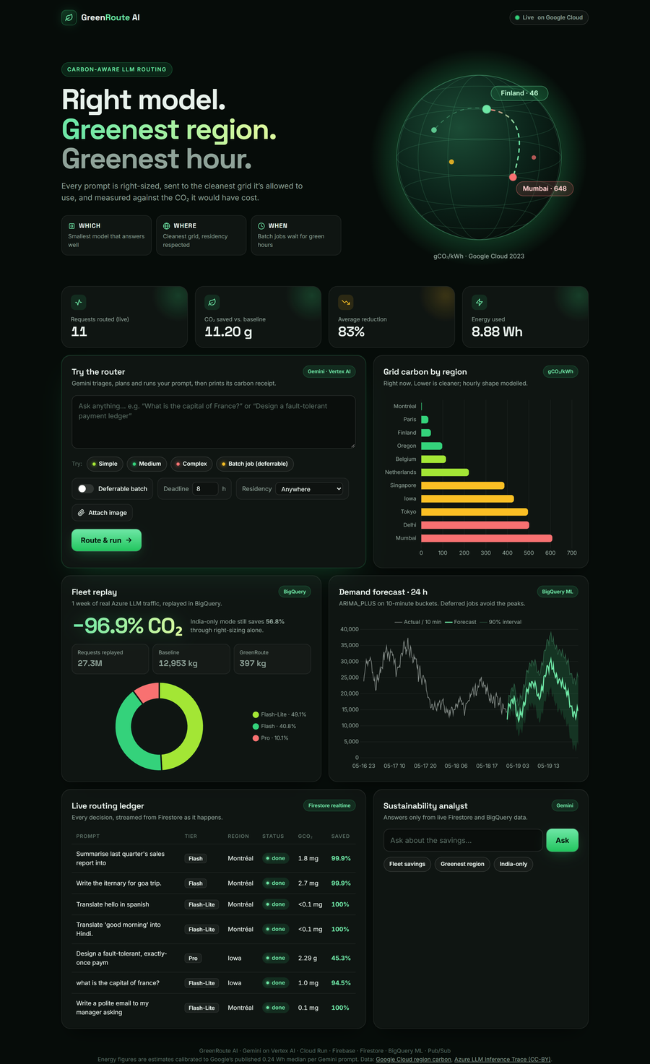
Wireframes/Mock diagrams of the proposed solution (optional)
One-page dashboard, live on Firebase Hosting
Dark UI built for a live demo: every panel is backed by a real Google Cloud service.
1
Hero
Live KPIs
1
Value proposition: which, where and when, with the grid globe.
2
Requests, CO₂ saved, % reduction and Wh, streamed from Firestore.
2
3
4
Router
Grid carbon chart
3
Prompt, presets, deferrable + deadline, residency, image upload.
4
gCO₂/kWh by region right now; hourly shape modelled.
5
6
Fleet replay
Demand forecast
5
BigQuery replay of 27.3M requests, with the tier mix.
6
BigQuery ML ARIMA_PLUS, next 24 h with a 90% band.
7
8
Live ledger
Analyst
7
Every routing decision, tier, region, CO₂ and % saved.
8
Plain-English Q&A grounded in live data (Gemini).

Slide 7
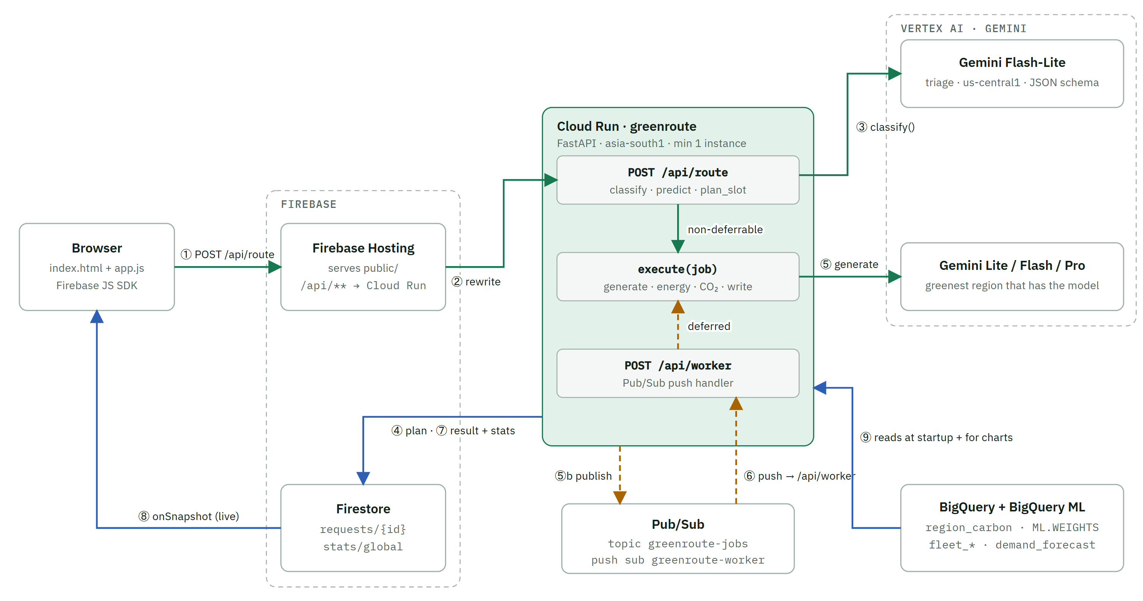
Architecture diagram of the proposed solution
Legend
Request path
Deferred (Pub/Sub)
Data read / write
Key facts
All writes go through Cloud Run (Admin SDK). Browsers only read; Firestore rules block client writes.
BigQuery is read at startup and cached for 1 h, never on the request path.
Numbers ①–⑨ match the process flow.

Slide 8








Technologies to be used in the solution
Gemini on Vertex AI
Cloud Run
Firebase Hosting
Firestore
Triage with a JSON schema; multi-region answers on 2.5 Flash-Lite, Flash and Pro; image prompts; analyst.
FastAPI router, carbon planner and Pub/Sub worker in asia-south1, min 1 instance.
Serves the web app and rewrites /api/** to Cloud Run on the same origin.
Realtime ledger requests/{id} plus atomic global counters in stats/global.
BigQuery
BigQuery ML + Model Registry
Pub/Sub
Cloud Storage
Google region-carbon data and the 27.3M-row Azure trace; fleet replay in SQL.
LINEAR_REG output-length model and ARIMA_PLUS 24 h demand forecast.
Event-driven queue for deferrable jobs; push subscription to /api/worker.
Landing zone for the raw datasets (1.1 GB trace CSV).
Stack Python 3.11 · FastAPI · google-genai SDK · Firebase Admin and JS SDKs · Chart.js · Docker · Cloud Build · Artifact Registry · IAM

Slide 9

Estimated implementation cost (optional)
Prototype running cost, per month (estimate)
Cost per prompt (real token counts)
Component | Basis | USD / month
Cloud Run | 1 always-warm instance (1 vCPU, 1 GiB) at idle rate | ≈ $13–18
Gemini (Vertex AI) | Pay per token; see cost per prompt → | usage-based
Firestore · Hosting · Pub/Sub | Within free tiers at prototype scale | $0
BigQuery + Cloud Storage | ≈1.5 GB stored; queries in the 1 TB free tier | < $1
One-time setup | Data load + BigQuery ML training | < $5 once
Total | Fixed cost to keep the prototype live | ≈ $15–20 + usage
Flash-Lite
≈ $0.0001
Polite email · 12 in / 209 out tokens
Flash
≈ $0.005
Goa itinerary · 9 in / 2,044 out
Pro
≈ $0.02
Payment-ledger design · 31 in / 2,044 out
Greener is cheaper
Flash-Lite output costs $0.40 vs Pro $10 per 1M tokens, so right-sizing cuts the bill about 25× along with CO₂.
Estimates at USD list prices: Vertex AI Gemini 2.5 per-token rates and Cloud Run Tier 1 idle min-instance rates; asia-south1 may differ. The triage call adds ≈ $0.00005 per prompt. Actual spend is visible in Billing → Reports.

Slide 10
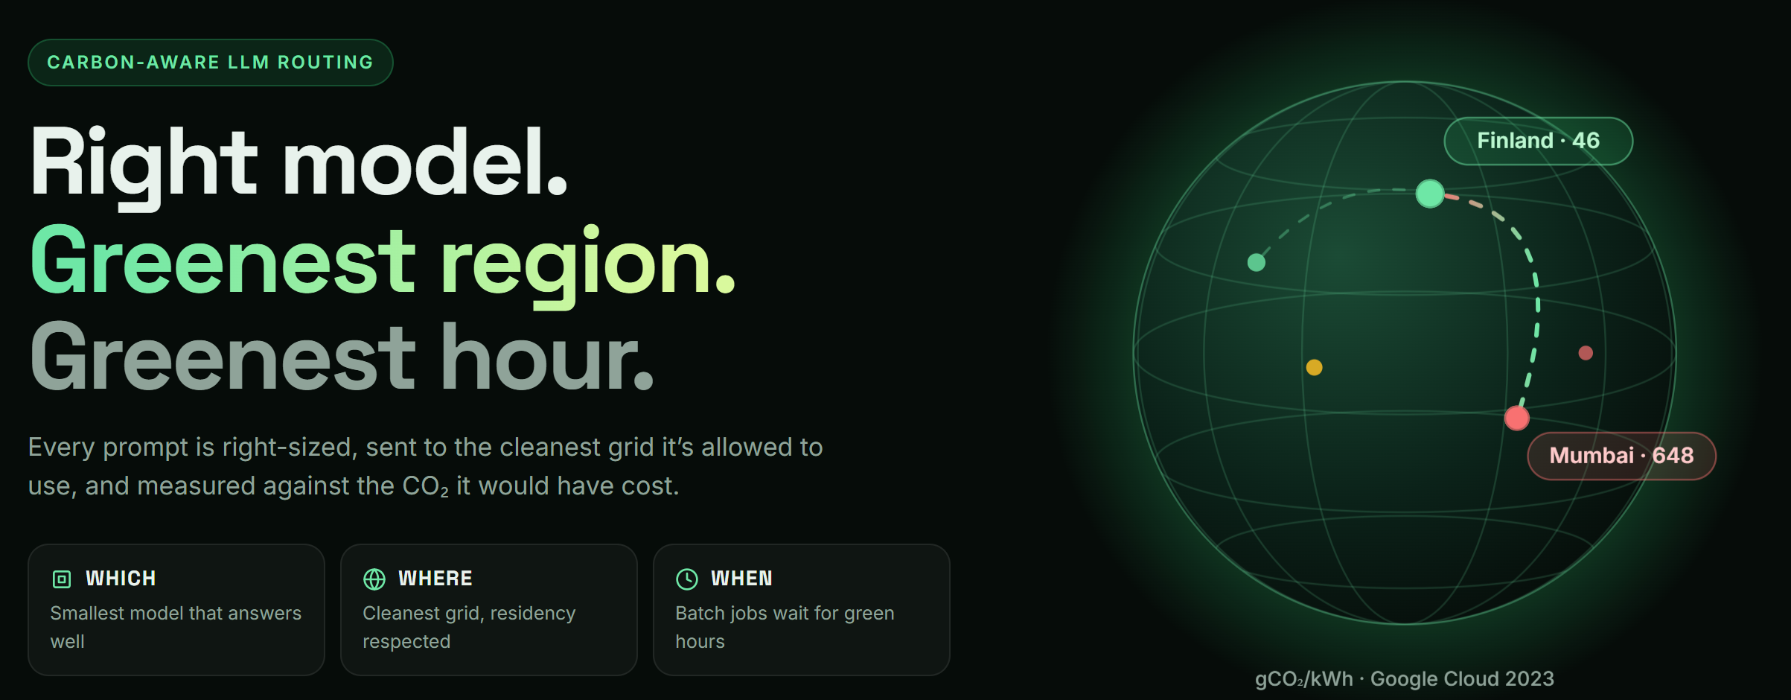
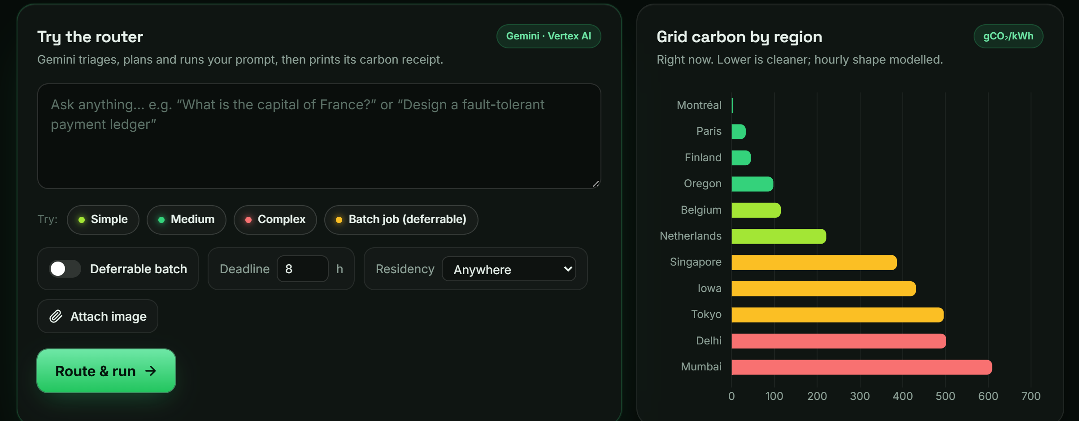
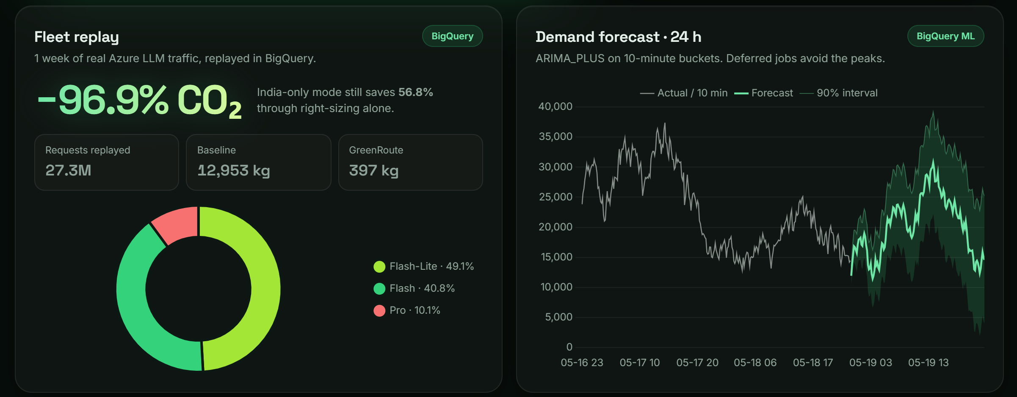
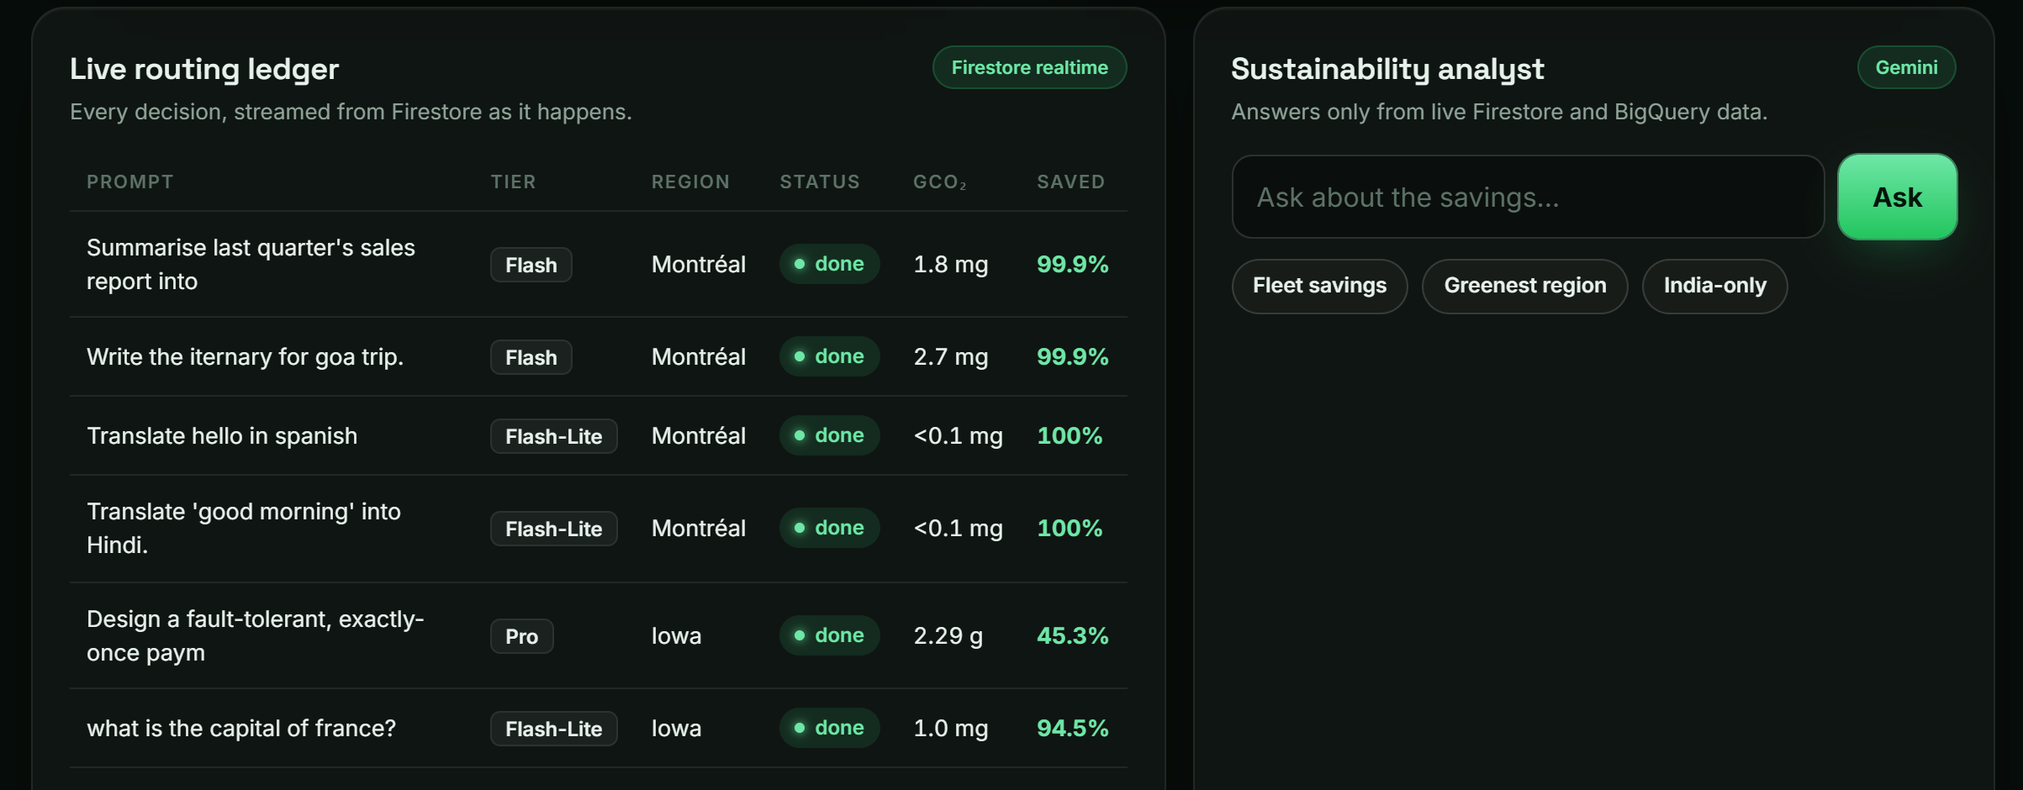
Snapshots of the prototype
1 Landing: the three decisions and the grid-carbon globe
2 Router controls and the live grid-carbon chart
3 Fleet replay (−96.9%, 27.3M requests) and demand forecast
4 Live Firestore ledger and the Gemini sustainability analyst

Slide 11
Prototype Performance report/Benchmarking
Fleet replay: 1 week of real Azure LLM traffic
Live prototype: 11 real requests on Gemini
kg CO₂ for 27.3M requests (DynamoLLM trace, replayed in BigQuery)
From the Firestore ledger of the deployed app (end-to-end, incl. triage)
Tier | Requests | Median latency | Avg energy | Avg CO₂ saved
Flash-Lite | 7 | 2.4 s | 0.022 Wh | 99.2%
Flash | 3 | 9.2 s | 1.05 Wh | 99.9%
Pro | 1 | 19.3 s | 5.58 Wh | 45.3%*
All | 11 | — | 8.88 Wh | 83%
What the live data shows
2.30 g CO₂ emitted vs 13.50 g for the baseline: 11.2 g saved.
Simple prompts answer in ≈2.4 s on Flash-Lite, served from Montréal (≈2 gCO₂/kWh).
Flash at 9–11 s is suited to batch and deferrable work.
−96.9%
−56.8%
27.3M
CO₂ vs baseline (best case)
India-only, right-sizing alone
real requests replayed
Tier mix assigned by request size: Flash-Lite 49.1%, Flash 40.8%, Pro 10.1%. A best-case upper bound; published live-grid routing studies report 30–75%.
* India-only request: no Gemini Pro endpoint was available in Mumbai/Delhi, so it fell back to the global endpoint and was accounted at Iowa. Strict residency is on the roadmap.

Slide 12

Additional Details/Future Development (if any)
1
NEXT 1 MONTH
2
3 MONTHS
3
6 MONTHS+
Harden the prototype
Prove quality
Scale it
Live grid data from Electricity Maps, WattTime or the Carbon Aware SDK
Real deferral with Cloud Tasks scheduled for the green slot
Strict residency: never fall back outside allowed regions
Benchmark triage accuracy against answer quality
Learned router trained on ledger data
Output-length model using prompt features, not only length
OpenAI-compatible drop-in proxy with auth and quotas
Capacity- and latency-aware multi-region routing
Org carbon budgets and ESG / BRSR reports
Outcome Real-world carbon numbers, not modelled ones
Outcome Lower carbon with quality guaranteed
Outcome One-line adoption for any GenAI app
Social impact
Lets startups, colleges and public-sector apps in India adopt GenAI with measurable, reportable emissions and a lower bill, without changing their product. Every gram saved is logged and auditable.

Slide 13


Assumptions and limitations
Assumptions (stated honestly)
Known limitations and fixes
Energy per 1k output tokens: Flash-Lite 0.25, Flash 0.6, Pro 2.5 Wh; input costs 1/10; PUE 1.09. Calibrated to Google’s published median of 0.24 Wh per Gemini text prompt.
Hourly grid intensity is modelled from Google’s 2023 annual averages with a daily solar-dip curve.
Baseline for every request: Pro model on the Mumbai grid (648 gCO₂/kWh), run immediately.
The receipt uses Gemini’s real token counts; only the pre-run estimate is predicted.
Deferred jobs run on arrival: carbon is counted at the green slot. Fix: Cloud Tasks with a schedule time.
Global fallback: if no allowed region serves the tier, the call goes to the global endpoint. Fix: strict residency.
Output-length model is rough: it predicts 11–17 tokens where answers ran 8–2,044. Fix: richer features.
Fleet replay is a best case: tiers come from actual sizes and all traffic goes to the cleanest grid.
Open API: no auth or rate limit in the prototype. Fix: API keys and quotas.
Data sources Google Cloud region carbon data (2023) · Azure LLM Inference Trace 2024 (DynamoLLM, HPCA 2025, CC-BY) · Google’s published Gemini per-prompt energy methodology (2025)

Slide 14



Provide links to your:
GitHub Public Repository
Demo Video Link (3 Minutes)
Final Product Link
https://greenroute-ai-511911.web.app
Built by Team AI Alchemists · Track: Sustainability & Social Impact

Slide 15


