Slide 1
Boxplot Based discretization

Slide 2
Multiple boxplot [Tukey 1977]
Outliers
Max
Q3
Me
Q1
Min
C1
C2
C3
C4

Slide 3


Boxplot-based Discretization (BbD) IFCS [Gib-PeBo06]
23394
23394
17854
I1
17854
I2
14543
14543
I3
14068
14068
I4
8900
8900
8752
I5
8752
7910
I6
7910
4910
4910
I7
numericalvariable
C1
C2
C3
C4
Categorization of Xk
Notes:
La propiedad de la discretizacion es que identifica los puntos donde las intersecciones entre las clases cambian.
Es un metodo rapido, eficaz y eficiente ya que no pasa por estudiar de forma explicita la interseccion entre las clases, lo q tiene un alto costo de calulo.
La base de la propuesta consiste en definir una discretizacion para las variables numericas, que permita la asociacion de conceptos diferenciales de las distintas clases.

Slide 4

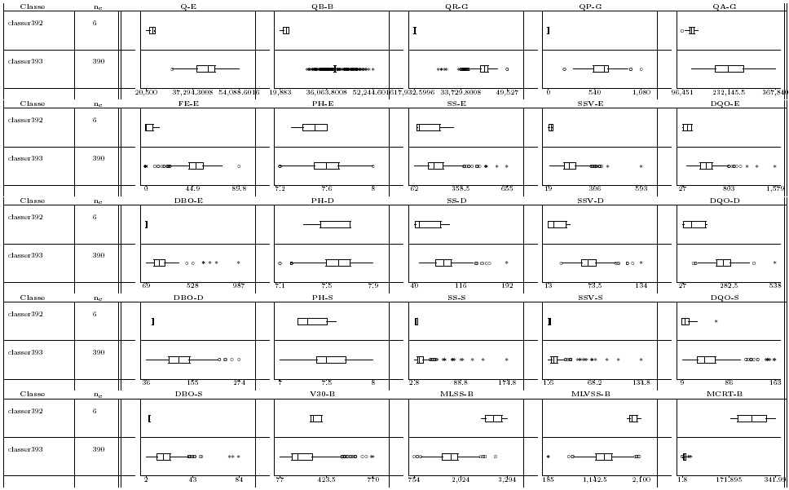
Revising Boxplot based discretization
X_{K} non overlapping
Class-panel Graph.
Notes:
Here we have got the class panel graph of the 25 variables.
which considered more relevant according to experts’ s opinion
regarding the top partition P2.
And in the next slide I’m going to analyze Q-E : Inflow wastewater.

Slide 5
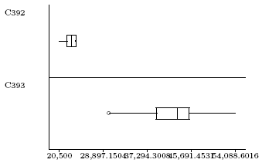
Revising Boxplot based discretization
RBbD for Q-E
Original Boxplot based discretization (BbD)
I₁^{k}= [z₁^{k}, z₂^{k}]
I₂^{k}= (z₂^{k}, z₃^{k}]
I₃^{k}= (z₃^{k}, z₄^{k}]
I1
I2
I3
20,500
23,662
29,920
54,088
I₁^{k}= [20500, 23662]; I₂^{k}= (23662, 29920]; I₃^{k}= (29920, 54088]
Notes:
Well focoussing at the minimus and maximus of both classes,we obtain the cutting points.
We construct the intervals set with using the Original Boxplot based discretization (BbD).

Slide 6
Revising Boxplot based discretization
RBbD for Q-E
ORIGINAL:
I₁^{k}= [20500, 23662]; I₂^{k}= (23662, 29920]; I₃^{k}= (29920, 54088]
REVISED:
I₁^{k}= [20500, 23662]; I₂^{k}= (23662, 29920); I₃^{k}= [29920, 54088]
I1
I2
I3
20,500
23,662
29,920
54,088
Notes:
Well focoussing at the minimus and maximus of both classes,we obtain the cutting points.
We construct the intervals set with using the Original Boxplot based discretization (BbD).

Slide 7
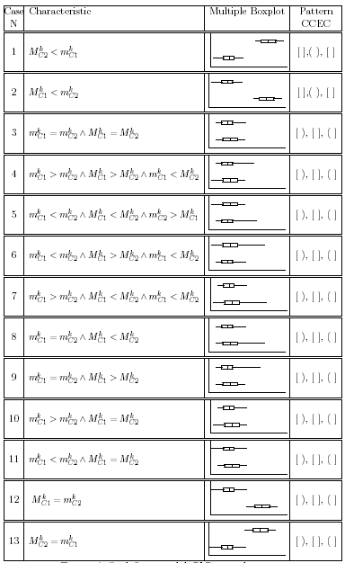
Revising Boxplot based discretization
Exhaustive case analysis
Only two patterns
If (M^{k}_{C2} < m^{k}_{C1}) or (M^{k}_{C1} <m^{k}_{C2})
then
Opened-Center:
I₁^{k}= [z₁^{k}, z₂^{k}]
I₂^{k}= (z₂^{k}, z₃^{k} )
I₃^{k}= [z₃^{k}, z₄^{k}]
else
Closed-Center:
I₁^{k}= [z₁^{k}, z₂^{k})
I₂^{k}= [z₂^{k}, z₃^{k}]
I₃^{k}= (z₃^{k}, z₄^{k}]
Notes:
From this analysis it was also seen that the condition to generate an open center pattern is: (M^{k}_{C2} < m^{k}_{C1}) or (MkC1 <mkC2).
cases should be treated as closed center.
These would represent a more realistic model for all different situations that can be found in the multiple Boxplot

Slide 8
Boxplot Based discretization
Transforms a numerical variable in a categorical variable (interpretative purpose only)
Intervals maximally associated with a reference class
Cut points identify changes in class intersections
Interactions analysis avoided (NP-hard problem)
Simple local max-min calculations
High efficiency

Slide 9
Totally characterizing variable. LNAI [Gib98]
Variable X is totally characterizing class C if:
It takes exclusive values in class C
Existence not guaranteed
X_{i, DQO-E} en (4910,8752)m³/day i is of C4
Notes:
DQO-E: Fracción de materia orgánica degradable por accion de agentes quimicos oxidantes bajo condiciones de acidez.
Valores bajos para la clase 4
De aquí se induce una doble implicación:
El objeto i pertenece a la clase 4 si esta entre....

