Slide 1
Conceptual Characterization
by
Embedded conditioning
1

Slide 2
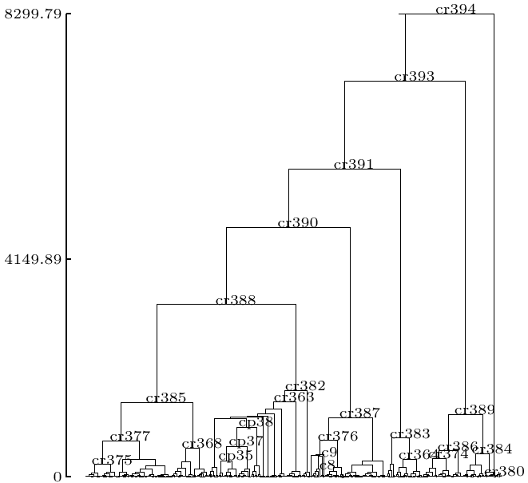
Methodology CCEC
A²_{Cr393}
A²_{Cr380}
Indexed hierarchy
t={P 1, P 2, P 3,…, P n}
Start with the 2-classes cut
Find differences
Characterize
(by some criteria)

Slide 3
Methodology CCEC
A²_{Cr393}
A²_{Cr393}
A²_{Cr380}
Indexed hierarchy
t={P 1, P 2, P 3,…, P n}
A²_{Cr393} ^
A³_{Cr391}
Go down one level of the tree
Identify the splitted class
A²_{Cr393} ^
A³_{Cr389}
Find local differences
Inherit from father concepts

Slide 4
Methodology CCEC
A²_{Cr380}
A²_{Cr393} ^ A³_{Cr391}
Indexed hierarchy
t={P 1, P 2, P 3,…, P n}
A²_{Cr393} ^ A³_{Cr391}
^
A⁴_{Cr390}
Go down one level of the tree
A²_{Cr393}
^
A³_{Cr389}
Identify the splitted class
Find local differences
A³_{Cr383}
^
Inherit from father concepts

Slide 5
Methodology CCEC
A²_{Cr380}
Indexed hierarchy
t={P 1, P 2, P 3,…, P n}
A²_{Cr393} ^ A³_{Cr391}
^
A⁴_{Cr390}
Stop at the target level
A²_{Cr393}
^
A³_{Cr389}
Class concepts found
A²_{Cr393} ^ A³_{Cr391}
A³_{Cr383}
^

Slide 6
Conceptual Characterization
by
Embedded conditioning
Concepts found in psi-1 iterations
Length of concepts < psi
Underlying hierarchy considered
Way of building A_{C}
Depending on the selected criteria
6

