Slide 1
Boxplot-based induction rules (BPbIR)
1

Slide 2
Totally characterizing variable. LNAI [Gib98]
Variable X is totally characterizing class C if:
It takes exclusive values in class C
Existence not guaranteed
X_{i, DQO-E} en (4910,8752)m³/day i is of C4
Notes:
DQO-E: Fracción de materia orgánica degradable por accion de agentes quimicos oxidantes bajo condiciones de acidez.
Valores bajos para la clase 4
De aquí se induce una doble implicación:
El objeto i pertenece a la clase 4 si esta entre....

Slide 3



Boxplot-based Induction Rules (BbIR)
Cross Table:
Conditioned distributions
x
=
C393
C392
C393
C392
I1
0 6
6
I1
0 1.000
I2
1 0
1
I2
1.000 0
I3
388 0
388
I3
1.000 0
X_{i} en I2 m³/day i is of C393
Rules Induction

Slide 4
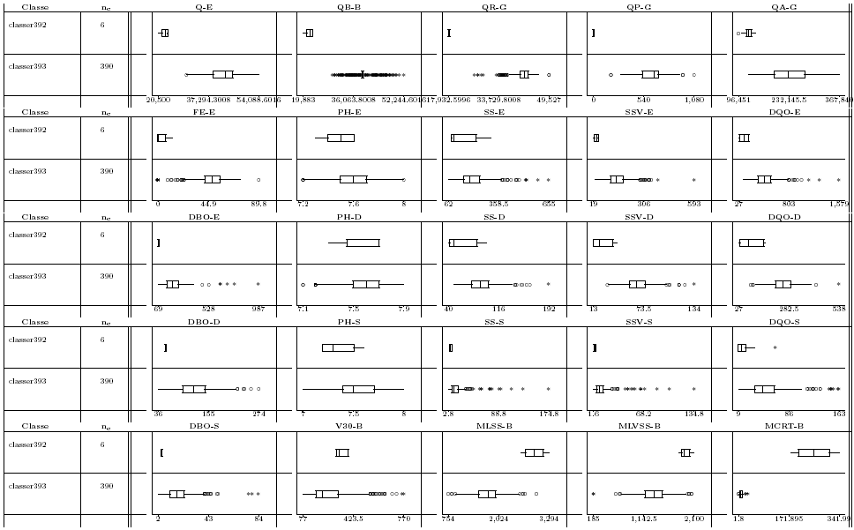
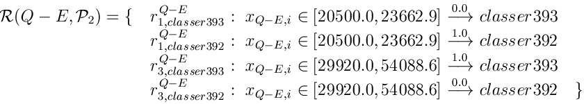
Totally characterizing variable. LNAI [Gib98]
If X_{k} is totally characterizing P
inducted Knowledge Base contains only certain rules
Imposible rules
Certain rules
Notes:
Esto se da cuando los Boxplot no solapan entre si, y las intersecciones entre clases son vacias

Slide 5
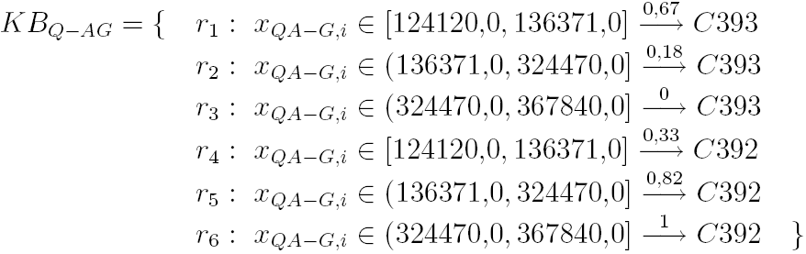
Boxplot-based Induction Rules
Induced Knowledge Base for Q-AG
When X_{k} is not totally characterizing P, the induced knwowledge base contains probabilistic rules
Complementary
rules
Impossible
rules
Certain rules

Slide 6
Boxplot-based induction rules (BPbIR)
Create discrete variable Ik associated to the numerical variable Xk by Boxplot based discretization
Build cross-table Ik x P (also valid for all Xk originally qualitative)
Induce probabilistic knowledge base associated to Ik according to the cells of cross table
Desambiguation
required
When repeated for every Ik
Inconsistencies might
appear
6

