Slide 1
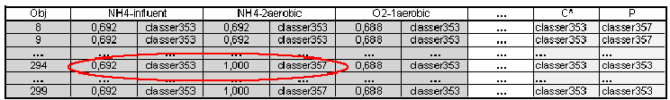
Inconsistency analysis
Inconsistency:
Rules induced from different variables assign different classes
Most probable
class upon Xk
p_{sc}
Objects

Slide 2
Desambiguation criteria
Voting (voting)
Assign the class recommended for more variables
Maximize probability (Pmax)
Assign the class recommended with maximum probability
Sum of probabilities (Sump)
Assing the class that accumulates maximum total probability
CCEC
Use quality criteria of the rules and consider the most discriminant
rules according to the underlying dendrogramm

Slide 3





Quality criteria for rules
Given a rule
Support:
Liu [2000]
Given a rule, the support of r is the proportion of objects in I that satisfy the antecedent of the rule
Notes:
El soporte de una regla mide la frecuencia con que una regla se activa (que tal popular es el antecedente en el conjunto total de objetos)
No tiene en cuenta si la regla se activa correcta o incorrectamente.

Slide 4

Quality criteria for rules
Given a rule
Support:
Liu [2000]
Given a rule, the support of r is the proportion of objects in I that satisfy the antecedent of the rule
Confidence:
Given a rule, the confidence of r is the proportion of objects in the antecedent A_{C(i)}=true that belong to C
Notes:
El soporte de una regla mide la frecuencia con que una regla se activa (que tal popular es el antecedente en el conjunto total de objetos)
No tiene en cuenta si la regla se activa correcta o incorrectamente.

Slide 5

Quality criteria for rules
Given a rule
Support:
Liu [2000]
Given a rule, the support of r is the proportion of objects in I that satisfy the antecedent of the rule
Confidence:
Given a rule, the confidence of r is the proportion of objects in the antecedent A_{C(i)}=true that belong to C
Relative Covering:
Given a rule, the relative covering is the proportion of objects in class C that satisfy the antecedent of rule
Notes:
El soporte de una regla mide la frecuencia con que una regla se activa (que tal popular es el antecedente en el conjunto total de objetos)
No tiene en cuenta si la regla se activa correcta o incorrectamente.

Slide 6
Quality criteria for rules
Given a rule
Support:
Liu [2000]
Popularity
Given a rule, the support of r is the proportion of objects in I that satisfy the antecedent of the rule
Confidence:
Given a rule, the confidence of r is the proportion of objects in the antecedent A_{C(i)}=true that belong to C
Error
Relative Covering:
Diagnostic
Power
Given a rule, the relative covering is the proportion of objects in class C that satisfy the antecedent of rule
Notes:
El soporte de una regla mide la frecuencia con que una regla se activa (que tal popular es el antecedente en el conjunto total de objetos)
No tiene en cuenta si la regla se activa correcta o incorrectamente.

Slide 7
Inconsistency analysis and quality criteria
Karina Gibert
Departamento de Estadística e Investigación Operativa
Universitat Politècnica de Catalunya
Thanks for your attention
questions?...
Oct 2011

Slide 8
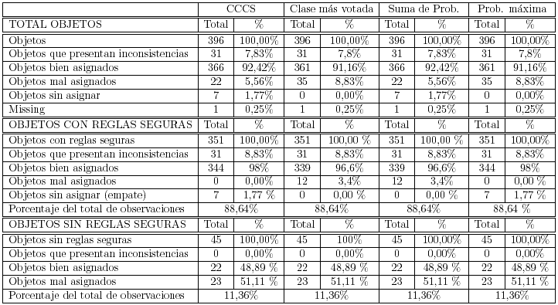
Results and comparisons
Catalunya waste water treatment plant
CCEC and SumP slightly better than Pmax and Voting
CCEC: 78% of objects with inconsistencies correctly assigned
(pmax y voting smaller)
CCEC: 94% of objects without inconsistencies correctly assigned
CCEC: 88, 94% of objects assigned with certain rules
All inconsistencies well desambiguated

Slide 9
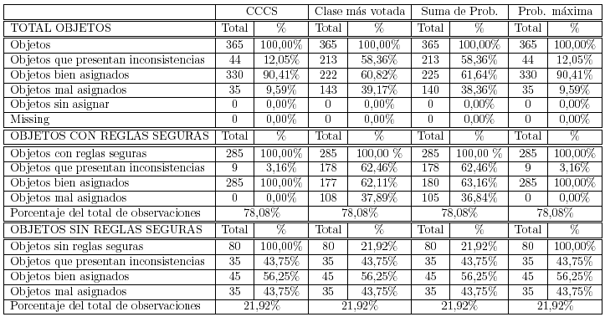
Results and comparison
Ljubljana waste water treatment plant
CCEC and SumP signifficantly better than Pmax y Voting
CCEC: 21% of objects with inconsistencies correctly assigned
(pmax y voting smaller)
CCEC: 100% of objects without inconsistencies correctly assigned
CCEC: 78% of objects assigned with certain rules
All correctly assigned

