Slide 1
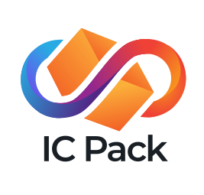
Save user from external control of their apps (in SaaS industry)

Slide 2
Problem: Lost Control
5.52 billion Internet users and all future AI agents
lost control over apps because of cloud services.
An app may be:
updated without user consent;
up-priced or blocked access;
hacked, even if the user maintains security;
even go bankrupt.

Slide 3
The Solution
Our SaaS IC Pack provides full user control over online apps (nobody, even me, can delete or update an app without user’s consent – even in the case if we go out of business).

Slide 4
The Market
Our fee 10% ⨯ paid apps TAM = $67.380bn by 2027.
Also big market of computations including AI.
Initial focus on existing ICP blockchain developers.

Slide 5

Business Model
Going to make money charging 10% of paid apps prices, 5% of hardware costs, and 3% of in-app payments.
Work by: Falia Vicky

Slide 6
Go to Market Strategy
We focus on developers (bootstrapping the PM together with a customer’s app). Developers will bring end-users.

Slide 7


The Team
Victor Porton, the CEO and developer,
the mathematician who discovered ordered semigroup actions (and wrote >600 pages about them), funcoids, and several other things as general as groups. AFAIK, nobody else did more than once, making Victor the best mathematician of all.
won multiple blockchain hackathons.
Syed Zahid, marketer, Digital Marketing Expert & Social Media Specialist.
Flying Stallion to PentaPlus LLC;
strong grip on markets in the US, UK, AUS, EU, and UAE;
skilled in social media marketing, digital marketing strategy, content writing, and graphic design.

Slide 8
Traction
It won 2nd place in Open Internet Summer 2024.
MVP has been shipped.

Slide 9
Forecast 2025-2026
Investing $8450 into SEO, a marketer forecasts 40–60 total "leads" (API + wallet). Take 20-30 API users.
An average SaaS company revenue is $15M/y.
Therefore, since 2026, more than
5%*15M*25 = $18.75M/y

Slide 10
THANK YOU
Victor Porton, the mathematician who discovered
ordered semigroup actions:
porton@package-manager.com
https://docs.package-manager.com

