Slide 1
Package Manager for ICP
Requesting $75,000 under $1M valuation.
Install software in the ICP to use it in a user’s subnet.
OS for ICP

Slide 2
Problem 1: Lost Control
Users lost control over their apps
in the cloud era, because now cloud controls apps.
Apps can be updated without user consent.
Apps can be hacked, even if the the user keeps secure.
An app may even go bankrupt.
We are to return control to the user,
or, in blockchain slang, make the user self-sovereign.

Slide 3
Problem 2: Blockchain Is Slow
Interoperability between apps on
ICP blockchain is slow.
We can make it much faster.

Slide 4
The Market
We also are going to enter paid apps market:
  projected market volume of US$673.80bn by 2027
  https://www.statista.com/outlook/dmo/app/worldwide
TAM: 67.380bn by 2027, if we will charge 10%.
We enter the market of computing Power for cloud apps:
  The Computing Power market size is projected to grow from USD 49.4 billion in 2024 to USD 79.3 billion by 2032 https://www.marketresearchfuture.com/reports/computing-power-market-21988
  We are going to charge the user 1% on top of his/her payments for blockchain gas. TAM: 793 million by 2032.

Slide 5
The Solution
A package manager that installs software in ICP blockchain (rather than on user’s computer or in cloud).
  Convenient, low TCO, super-secure.
Now companies use locally installed Web software for this purpose, which has very high TCO, almost no interactability, slow and unreliable operations (need to phone the sysadmin and beg him to agree), low security. Home users usually just don’t.

Slide 6
Target Audience
Web app developers
  dapp developers;
Former installable app developers.
Users who want control and security.
Users drawn in by app developers.

Slide 7
Features
Features like: Google Play, Linux package managers.
1

Slide 8
Features like Linux
Install dependencies
2

Slide 9
Features like Google Play
Give permissions,
process events.
3

Slide 10
Unique features
Choose vendors.
3

Slide 11
Support for multiple repos (DAOs), multiple installs, and multiple subnets
Choice
Permissions and events
Support big repos
Choose, for example, between several email clients.
Android-like permissions, inter-app events.
Practically no limit for repository size.
Unlike Linux distros, you can install from multiple repositories.

Slide 12
Writing repository specs
Frontend
(partly written)
Writing package manager specs (mostly done)
Backend
(partly written)
Start
Done

Slide 13

Scenario 1: 100M paid users, each paying $200, our 10% tax =
$2B revenue.
Work by: Falia Vicky

Slide 14
Scenario 2: 1B users, each installs 100 apps with 3 modules each, $2 paid in gas, our 1% tax =
$6B revenue.
Scenario 3: 10K corporate AI users, each spends $10000 on running AI, our 1% tax = $1M revenue.
Work by: Falia Vicky

Slide 15
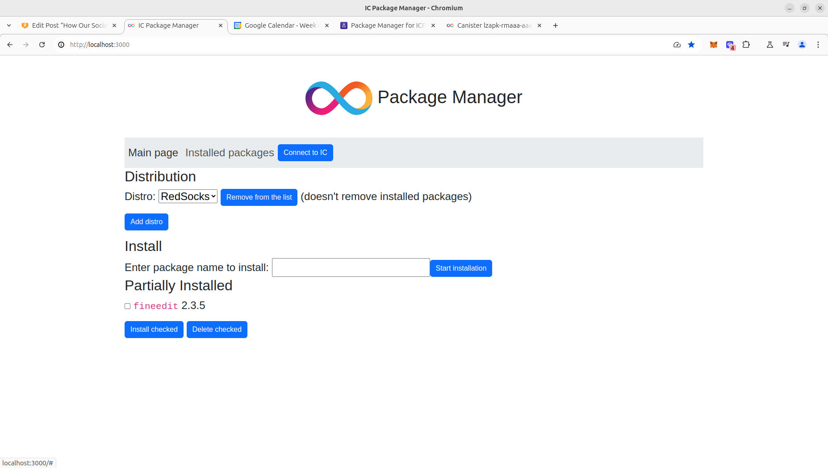

Slide 16
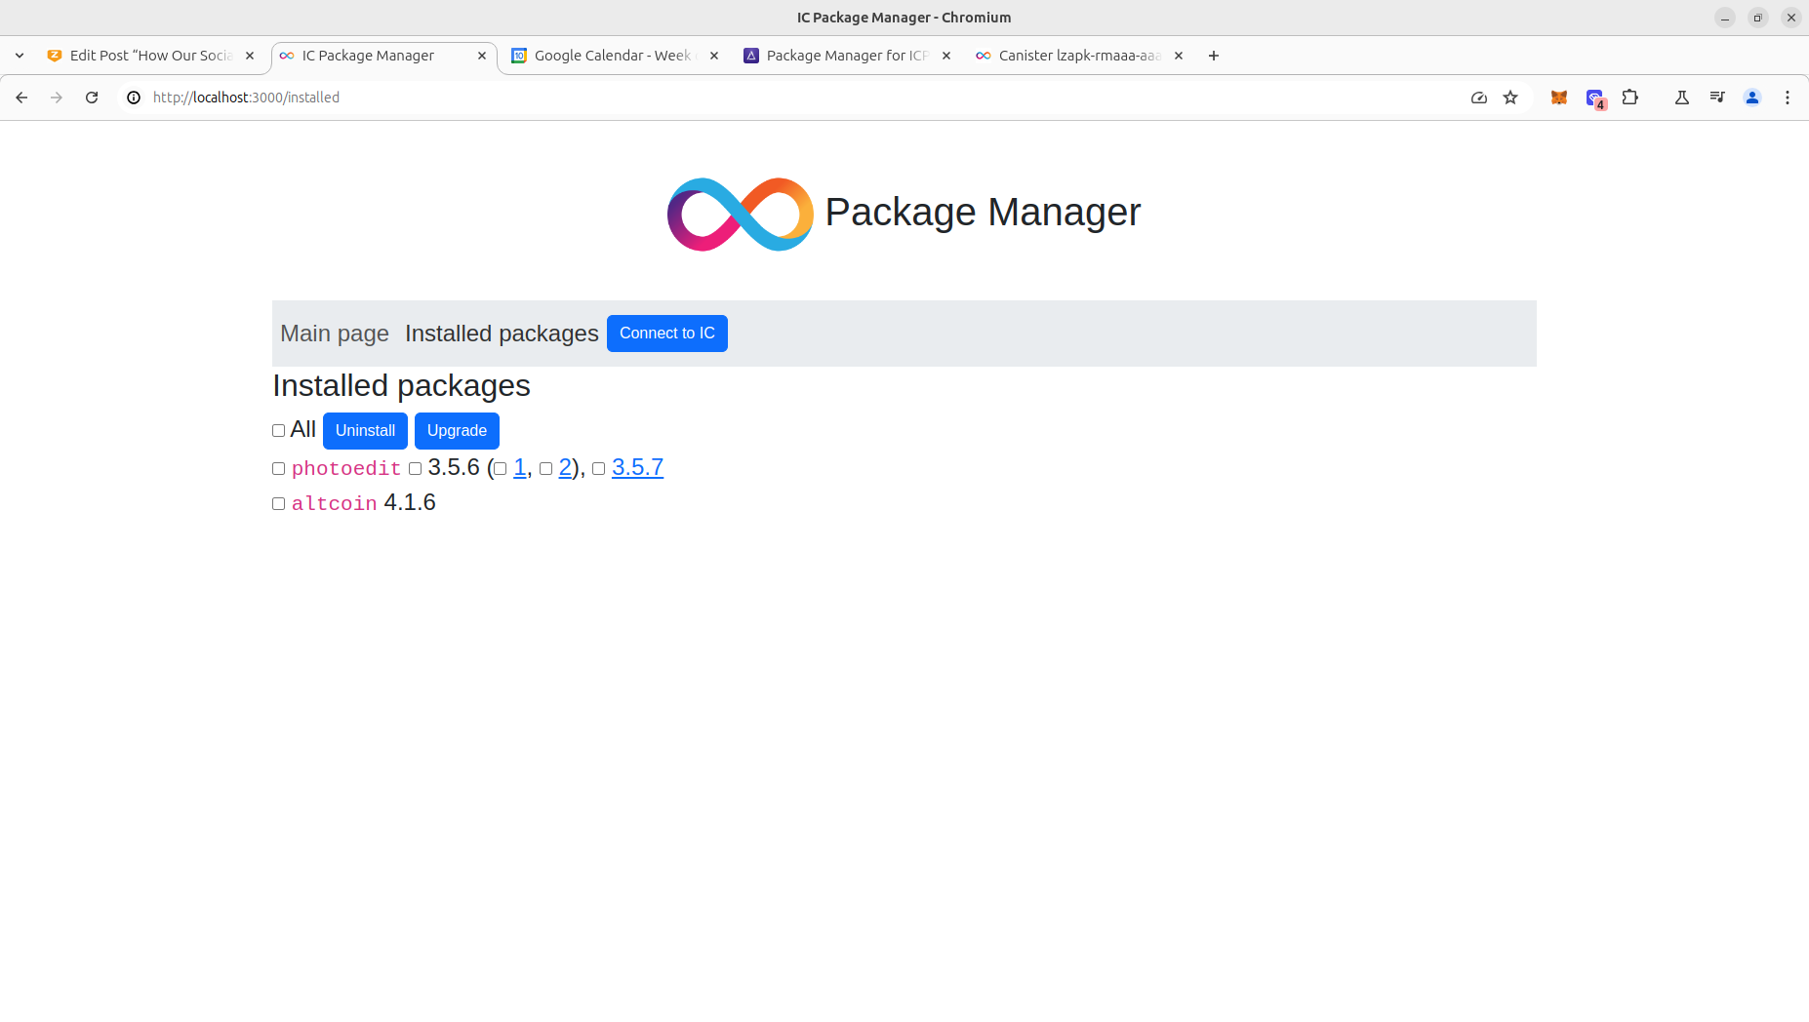

Slide 17

Raising $75K
At this stage raising $75K for SEO, SM, and the developer’s salary.
The company is backed by one of the best mathematicians in History
(I discovered ordered semigroup actions.)
2nd prize in Open Internet Summer 2024
(numerous other blockchain hackathons won).

Slide 18
THANK YOU
Victor Porton, the mathematician who discovered
ordered semigroup actions.

