Slide 1
Package Manager for ICP
Requesting $75,000 under $1M valuation.
Install software in the ICP to use it in a user’s subnet.
OS for ICP

Slide 2
Problem 1: Lost Control
Users lost control over their apps
in the cloud era, because now cloud controls apps.
We are to return control to the user,
or, in blockchain slang, make the user self-sovereign.

Slide 3
Problem 2: Blockchain Is Slow
Interoperability between apps on
ICP blockchain is slow.
We can make it much faster.

Slide 4
The Market
Paid apps TAM: 67.380bn by 2027, if we will charge 10%.
The Computing Power TAM: 793 million by 2032.

Slide 5
The Solution
A package manager that installs software in ICP blockchain (rather than on user’s computer or in cloud).
  Convenient, low TCO, super-secure.

Slide 6
Target Audience
Web app developers
  dapp developers;
Former installable app developers.
Users who want control and security.
Users drawn in by app developers.

Slide 7

Scenario 1: 100M paid users, each paying $200, our 10% tax =
$2B revenue.
Work by: Falia Vicky

Slide 8
Scenario 2: 1B users, each installs 100 apps with 3 modules each, $2 paid in gas, our 1% tax =
$6B revenue.
Scenario 3: 10K corporate AI users, each spends $10000 on running AI, our 1% tax = $1M revenue.
Work by: Falia Vicky

Slide 9
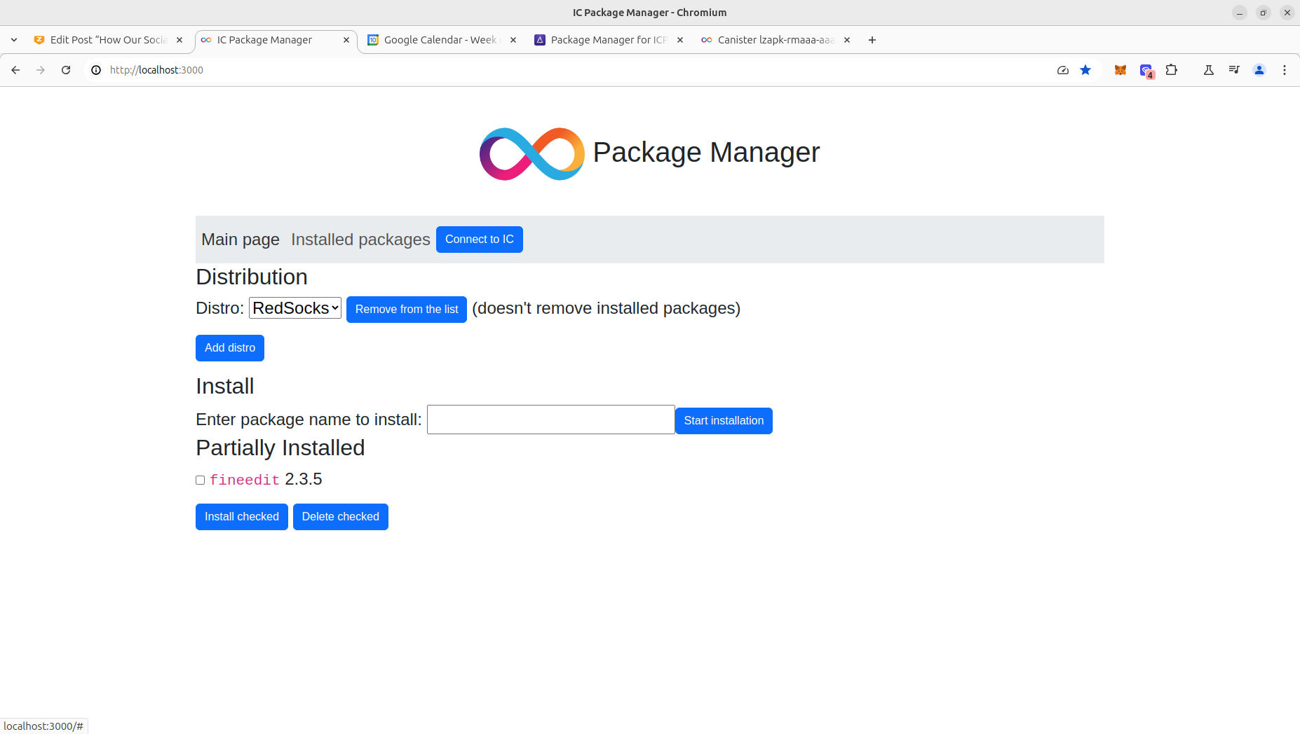

Slide 10
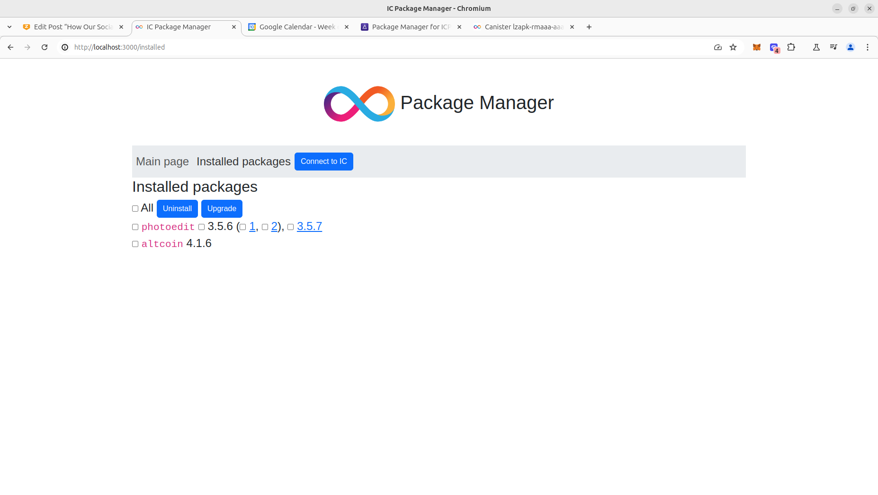

Slide 11

Raising $75K
At this stage raising $75K for SEO, SM, and the developer’s salary.
The company is backed by one of the best mathematicians in History
(I discovered ordered semigroup actions.)
2nd prize in Open Internet Summer 2024
(numerous other blockchain hackathons won).

Slide 12
THANK YOU
Victor Porton, the mathematician who discovered
ordered semigroup actions.

