Slide 1
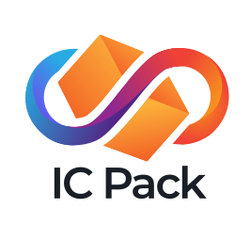
Save user from external control of their apps (in SaaS industry)

Slide 2
Why devs need this?
You support your users: User’s data is at risk.
Tell your users that you care about this.
You get rid of all DevOps and simplify
development.

Slide 3
Problem: Lost Control
In short: User’s data is at risk.
5.52 billion Internet users and all future AI agents
lost control over apps because of cloud services.
An app may be:
updated without user consent;
up-priced or blocked access;
hacked, even if the user maintains security;
even go bankrupt.

Slide 4
The Solution
IC Pack provides full user control over the apps (nobody, even the dev, can delete or update an app without user’s consent – even in the case if we go out of business).
Now companies use locally installed Web software for this purpose, which has very high TCO, almost no interoperability, slow and unreliable operations (need to phone the sysadmin and beg him to agree), low security. Home users usually just don’t.

Slide 5
Build on ICP Blockchain
ICP blockchain replacing cloud:
works at Web speed
only $4/year for storing 1GB
easier dev, no need for DevOps.

Slide 6
Our Technology
IC Pack gives users full control by installing apps in ICP blockchain: convenient, low TCO, secure. App works, while one pays for hardware.

Slide 7
Traction and Funding
It won 2nd place in Open Internet Summer 2024.
$7,000 in grant money.
Post-MVP product.

Slide 8
Target Audience
Web app developers
  dapp developers;
Former installable app developers.
Users who want control and security.
Users drawn in by app developers.
An average SaaS company (our potential customer) has $15M/year revenue.

Slide 9

Business Model
Going to make money charging 10% of paid apps prices, 5% of hardware costs, and 3% of in-app payments.
Work by: Falia Vicky

Slide 10
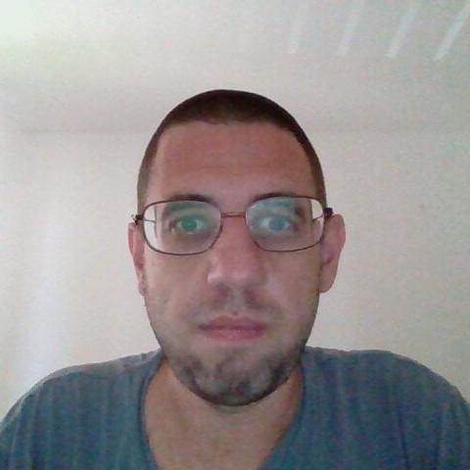
The Team
Victor Porton, the CEO and developer, is the mathematician, who discovered ordered semigroup actions (and wrote >600 pages about them), funcoids, and several other things as general as groups. AFAIK, nobody else did more than once, making Victor the best mathematician of all.
Victor won multiple blockchain hackathons.

Slide 11
Support for multiple repos (DAOs), multiple installs, and multiple subnets
Choice
Permissions and events
Support big repos
Choose, for example, between several email clients.
Android-like permissions, inter-app events.
Practically no limit for repository size.
Unlike Linux distros, you can install from multiple repositories.

Slide 12
Competition: the Lowest TCO
Intranet apps | SaaS | PC/phone apps | IC Pack
buy in advance | rent on as-needed basic | buy in advance | rent on as-needed basic | Hardware
bad | good | bad | good | Inter-app security
no | imperfect | no | yes | Crypto/blockchain integrated
through admin | no | yes | yes | User in control
very high | low | low | lowest | TCO
no | yes | yes | yes | Easy

Slide 13
THANK YOU
Victor Porton, the mathematician who discovered
ordered semigroup actions:
porton@package-manager.com

