Slide 1

Raising $50K-250K
Seed funding
SaaS B2B:
social network
Twitter+Kindle+LiveJournal+Wiki+Dmoz+,
A fusion of social network, marketplace, wiki, and Web directory
Nov 2025
Deck 2.0.7

Slide 2
Strong points
Affiliate program (all authors can earn)
Good for indie authors (the mission to eliminate network effect)
Fusion of social network, Web directory, and marketplace – profit multiplier for authors and for us

Slide 3
The Problem: Fragmented social platforms that don't benefit creators
Twitter, LiveJournal, Kindle are separate
Not all Twitter authors earn
Dmoz is dead
Indie authors have a difficulty to succeed on Twitter

Slide 4
The Solution: An integrated blockchain-based platform with built-in monetization
A simple system of items and folders.
Folders of two kinds: communal (everybody can
post, order is decided by voting) and owned
(only owner can post). An item can be in
multiple folders (helps indie authors, among other).
Moderated by users.

Slide 5
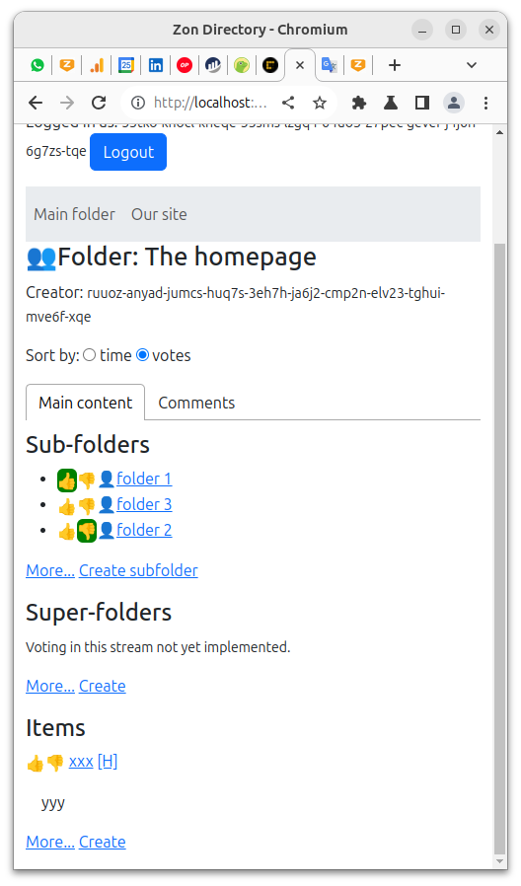

Slide 6
Go-To-Market & Traction Plan
We expect to get in the best case up to 10%
of the market of Twitter (not 100%, because
our product is more difficult to use than Twitter).
10% of 556M = 55.6M active monthly users.
Use SEO, Twitter ads.

Slide 7

Use cases
A user creates one folder and uses it like
Twitter to post short posts/links.
A user creates one folder and uses it like
LiveJournal (blog).
Multiple interlinked folders (Dmoz).
Folders with paid items (marketplace).

Slide 8
Business model
01 Aff. Program
Our system advertised with help of the affiliate program.
02 Benefits
The affiliate program benefits both the network and individual authors, who actually can make money.
Sell files,
sell ads,
accept donations.
03 Spread money
The money is spread between the network, the author, the buyer’s affiliate and the seller’s affiliate.

Slide 9
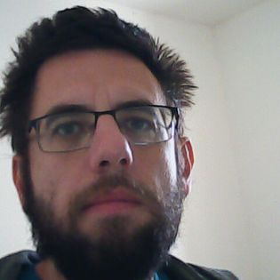
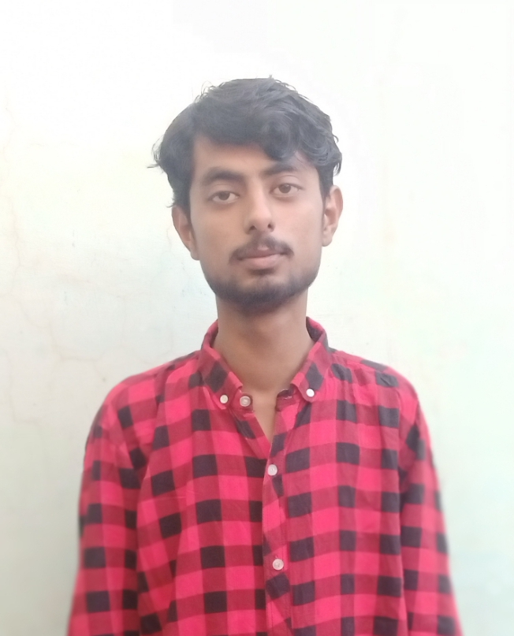
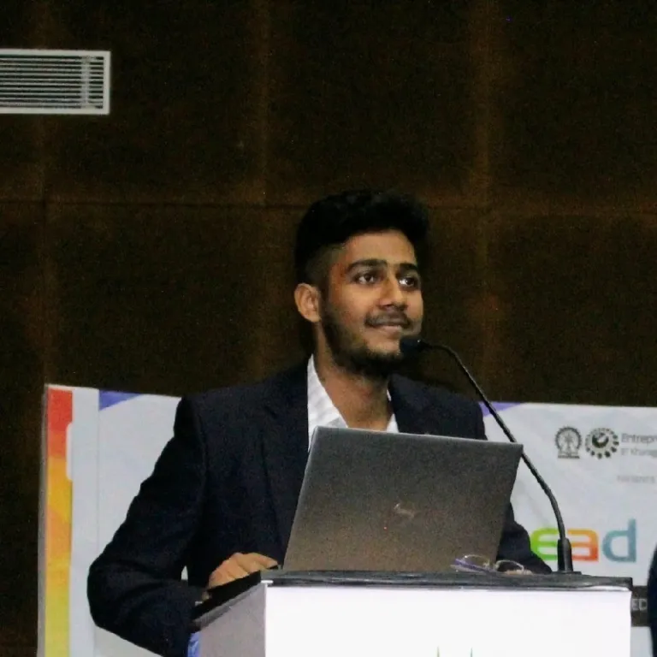
Victor Porton – the mathematician
who discovered ordered semigroup actions
and a serial blockchain hackathons winner.
Atiq Kaka – a Meta-certified marketer.
Sagar Kumar – co-founder of Lets Lance and
Associate Manager at
Entrepreneurship Cell, IIT Kharagpur

Slide 10
Development status:
First beta has been released.
Lacking features:
Monetization and collaborative editing

Slide 11
Internet Computer
Folders order
Both backend and frontend on Internet Computer blockchain
We order items in folders accordingly to user voting.
CanDB
An advanced no-SQL DB used for data storage, allowing seamless software upgrades.
NacDB
I am creating a new DB for Internet Computer that unlike CanDB will allow seamless enumeration of DB items, thus allowing to display folder items in order.

Slide 12
Use of Funds
Up to about $10-15K for
quality assurance
(security bounties).
The rest for marketing.

Slide 13

Presented by Victor Porton, the mathematician
who discovered ordered semigroup actions,
porton@zoncircle.com
+ 2 other team members.
By investing you support Science.
https://docs.zoncircle.com

