Slide 1
Smart Underwriting Workbench
A Smart Intuitive Insurance Accelerator for Underwriters
August 2025

Slide 2
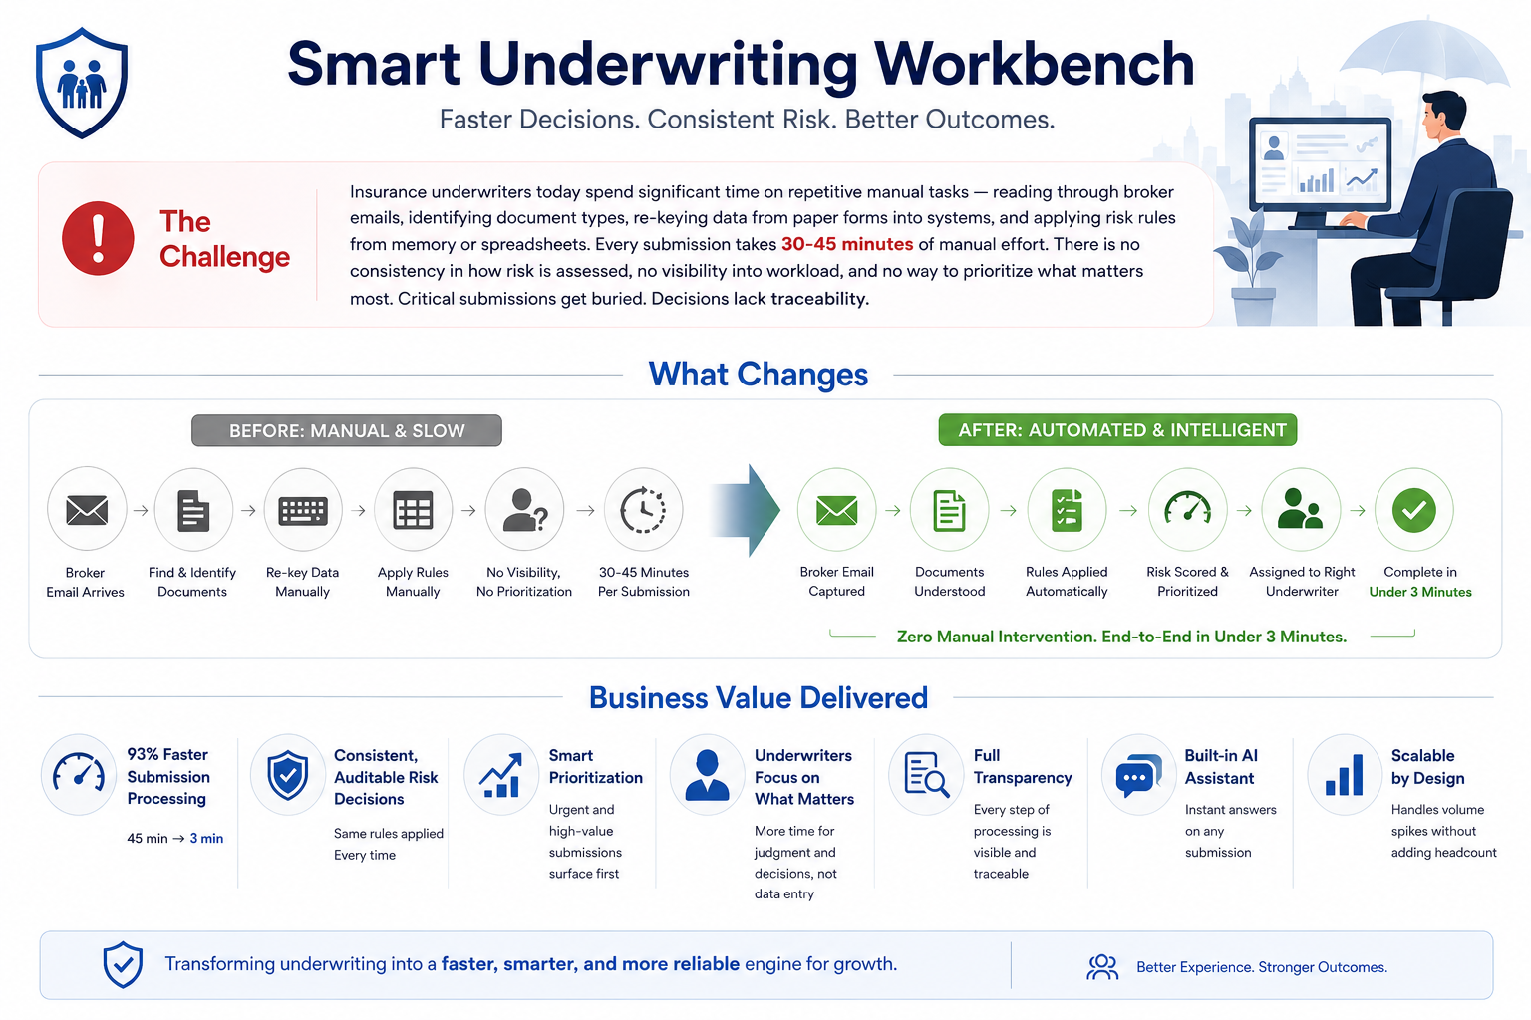

Slide 3
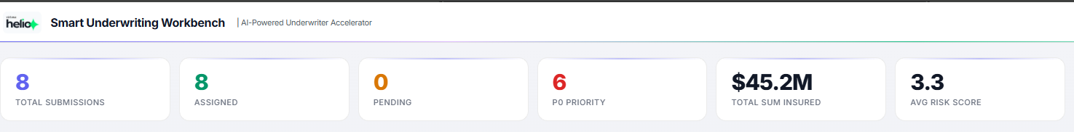
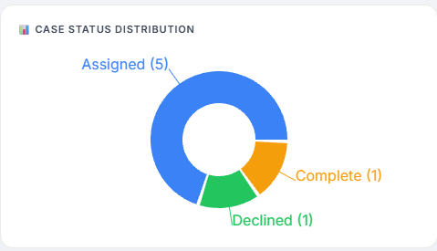
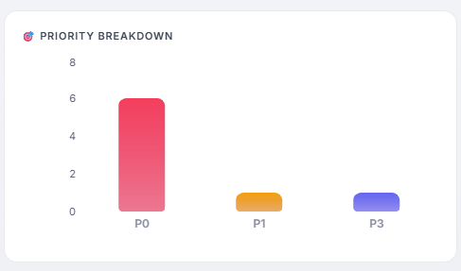
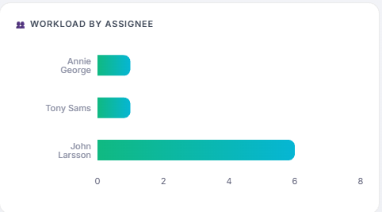
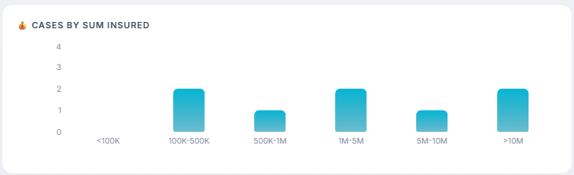
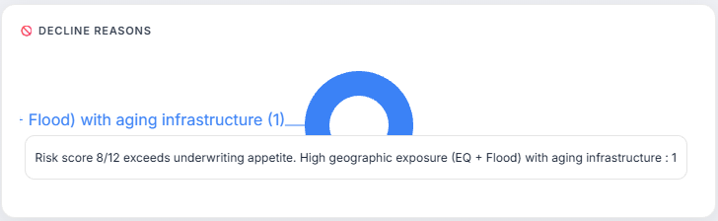
Underwriting Dashboard Key Metrics

Slide 4
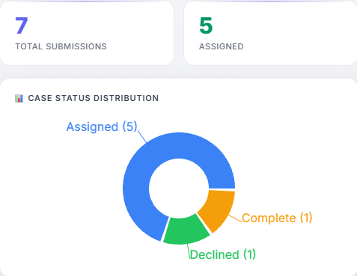
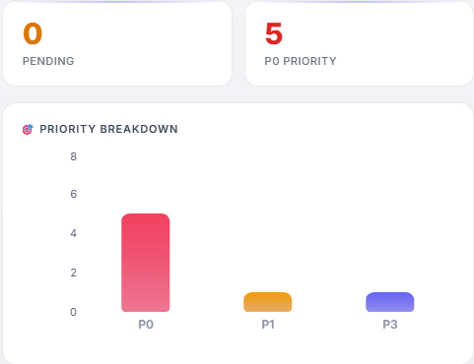
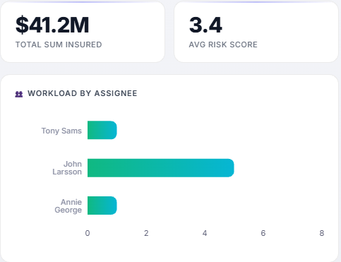
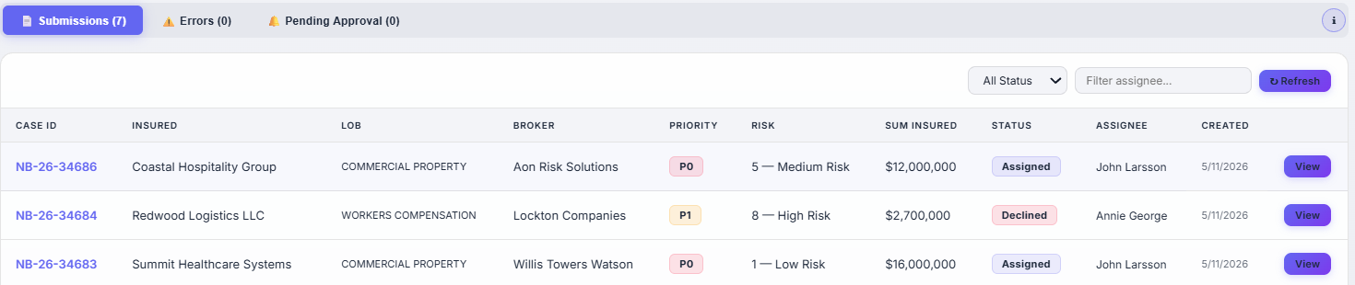
Underwriter’s Dashboard

Slide 5
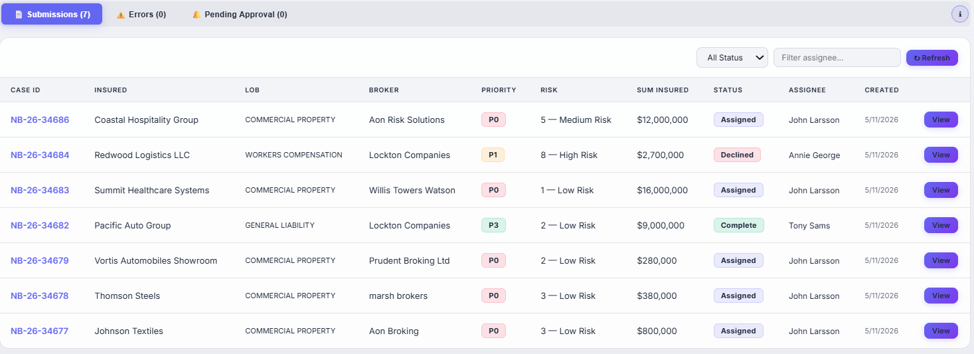
Submissions Listing Screen

Slide 6
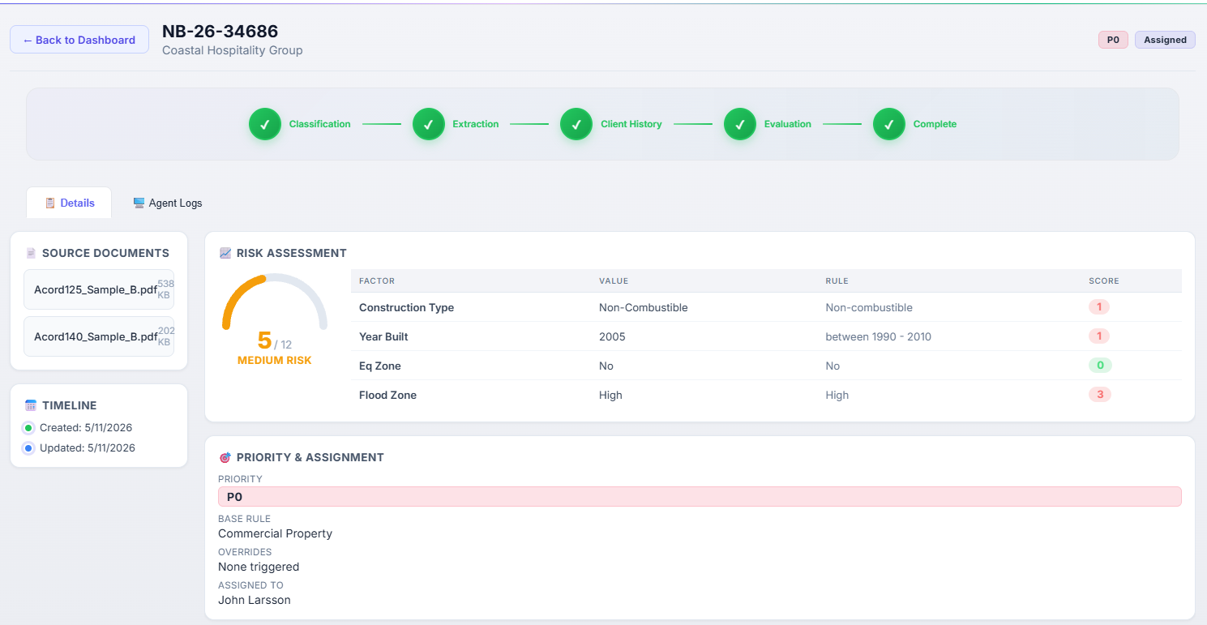
Submission Details Screen

Slide 7
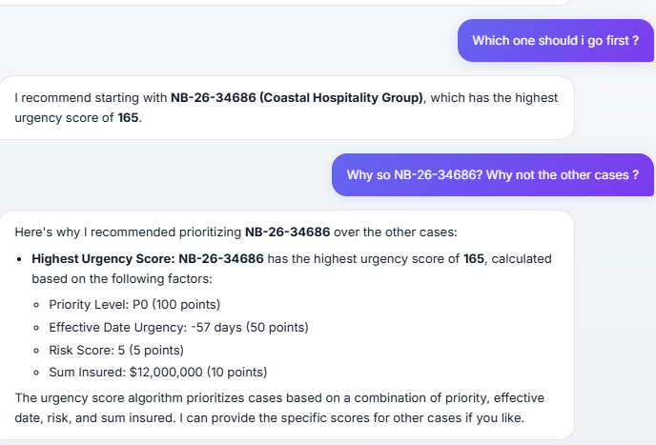
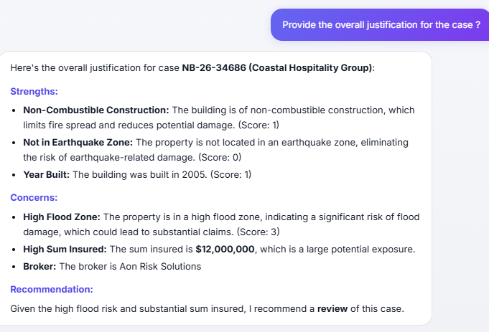
Agentic Driven Smart Underwriter Assistant

Slide 8







UW Submission Intake Use Case – Process Flow
Brokers receive New business submission from clients for Insurance
Intake Channels
Smart UW Workbench
Business Logic to determine priority
Line of business; Type, Limits
Characteristic of risk - nature of business, year built
Risk appetite; Priority client/broker
Annual revenues, premium, claims
Call transcripts & email data etc.
Auto Extraction from Documents
Submission Priority
Broker
Brokers send the submission to insurance companies for Quotation
Business logic for Predicting UW Risk Score:
Risk Location, Exposure like EQ, flood
Lob, Nature of business, Coverages
Year built, Type of construction
Limits of liability, Previous losses
Presence of Fire extinguishers, sprinklers
Submission data has ACORD forms; Loss Run report; Schedule of Values; Broker specification document; Email data.
UW Risk Score Prediction
Underwriter
Underwriter logs into his workbench and receives the auto processed submission.
Poor Risk Score ?
Submission Assignment
No
Yes
Business logic for submission assignment:
Submission Priority; Risk Score
Line of business
Submission Type
Limits of liability
UW’s workload, efficiency & availability
Underwriter validates the submission data and processes the quotation
Submissions are automatically declined
Final Quotation is sent to broker
Integration
Core Systems
Broker Portal
Rating Engine

Slide 9
Thank you.

