Slide 1
Research Objectives
Quantify the correlation between user engagement (reviews, tips, check-ins) and review count/average star rating.
Analyze the impact of sentiment on review count and average star rating.
Analyze the impact of sentiment on review count and average star rating.

Slide 2
Problem Statement
The restaurant industry is highly competitive, making it essential to understand factors driving business success.
Yelp dataset provides valuable insights into customer interactions and business performance.
This project investigates the relationship between user engagement (reviews, tips, check-ins) and business success metrics (review count, average ratings) for restaurants.

Slide 3
Data Overview
Subset of Yelp dataset with business information across 8 metropolitan areas in the USA and Canada.
Data provided by Yelp in JSON format.
Five JSON files: Business, Review, User, Tip, Check-in.
JSON files stored in a database for efficient data retrieval.

Slide 4
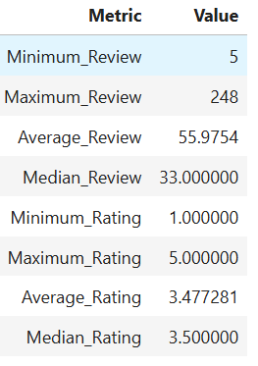
Analysis and Findings
Out of 150k businesses, 35k are restaurants business and are open.
Table showing distribution of business success metrics (review count and average rating):

Slide 5
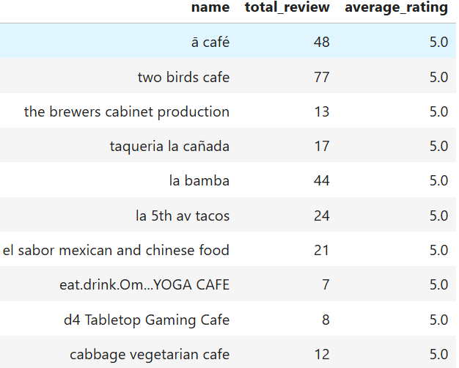
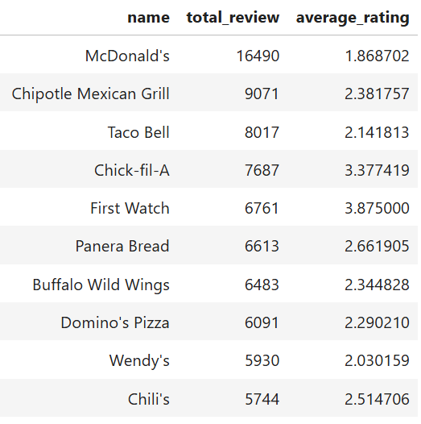
Highest Rating
Highest Review Count
Key Insights
A higher rating does not guarantee a higher review count, and vice versa.
The success of a restaurant is not solely determined by ratings and review counts.
Review count reflects user engagement, but not necessarily customer satisfaction or business performance

Slide 6
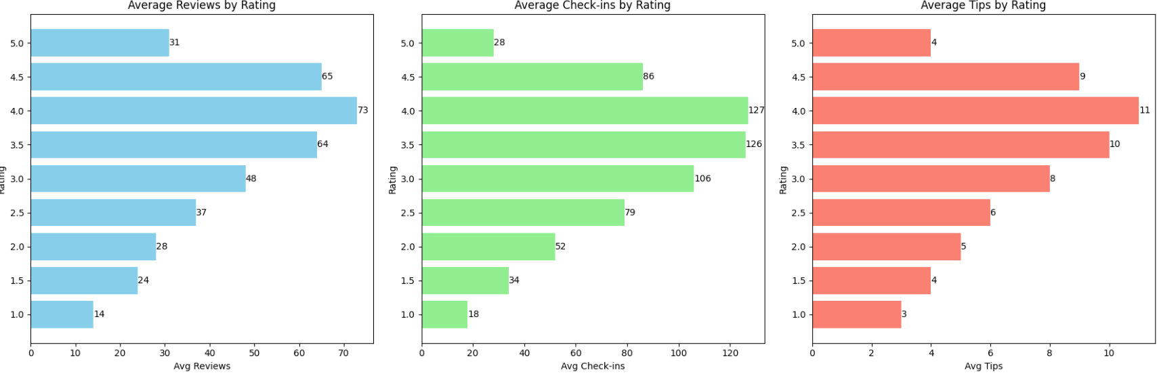
Do higher engagement levels lead to higher ratings?
Engagement (reviews, check-ins, tips) increases with ratings from 1⭐ to 4⭐.
4⭐ restaurants show the highest engagement.
Engagement drops at 5⭐, suggesting:
Fewer customers feel the need to review, or
Only a small, loyal audience visits these places.

Slide 7
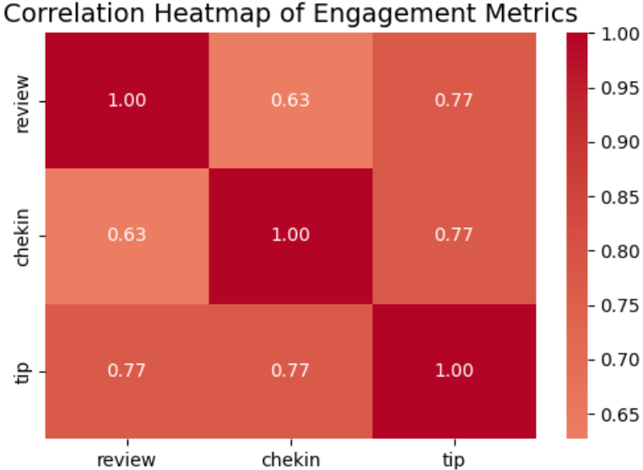
Is there a correlation between the number of reviews, tips, and check-ins for a business?
Correlations suggest that user engagement across different platforms (reviews, tips, and check-ins) is interlinked; higher activity in one area tends to be associated with higher activity in others.
Businesses should focus on strategies that boost all types of user engagement, as increases in one type of engagement are likely to drive increases in others, enhancing overall visibility and interaction with customers.

Slide 8
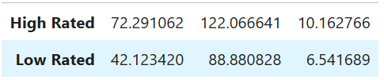
Is there a difference in the user engagement between high-rated and low-rated businesses?
Higher Engagement in High-Rated Businesses
Data indicates a clear correlation between higher ratings and increased user engagement across reviews, tips, and check-ins.
This indicates that satisfied customers are more likely to engage actively across multiple platforms.

Slide 9
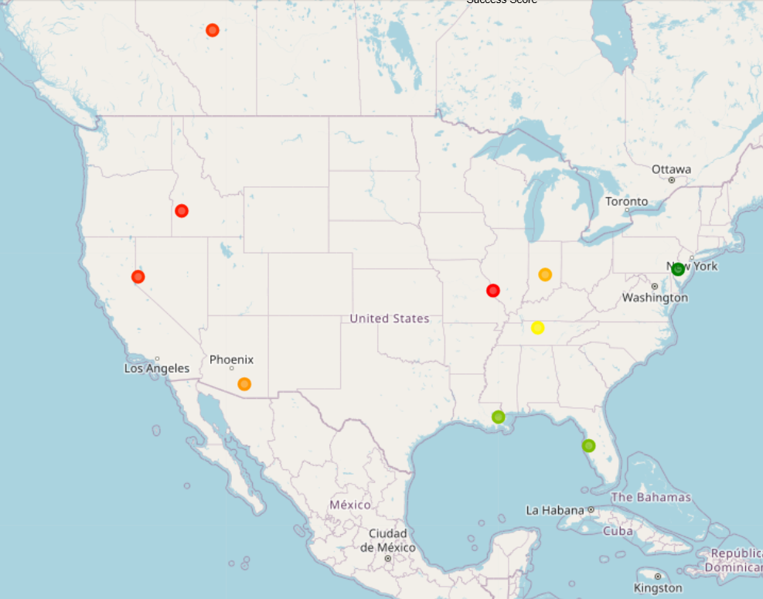
How do the success metrics of restaurants vary across different states and cities?
Philadelphia emerges as the top city with the highest success score, indicating a combination of high ratings and active user engagement.
Following Philadelphia, Tampa, Indianapolis, and Tucson rank among the top cities with significant success scores, suggesting thriving restaurant scenes in these areas.

Slide 10
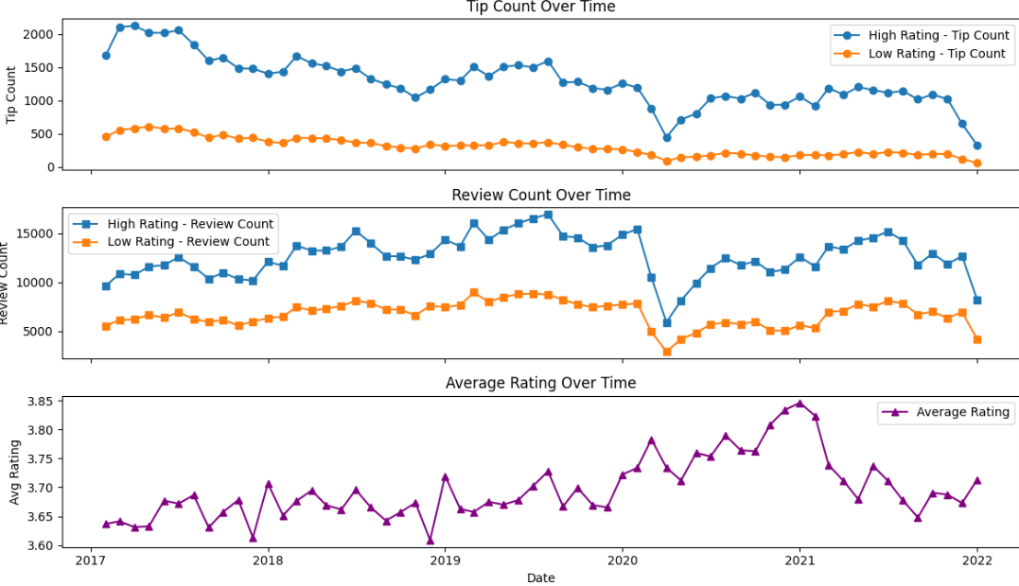
Are there any patterns in user engagement over time for successful businesses compared to less successful ones?
Successful businesses, particularly those with higher ratings (above 3.5), exhibit consistent and possibly increasing user engagement over time.
High-rated restaurants maintain a steady or growing level of user engagement over time, reflecting ongoing customer interest and satisfaction.

Slide 11
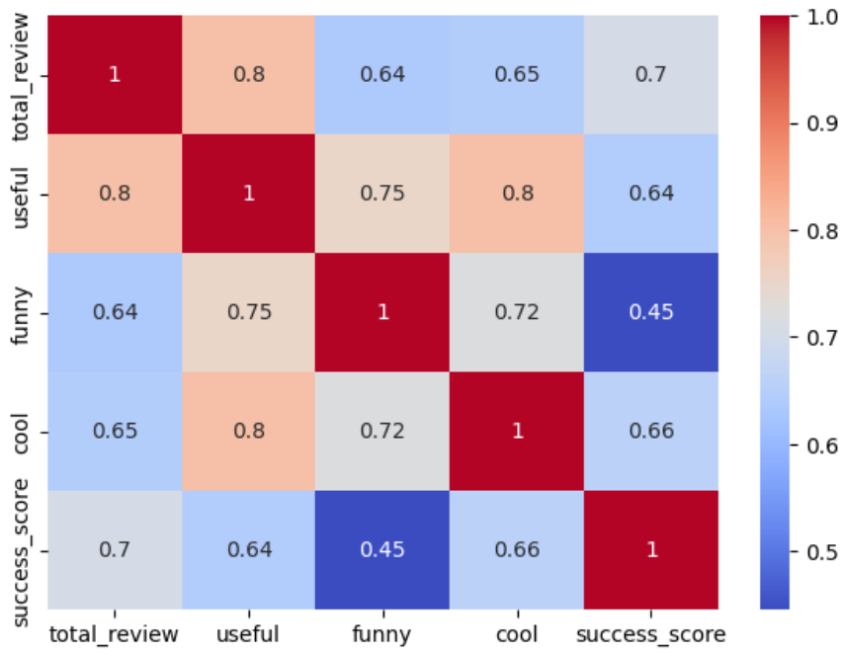
How does the sentiment of reviews and tips correlate with the success metrics of restaurants?
"Useful," "funny," and "cool" are attributes associated with user reviews. They reflect the feedback from users about the usefulness, humor, or coolness of a review.
Higher counts of useful, funny, and cool reviews suggest greater user engagement and satisfaction, which are key factors contributing to a restaurant's success.

Slide 12
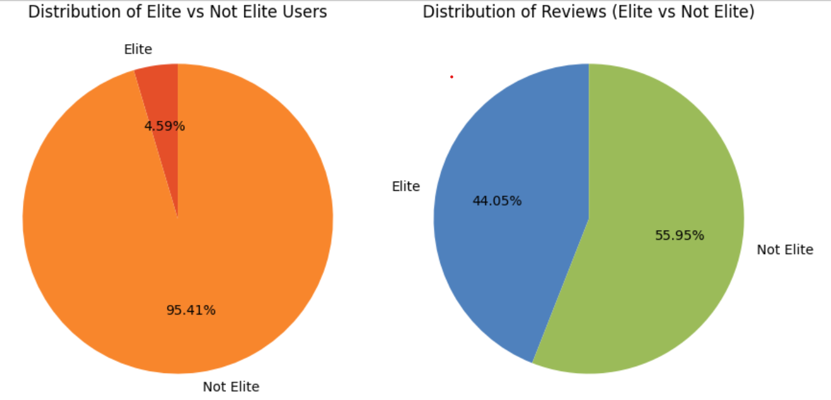
Engagement Difference: Elite vs Non-Elite Users
Elite users are recognized by Yelp for their active and high-quality contributions.
Although elite users make up only a small portion of the user base, they contribute a significant share of total reviews.
Building positive relationships with elite users can foster repeat visits and long-term loyalty, as they tend to support businesses, they’ve had good experiences with.

Slide 13
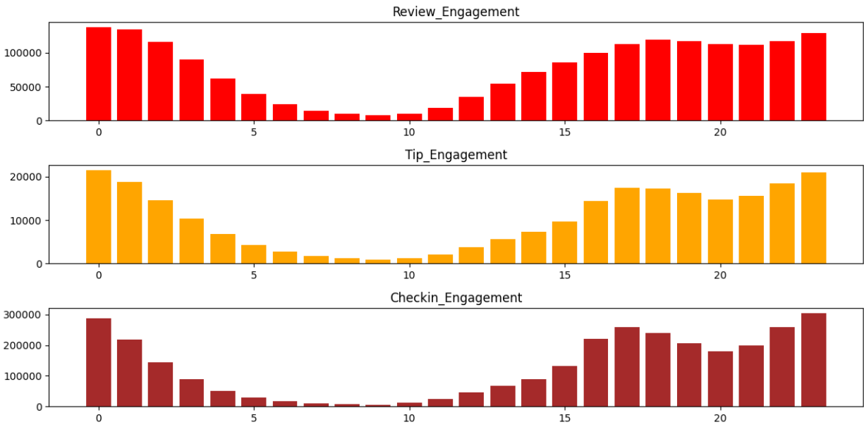
Busiest Hours
The busiest hours for restaurants, based on user engagement, span from 4 PM to 1 AM.
Understanding peak hours helps businesses:
Optimize staffing levels
Allocate resources efficiently
Ensure smooth operations and high-quality service delivery

Slide 14
RECOMMENDATIONS
1. Cultivate a Holistic Engagement Strategy 🤝
Encourage all forms of engagement: reviews, tips, and check-ins.
Prompt feedback from satisfied customers (even 5⭐ guests).
Nurture Elite Yelp users:
Only 4.59% of user base, but contribute 44.05% of reviews.
Build loyalty through positive relationships.
2. Optimize Operations Using Data Insights 📈
Peak Hours (4 PM – 1 AM): Optimize staffing & resources.
3. Redefine Business Success 🏆
Success ≠ Just Ratings.
Combine strong ratings + consistent engagement (reviews, tips, check-ins).
Track engagement growth over time as a success indicator.

