Slide 1
Software Engineering Demo #1, Group 2
Heart Rate Modulator
HomePage:
http://healthmonitoringhomepage-env.5ndteffiz2.us-east-2.elasticbeanstalk.com/
System Page: http://healthmonitoringsystem.us-east-2.elasticbeanstalk.com/
Github: https://github.com/vpranathy/Health-Monitor
Aniket Anilkumar
Yuyang Chen
Divyaprakash Dhurandhar
Zihao Ding
Malay Shah
Pranathy Veldandi

Slide 2
Problem
Lack of education about proper fitness
People only have a limited amount of time on their hands to exercise
People are unable to have uninterrupted deep sleep due to stress or unhealthy lifestyle
People do not have the required resources to analyse and improve their sleep cycle

Slide 3
What will the product do?
Web application & Mobile application integrated with a pulse sensor
Allowing the user information on how to improve his/her lifestyle
Use of music to regulate heartbeat to provide better workouts and sleep cycles
The user will sleep with the pulse sensor on their finger and the database connected to our application would thus get their heart rate fluctuations over their entire sleep period.
Improve sleep cycles by playing soothing music to help the user relax

Slide 4
Who will benefit from the product?
User - To increase heart rate for exercising & to decrease heart rate for sleeping, to analyze health information from given graphs
Doctor/Fitness Instructor - To consult the changes that should be brought to improve health of the heart
Cardiologists:The cardiologists will use this application to get the rest heart-rate and comment on the health of the heart based on the physical structure of the patient.
Fitness-instructor: The instructor can monitor the heart-rate of the students during their fitness activity and suggest changes in the warm-up regime to get the heart-rate to the optimal level.

Slide 5
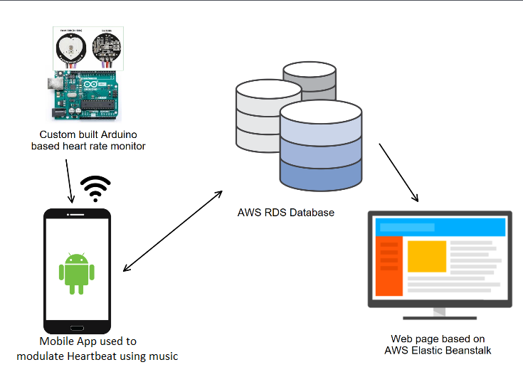
System Architecture Diagram

Slide 6
Plan for the rest of the semester
Aniket, Pranathy and Malay will implement the music selection process due to the heart rate monitoring. This will be influenced by the current heart rate and activity of the user. For the next part, we intend to gather the data from the arduino.
Yuyang will also work on the web development to synchronize all information between web client and mobile client, making it easier for users to use the system. The data will be stored in the database with timeline and date, he will use javascript to do the data visualization based on the timeline, then user will be allowed to select a time range to view his/her heart rate on the website.
Divyaprakash and Zihao will be responsible for designing and programming the Heart Rate Monitor using the Arduino board as well as configuring it to connect via bluetooth to the android smartphone.

