Slide 1
Manual Testing

Slide 2
Module 1
Introduction to Testing

Slide 3
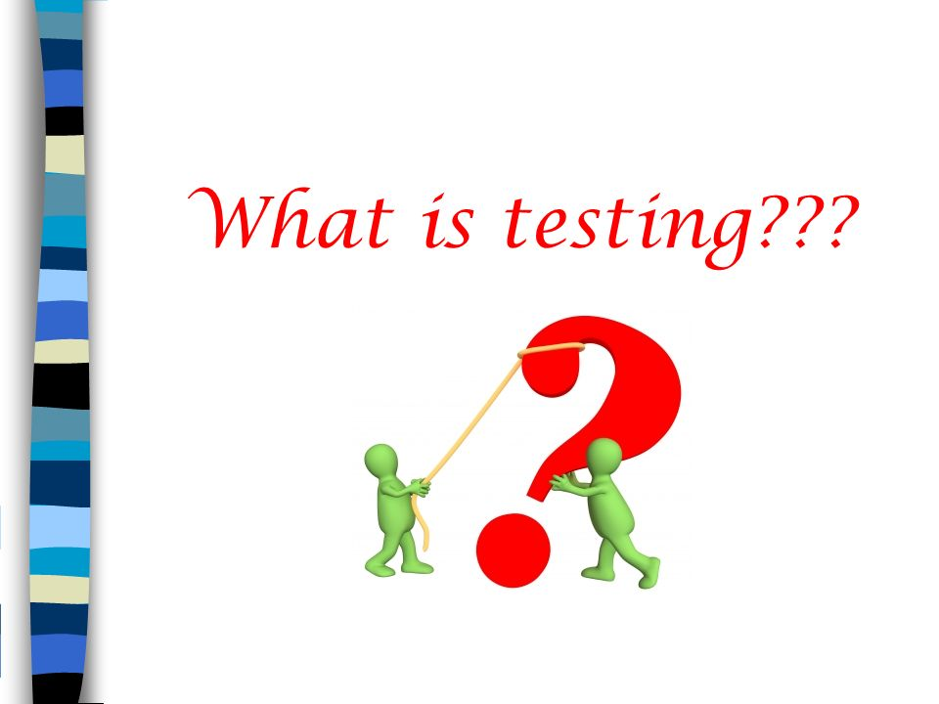
Introduction to Software Testing
  What is Software Testing

Slide 4
Introduction to Software Testing
  What is Software Testing
    Testing is nothing but set of activities conducted with the Intention of Finding defects in software
    According to ANSI/IEEE 1059 standard, Testing can be defined as - A process of analyzing a software item to detect the differences between existing and required conditions (that is defects/errors/bugs) and to evaluate the features of the software item.

Slide 5
Introduction to Software Testing
  What is Objective of Software Testing ?
    Finding the Defect in the software by executing it and get them fix from the programmers.
    To prevent defects
    The objectives of testing can vary.

Slide 6

Introduction to Software Testing
  What is Defects:
    Difference between the expected and actual behavior of the software

Slide 7
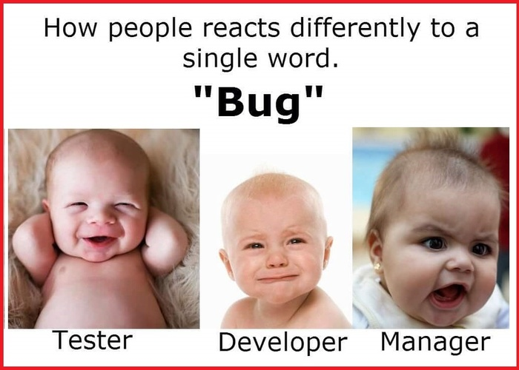
Introduction to Software Testing
  Different Rections on Bug

Slide 8
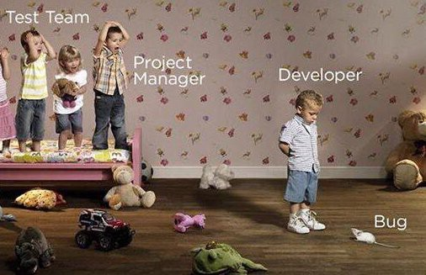
Introduction to Software Testing
  Different Rections on Bug

Slide 9
Introduction to Software Testing
  What is Synonyms Defect ?
    Incident
    Bug
    Failure
    Error

Slide 10
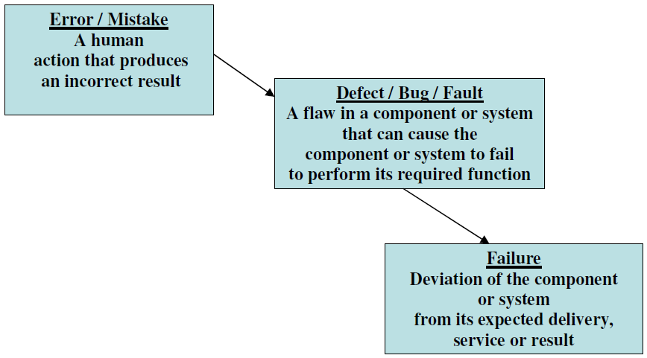
Introduction to Software Testing
  Error, Defect & Failure

Slide 11
Introduction to Software Testing
  Defect Types ?
    Functional Defect
    Non-Functional Defect

Slide 12
Introduction to Software Testing
  Categories of Functional Defect
    Wrong Defect
    The Software does something that the software specification says it should not do.
    Missing Defect
    The Software does not do something that the software specification says it should do.
    Extra Defect
    The Software does something that is not mention in the software specification

Slide 13
Introduction to Software Testing
  Non-Functional Defect
    Hard to use ,Hard to Learn and Understand(GUI Related issue), Performance issue(Slow) etc.

Slide 14

Introduction to Software Testing
  Debugging and Testing:
    Testing can show failures that are caused by defects.

Slide 15

Introduction to Software Testing
  Debugging and Testing:
    Debugging is the development activity that finds, analyzes and removes the cause of the failure.

Slide 16
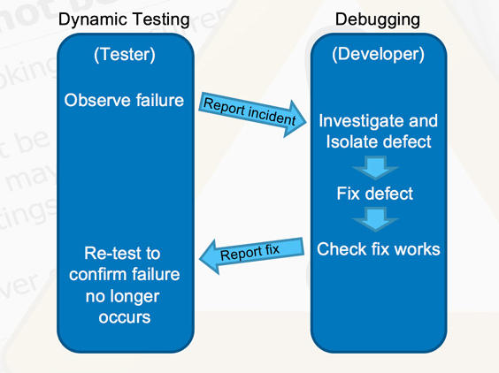
Introduction to Software Testing
  Debugging and Testing:
    The responsibility for these activities is usually testers test and developers debug

Slide 17
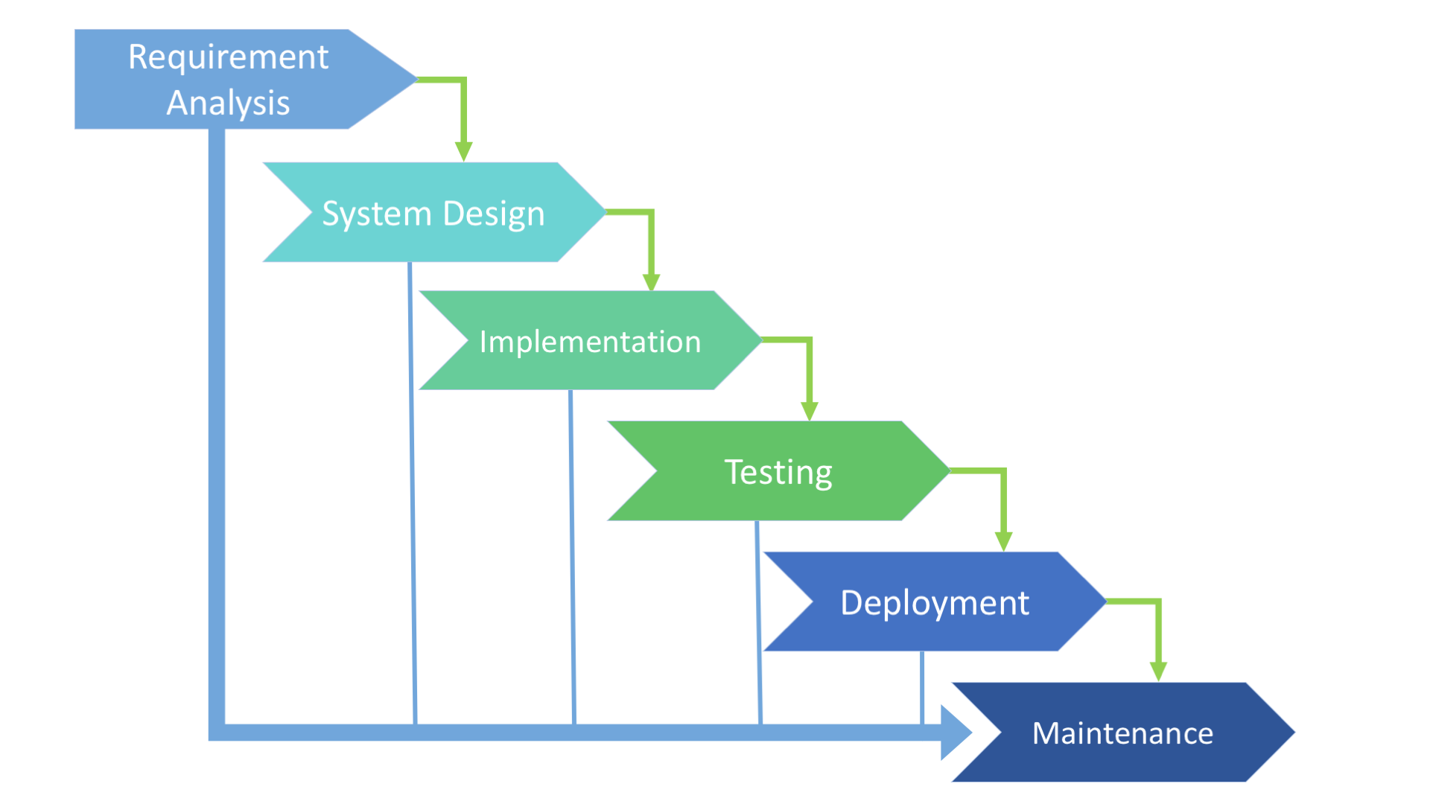
Introduction to Software Testing
  Software Development Life Cycle:

Slide 18
Introduction to Software Testing
  Software Development Life Cycle:
    Requirement Gathering and Analysis
    Planning & Software Design
    Implementation / Coding
    Testing
    Deployment
    Maintainance

Slide 19
Introduction to Software Testing
  Requirement Gathering And Analysis
    During this phase requirement is gathered by Business Analyst from customer, Analyse the requirements and BRS is prepared
    After BRS document SRS document is prepared by System Analyst.

Slide 20
Introduction to Software Testing
  Planning & Design
    During this phase Planning is done for Complete Project and Project Plan will be prepared
    During this phase Software Design will be done. Two Documents are prepared here
    1.HLD(For Entire System)
    2.LLD(Programming Level/Detailed Design for Component)

Slide 21
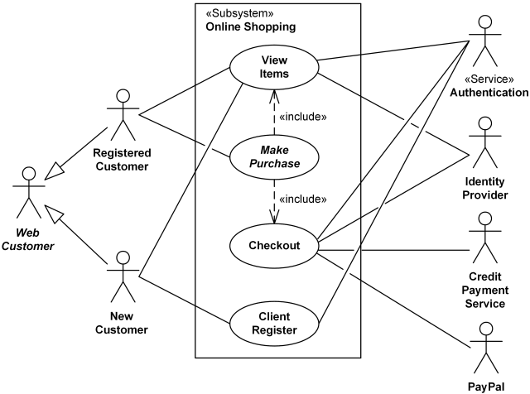
Introduction to Software Testing
  Design
    HLD

Slide 22
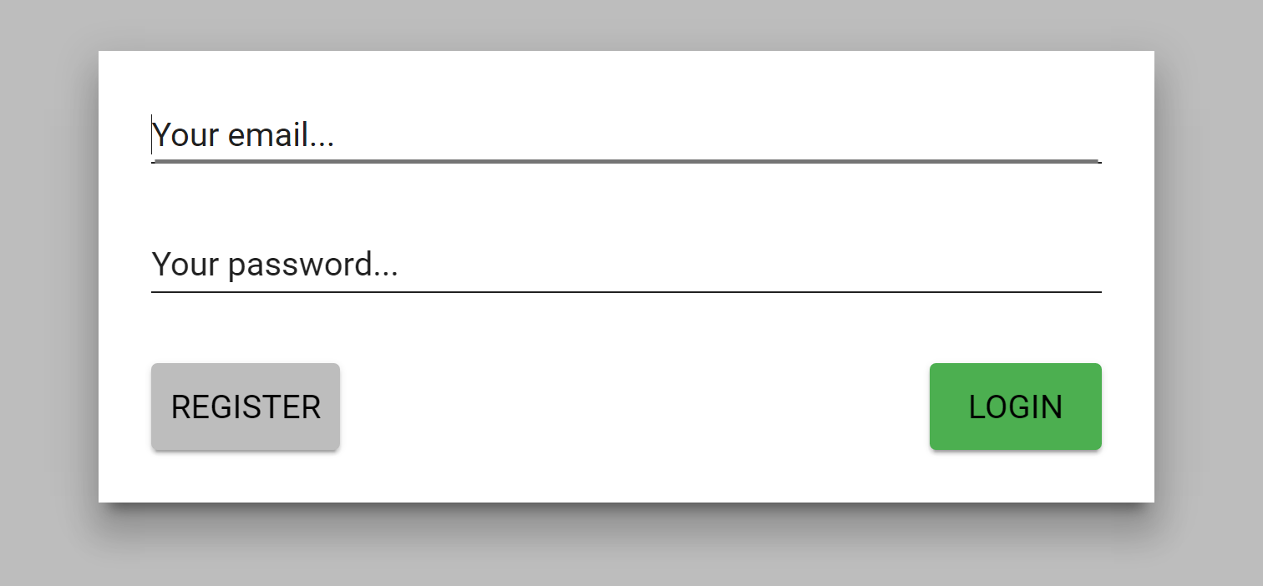
Introduction to Software Testing
  Design
    LLD

Slide 23
Introduction to Software Testing
  Coding
    During this phase programs are written in selected Language
    Source Code document is produced

Slide 24
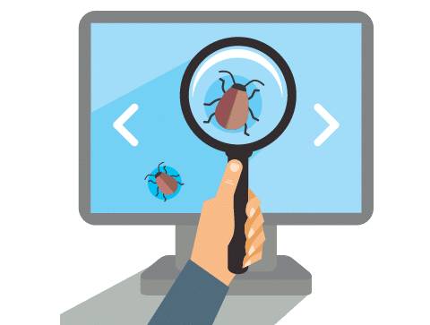
Introduction to Software Testing
  Testing
    During this phase test cases are executed
    Tester make sure that system fulfills the customer needs.
    If any defect is found it is forwarded to the Developer to fix it.

Slide 25
Introduction to Software Testing
  Deployment and Maintainance
    During this phase Tested software is Deployed at Client side.
    If any Defect found while using that product it will be handled by Maintainance Team.

Slide 26
Introduction to Software Testing
  Test Method:
    Black Box Testing
    White Box Testing

Slide 27
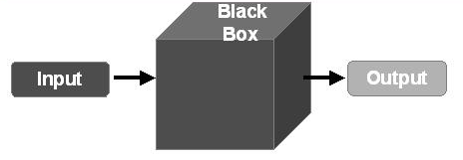
Introduction to Software Testing
  Test Method:
    Black Box Testing
      Black box testing is testing which is done without reference to the internal code or structure of the system( either functional or non-functional )
      Typically, while performing a black-box test, a tester will interact with the system's user interface by providing inputs and examining outputs without knowing how and where the inputs are worked upon.

Slide 28
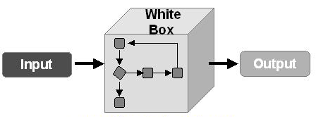
Introduction to Software Testing
  Test Method:
    White Box Testing
      White Box testing test the internal structure or working of application.
      The tester needs to have a look inside the source code and find out which unit/chunk of the code is behaving inappropriately

Slide 29
Introduction to Software Testing
  Software Testing Life Cycle
    Test planning
    Test Monitoring & Control
    Test analysis
    Test Design.
    Test Implementation
    Test Execution
    Test Closure Activities

Slide 30
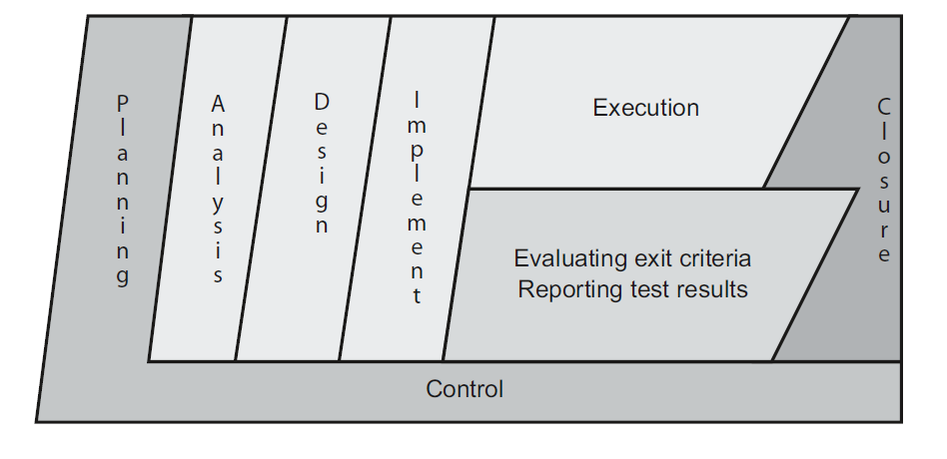
Introduction to Software Testing
  Software Testing Life Cycle

Slide 31
Introduction to Software Testing
  Test Planning
    Test planning activity is very important where testing strategy is defined.
    During Test Planning Scope of Testing, Schedule, Roles & Responsibilities etc. is decided.
    Done By Test Manager/ Test Lead
    Scope of Testing, Roles & Responsibilities, Approach, Test Environment are decided.

Slide 32
Introduction to Software Testing
  Test Monitoring & Control
    Test monitoring involves the on-going comparison of actual progress against the test plan using any testmonitoring metrics defined in the test plan.
    Test control involves taking actions necessary to meet the objectives of the test plan (which may be updated over time).
    Test monitoring and control are supported by the evaluation of exit criteria, which are referred to as the definition of done in some lifecycles.

Slide 33
Introduction to Software Testing
  Test Analysis
    During test analysis, the test basis(SRS, BRS, HLD & LLD ) is analyzed to identify testable features and define associated test conditions.
    Evaluating testability of the test basis and test objects
    In other words, test analysis determines “what to test” in terms of measurable coverage criteria.
    Writing and prioritizing test conditions & Test Cases based on analysis of test items, the specification, behavior and structure of the software

Slide 34
Introduction to Software Testing
  Test Design
    During test design, the test conditions are elaborated into high-level test cases, sets of high-level testcases, and other testware.
    So, test analysis answers the question “what to test?” while test design answers the question “how to test?”
    Designing and prioritizing test cases and sets of test cases
    Identifying necessary test data to support test conditions and test cases
    Designing the test environment and identifying any required infrastructure and tools
    Capturing bi-directional traceability between the test basis, test conditions, test cases, and test procedures

Slide 35
Introduction to Software Testing
  Test Implementation
    During test implementation, the testware necessary for test execution is created and/or completed,
    including sequencing the test cases into test procedures.
    So, test design answers the question “how to test?” while test implementation answers the question “do we now have everything in place to run the tests?”
    Developing and prioritizing test procedures, and, potentially, creating automated test scripts
    Creating test suites from the test procedures and (if any) automated test scripts

Slide 36
Introduction to Software Testing
  Test Implementation and Execution
    Arranging the test suites within a test execution schedule in a way that results in efficient test execution.
    Building the test environment and verifying that everything needed has been set up correctly

Slide 37
Introduction to Software Testing
  Test Execution
    During test execution, test suites are run in accordance with the test execution schedule.
    Executing tests either manually or by using test execution tools.
    Comparing actual results with expected results Reporting defects based on the failures observed.
    Logging the outcome of test execution (e.g., pass, fail, blocked)
    Repeating test activities either as a result of action taken for an anomaly, or as part of the planned testing

Slide 38
Introduction to Software Testing
  Test Closure Activities
    Test closure activities occur at project milestones such as when a software system is released, a test project is completed (or canceled), a milestone has been achieved.
    Finalizing and archiving test ware, the test environment and the test infrastructure for later reuse
    Handing over the test ware to the maintenance organization

Slide 39
Introduction to Software Testing
  Seven Principles of Testing
    Principle 1: Testing Shows Presence of Defect
    Testing can show that defects are present, but cannot prove
    that there are no defects. Testing reduces the probability of
    undiscovered defects remaining in the software but, even if no
    defects are found, it is not a proof of correctness
    Principle 2: Exhaustive Testing is impossible
    Testing everything (all combinations of inputs and
    preconditions) is not feasible except for trivial cases.
    Principle 3: Early Testing
    To find defects early, testing activities should start as early as
    possible in the software or system development life cycle, and
    should be focused on defined objectives

Slide 40
Introduction to Software Testing
  Seven Principles of Testing
    Principle 4: Defect Clustering
    A small number of modules usually contain most of the
    defects discovered during pre-release testing, or is
    responsible for the most operational failures.
    Principle 5: Pesticide Paradox
    If the same tests are repeated over and over again,
    eventually the same set of test cases will no longer find any
    new defects. To overcome this “pesticide paradox”, the test
    cases need to be regularly reviewed and revised, and new
    and different tests need to be written.

Slide 41
Introduction to Testing
  Seven Principles of Testing
    Principle 6: Testing is Context Dependant:
    Testing is done differently in different contexts. For example,safety-critical software is tested differently from anecommerce site.
    Principle 7: Absence of Error fallacy
    Finding and fixing defects does not help if the system built is unusable and does not fulfill the users’ needs and
    expectations.

Slide 42
Introduction to Software Testing
  Human Psychology & Testing
    It is a common human trait to blame the bearer of bad news, and information produced by testing often contains bad news.
    Identifying failures during testing may be perceived as criticism against the product and against the author.
    As a result, testing is often seen as a destructive activity, even though it is very constructive in the management of product risks.

Slide 43
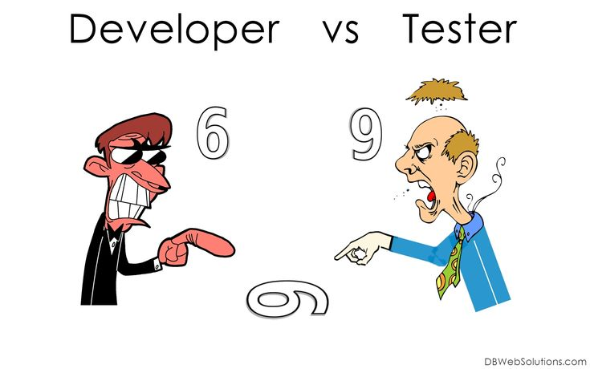
Introduction to Software Testing
  Human Psychology & Testing

Slide 44
Introduction to Software Testing
  Ways to communicate well
    Start with collaboration rather than battles. Remind everyone of the common goal of better quality systems.
    Emphasize the benefits of testing. For example, for the authors, defect information can help them improve their work products and their skills. For the organization, defects found and fixed during testing will save time and money and reduce overall risk to product quality.
    Communicate test results and other findings in a neutral, fact-focused way without criticizing the person who created the defective item. Write objective and factual defect reports and review findings.

Slide 45

Introduction to Software Testing
  Human Psychology & Testing

Slide 46
Introduction to Software Testing
  Tester’s & Developer’s Mindset
    The mindset to be used while testing and reviewing is different to that used while developing software.
    With the right mindset developers are able to test their own code, but separation of this responsibility to a tester is typically done to help focus effort and provide additional benefits, such as an independent view by trained and professional testing resources. Independent testing may be carried out at any level of testing.
    A certain degree of independence (avoiding the author bias) is often more effective at finding defects and failures. Independence is not, however, a replacement for familiarity, and developers can efficiently find many defects in their own code.

Slide 47
Introduction to Software Testing
  Tester’s & Devloper’s Mindset

Slide 48
Introduction to Software Testing
  Several Levels of Independance
    Tests designed by the person(s) who wrote the software under test (low level of independence).
    Tests designed by another person(s) (e.g. from the development team.
    Tests designed by a person(s) from a different organizational group (e.g. an independent test team) or test specialists (e.g. usability or performance test specialists).
    Tests designed by a person(s) from a different organization or company (i.e. outsourcing or certification by an external body

