Slide 1
Manual Testing

Slide 2
Module 1
Introduction to Testing

Slide 3
Introduction to Software Testing
  What is Software Testing
    Testing is nothing but set of activities conducted with the Intention of Finding defects in software
    According to ANSI/IEEE 1059 standard, Testing can be defined as - A process of analyzing a software item to detect the differences between existing and required conditions (that is defects/errors/bugs) and to evaluate the features of the software item.

Slide 4
Introduction to Software Testing
  What is Objective of Software Testing ?
    Finding the Defect in the software by executing it and get them fix from the programmers

Slide 5
Introduction to Software Testing
  What is Defects:
    Difference between the expected and actual behavior of the software

Slide 6
Introduction to Software Testing
  What is Synonyms Defect ?
    Incident
    Bug
    Failure
    Error

Slide 7
Introduction to Software Testing
  Defect Types ?
    Functional Defect
    Non-Functional Defect

Slide 8
Introduction to Software Testing
  Categories of Functional Defect
    Wrong Defect
    The Software does something that the software specification says it should not do.
    Missing Defect
    The Software does not do something that the software specification says it should do.
    Extra Defect
    The Software does something that is not mention in the software specification

Slide 9
Introduction to Software Testing
  Non-Functional Defect
    Hard to use ,Hard to Learn and Understand(GUI Related issue), Performance issue(Slow) etc.

Slide 10
Introduction to Software Testing
  Debugging and Testing:
    Debugging and testing are different. Dynamic testing can show failures that are caused by defects.
    Debugging is the development activity that finds, analyzes and removes the cause of the failure.
    The responsibility for these activities is usually testers test and developers debug

Slide 11
Introduction to Software Testing
  Debugging and Testing:
    Debugging and testing are different. Dynamic testing can show failures that are caused by defects.
    Debugging is the development activity that finds, analyzes and removes the cause of the failure.
    The responsibility for these activities is usually testers test and developers debug

Slide 12
Introduction to Software Testing
  Software Development Life Cycle:
    Requirement Gathering and Analysis
    Planning
    Software Design
    Coding
    Testing
    Release & Maintainance

Slide 13
Introduction to Software Testing
  Requirement Gathering And Analysis
    During this phase requirement is gathered by Business Analyst from customer, Analyse the requirements and BRS is prepared
    After BRS document SRS document is prepared by System Analyst.

Slide 14
Introduction to Software Testing
  Planning
    During this phase Planning is done for Complete Project and Project Plan will be prepared

Slide 15
Introduction to Software Testing
  Design
    During this phase Software Design will be done. Two Documents are prepared here
    1.HLD(For Entire System)
    2.LLD(Programming Level/Detailed Design for Component)

Slide 16
Introduction to Software Testing
  Coding
    During this phase programs are written in selected Language
    Source Code document is produced

Slide 17
Introduction to Software Testing
  Testing
    During this phase test cases are executed
    Tester make sure that system fulfills the customer needs.
    If any defect is found it is forwarded to the Developer to fix it.

Slide 18
Introduction to Software Testing
  Relase and Maintainance
    During this phase Tested software is Deployed at Client side.
    If any Defect found while using that product it will be handled by Maintainance Team.

Slide 19
Introduction to Software Testing
  Test Method:
    Black Box Testing
    White Box Testing

Slide 20
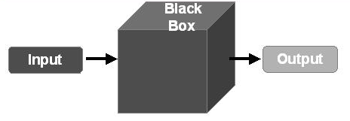
Introduction to Software Testing
  Test Method:
    Black Box Testing
      Black box testing is testing which is done without reference to the internal code or structure of the system( either functional or non-functional )
      Typically, while performing a black-box test, a tester will interact with the system's user interface by providing inputs and examining outputs without knowing how and where the inputs are worked upon.

Slide 21
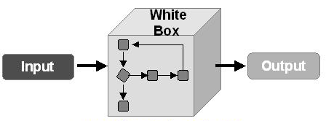
Introduction to Software Testing
  Test Method:
    White Box Testing
      White Box testing test the internal structure or working of application.
      The tester needs to have a look inside the source code and find out which unit/chunk of the code is behaving inappropriately

Slide 22
Introduction to Software Testing
  Software Testing Life Cycle
    Test planning and Control
    Test analysis and Design.
    Test Implementation and Execution
    Evaluating Exit criteria and Reporting
    Test Closure Activities

Slide 23
Introduction to Software Testing
  Test Planning & Control
    Test planning activity is very important where testing strategy is defined.
    During Test Planning Scope of Testing, Schedule, Roles & Responsibilities etc. is decided.
    Test control is the ongoing activity of comparing actual progress against the plan, and reporting the status, including deviations from the plan.
    It involves taking necessary actions to meet the mission and objectives of the project

Slide 24
Introduction to Software Testing
  Test Analysis and Dersign
    Reviewing and understanding the test basis (BRS, SRS)
    Evaluating testability of the test basis and test objects
    Writing and prioritizing test conditions & Test Cases based on analysis of test items, the specification, behaviour and structure of the software
    Identifying necessary test data to support the test conditions and test cases

Slide 25
Introduction to Software Testing
  Test Implementation and Execution
    Test implementation and execution is the activity where test procedures or scripts are specified.
    Environmental set up will be done and the tests are run
    Comparing Expected Result with Actual Result.
    Defect Reporting and fixing will done.

Slide 26
Introduction to Software Testing
  Evaluate Exit Criteria and Reporting
    Checking test logs against the exit criteria specified in test planning.
    Assessing if more tests are needed or if the exit criteria specified should be changed.
    Writing a test summary report for stakeholders against the defined objectives.

Slide 27
Introduction to Software Testing
  Test Closure Activities
    Test closure activities occur at project milestones such as when a software system is released, a test project is completed (or canceled), a milestone has been achieved.
    Finalizing and archiving test ware, the test environment and the test infrastructure for later reuse
    Handing over the test ware to the maintenance organization

Slide 28
Introduction to Software Testing
  Seven Principles of Testing
    Principle 1: Testing Shows Presence of Defect
    Testing can show that defects are present, but cannot prove
    that there are no defects. Testing reduces the probability of
    undiscovered defects remaining in the software but, even if no
    defects are found, it is not a proof of correctness
    Principle 2: Exhaustive Testing is impossible
    Testing everything (all combinations of inputs and
    preconditions) is not feasible except for trivial cases.
    Principle 3: Early Testing
    To find defects early, testing activities should start as early as
    possible in the software or system development life cycle, and
    should be focused on defined objectives

Slide 29
Introduction to Software Testing
  Seven Principles of Testing
    Principle 4: Defect Clustering
    A small number of modules usually contain most of the
    defects discovered during pre-release testing, or is
    responsible for the most operational failures.
    Principle 5: Pesticide Paradox
    If the same tests are repeated over and over again,
    eventually the same set of test cases will no longer find any
    new defects. To overcome this “pesticide paradox”, the test
    cases need to be regularly reviewed and revised, and new
    and different tests need to be written.

Slide 30
Introduction to Testing
  Seven Principles of Testing
    Principle 6: Testing is Context Dependant:
    Testing is done differently in different contexts. For example,
    safety-critical software is tested differently from an
    ecommerce site.
    Principle 7: Absence of Error fallacy
    Finding and fixing defects does not help if the system built is
    unusable and does not fulfill the users’ needs and
    expectations.

Slide 31
Module 2
Software Development Model

Slide 32
Software Devlopment Model
  Software Development Model
    Waterfall
    Incremental/Iterative
    Agile
    RAD
    Spiral

Slide 33
Software Development Model
  Sequential Model ( Waterfall )
    The Waterfall Model was first Process Model to be introduced. It is also referred to as a linear-sequential life cycle model. It is very simple to understand and use.
    In a waterfall model, each phase must be completed fully before the next phase can begin. This type of software development model is basically used for the for the project which is small and there are no uncertain requirements.

Slide 34
Software Development Model
  Sequential Model ( Waterfall ) Cont..
    At the end of each phase, a review takes place to determine if the project is on the right path and whether or not to continue or discard the project. In this model software starts only after the development is complete. In waterfall model phases do not overlap.
    Recommended for small scale, Low budget and Short term projects

Slide 35
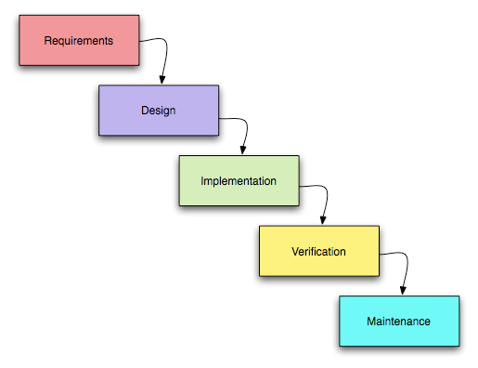
Software Development Model
  Sequential Model ( Waterfall ) Cont...

Slide 36
Software Development Model
  Iterative /Incremental Model
    Software is developed step by step
    First increment is the core product
    After the first increment is ready it is released for the use of the client
    As a result of user the plan is prepared for the next increment
    Modification is made to the core product to meet the needs of the customer
    Client gets Early working software
    Example :Spiral and Agile model

Slide 37
Software Development Model
  Agile( Iterative /Incremental Model)
    In Agile, the whole-team approach used means involving everyone with different knowledge and skills to ensure project success
    The team includes representatives from the customer also known as the Product Owner, and other business stakeholders who determine product features
    Engages the stakeholders continuously so that the new requirements are gathered faster and there is no scope for guess work by the teams

Slide 38
Software Development Model
  Agile( Iterative /Incremental Model) Cont...
    Provides the end result of higher quality of the software delivered and a highly satisfied customer.

Slide 39
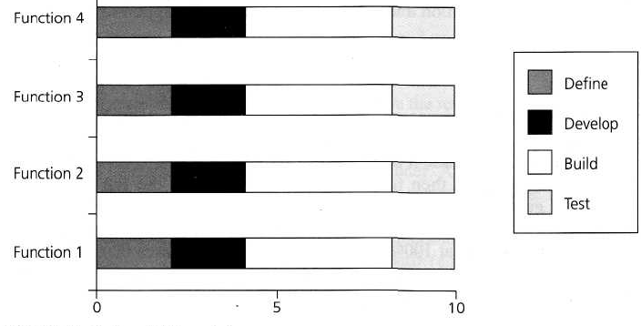
Software Development Model
  RAD( Iterative /Incremental Model ):
      Rapid Application Development (RAD) is formally a parallel development of functions and subsequent integration

Slide 40
Software Development Model
  RAD(Iterative /Incremental Model) Cont..
    It is a type of incremental model. In RAD model the components or functions are developed in parallel as if they were mini projects. The developments are time boxed, delivered and then assembled into a working prototype.
    There are some advantages of rad model like..Product can develop soon, can take initial reviews quickly, Integration from very beginning solves a lot of integration issues.

Slide 41
Software Development Model
  RAD(Iterative /Incremental Model) Cont..
    And some disadvantages like it required strong team and good individual performance to understand business requirements..,Only system that can be modularized can be built using RAD. Rad model should be chosen only if resources with high business knowledge are available and there is a need to produce the system in a short span of time (2-3 months).

Slide 42
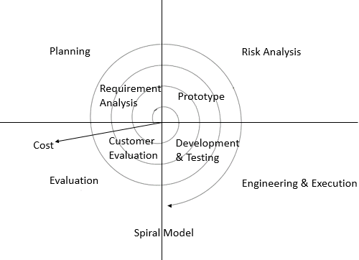
Software Development Model
  Spiral( Iterative /Incremental Model ):
      The spiral model is a risk-driven process model generator for software projects.

Slide 43
Software Development Model
  Spiral( Iterative /Incremental Model ) Cont..
      This model is best used for large projects which involves continuous enhancements.
      There are specific activities which are done in one iteration (spiral) where the output is a small prototype of the large software. The same activities are then repeated for all the spirals till the entire software is build. Some advantages of Spiral model is It is use for Larger projects, More and more features are added in systematic way.

Slide 44
Software Development Model
  Spiral( Iterative /Incremental Model ) Cont..
      Some Disadvantage is that It is costly for smaller projects, is not beneficial for smaller projects, and time consuming also.

