Slide 1
Module 3
Verification & Validation

Slide 2
Verification & Validation
  Verification
    Verification is the process of evaluating work-products of a development phase to determine whether they meet the specified requirements
    Also called as Static Testing
    Are we building the product right?
    Verification ensures that the product is built according to the requirements and design specifications.

Slide 3
Verification & Validation
  Verification Cont...
    Verification rely on manual examination (reviews) of Documents(Workproducts)
    Defects found costs less to fix as compare to Dynamic Testing
    Verification can happen on Any software work product, including requirements specifications, design specifications, code, test plans, test specifications, test cases, test scripts, user guides etc.
    Benefits of verification include early defect detection.
    And it avoids defect multiplication.

Slide 4
Verification & Validation
  Verification Cont...
    Verification and Dynamic testing(Validation) have the same objective – identifying defects.
    Compared to dynamic testing, Verification find causes of failures (defects) rather than the failures themselves
    Done by QA(Quality Assurance) Team
    Verification Techniques:
      Walk-through
      Inspection

Slide 5
Verification & Validation
  Walkthrough
    Led by author
    It is a step-by-step presentation by the author of a document in order to gather information and to establish a common understanding of its content
    Done between colleagues.
    It may be formal or informal process
    Main purposes: learning, gaining understanding, finding defects

Slide 6
Verification & Validation
  Inspection
    Led by trained moderator (not the author);
    Done at Each phase to have opinion ,is phase is completed & can we move to next phase ?
    It is formal process
    Main purposes: Finding defects
    5 Major Roles in Inspection Meeting
      Moderator: Activity Leader
      Author : who’s document under inspection
      Reader : Reads documents for all
      Recorder : Notes Minutes of meeting
      Inspector : Domain Expert

Slide 7
Verification & Validation
  Validation Testing
    Validation, which requires the execution of Software
    Also Called as Dynamic Testing
    It requires Execution of Software
    Ensures Are we building the right product ?
    Validation is the process of evaluating software during or at the end of the development process to determine whether it satisfies specified requirements

Slide 8
Verification & Validation
  Validation/Dynamic Testing
    Defect found in Dynamic Testing Cost more as Compare to Verification
    Dynamic Testing finds just failures not causes of failures
    Checks the Product, not process.
    Done by QC(Quality Control) team
    Advantages of Validation if During verification some defects are missed then during validation process it can be caught as Defect

Slide 9
Verification & Validation
  Validation Technique/ Levels of Testing
    Unit Testing
    Integration Testing
      Unit Integration Testing
      System Integration Testing
    System Testing
    Acceptance Testing

Slide 10
Verification & Validation
  Component Testing
    Component testing is also known as unit, module or program testing
    Testing small piece of executable code.
    The unit testing purpose is to ensure that the unit satisfies its functional specification
    If Unit is working properly further testing(i.e. Integration Testing ) will be simplified.
    Typically done by Programmer since it requires access to code
    Defects found & fix during Unit testing typically not recorded( Reported).

Slide 11
Verification & Validation
  Integration Testing
    The purpose of integration testing is to expose defects in the interfaces and in the interactions between integrated components or systems
    There may be more than one level of integration testing as follows
    Component integration testing tests the interactions between software components and is done after component testing
    System integration testing tests the interactions between different systems or between hardware and software and may be done after system testing.

Slide 12
Verification & Validation
  Integration Testing cont ..
    At each stage of integration, testers concentrate solely on the integration itself.
    For example, if they are integrating module A with module B they are interested in testing the communication between the modules, not the functionality of the individual module as that was done during component testing. Both functional and structural approaches may be used.
    Integration Testing Approaches
      Top-Down
      Bottom-Up

Slide 13
Verification & Validation
  Bottom Up Approach
    Bottom up testing, as the name suggests starts from the lowest or the innermost unit of the application, and gradually moves up. The Integration testing starts from the lowest module and gradually progresses towards the upper modules of the application.
    This integration continues till all the modules are integrated and the entire application is tested as a single unit.
    we would need some program or a “stimulator”. These stimulator programs are called DRIVERS.

Slide 14
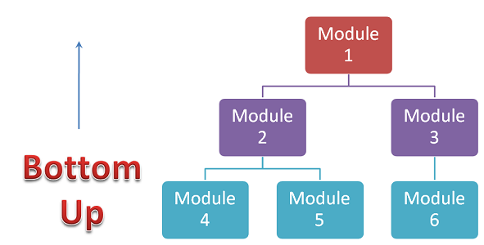
Verification & Validation
  Bottom Up Approach
    In simple words, DRIVERS are the dummy programs which are used to call the functions of the lowest module in case when the calling function does not exists.

Slide 15
Verification & Validation
  Top – Down Approach
    This technique starts from the top most module and gradually progress towards the lower modules. Only the top module is unit tested in isolation.
    After this, the lower modules are integrated one by one. The process is repeated until all the modules are integrated and tested
    we would need some program or a “stimulator”. These stimulator programs are called STUBS.

Slide 16
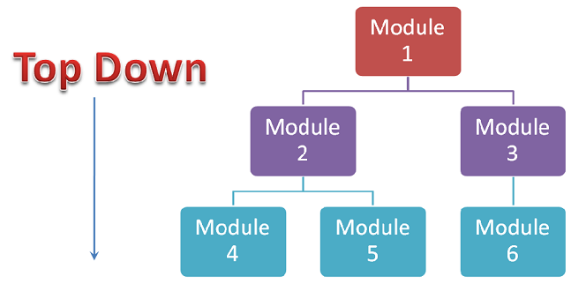
Verification & Validation
  Top – Down Approach
    “Stubs” can be referred to as code a snippet which accepts the inputs / requests from the top module and returns the results/ response

Slide 17
Verification & Validation
  System Testing
    System testing is concerned with the behavior of a whole system/product as defined by the scope of a development project or product.
    System testing is most often the final test to verify that the system to be delivered meets the customer need or requirement.
    Its purpose is to find as many defects as possible
    System testing should investigate both functional and non-functional requirements of the system

Slide 18
Verification & Validation
  System Testing cont..
    In system testing, the test environment should correspond to the final target or production environment as much as possible in order to minimize the risk of environment-specific failures not being found in testing
    Most often it is carried out by independent test team
    In some organizations system testing is carried out by a third party team.

Slide 19
Verification & Validation
  User Acceptance Testing
    Acceptance testing is most often the responsibility of the user or customer
    User acceptance is a type of testing performed by the Client to certify the system with respect to the requirements that was agreed upon.
    The acceptance test should answer questions such as: 'Can the system be released?'
    The main purpose of this testing is to validate the end to end business flow & not to find defects.

Slide 20
Verification & Validation
  User Acceptance Testing Cont..
    This testing happens in the final phase of testing before moving the software application to Market or Production environment.

Slide 21
Verification & Validation
  Alpha Testing
    A type of UAT in which customer or client do testing in production environment.
    Developers and Testers monitor Alpha Testing.
    It is always performed within the organization not open for market or public.
    Alpha Testing is done before the launch of software product into the market

Slide 22
Verification & Validation
  Beta Testing
    A type of UAT in which customer or client do testing in live environment.
    It is performed at the user’s premises in the absence of the development team
    It is always performed open for market or public.
    Beta Testing is always performed at the time when software product and project are marketed
    Beta Testing is also known by the name Field Testing.

Slide 23
Verification & Validation
  Testing within a Life Cycle Model
    For every development activity there is a corresponding testing activity
    The analysis and design of tests for a given test level should begin during the corresponding development activity
    Advantage:
      Avoid defect Multiplication

Slide 24
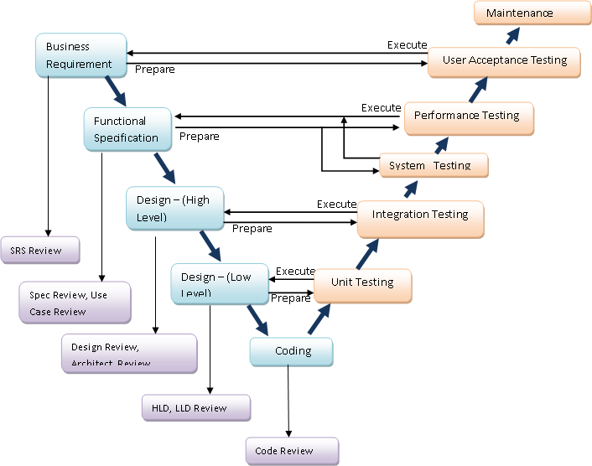
Verification & Validation
  V model

