Slide 1
Principles
Principle 1: Testing Shows Presence of Defect
Principle 2: Exhaustive Testing is impossible
Principle 3: Early Testing
Principle 4: Defect Clustering
Principle 5: Pesticide Paradox
Principle 6: Testing is Context Dependant:
Principle 7: Absence of Error fallacy
Notes:
1

Slide 2
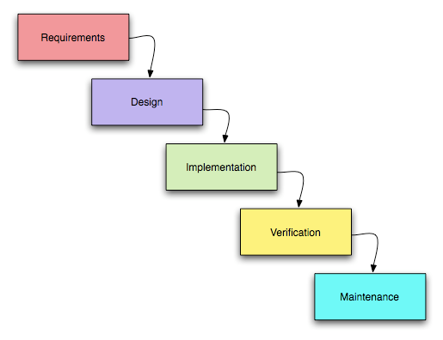
Software Development Model
Sequential Model ( Waterfall )
Notes:
2

Slide 3
Software Development Model
Sequential Model ( Waterfall )
The Waterfall Model was first Process Model to be introduced. It is also referred to as a linear-sequential life cycle model. It is very simple to understand and use.
In a waterfall model, each phase must be completed fully before the next phase can begin. This type of software development model is basically used for the for the project which is small and there are no uncertain requirements.
Notes:
3

Slide 4
Software Development Model
Sequential Model ( Waterfall ) Cont..
At the end of each phase, a review takes place to determine if the project is on the right path and whether or not to continue or discard the project. In this model software starts only after the development is complete. In waterfall model phases do not overlap.
Recommended for small scale, Low budget and Short term projects
Notes:
4

Slide 5
Software Development Model
Iterative /Incremental Model
Software is developed step by step
First increment is the core product
After the first increment is ready it is released for the use of the client
As a result of user the plan is prepared for the next increment
Modification is made to the core product to meet the needs of the customer
Client gets Early working software
Example :Spiral and Agile model
Notes:
5

Slide 6
Software Development Model
Agile( Iterative /Incremental Model)
In Agile, the whole-team approach used means involving everyone with different knowledge and skills to ensure project success
The team includes representatives from the customer also known as the Product Owner, and other business stakeholders who determine product features
Engages the stakeholders continuously so that the new requirements are gathered faster and there is no scope for guess work by the teams
Notes:
6

Slide 7
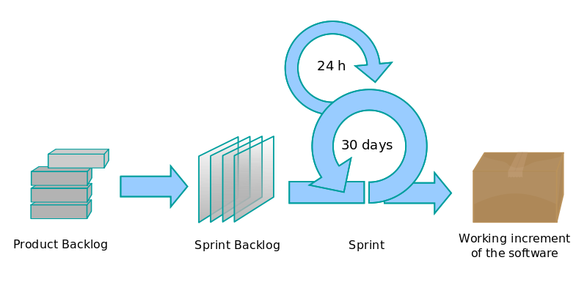
Software Development Model
Agile( Iterative /Incremental Model) Cont...
Provides the end result of higher quality of the software delivered and a highly satisfied customer.
Notes:
7

Slide 8
Verification & Validation
Are we building the product right?
Are we building the right product?
Are we building the product right?
Checks process
Verification
Are we building the right product?
Checks product
Validation
Notes:
8

Slide 9
Verification & Validation
Verification
Validation
Checks Process
Static Testing
Are we Building Product Right?
Done By Manually Reading Documents
Its Defect Preventive Approach
Less Cost consuming
Done in All Phases of SDLC
Checks Product
Dynamic Testing
Are we Building Right Product?
Done By Executing Product /Software
Its Defect Detective and Corrective Approach
More Cost consuming
Done in Last three phases of SDLC

