Slide 1

HigherHRNet: Scale-Aware Representation Learning for Bottom-Up Human Pose Estimation
CVPR 2020
Microsoft Research Asia
XuWei
2020/06/17

Slide 2
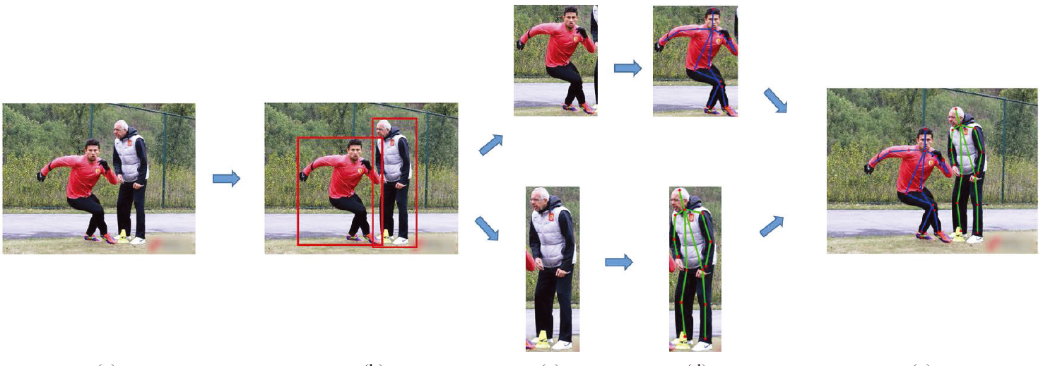
Human Pose Estimation
Category
2D & 3D Human Pose Estimation
Singe Person & Multiple Person
Top-down & Bottom-up
Notes:
more accurate, need more computing resource, not end-to-end

Slide 3
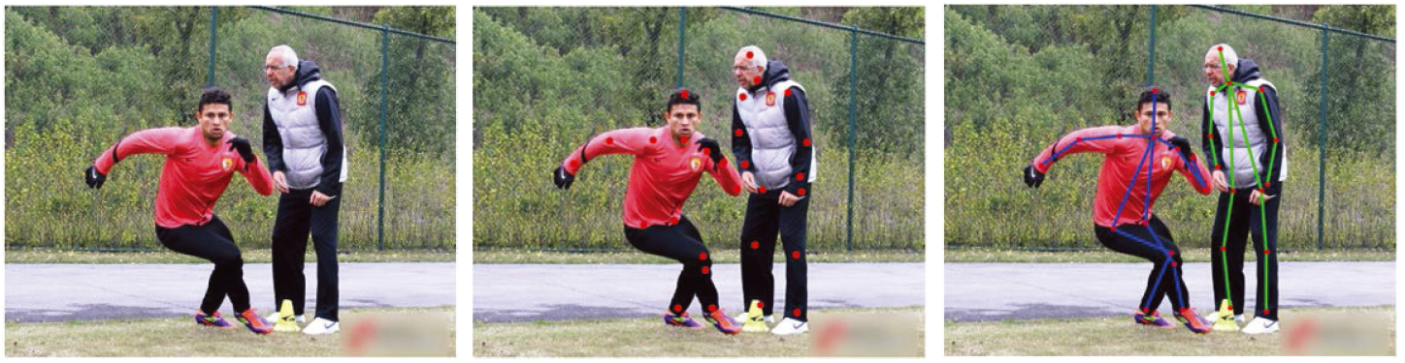
Human Pose Estimation
Category
2D & 3D Human Pose Estimation
Singe Person & Multiple Person
Top-down & Bottom-up
Notes:
fast, real time, performance gap with top-down, sensitive to the scale variance

Slide 4
HigherHRNet
Background
Top-down: person detector → single person pose estimation.
less sensitive to the scale variance of persons
normally computationally intensive
not truly end-to-end
Bottom-up: localizing identity-free keypoints → grouping
need to deal with scale variation
exists performance gap with top-down methods

Slide 5
HigherHRNet
Contributions
Address the scale variation challenge in bottom-up multi person pose estimation.
Propose a HigherHRNet to predict scale-aware high-resolution heatmaps that are beneficial for small persons.
Effectiveness. Outperforms all other bottom-up methods on COCO dataset.
Achieve a new state-of-the-art result on the CrowdPose dataset.

Slide 6
Deep High-Resolution Representation Learning for Human Pose Estimation
CVPR 2019
Microsoft Research Asia

Slide 7
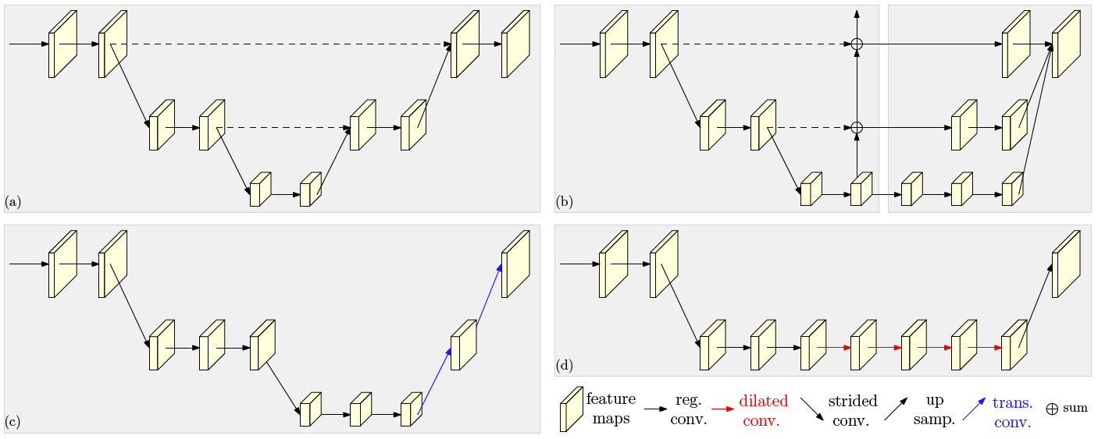
HRNet
HPE rely on high-to-low and low-to-high framework
Notes:
(a) Hourglass (b) Cascaded pyramid networks (c) Simple Baseline: transposed convolutions for low-to-high processing. (d)Deepercut: Combination with dilated convolutions.

Slide 8
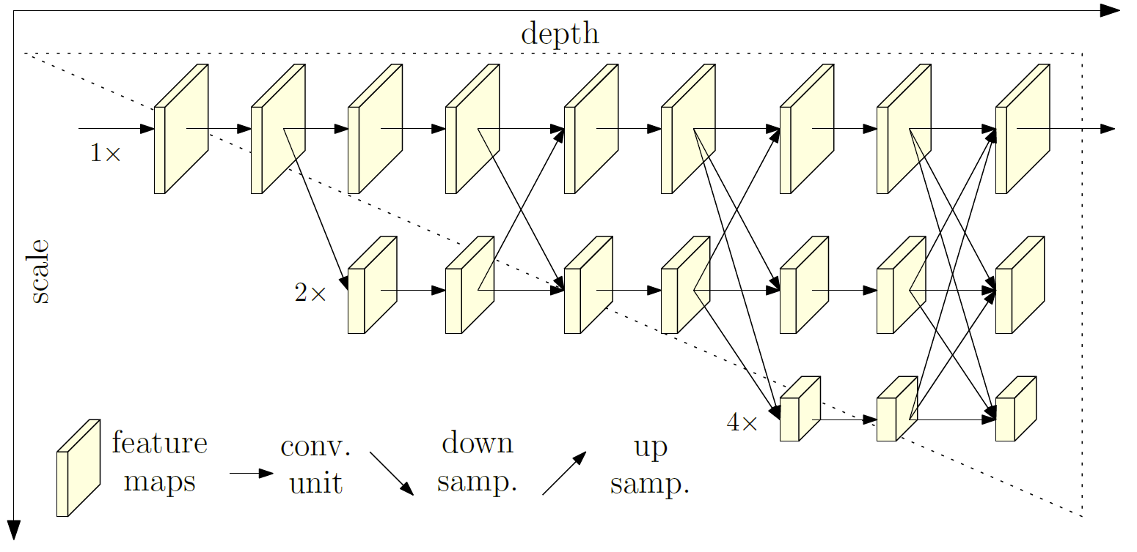
HRNet
Architecture of HRNet
Notes:
1.Our approach connects high-to-low resolution subnetworks in parallel. Maintain the high resolution instead of recovering the resolution through a low-to-high process.
2.perform repeated multiscale fusions to boost the high-resolution representations with the help of the low-resolution representations.

Slide 9
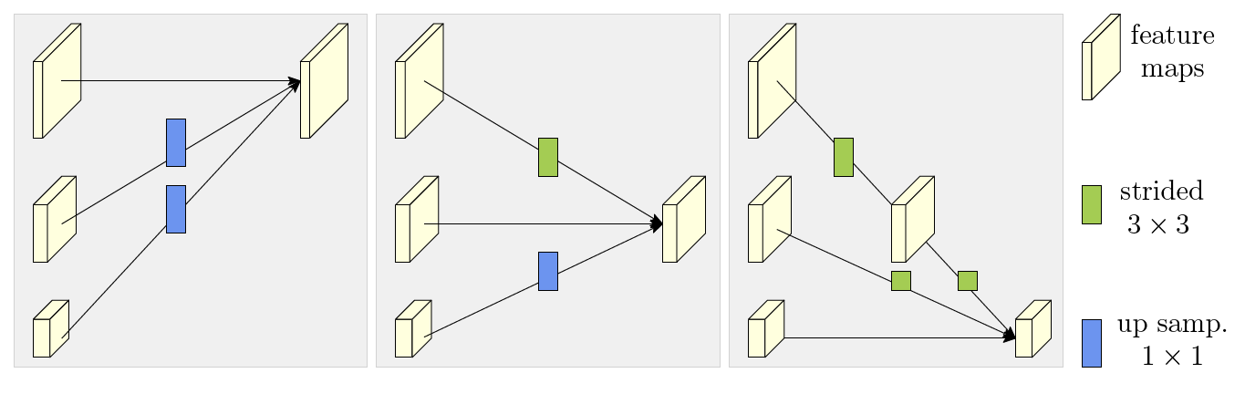
HRNet
Architecture of HRNet
Illustrating how the exchange unit aggregates the information for high, medium and low resolutions from the left to the right.
Notes:
strided 3×3 convolution
nearest neighbor up-sampling following a 1 × 1 convolution

Slide 10
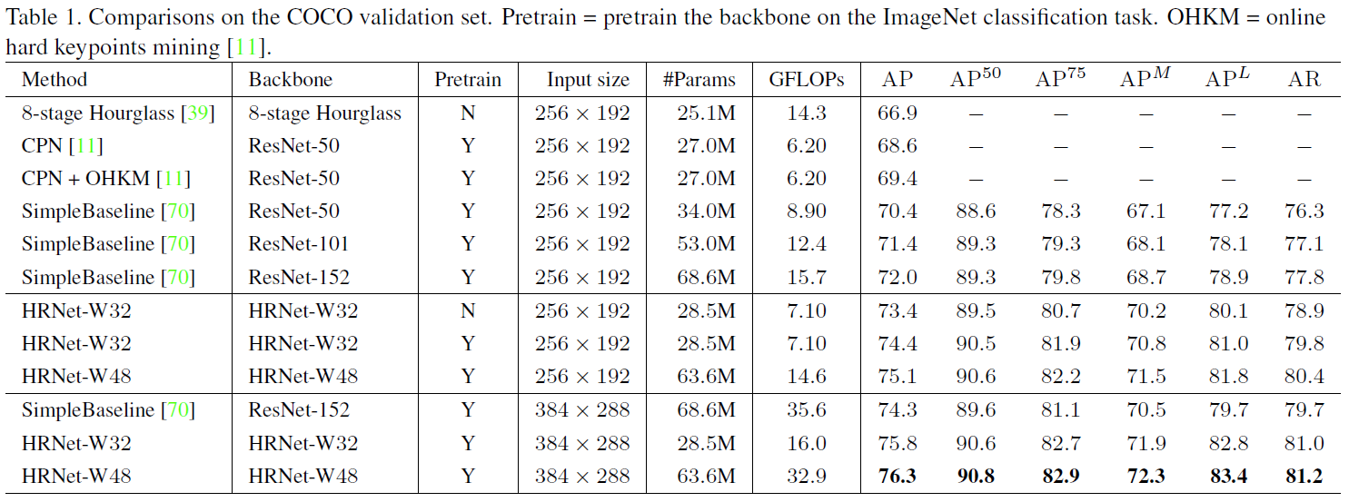
Experiments
Results on the COCO validation set
Notes:
Average precision and recall scores

Slide 11
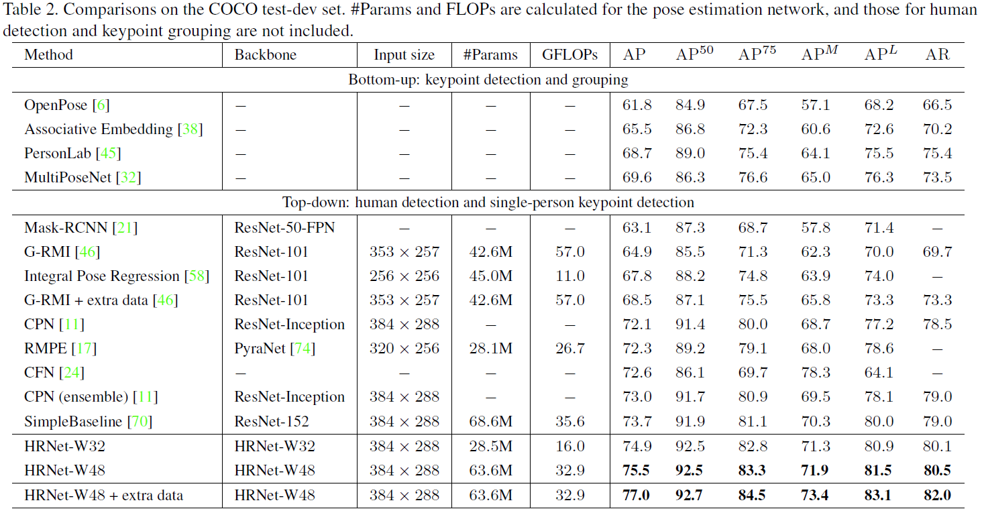
Experiments
Results on the COCO test-dev set
Notes:
extra data from AI Challenger

Slide 12
HigherHRNet
Background
Top-down: person detector → single person pose estimation.
less sensitive to the scale variance of persons
normally computationally intensive
not truly end-to-end
Bottom-up: localizing identity-free keypoints → grouping
need to deal with scale variation
exists performance gap with top-down methodsc

Slide 13
HigherHRNet
Challenges
Challenges in predicting keypoints of small persons
Dealing with scale variation. Improve the performance of small person without sacrificing the performance of large persons.
Generating a high-resolution heatmap with high quality for precise localizing keypoints of small persons.

Slide 14
HigherHRNet
Contributions
Address the scale variation challenge in bottom-up multi person pose estimation.
Propose a HigherHRNet to predict scale-aware high-resolution heatmaps that are beneficial for small persons.
Effectiveness. Outperforms all other bottom-up methods on COCO dataset.
Achieve a new state-of-the-art result on the CrowdPose dataset.

Slide 15
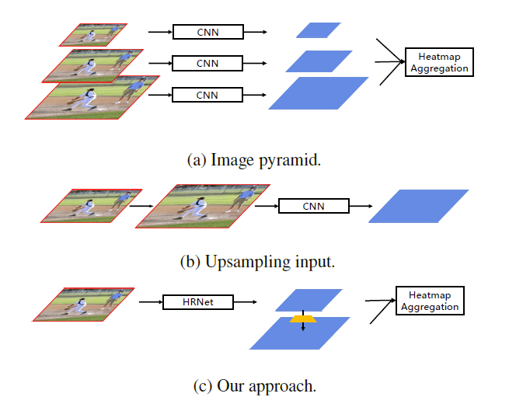
Method
Generates high-resolution heatmaps
Smaller resolution feature maps in a top-down feature pyramid usually suffer from the second challenge.
Performance of large persons begin decreasing when input resolution is too large.
Notes:
Resolution of the heatmap is important for predicting keypoints for small persons.

Slide 16
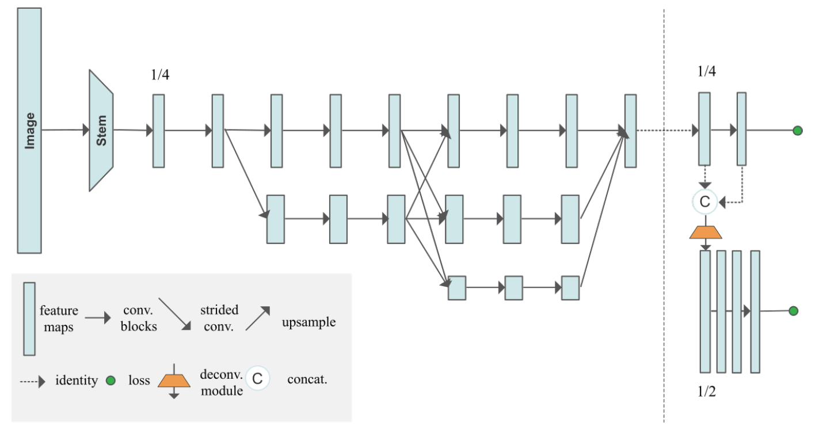
Method
The network architecture

Slide 17
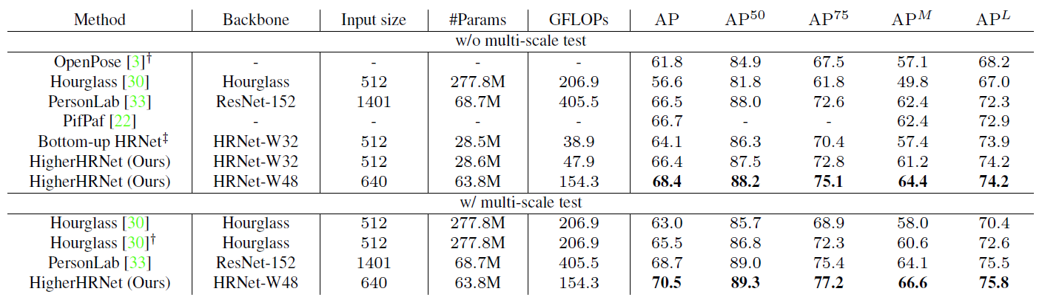
Experiments
Results on COCO2017 test-dev

Slide 18
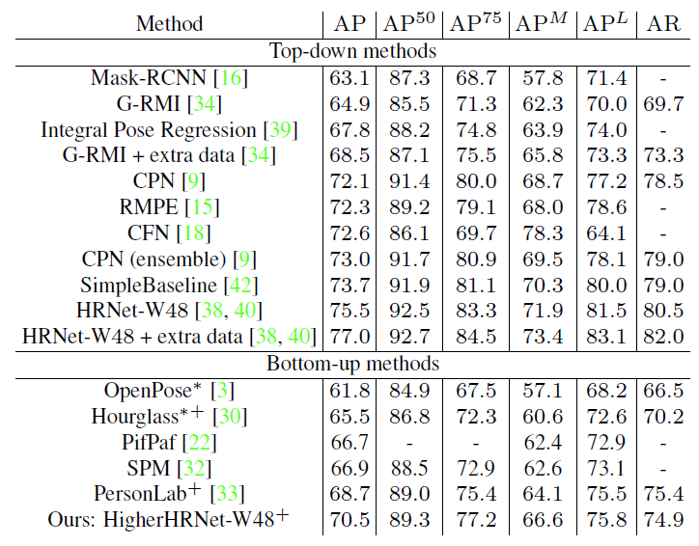
Experiments
Comparisons with both top-down and bottom-up methods.
Notes:
HigherHRNet further closes the performance gap between bottom-up and top-down methods

Slide 19
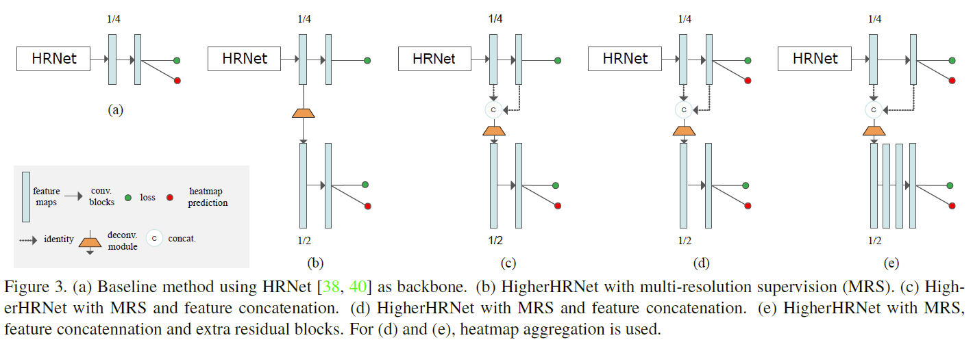
Ablation study
HigherHRNet gain breakdown.
Notes:
To better understand the gain of the proposed components, we perform detailed ablation studies on each individual component.

Slide 20
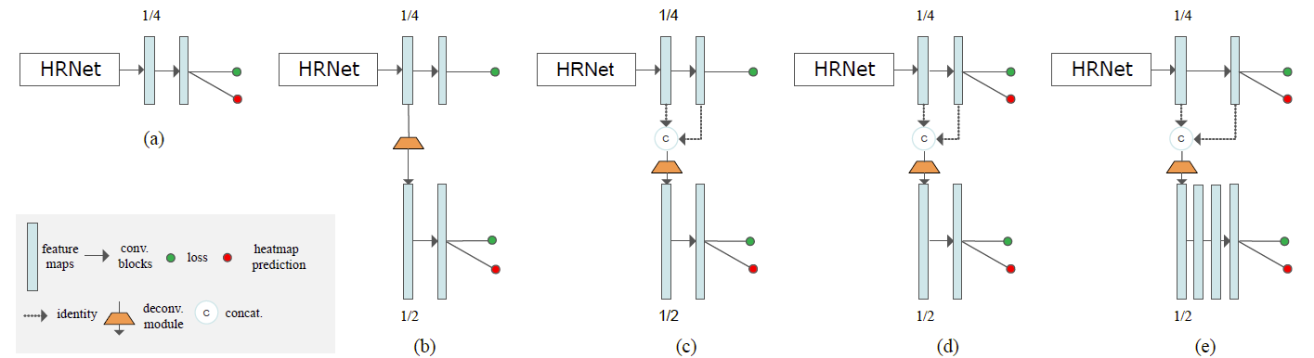
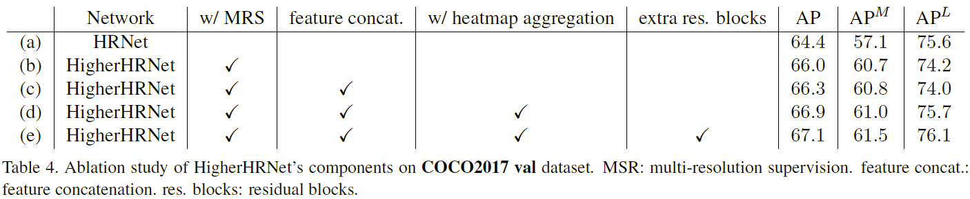
Ablation study
HigherHRNet gain breakdown.

Slide 21
Conclusions
Contributions
Address the scale variation challenge in bottom-up multi person pose estimation.
Propose a HigherHRNet to predict scale-aware high-resolution heatmaps that are beneficial for small persons.
Effectiveness. Outperforms all other bottom-up methods on COCO dataset.
Achieve a new state-of-the-art result on the CrowdPose dataset.
Limitations
Requires a large amount of GPU memory

Slide 22
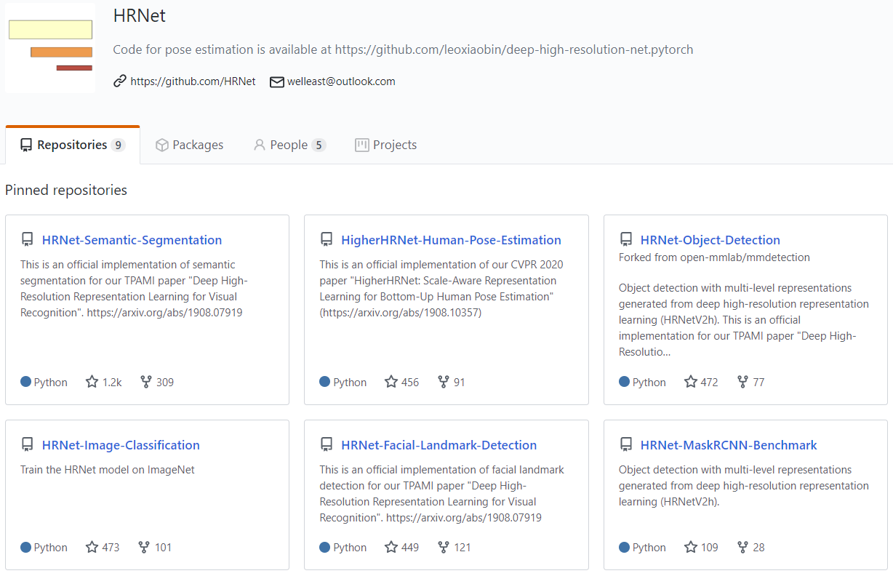
Conclusions
https://github.com/HRNet

Slide 23
Thanks

