Slide 1
Ravi – a Lua 5.3 Dialect
Dibyendu Majumdar

Slide 2
Introduction
Ravi is a dialect of Lua 5.3
Features language enhancements to allow limited optional static typing of local declarations and function parameters
Mixes static typing and dynamic typing to maintain (as far as possible) compatibility with Lua
Lua and Ravi functions can be JIT compiled, automatically or upon user request
Two JIT compiler implementations - LLVM and libgccjit
Unit of compilation is a Lua closure
Not 100% Lua compatible hence new name for the language
Uses extended bytecodes specialized for types
For selected benchmarks, Ravi matches LuaJIT performance

Slide 3
History
Discovered Lua in 2014 while looking for an embedded scripting language
Got interested in LuaJIT for performance
However LuaJIT did not work well on all platforms, and did not play well with use cases where it would be embedded in a Java application
Decided to try to understand LuaJIT with a view to enhancing it
This was just too hard
So Ravi was born as an attempt to create an alternative to LuaJIT for specific use case (numeric computing)
Static typing is used to help the JIT compiler; strong type guarantees are necessary to ensure correctness of JIT compiled code

Slide 4
Comparison with LuaJIT
Ravi
LuaJIT
LLVM and libgccjit JIT compilers
JIT compiler is slow
Large runtime image due to LLVM
Not suited for small devices
Simpler implementation; easy to understand and support
No FFI, but LLVM binding available
Like Lua, safe for programmers coding in Lua
Safety and maintainability are top priorities
Custom tracing JIT compiler
JIT compiler is fast
Small runtime image
Suited for small devices
Complex implementation; significantly harder to understand and support
FFI integrated into the system
Unsafe due to FFI – you need to know what you are doing
Performance and small runtime image size are the top priorities

Slide 5
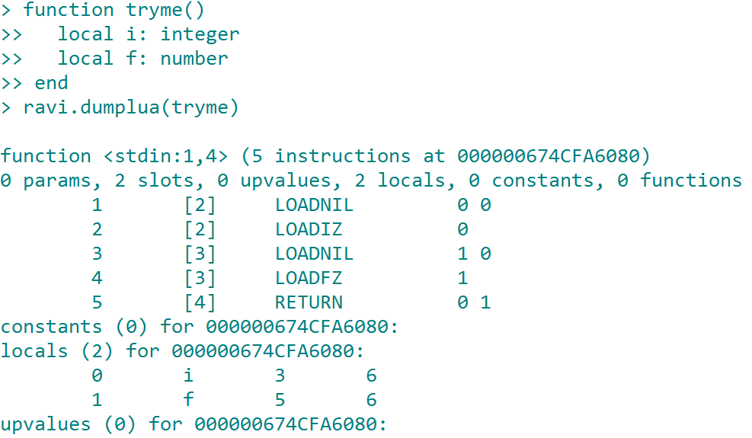
Ravi extension – typed local variables
Local variables can be annotated with types
Only 4 static types implemented:
Integer (64-bit)
Number (double)
Integer array (table subtype)
Number array (table subtype)
Local variables initialized automatically
The static types above are most relevant for numeric computing

Slide 6
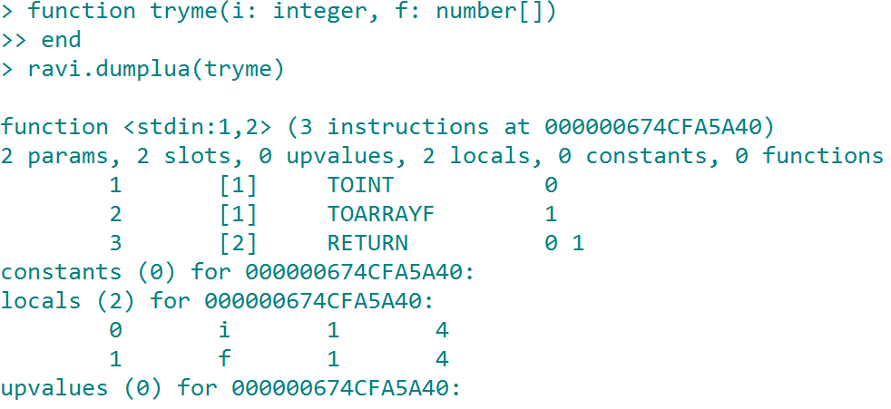
Ravi extension – typed function arguments
Function arguments can be annotated with types
If annotated, type checks performed upon entry to function (i.e. at runtime)
The type checks ensure that JIT compilation can proceed with certainty regarding the types of the function arguments

Slide 7
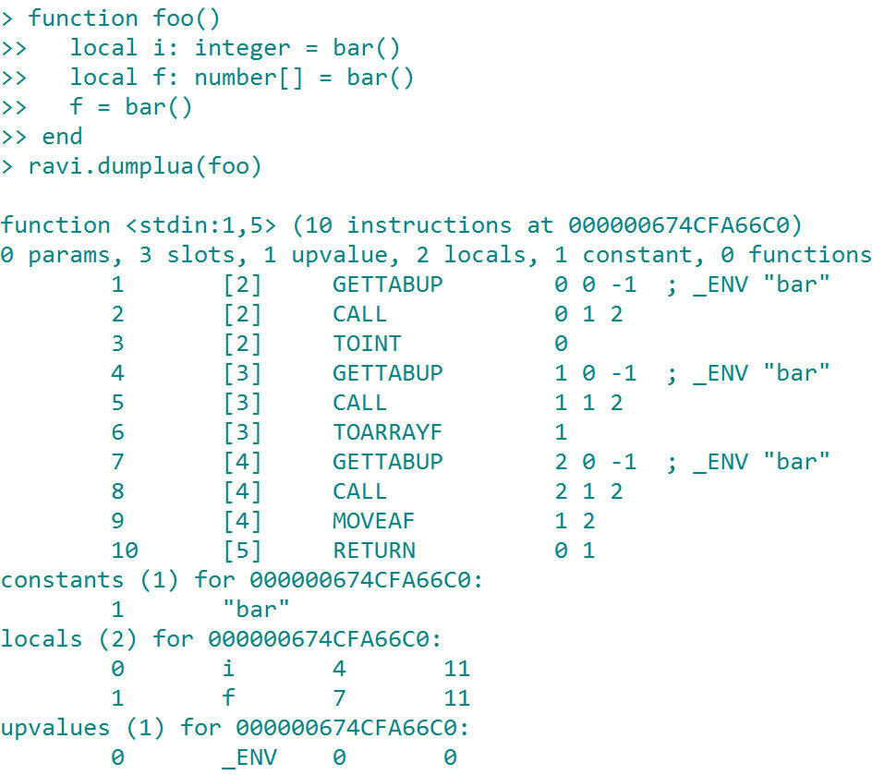
Ravi extension – return type coercion
If the value of a function call is assigned to a typed variable then a type check / coercion is performed at run time
Static type checking alone would not provide strong guarantee needed by JIT compiler

Slide 8
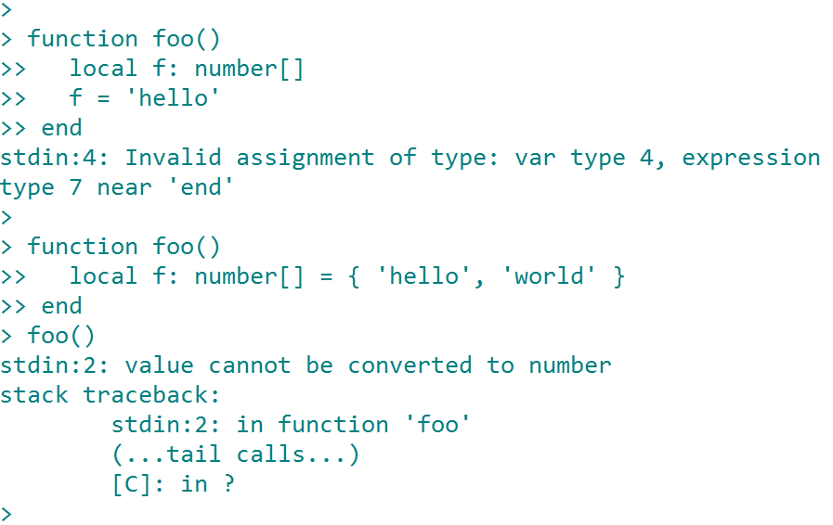
Ravi extension - arrays
Ravi arrays are subtypes of Lua tables
When types are known static checking is done where possible to ensure correct behaviour
Table initializers are checked at runtime rather than compile time as each value could result from an expression

Slide 9
Ravi extension - arrays
A Ravi array crossing into Lua looks like a table but has restrictions on types of values and indexing operations
Meta methods not supported on arrays
Array type uses additional fields in the Lua Table structure
The array data is held in contiguous memory compatible with native arrays
Arrays are initialized to 0 not nil
For performance reasons the arrays have a slot at index 0 but this is not visible in initializers or iterators; however direct indexing will reveal
The extra slot at index 0 can be used to hold any 8-byte value; for instance the Ravi Matrix library uses this to hold two 32-bit integers
Accessing out of bounds array elements results in error
Slices can be created from arrays using a library function; a slice maintains a reference to the original array.
Arrays can never shrink – they can only grow; no way to delete an array element
Array growth is automatic when value assigned to last+1 slot
Arrays maintain their length so computing array length is fast
The normal Lua hash and array parts cannot directly be accessed in array types; however the slice implementation uses the hash part to hold a reference to parent array
Array indexing can exploit static typing to generate more efficient code
C API allows direct access to array data

Slide 10
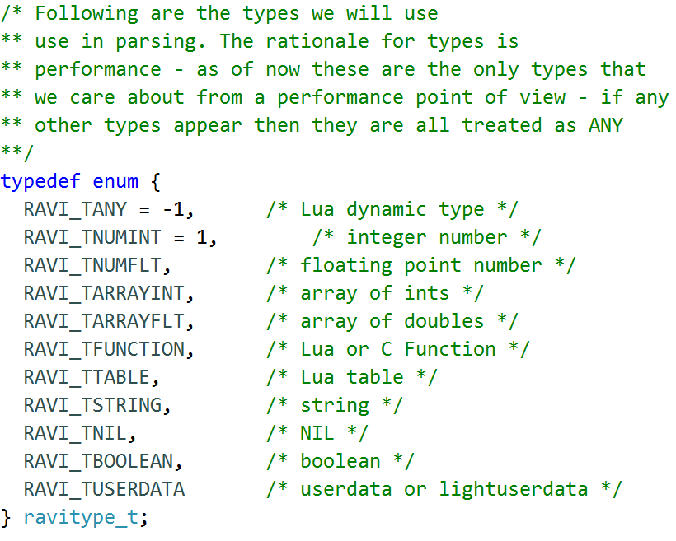
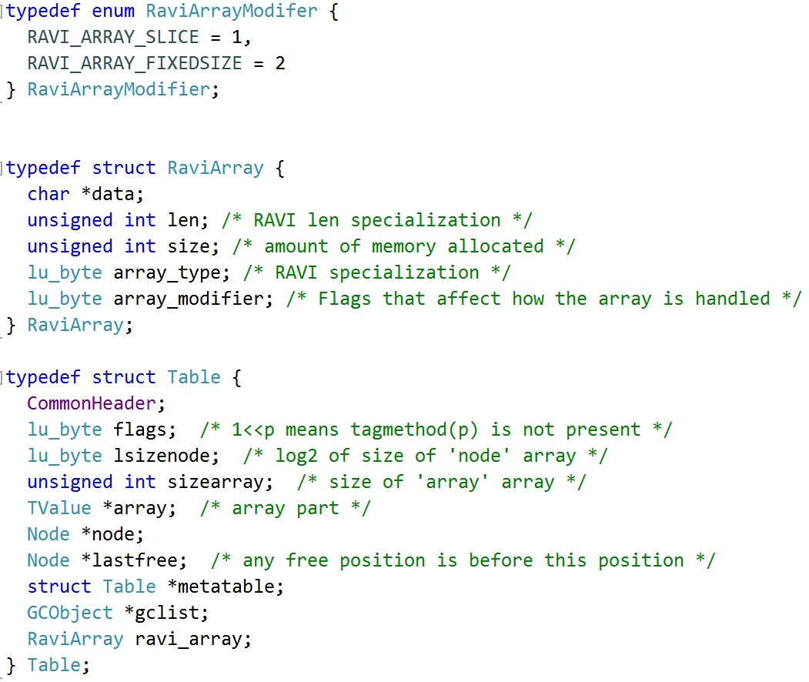
Ravi extension - arrays

Slide 11
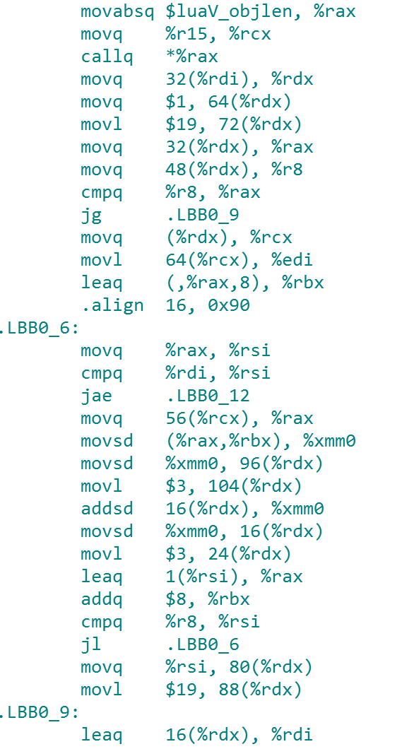
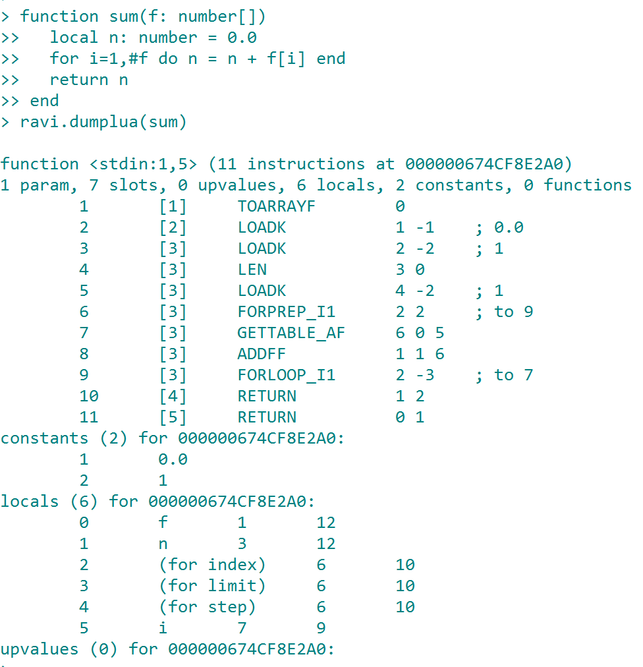
Ravi extension - arrays

Slide 12
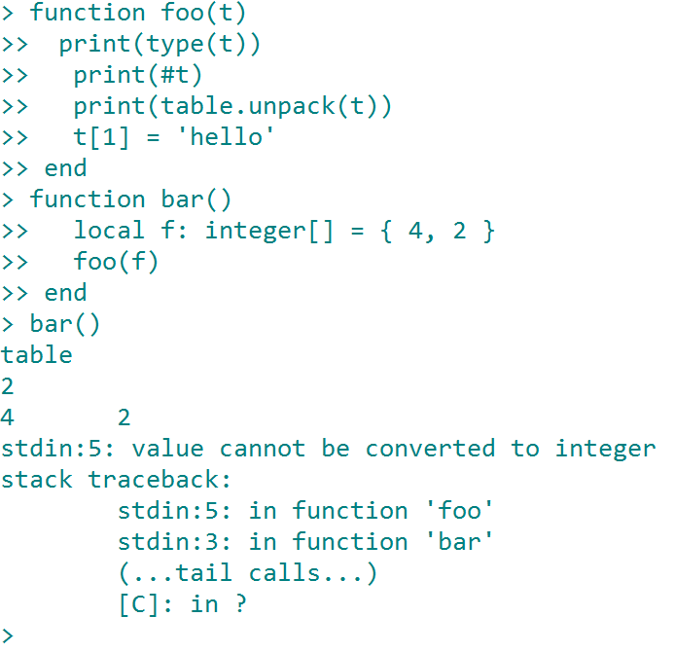
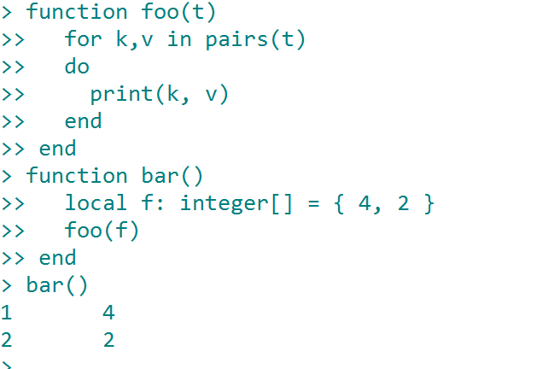
Ravi extension - arrays

Slide 13
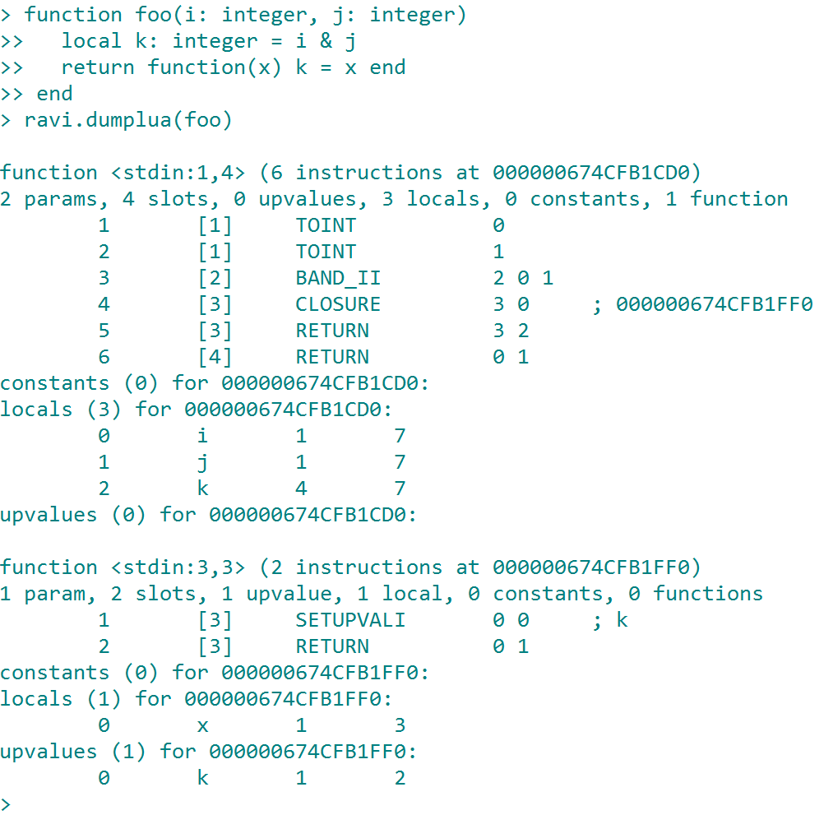
Ravi bytecode extensions
Fornum loops are specialized, especially when index is integer and step is a positive constant (most common use case)
Bitwise operations are specialized when operands are known to be of integer types
Numeric operations are specialized when operands are known to be numeric types
Up-value access is specialized when target is a typed scalar variable
Array indexing is specialized when types are known at compilation time

Slide 14
Ravi Bytecode extensions
MOVE | MOVEI, MOVEF, MOVEAI, MOVEAF
LOADNIL | LOADIZ, LOADFZ
SETUPVAL | SETUPVALI, SETUPVALF, SETUPVALAI, SETUPVALAF
GETTABLE | GETTABLE_AI, GETTABLE_AF
SETTABLE | SETTABLE_AI, SETTABLE_AF, SETTABLE_AII, SETTABLE_AFF
NEWTABLE | NEWARRAYI, NEWARRAYF
ADD | ADDFF, ADDFI, ADDII
SUB | SUBFF, SUBFI, SUBIF, SUBII
MUL | MULFF, MULFI, MULII
DIV | DIVFF, DIVFI, DIVIF, DIVII
BAND | BAND_II
BOR | BOR_II
BXOR | BXOR_II
BNOT | BNOT_I
SHR | SHR_II
SHL | SHL_II
EQ | EQ_II, EQ_FF
LT | LT_II, LT_FF
LE | LE_II, LE_FF
FORPREP | FORPREP_IP, FORPREP_I1
FORLOOP | FORLOOP_IP, FORLOOP_I1
 | TOINT, TOFLT, TOARRAYI, TOARRAYF

Slide 15
Performance
Benchmark Program | Lua5.3 | Ravi(LLVM) | Luajit 2.1
fornum_test1 | 9.187 | 0.31 | 0.309
fornum_test2 | 9.57 | 0.917 | 0.906
fornum_test3 | 53.932 | 4.598 | 7.778
mandel(4000) | 21.247 | 1.582 | 1.633
fannkuchen(11) | 63.446 | 4.55 | 4.751
matmul(1000) | 34.604 | 1.018 | 0.968
Above benchmarks were run on Windows 64-bit
Ravi code made use of static typing
The LLVM JIT compilation time has been excluded in this comparison

Slide 16
Performance
Matmul(1000) implementation | Timing | Remarks
Lua code interpreted | 36.05 seconds | Slightly slower than standard Lua
Lua code JIT compiled | 19.06 seconds | Without type information hard to optimise the code
LuaJIT using FFI | 0.969 seconds | Equally fast without FFI; includes JIT compilation time
Ravi extensions and JIT compilation | 0.986 seconds | Excludes LLVM compilation time and omits array bounds checks on reads
Ravi extensions without JIT | 30.7 seconds | Interpreted
Ravi Matrix using OpenBLAS | 0.046 seconds | Amazing performance!
Ravi Matrix using userdata metamethod indexing without type checking | 93.58 seconds | Slower than interpreted Lua!
Ravi Matrix using userdata with type checking | 211 seconds | Type checking uses the optimisation described in Lua mailing list
Userdata indexing performance is very poor; even interpreted Lua is faster
Indexing performance main reason for introducing arrays in Ravi

Slide 17
Lua API extensions
Lua code can call following API functions:
ravi.jit(mode) – sets JIT on/off; defaults to true
ravi.dumplua(function) – dumps Lua bytecode
ravi.compile(function) – JIT compiles a Lua function
ravi.auto(mode[ ,min_size [, min_exeutions]]) – sets auto compilation; defaults are true, 150, 50. Additionally if function has a fornum loop then also JIT compilation is triggered when auto compilation is switched on.
ravi.dumpir(function) – dumps the LLVM IR
ravi.dumpasm(function) – dumps the generated assembly code
ravi.optlevel(level) – sets optimizer level (0-3); default is 2
ravi.sizelevel(level) – sets code size level (0-3)
table.intarray(num_elements, init_value) – returns integer[]
table.numarray(num_elements, init_value) – returns number[]
table.slice(array, start_index, num_elements) – returns slice, original array memory is frozen (i.e. array cannot be resized anymore due to memory reference)

Slide 18
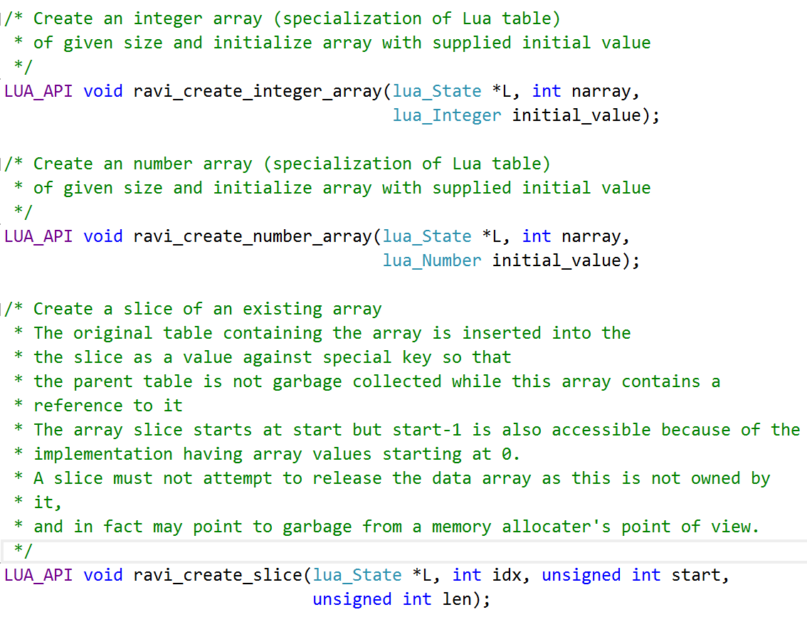
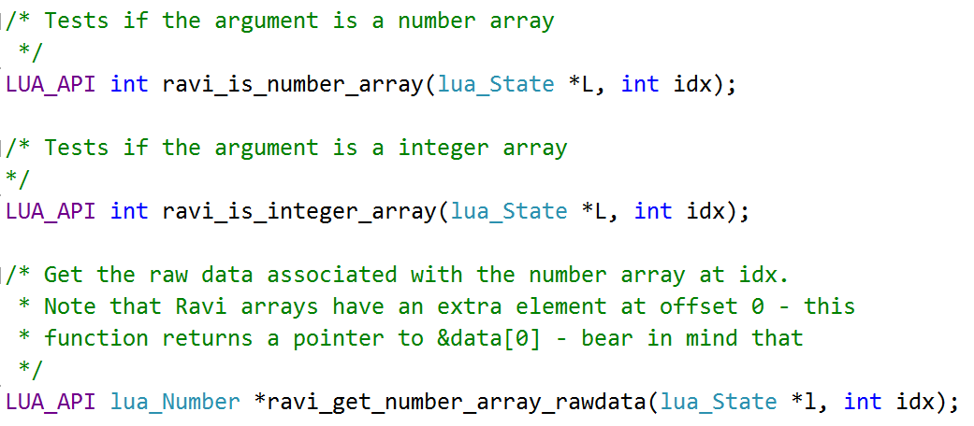
C API extensions

Slide 19
LLVM
Pros
Cons
Well documented intermediate representation called LLVM IR
The LLVM IRBuilder implements type checks so that basic type errors are caught by the builder
Verifier to check that the generated IR is valid
CLANG can generate LLVM IR; very useful for checking what the IR should look like
LLVM IR is low level – lots of tedious coding required
LLVM is huge in size. Lua on its own is tiny - but when linked to LLVM the resulting binary is a monster
Compilation is costly so only beneficial when Lua function will be used again and again
LLVM must be statically linked

Slide 20
JIT Compilation architecture
The unit of compilation is a Lua function
Each Lua function is compiled to a Module/Function in LLVM parlance (Module=Compilation Unit)
The compiled code is attached to the Lua function prototype (Proto)
The compiled code is garbage collected as normal by Lua
The decision to call a JIT compiled version is made in the Lua Infrastructure (specifically in luaD_precall() function in ldo.c)
The JIT compiler translates Lua/Ravi bytecode to LLVM IR - i.e. it does not translate Lua source code
There is no in-lining of Lua functions
Generally the JIT compiler implements the same instructions as in lvm.c - however for some bytecodes the code calls a C function rather than generating inline IR. These opcodes are OP_LOADNIL, OP_NEWTABLE, OP_RAVI_NEWARRAYI, OP_RAVI_NEWARRAYF, OP_SETLIST, OP_CONCAT, OP_CLOSURE, OP_VARARG
Ravi represents Lua values as done by Lua 5.3 - i.e. in a 16 byte structure

Slide 21
Problem areas
The Lua program counter (savedpc) is not maintained in JIT code therefore debug API doesn’t work with JITed functions
Maintaining the program counter would inhibit optimisation; perhaps a debug mode can be implemented
Co-routines not supported in JIT mode; therefore only main thread executes JITed code; co-routines (secondary threads) always work in interpreted mode. Resuming a JITed function is a hard problem
Tail calls are implemented as normal calls in JITed code hence tail recursion is limited to a finite depth
Currently only 64-bit integer implemented

Slide 22
Batteries
Aim to provide a bunch of standard libraries with Ravi; however these are additional packages rather than part of Ravi
Work ongoing in following areas:
LLVM bindings – users can generate machine code from Lua
Ravi-Matrix – wrapper for BLAS and LAPACK libraries; OpenBLAS supported
Ravi-GSL – wrapper for GNU Scientific Library
Ravi-Symbolic – will wrap SymPy’s SymEngine

Slide 23
Closing thoughts about Ravi
In Lua, byte-code is generated while parsing – hence it is harder to implement static type checks; so far have managed to workaround issues but the implementation is ugly – not yet confident that all corner cases are handled correctly
Introducing AST will degrade code generation performance and increase memory usage but on plus side may allow future enhancements such as incorporating a macro facility similar to Metalua
Lua’s parsing and code generation implementation is one of the most complex parts of Lua; documentation is sparse in this area
Maintaining compatibility with Lua could be difficult if significant changes occur to the Lua language or implementation; hence need to ensure merging of upstream changes is relatively easy (complete new codebase would cause the issues LuaJIT is having with incorporating upstream changes)
Ravi as it stands is a specialized dialect for a particular use case (Desktop or Server, numeric computing); this makes it difficult to get others interested in contributing to Ravi (so far no contributions)
Making a more generic language would entail providing better support for aggregate types; but this is hard to do in Lua due to existing semantics of tables (Wren illustrates how one might approach this)
LuaJIT, Pure, Julia – all offer easy and efficient FFI; but there is no safe way to offer this in Ravi
Function calls are expensive in Lua and Ravi – I would love to have a solution for in-lining functions; macros seem the most promising approach
It would be nice to be able to share generated code across Lua states as JIT compilation is expensive

Slide 24
Closing thoughts about Lua
Small yet powerful
Carefully designed implementation
Somewhat geeky although appears simple at first glance (fornum loops, logical operators, metatables, DIY class systems, co-routines)
Core VM encapsulated in well defined API – even standard Lua libraries need to go through the API
Hugely appreciate the availability of the Lua test suite
Sadly not well known in some programming communities

Slide 25
Links
http://ravilang.org
https://github.com/dibyendumajumdar/ravi

