Slide 1

Paper-To-Podcast
Generating Research Paper Summary and Podcast
Group 1:
Deepika Harshita
Manisha Vijayalaxmi

Slide 2

Motivation
The project aims to generate detailed summarization of the research paper and convert it to a podcast (audio mp3 file).
It provides an alternative method of reading and understanding the research paper content.
The main goal of the project is not just to extract summary from the abstract of the research paper, rather it should summarize the information present on each page and generate an informative and detailed summary.
Portland State University

Slide 3
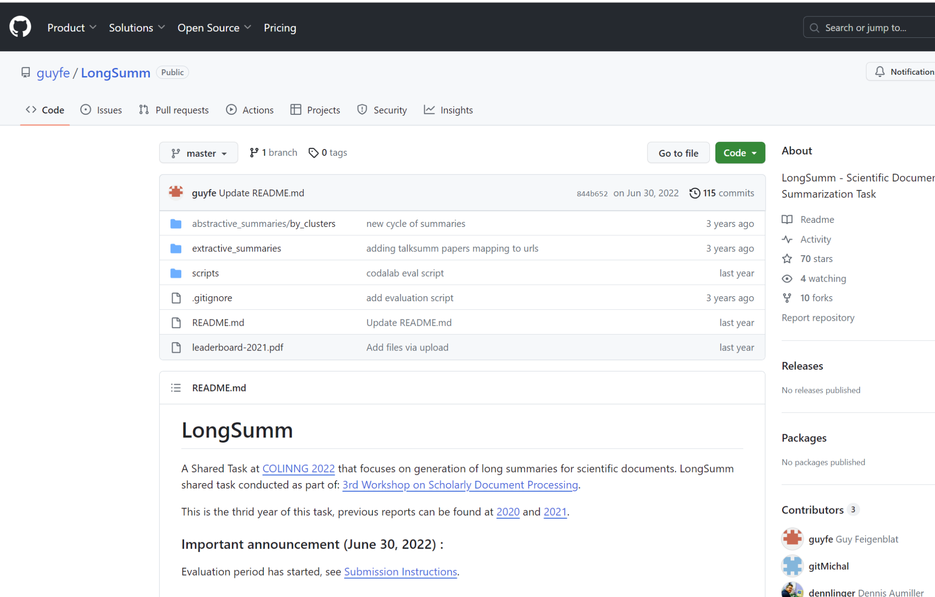
Dataset
The dataset requirement for our project was to have target summary for each page of all the research papers in the training corpus.
Dataset Name: LongSumm https://github.com/guyfe/LongSumm/blob/master/extractive_summaries/talksumm_papers_titles_url.txt
Portland State University

Slide 4
More on Dataset
The selected dataset is NLP domain specific.
It has extractive and abstractive summaries. We have selected the extractive summaries for creating our dataset.
The extractive raw summaries consists of 1705 NLP based research papers along with page-wise target summary of each research paper.
Portland State University

Slide 5
Dataset Generation:
Available Dataset:
Text file with title of each paper and the corresponding url to load the pdf
Target Summary format:
Each line contains:
sentence index (in original paper)
sentence score (i.e. duration)
sentence itself.
The fields are tab-separated
The order of the sentences is according to their order in the paper.
Portland State University

Slide 6
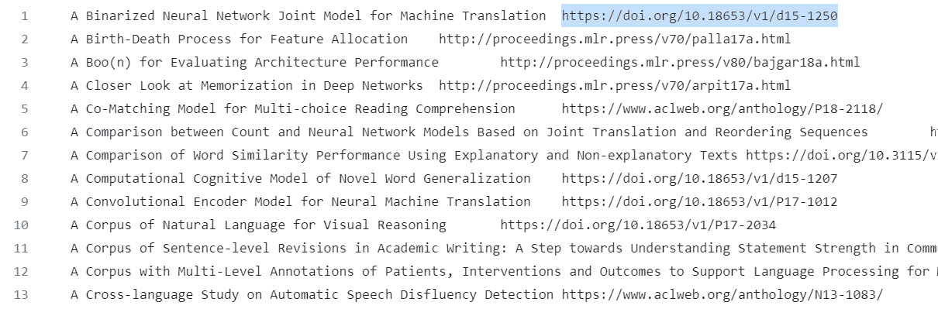
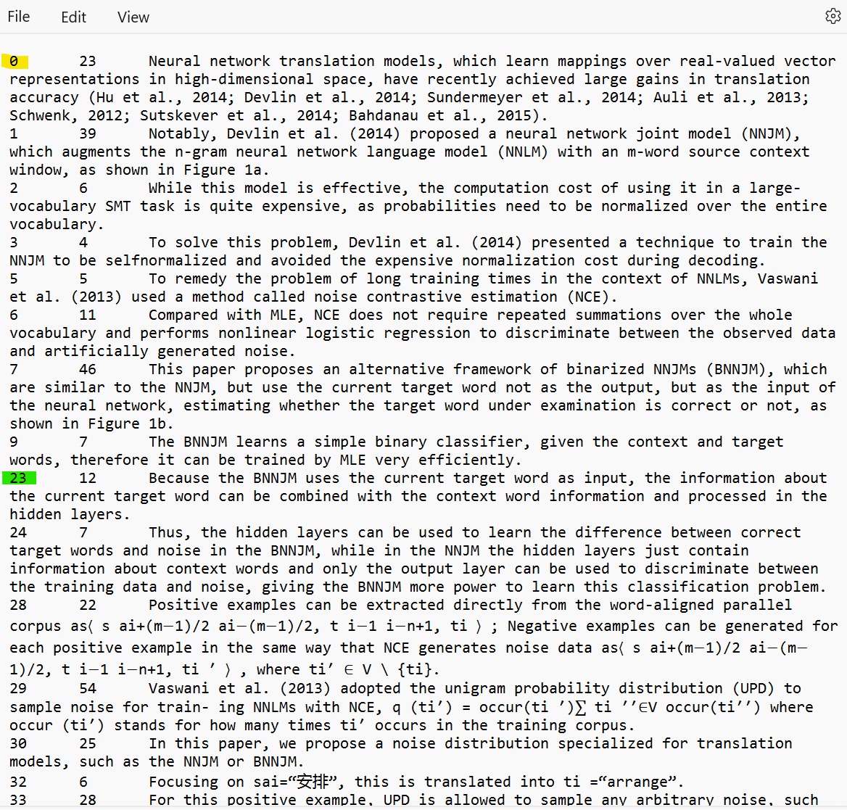
Dataset Generation:
Portland State University

Slide 7
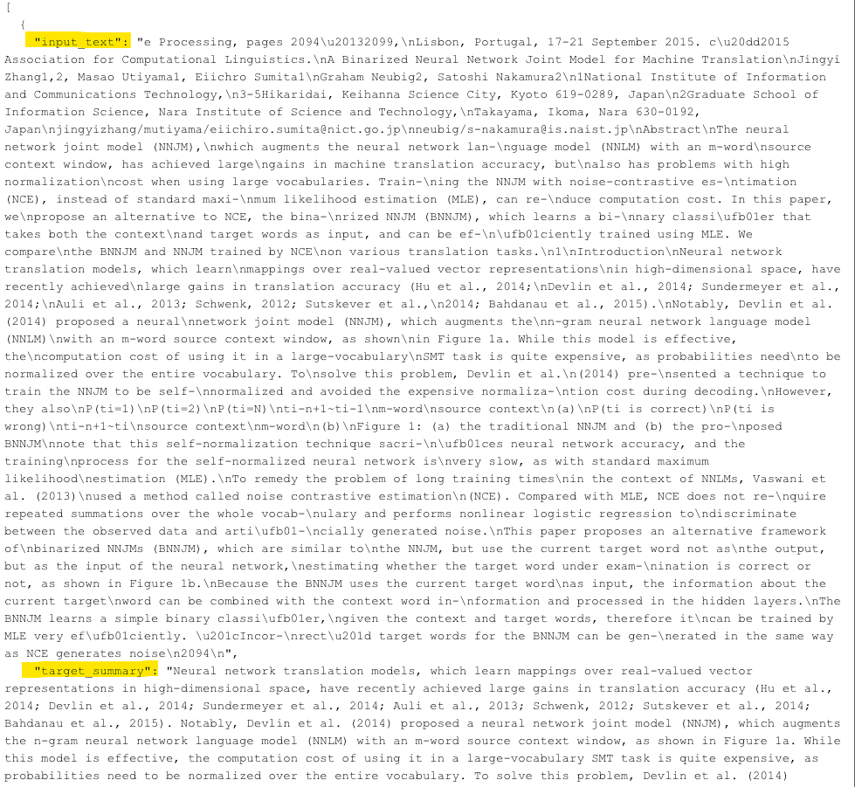
Generated Dataset Format:
We generated a final dataset having a list of json objects with each object having the input_text and target_summary for each page of all the downloadable research papers.
967 papers
Json object :
<input_text> page-wise
<target_summary> for that page
Portland State University

Slide 8
Models:
In order to perform text summarization task we needed models that can consider the context of the input text and accordingly generate meaningful summaries. So we selected below models:
T5 Model (Baseline Model):
GPT 3.5/4
Portland State University

Slide 9
T5 Model:
Bidirectional model - left and right contexts
attention masks - focus on relevant parts of the input text
It can be fine-tuned to perform specific text processing tasks using the domain specific datasets.
Portland State University

Slide 10

T5 Model
T5-Small text summarization resulted in less tokens which could not generate enough meaningful summary
T5-Large resulted in more tokens but higher computational requirements
Opted T5-base with a 512-token limit per page to generate longer summaries along with less computations.
Dataset split into train, validation and test:
Portland State University

Slide 11
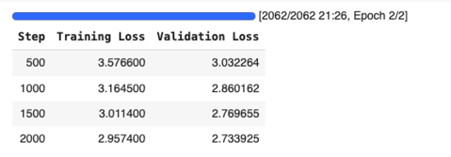
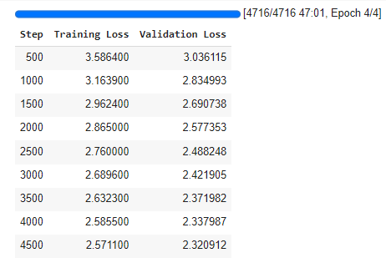
T5-Base Model Fine Tuning
Colab crashed due to memory issue while using the 512 token limit for the T5-base model during training. So, we trained the model by using 128 token limit along with padding.
Training comparison between 2 and 4 epochs:
epochs = 2; batch-size = 8
epochs = 4; batch-size = 7
Portland State University

Slide 12
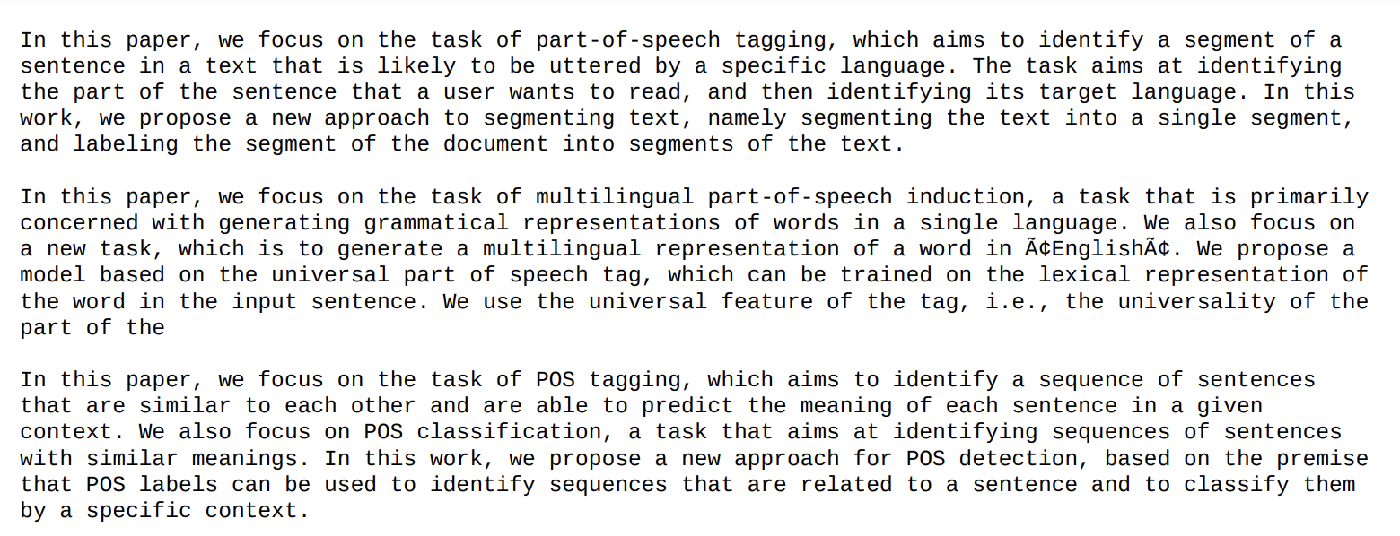
T5-Base Fine-Tune Model Results
Test Research Paper Link: https://www.aclweb.org/anthology/P11-1061.pdf
Generated Summary:

Slide 13
Reference-Free Evaluation Matrix
ROUGE-1: Score(precision=0.11086154339804268, recall=0.7686318131256952, fmeasure=0.19377453729669097)
ROUGE-L: Score(precision=0.05519011711856249, recall=0.38264738598442716, fmeasure=0.09646662927650028)
ROUGE-1 specifically focuses on unigram overlap between the generated summary and the reference summary. It measures the precision and recall of overlapping unigrams (individual words) between the generated summary and the reference summary.
ROUGE-L specifically focuses on the longest common subsequence (LCS) between the generated summary and the reference summary. Unlike ROUGE-1, which assesses unigram overlap, ROUGE-L considers the longest matching sequence of words (subsequence) between the generated summary and the reference summary.
Portland State University

Slide 14
Challenges
Dataset Generation:
Fine-Tuning T5 Model
Difficulty in finding NLP domain specific dataset in an appropriate format
Downloading the research papers due to their inconsistent formats
Preprocessing required for each input research paper to not to include the paper titles, author details and reference pages to match the indices with available target summaries.
Making the generated dataset compatible with the input format expected by the Trainer.
Training using CPU required 20 hrs. So, utilized T4 GPU provided by Google Colab, which was able to train the model in 3 hrs.
Portland State University

Slide 15
GPT 3.5 turbo
GPT 4
Architecture : Built on Transformer
Learning Approach: Zero or Few-Shot.
Summary Type: Abstractive Summary
Token Limits: Upto 4096 tokens
Unimodal Input : Processing text page-wise, excluding reference pages.
API Integration: Hosted on Rapid API.
Degree of Randomness (temperature): Set temperature hyper-parameter to 0.8.
Portland State University
Architecture : Built on GPT-4 Architecture.
Learning Approach: Zero or Few-Shot.
Summary Type: Abstractive Summary
Token Limits: Upto 32,000 tokens
Multimodal Input : Flexible input handling (can be used in future scope)
API Integration: Hosted on Rapid API.
Degree of Randomness (temperature): Default - 1.0

Slide 16
How does it work?
Import Libraries : Utilizing torch, Rouge, pymupdf, gTTs
Preprocessing: Extracting text page-wise and passing it to the model prompt.
Summary Generation: Generating summaries for each page.
Concatenation: Combining page summaries into a comprehensive summary for the entire paper.
Audio Generation
Portland State University

Slide 17
GPT 3.5 v/s GPT 4
Rouge-1 | GPT 3.5 | GPT 4
Precision | 0.24 | 0.24
Recall | 0.93 | 0.95
F1 Score | 0.39 | 0.38
GPT-4 outperforms in all metrics with recall of 95% in Rouge-1.
To our surprise ,GPT 3.5 is slightly better with Rouge-L metrics.
Rouge-L | GPT 3.5 | GPT 4
Precision | 0.16 | 0.14
Recall | 0.60 | 0.56
F1 Score | 0.25 | 0.23
Portland State University

Slide 18
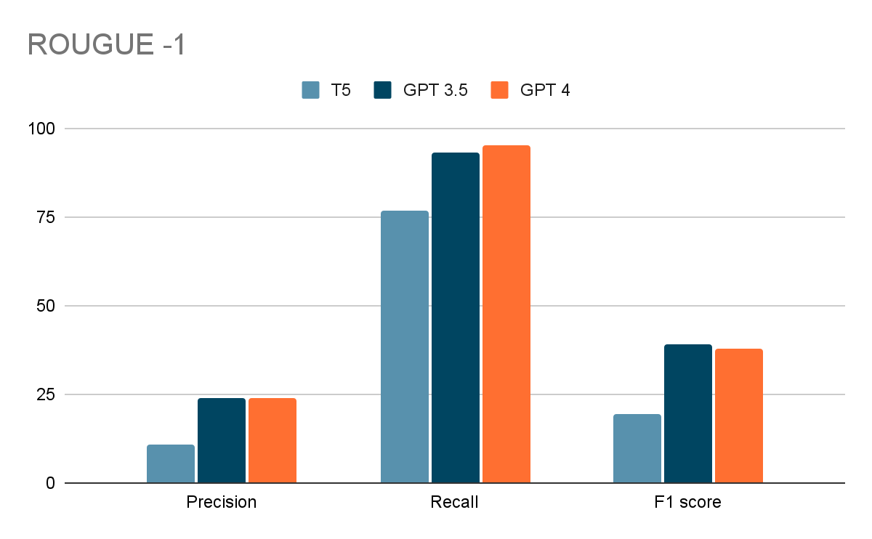
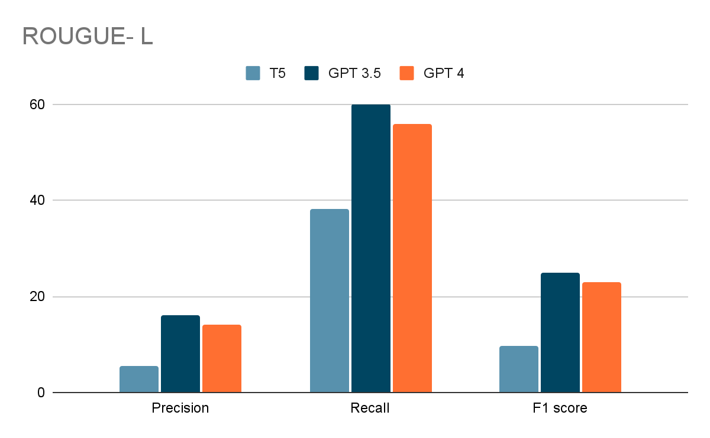
Comparison
ROUGE-1 Precision: Ratio of Unigrams in generated summary(appears in the paper) over number of unigrams in research paper.
ROUGE-1 Recall: Ratio of the number of unigrams in the paper that appear in generated summary, over the number of unigrams in research paper.
ROUGE-1 F1-score can be obtained from the ROUGE-1 precision and recall using the standard F1-score formula
ROUGE-L is based on the longest common subsequence (LCS) between our generated summary and research paper, i.e. the longest sequence of words (not necessarily consecutive, but still in order) that is shared between both.
Portland State University

Slide 19
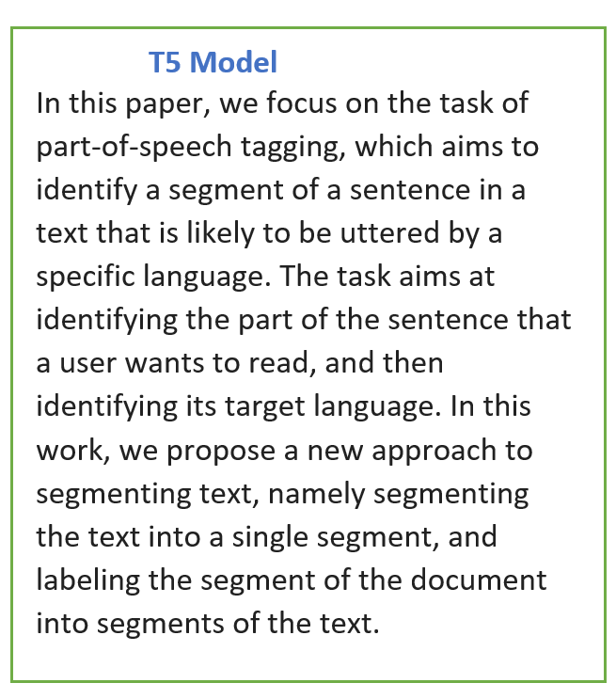
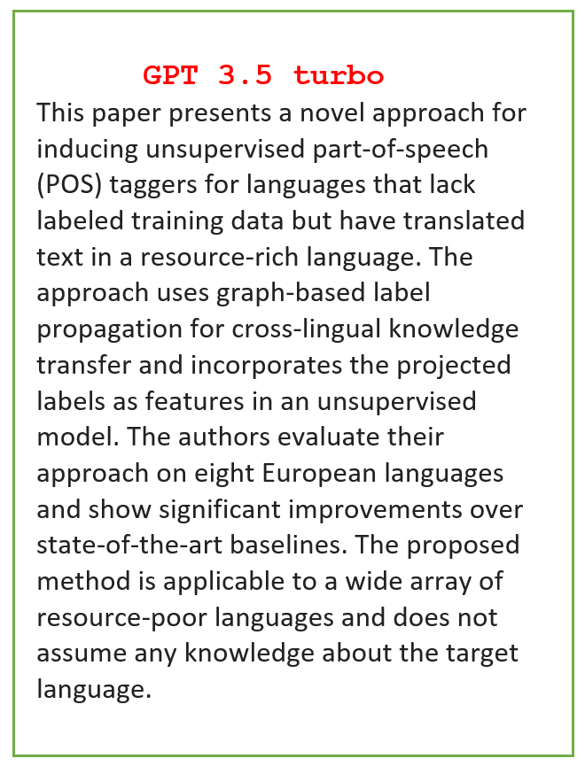
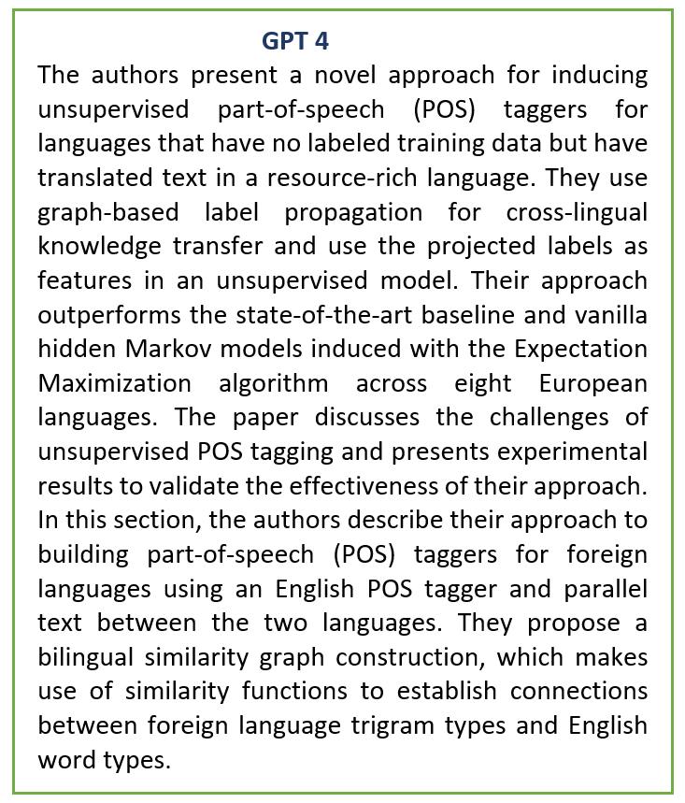

Avg Time: ~3 mins
No. of tokens: 1098 tokens
Audio duration: 6.42 mins
Avg Time: ~3 mins
No. of tokens: 1637
Audio duration: 12.06 mins
Avg Time: ~3 mins
No. of tokens: 1677
Audio duration: 11.08 mins
T5 Summary
GPT 3.5 Summary
GPT 4 Summary

Slide 20
Limitation
T5 Model:
Token Limit: Restricted to 512 tokens, limiting the length of summaries.
GPT 3.5 Turbo and GPT-4:
Fine-Tuning Constraints: Not available for fine-tuning; access is paid.
GPT-3.5 turbo: Limited to 50 requests
GPT-4: Limited to 25 requests /month with 3 requests/minute.
Language Support
English-Only: All Models tried and tested exclusively for English research paper.
Content Exclusion:
Excludes Visual Elements: Summaries omit tables, images, graphs, and mathematical equations.
Portland State University

Slide 21
Future Scope
Extracting tables/graphs: - Ex : Tabula py , Camelot Python library.As GPT 4 is multimodal in future we can extract PDF with tables and images to generate summary.
Understanding the content within the image: Involves Optical Character Recognition (OCR) for text extraction and for understanding image content, additional computer vision
techniques. Ex: pytesseract library for OCR and the pillow (PIL) library for image processing.
Mathematical equation: Ex: MathOCR tool, python libraries Sympy, Mathjax or Latex to text conversion then passing to NLP model
Generating summaries for multilingual research paper.
Portland State University

Slide 22
Ethical Consideration
Publicly Available Information:
Source: Dataset prepared by ACL Anthology, consisting of publicly available research papers.
Transparency:
Clear Communication: Transparent about the use of ACL Anthology data, the summarization process, and any limitations.
Computational Resources:
Optimized Usage: Mindful use of computational resources to minimize environmental impact and promote efficiency.
Academic Integrity:
Promoting Integrity: Discouraging the use of automated summarization as a substitute for genuine engagement with research papers.
Encouragement: Emphasizing the importance of referring to the original papers for a comprehensive understanding.
Portland State University

Slide 23
Thank you!
Questions?

