Slide 1
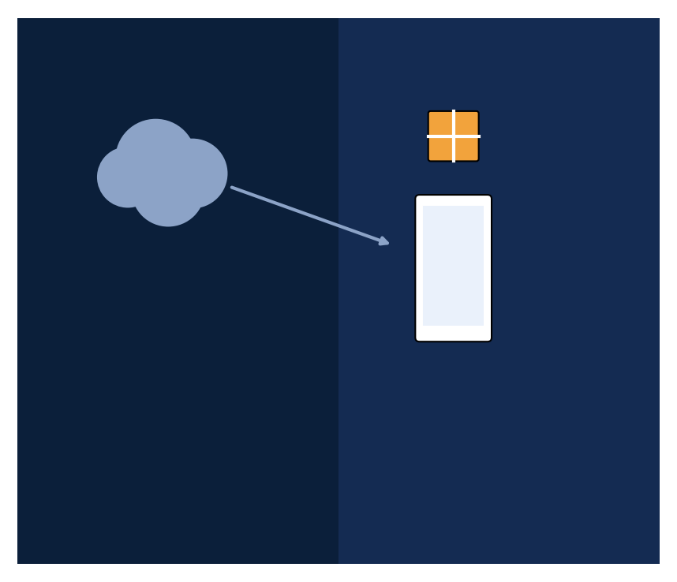
WL Playstore
A Private Enterprise App Store for Worldline Payment Terminals
• Secure, self-hosted Android app distribution platform
• Built exclusively for Worldline-managed POS / kiosk terminals
• Replaces Google Play Store with a fully controlled, enterprise-owned alternative
• Worldline Global Services India · 2026

Slide 2
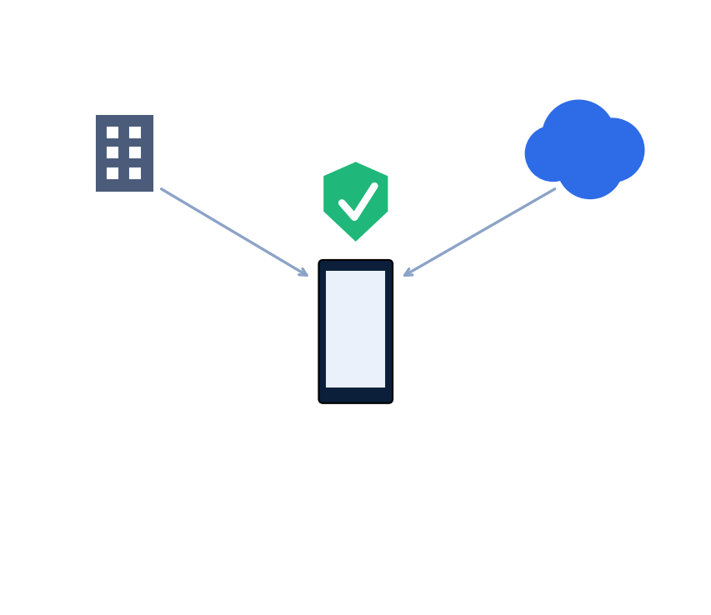
02 What Is WL Playstore?
• A private, enterprise-only app store — not available on the public internet / Play Store
• Distributes apps exclusively to company-managed POS/kiosk terminals
• Every terminal is enrolled with a unique cryptographic identity before it can see or download anything
• Apps are organized by category and assigned to customers via an entitlement model
• Every download is logged with GPS location, timestamp, and install result
• Supports silent, unattended installation on Android Enterprise kiosk devices

Slide 3
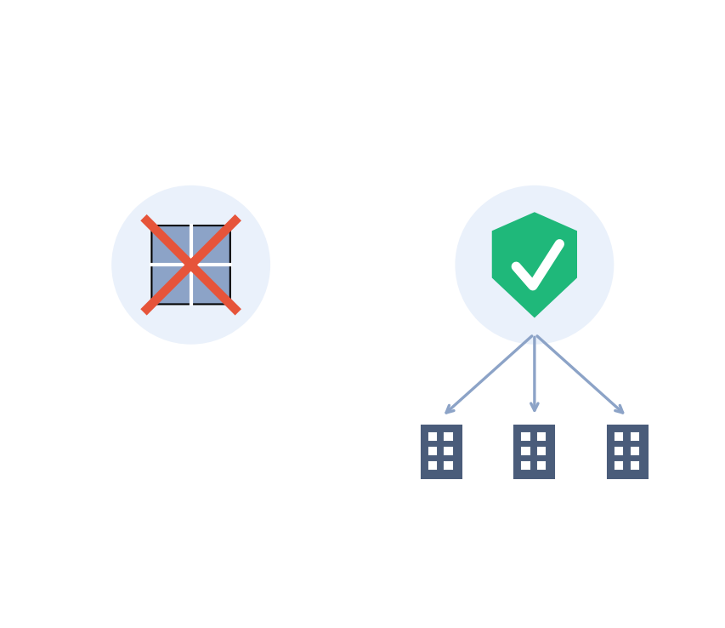
03 Why a Private App Store?
• Public app stores give no control over which apps/versions are distributed
• No way to restrict visibility per customer / bank / retailer
• No enterprise-grade audit trail of who downloaded what, when, and where
• WL Playstore: customer-level entitlements — Bank A never sees Retailer B's apps
• Checksum-verified binaries — tamper-proof distribution
• Centralized kill-switch — retire/wipe a terminal, instantly revoking its API key
• Full compliance trail — every admin action and download is audit-logged

Slide 4
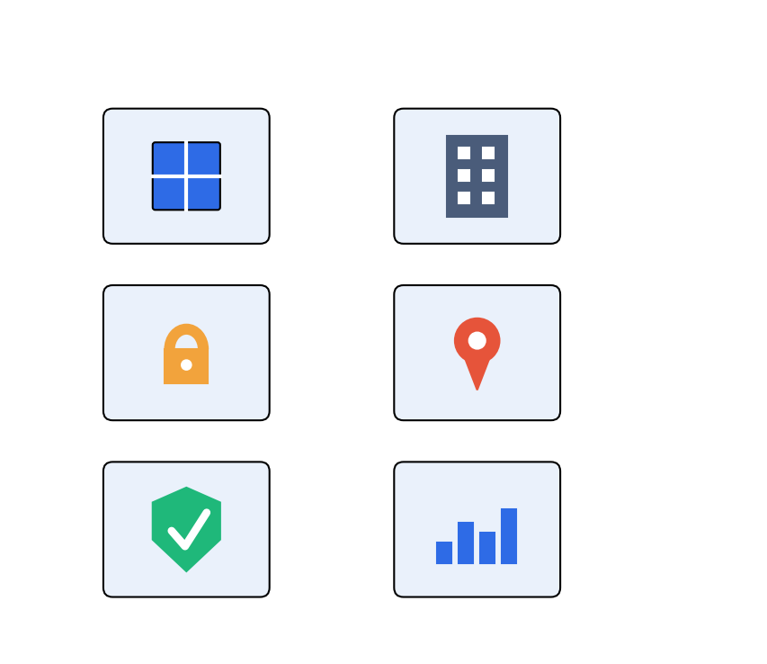
04 Key Features
• Centralized app catalog — categorized, versioned, with descriptions & screenshots
• Customer entitlement management — assign apps to specific organizations
• Per-terminal enrollment — unique, rotatable/revocable API key per device
• GPS-tagged download telemetry on every download event
• Checksum-verified, silent installs (Device Owner mode)
• Admin analytics dashboard — trends, top apps, live terminal map
• One-click Excel export of apps / customers / downloads
• Full audit log of every admin action

Slide 5
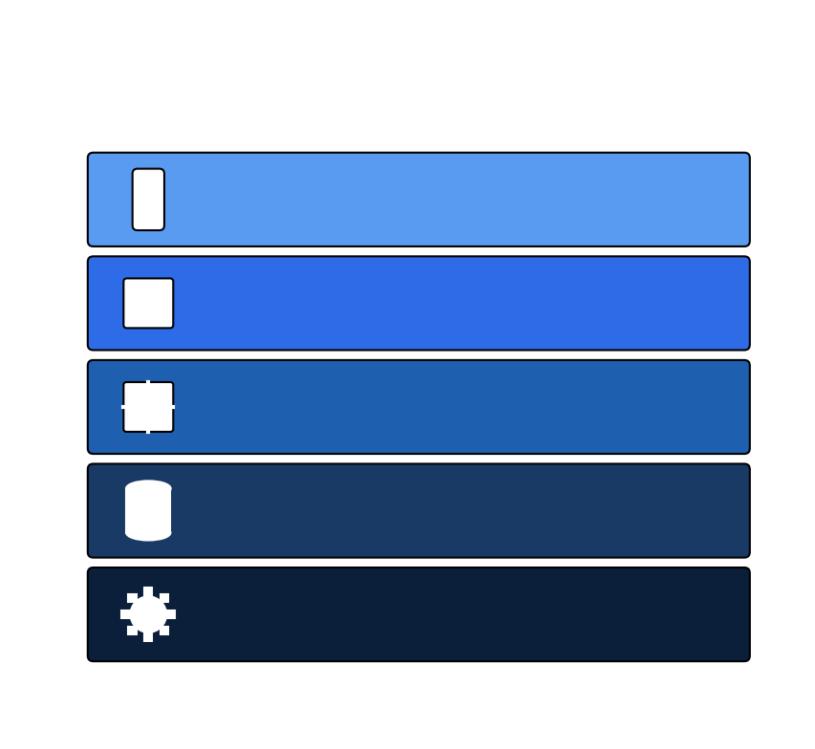
05 Technology Stack Overview
• Frontend (Admin Portal): React 19 + TypeScript + Vite 8, React Router, Recharts, Leaflet, Axios
• Backend API: Node.js 20 + Express 4 + TypeScript, Prisma ORM, Zod, JWT + bcrypt, Helmet, express-rate-limit
• Database: PostgreSQL 15
• Object Storage: MinIO (S3-compatible), AWS SigV4 pre-signed URLs
• Android Client: Kotlin, minSdk 26 / targetSdk 34, Retrofit2 + OkHttp, Coroutines, Device Owner APIs
• Infrastructure: Docker + Docker Compose, Nginx reverse proxy, Let's Encrypt / Certbot
• Deployment: Self-hosted Ubuntu VPS, horizontally scalable to Kubernetes

Slide 6
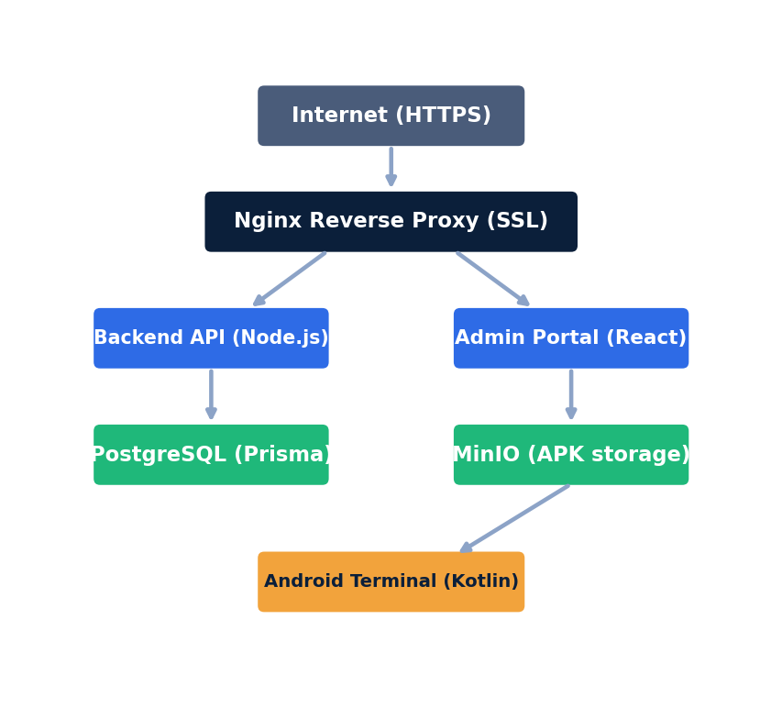
06 High-Level System Architecture
• Nginx is the single public entry point for the entire platform
• /api/* routes to the Node.js backend; / serves the React admin portal
• All internal services (Postgres, MinIO, backend) are bound to 127.0.0.1 only
• Every component runs as an isolated Docker container via docker-compose
• The backend never streams APK bytes itself — it only issues signed download URLs

Slide 7
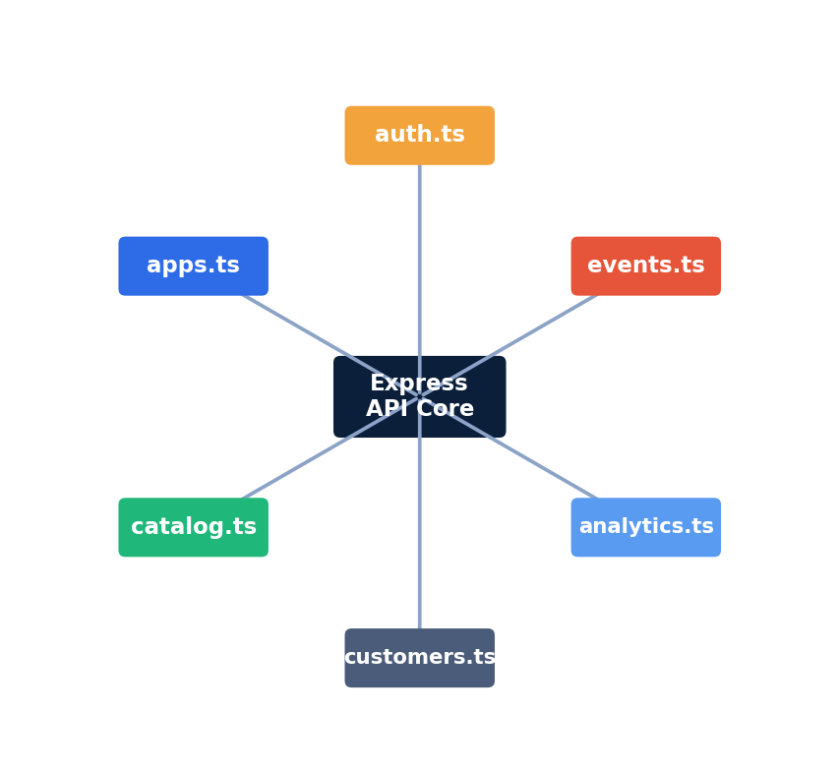
07 Backend API Architecture
• Modular Express + TypeScript route files: auth, apps, catalog, customers, categories, terminals, analytics, events
• Middleware layer enforces three access levels: requireAdmin, requireSuperAdmin, requireTerminal
• Every request body validated with Zod schemas before touching the database
• Prisma ORM provides type-safe PostgreSQL access and migration management

Slide 8
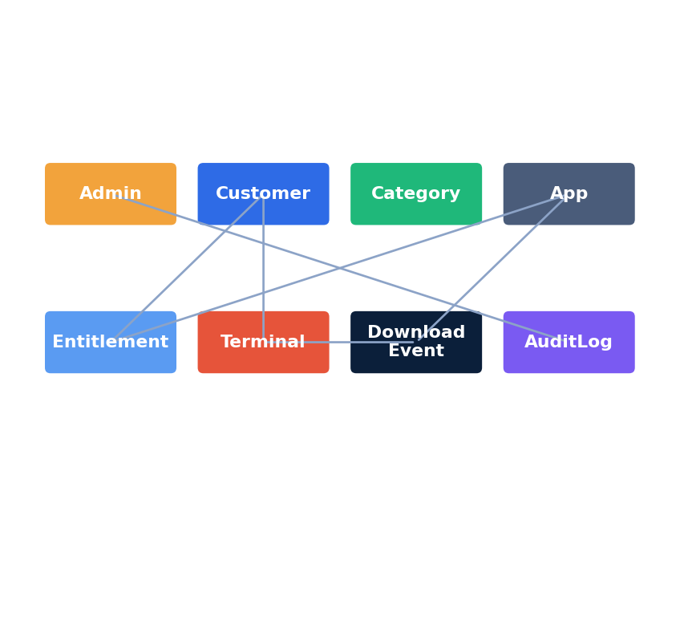
08 Data Model (Database Schema)
• Admin — portal users with role-based access (ADMIN / SUPER_ADMIN)
• Customer — business organizations, each with a short human-readable code
• Category — app groupings (Payment, Utilities, Reporting, Security...)
• App — package name, version, checksum, size, MinIO reference, publish status
• CustomerEntitlement — which apps a customer's terminals are allowed to see
• Terminal — enrolled devices, API key, branch code, status
• DownloadEvent — one row per download attempt with GPS + install status
• AdminAuditLog — immutable record of every admin action

Slide 9
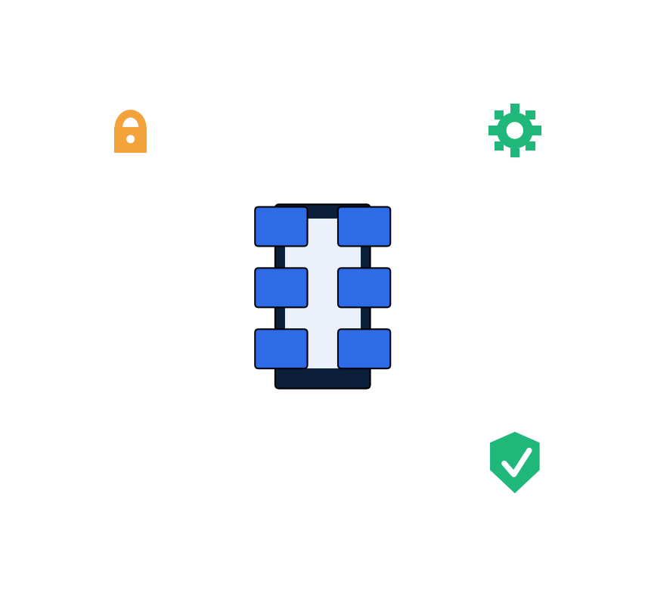
09 Android Client App
• Native Kotlin app, minSdk 26 (Android 8.0+) to targetSdk 34
• Built for Android Enterprise Device Owner mode — fully silent install, zero user prompts
• Retrofit2 + OkHttp with an X-Terminal-Key header interceptor for authenticated requests
• Kotlin Coroutines handle async download/install flows without blocking the UI
• Core screens: Enrollment, Catalog, App Detail (download → verify → install → report)
• Terminal API key stored in EncryptedSharedPreferences (AES-256-GCM)

Slide 10
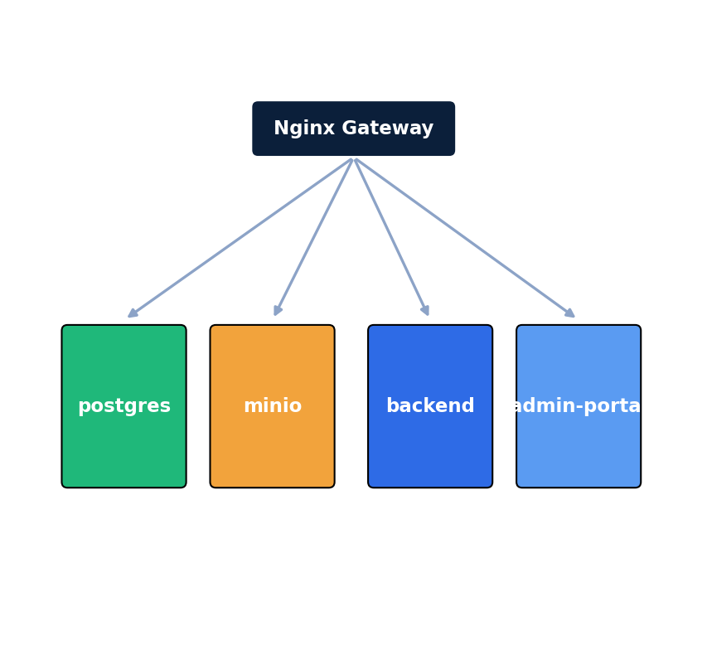
10 Containerization & Deployment
• Entire stack defined in docker-compose.yml + a production override file
• Independent containers: postgres, minio, backend, admin-portal
• Nginx terminates SSL (Let's Encrypt) and routes to each container
• Internal services bound to 127.0.0.1 only — never directly exposed to the internet
• One command (docker compose up -d --build) rebuilds and redeploys the entire platform

Slide 11
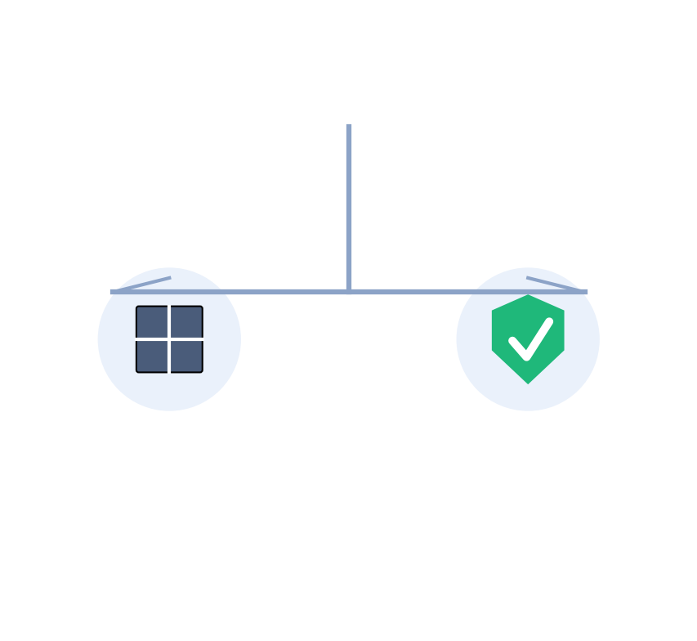
11 Security Architecture: Overview
• User Auth: JWT + bcrypt + refresh tokens (vs. Google Account + 2FA)
• Device Auth: per-device cryptographic API key (vs. Google Play Services)
• App Integrity: SHA-256 checksum, verified server + client side (vs. Play Protect)
• Distribution Control: Customer Entitlement model, per-app per-org
• Audit Trail: full AdminAuditLog on every write action
• Transport: HTTPS + Android Network Security Config (cleartext blocked)
• Rate Limiting: express-rate-limit, 200 req / 15 min per IP
• Secrets Storage: EncryptedSharedPreferences (AES-256-GCM)

Slide 12
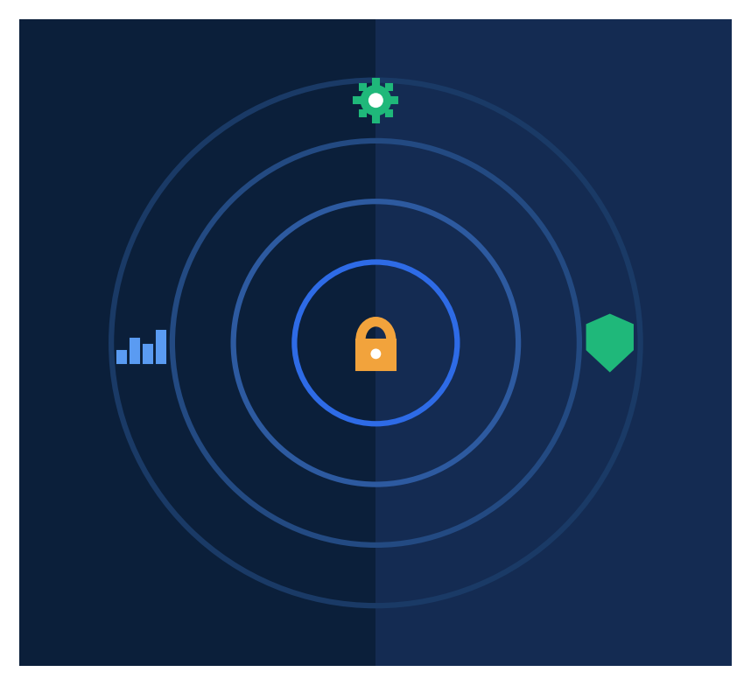
12 Security Deep Dive: Authentication & Access Control
• Admin login: bcrypt-hashed passwords, 1-hour JWT access tokens + 7-day refresh tokens (separate secret)
• Generic "Invalid credentials" error — prevents user/email enumeration
• Terminal enrollment: 48-character cryptographically random API key per device
• Role-based middleware rejects retired/wiped terminals even with a valid key
• Helmet applies 11 HTTP security headers to every response
• Zod validates every endpoint's input before it reaches the database

Slide 13
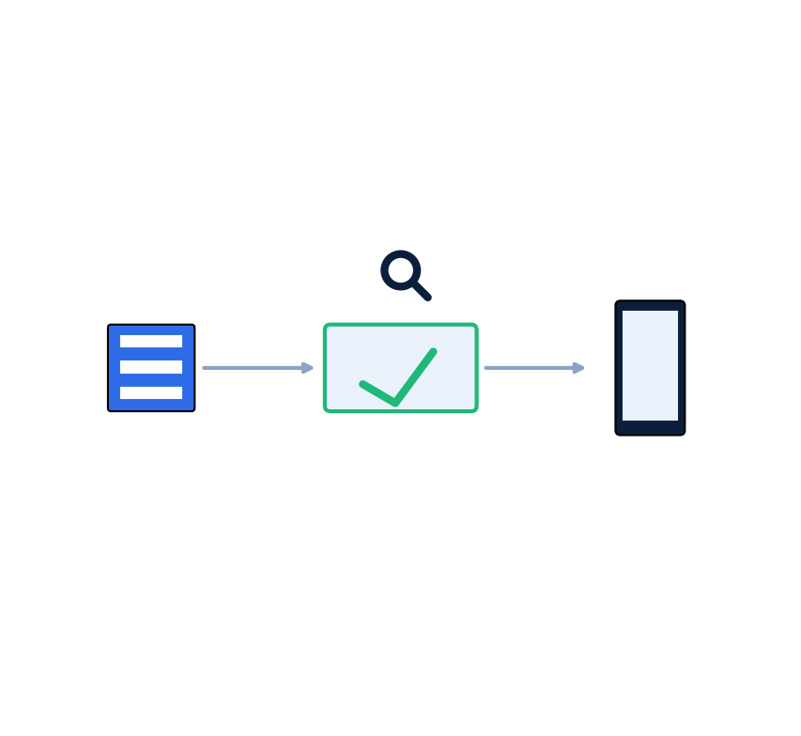
13 Security Deep Dive: App Integrity & Data Protection
• Upload time: server computes SHA-256 checksum, stored immutably with the binary
• Download time: Android client re-computes SHA-256 and rejects install on mismatch
• Pre-signed URLs (AWS SigV4): scoped to one object, expire after 15 minutes
• Request size limits: 10 MB JSON cap, 200 MB APK upload cap
• Strict package-name regex prevents path-traversal-style identifiers
• All traffic forced over HTTPS/TLS; cleartext HTTP blocked on Android

Slide 14
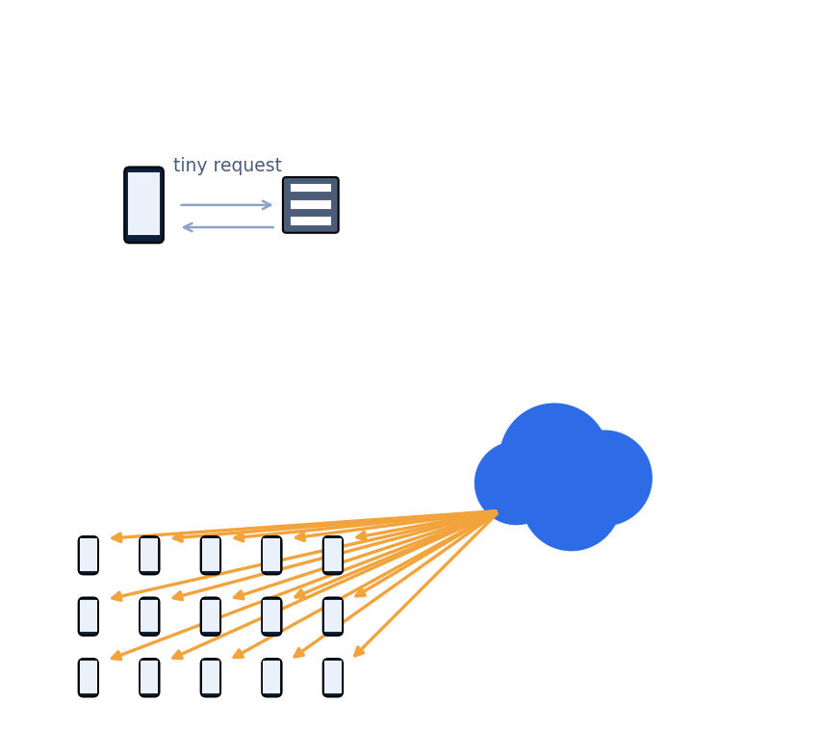
14 Scaling to Millions of Downloads: The Core Design Choice
• The single most important decision: APK binaries are 100% offloaded from the API servers
• 1. Terminal sends a tiny (~1 KB) request → backend checks entitlement in milliseconds
• 2. Backend returns a pre-signed URL pointing directly at object storage
• 3. Terminal downloads the APK directly from storage/CDN — API never touches the bytes
• Same pattern used by Google Play, Apple App Store, and Netflix
• API tier's CPU/memory stays flat whether 100 or 500,000 terminals download at once

Slide 15
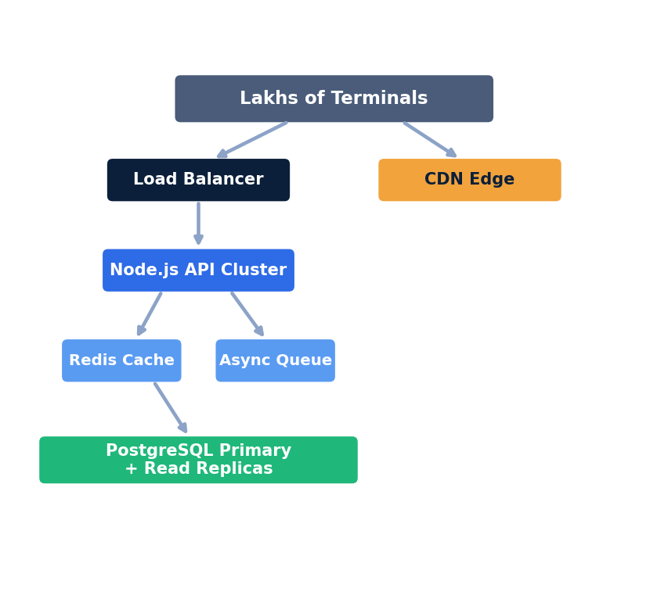
15 High-Concurrency Architecture (100K+ Terminals)
• Redis catalog caching: 50,000 terminals hit Redis (<1ms), not the database
• Async telemetry queue: events return 202 Accepted in ~2ms, batch-inserted by a worker
• Phased rollout + jitter delay prevents a 'thundering herd' of simultaneous requests
• Stateless JWT/API-key auth allows any number of Node.js replicas behind a load balancer

Slide 16
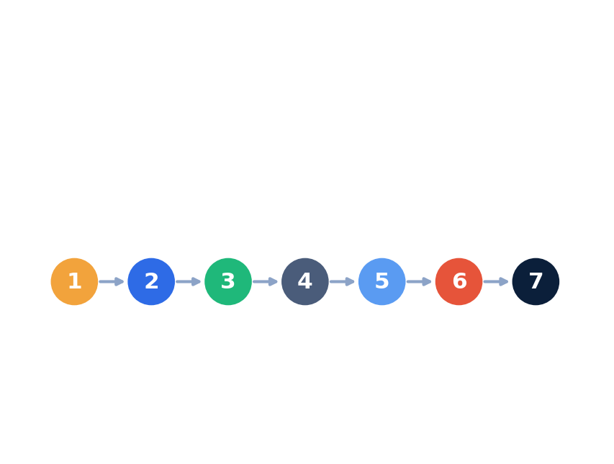
16 End-to-End Flow: Enroll → Download → Install
• 1. Enroll — short Customer Code binds the device, backend issues a unique API key
• 2. Browse — terminal fetches its entitled catalog, filtered by category
• 3. Request — backend verifies entitlement, returns pre-signed URL + checksum
• 4. Download — terminal streams the APK directly from object storage
• 5. Verify — terminal re-computes SHA-256 and compares checksums
• 6. Install — silent install via Device Owner APIs
• 7. Report — install result + GPS sent back as a telemetry event

Slide 17
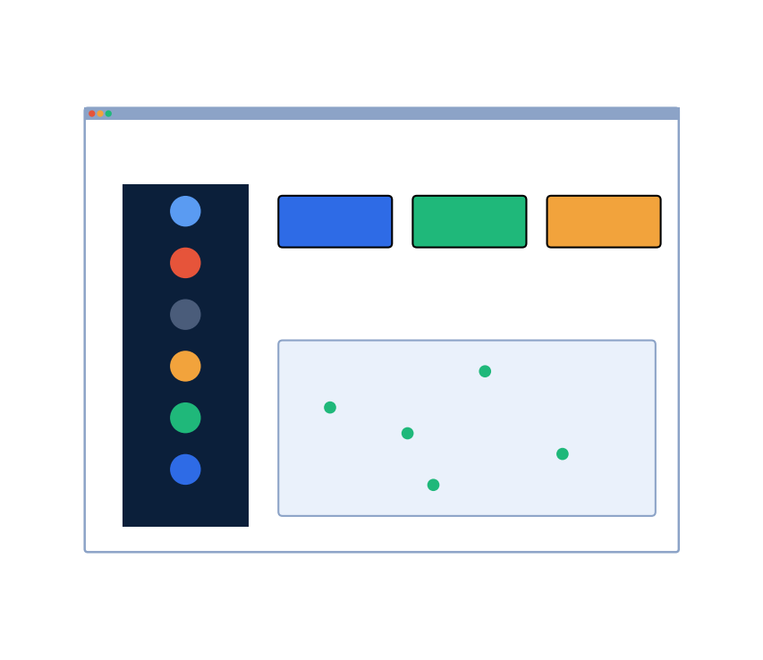
17 Admin Portal Capabilities
• Dashboard — real-time KPIs: total apps, active terminals, downloads today, top apps
• Apps — upload APKs, publish/unpublish, per-app download history, Excel export
• Categories — organize the catalog; click into a category to see its apps
• Customers — manage organizations and their app entitlements
• Terminals — view/rotate/retire device API keys
• Analytics Map — live geographic visualization of download events
• Downloads — searchable/filterable download event log

Slide 18
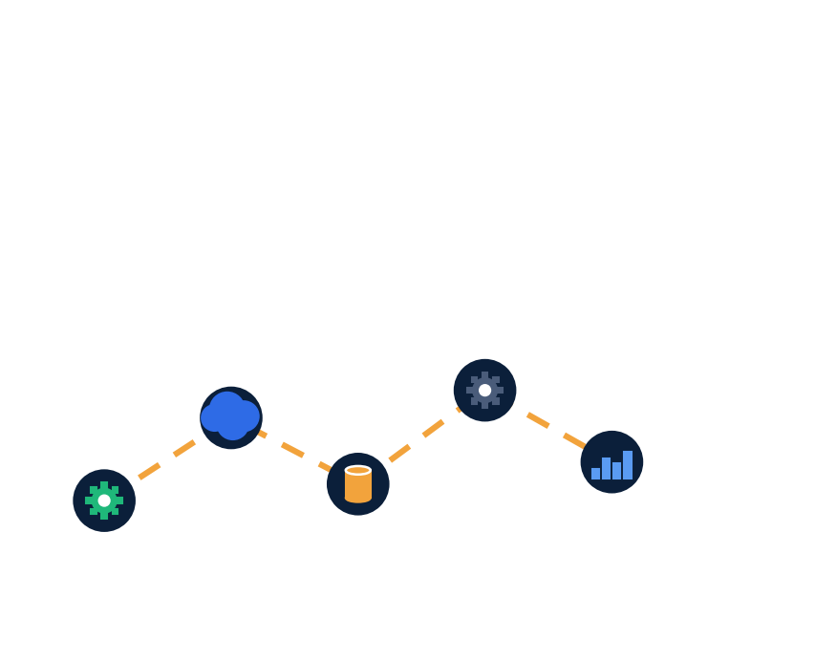
18 Roadmap & Future Enhancements
• Redis-backed catalog caching and async telemetry queue
• CDN integration (Cloudflare/CloudFront) in front of MinIO/S3
• PostgreSQL read replicas + PgBouncer connection pooling
• Kubernetes-based auto-scaling for the backend API tier
• Push-notification-driven, phased update rollout
• Enhanced reporting: scheduled digests, customizable dashboards

Slide 19
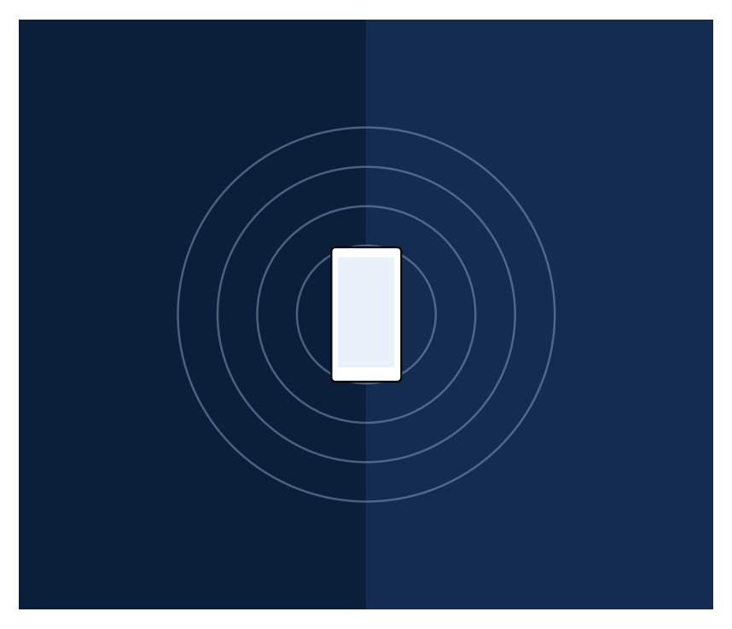
Thank You
WL Playstore — Secure, Scalable, Enterprise-Owned App Distribution
• Questions & Discussion

