Slide 1
Tuning of GPT2 model to generate abstracts for research articles
Viacheslav Pysmennyi
Hillel IT-school
2021

Slide 2
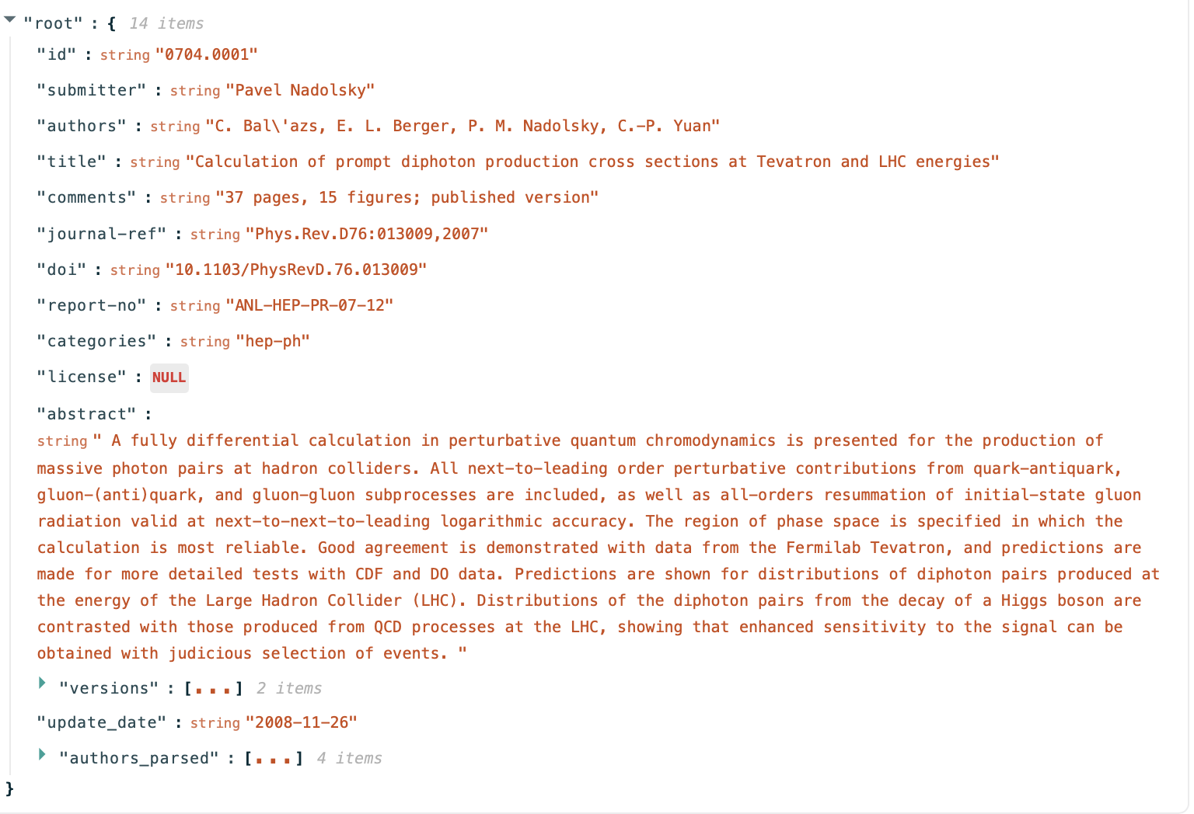
Dataset
Initial dataset is a json file containing metadata (including abstract) for articles from arXiv.org resource.
Link: https://www.kaggle.com/Cornell-University/arxiv

Slide 3
Dataset formatting
“abstract” item was extracted from initial dataset and wrapped with EOS and BOS tokens:
No of samples in dataset: 1,796,911

Slide 4
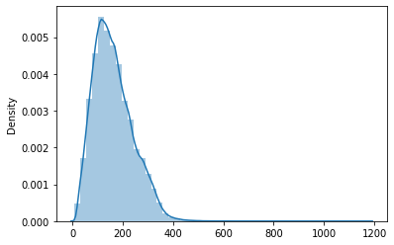
Tokens distribution
Average sample length: 162
Max sample length: 1179
% of samples with length > 256 tokens: 13%
Chosen max encoding length: 256

Slide 5
Model
GPT2-small (huggingface transformers library):
| Name | Type | Params
------------------------------------------
0 | model | GPT2LMHeadModel | 163 M
------------------------------------------
163 M Trainable params
0 Non-trainable params
163 M Total params
652.167 Total estimated model params size (MB)
Optimizer:
transformers.AdamW
Schedulers:
transformers. get_linear_schedule_with_warmup
transformers. get_cosine_schedule_with_warmup

Slide 6
Hardware
Google Colab
TPUv2
RAM 12 GB
CPU cores 2
Google Cloud
TPUv3
RAM 128 GB
CPU cores 16

Slide 7
Implementation using XLA driver for TPU processing
Training in Colab on 1 TPUv2 core:
Total samples: 80000
encoding_max_length | 256
num_tpu_cores | 1
train_batch_size | 2
train_size_percent | 95
num_epochs | 5
lr | 0.00005
warmup_steps | 100
epsilon | 1E-08

Slide 8
Training results
Training log:
TPU cores=1
Total elapsed: 7:47:55
Generated samples:
0 : planet This is a comment on a review article by D. Cazenave, P. Geitel, J. A. Kulkarni, A. J. Shor and B. I. Bohm. enger's papers ``Statistical analysis of the electromagnetic energy in a nonrelativistic plasma'' [arXiv:0808.4517] enger's comments ``The case for the existence of Lorentz-invariant and Lorentz-invariant energy scales for the total electromagnetic energy in relativistic plasmas'' [arXiv:0808.5377] enger's comments ``Nonrelativistic plasma models of the electromagnetic energy spectrum: implications of new physics models''
1 : planet We describe the recent development of the 3D magnetohydrodynamics code HADES for studying the evolution of magnetically-driven, rotating accretion disks. The code calculates stellar magnetospheres that are in a spin-down state, rotating rapidly, and which are highly magnetically-driven (R = 10^9 K and 3 degrees). As a first application, we calculate the vertical and radial distributions of accreting disks, in the presence of their spin-down or spin-up conditions. We show that at the stellar poles the vertical and radial distributions of accretion disks are dominated by disk-jet components. Thus the horizontal and vertical distributions of these accreting disks follow a different kinematical and structural phase than those of normal accreting disks. The disk-jet components contribute substantially to the rotational magnetization, and this effect can be enhanced when the disk inclination is angle-resolved. We also show how to modify the disk dynamics to
2 : planet Theoretical predictions of the neutrino mass hierarchy for the first few neutrino oscillation period after leptogenesis are presented. Numerical simulations of an isotropic (0.1,0.1) neutrino oscillation with a fixed number of particles and a fixed effective temperature of 0.01 $\mu$B are performed. The numerical results show that if the initial neutrino mass hierarchy for the first one year is of order $\mu$B, the second one year should be much larger than the first one year. If the initial neutrino mass hierarchy has a constant value $\mu_{13}=2\nu_\mu^2$, then the neutrino mass hierarchy must be of order $\mu_{13}^{+2}$ for some range of $\mu \ll 1$ and $\mu \ll 6$ times larger than $\mu_{11}=1.3 \nu_\mu^2
Epoch | Training Loss | Valid. Loss | Training Time | Validation Time
1 | 2.16 | 1.96 | 1:31:42 | 0:01:57
2 | 1.93 | 1.90 | 1:30:48 | 0:01:59
3 | 1.84 | 1.88 | 1:34:02 | 0:02:00
4 | 1.78 | 1.86 | 1:30:36 | 0:01:58
5 | 1.74 | 1.86 | 1:30:17 | 0:01:58

Slide 9
Implementation using pytorch-lightning
Training in Google Cloud on 8 TPUv3 cores
Total samples: 1000000
encoding_max_length | 256
num_tpu_cores | 8
train_batch_size | 24
train_size_percent | 96
num_epochs | 5
lr | 0.00005
warmup_steps | 100
epsilon | 1E-08

Slide 10
Training results
Generated samples:
0 : bipartisan We study the interaction between the charge-transfer electron (CTE) and the charge-transfer electron (CTE-ET) in an electron gas. In the case of a spin-orbit coupling the electron gas undergoes an irreversible transition between a spin-orbit-transition regime and a spin-orbit-reservoir regime, which is described by a generalized Green's function model. We show that the spin-orbit-transition time, the time at which the electron-electron interactions are suppressed and the electric field strength depend on the spin-orbit coupling. We calculate the exchange interaction and the charge-transfer electron (CTE) in the spin-orbit-transition regime and discuss the consequences of these results. uing
1 : bipartisan We have studied the effects of the orbital period of a stellar mass-dependent star-forming region on the evolution of its stellar mass function and the mass function of its host star. Using the method of a general nonparametric model we have considered the evolution of a sample of ~6,000 young stellar-forming regions, selected from the Local Group and the Galactic Plane, spanning the stellar-mass range 0.5 < M < 30 M_sun. We have found that the orbital period of the host star decreases with the mass of the star-forming region. We have found that the eccentricity of the host star decreases with M < M_sun, and the eccentricity of the stellar-mass-dependent star-forming region decreases with M < M_sun. The orbital period of the host star decreases with M < M_sun, while the orbital period of the stellar-mass-dependent star-forming region decreases with M < M_sun. The orbital period
2 : bipartisan The paper considers the following problem: To find the optimal number of particles for an optimal solution of the problem of minimizing the average number of particles required to be transferred to the destination of a wireless sensor system. To this end, a novel algorithm is proposed that combines the best known classical algorithm with an efficient algorithm that is more suitable for wireless sensor applications. The proposed algorithm is based on the use of a non-smooth bounded domain of the Shannon entropy. The proposed algorithm is able to approximate the Shannon entropy with an efficient approximation method. The theoretical results show that the proposed algorithm can successfully approximate the Shannon entropy of the wireless sensor system.
Training log:
TPU cores=8
Total elapsed: 3:12:02
Epoch | Training Loss | Valid. Loss | Training Time | Validation Time
1 | 2.70 | 2.87 | 0:37:59 | 0:00:47
2 | 2.47 | 2.50 | 0:37:45 | 0:00:28
3 | 2.38 | 2.37 | 0:38:10 | 0:00:29
4 | 2.32 | 2.30 | 0:37:38 | 0:00:28
5 | 2.29 | 2.25 | 0:37:49 | 0:00:29

Slide 11
Sampling parameters
decode_top_k | 50
decode_max_length | 200
decode_top_p | 0.92
decode_num_test_samples | 3

Slide 12
Thank you

