Slide 1
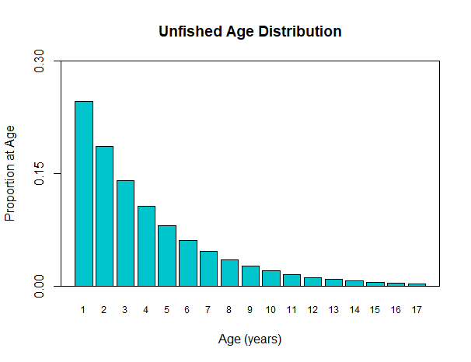
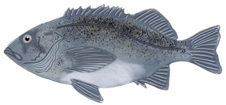
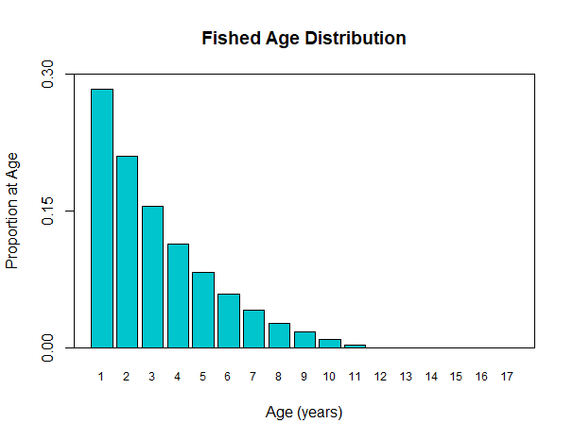
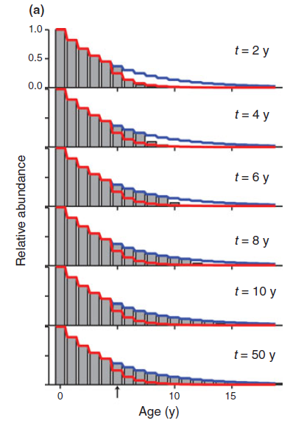
Accounting for population dynamics improves the use of no-take marine reserves for fishery management
Victoria Quennessen, MS Student in Fisheries and Wildlife, Oregon State University
Abstract: see abstract submitted for talk already
Effects of fishing on age structure
Unfished
Fished
Bigger, older individuals
Bigger, older individuals
After protections, the age structure fills back in over time
During the transition from a fished to an unfished age structure, the stock has transient dynamics
There is higher variability in population size
Timescales depend on M (natural mortality)
White et al., 2013

