Slide 1
Design of a SAR for LEO
Quentin Van Overmeere

Slide 2
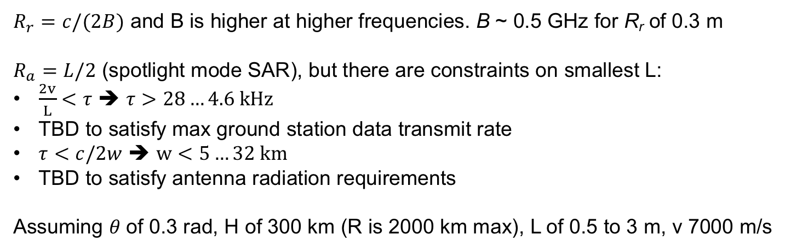
Choice of frequency band
Center f (GHz) | Advantages | 𝝀 (cm) | Power requirements (mW) | 𝝀_{board} (cm)
2.4 (L band) | Cheapest components Penetrates objects | 12
5.0 (C band) | Cheap components | 6
10 (X band) | Highest resolution | 3
$R_{r}=c/(2B)$ and B is higher at higher frequencies. B ~ 0.5 GHz for R_{r} of 0.3 m
$R_{a}=L/2$ (spotlight mode SAR), but there are constraints on smallest L:
$\frac{2v}{L}<τ$ ➔ $τ>28…4.6 kHz$
TBD to satisfy max ground station data transmit rate
$τ<c/2w$ ➔ $w<5…32 km$
TBD to satisfy antenna radiation requirements
Assuming 𝜃 of 0.3 rad, H of 300 km (R is 2000 km max), L of 0.5 to 3 m, v 7000 m/s

Slide 3
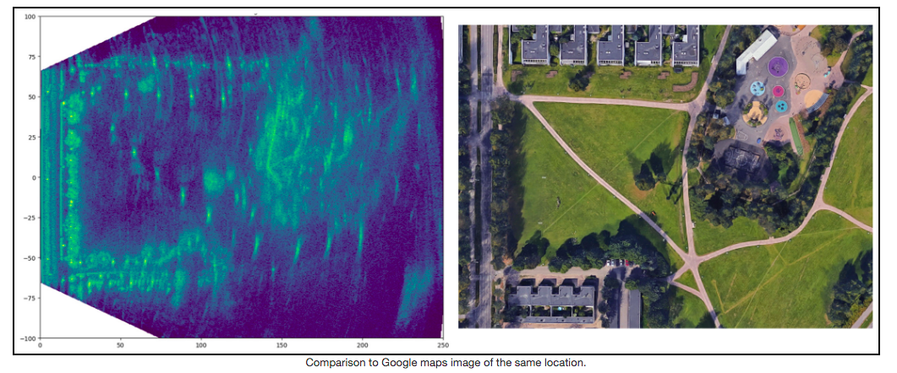
First design
Objectives
Build a 5 GHz FMCW radar
Familiarize hands-on with hardware and software required
Understand the trade-offs
First step to SAR prototype
https://hforsten.com/6-ghz-frequency-modulated-radar.html

Slide 4
Block diagram
PA
∫
VCO
ATT
Tx
MCU
LfA
LNA
ADC
Rx

Slide 5
Component selection (in progress)
Use 5180-5825 MHz wifi band
VCO: HMC431LP4E 5.5-6.1 GHz, 18.33 €
PA: TQP5525 6.61 €
Mixer: LTC5552IUDB#TRMPBF, 31.76 €
LNA: SKY65404-31, 1 €
Various filters: cheap
Voltage converters: cheap
MCU: ARM Cortex M0 Dual LPC4320FET100,551, 10 €

Slide 6
Timeline & milestones
1 yr ± 6 mo to engineering prototype (vs. 2 yr order-of-magnitude from George)
f < 10 GHz for design simplicity, unless weight constraints
Testing
Drones 45-90 m
Aeroclub 3-4 km
…

Slide 7
Additional ideas
Boost S/N of Rx by leveraging coldness of space
Leverage constellation by separating Tx/Rx

Slide 8
Leveraging contacts
George Daniel, radar lead at Cruise
ex-Xerox PARC
Phased arrays, beam-forming, metamaterial antennas & SAR
Could be a go-to person for troubleshooting and generating new ideas (beyond UCLouvain-network)

