Slide 1
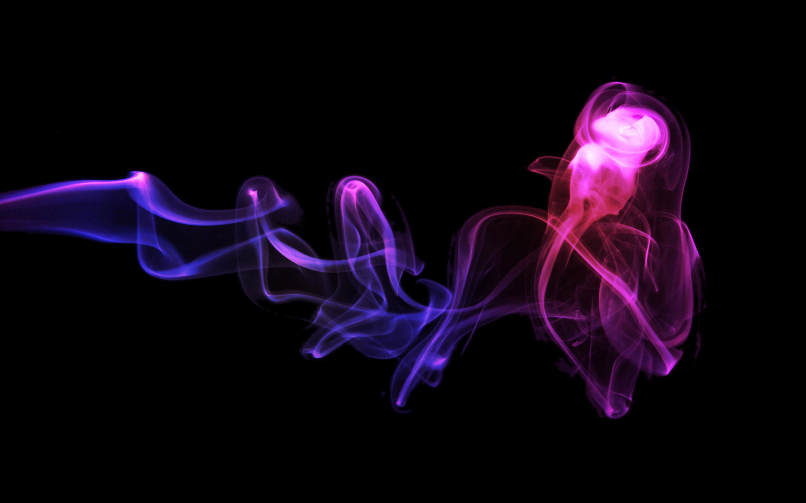

屌炸的setTimeout
题目只是为了
显得很牛逼，
仅此而已

Slide 2
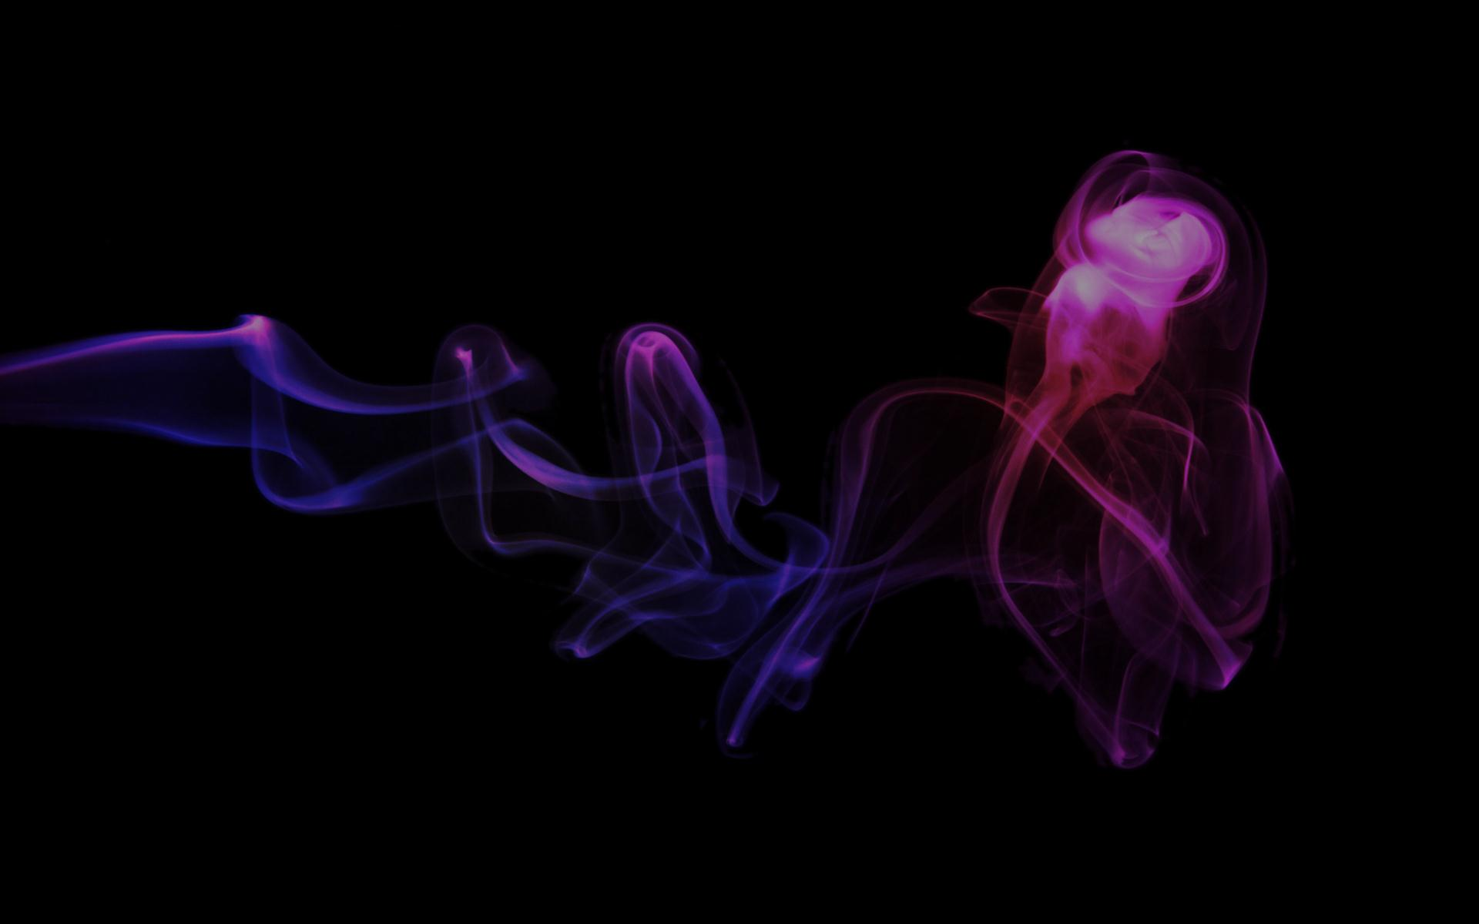
Preview
- What is setTimeout
- UI Thread
- The Real setTimeout
- A Fucking Example
- Others

Slide 3
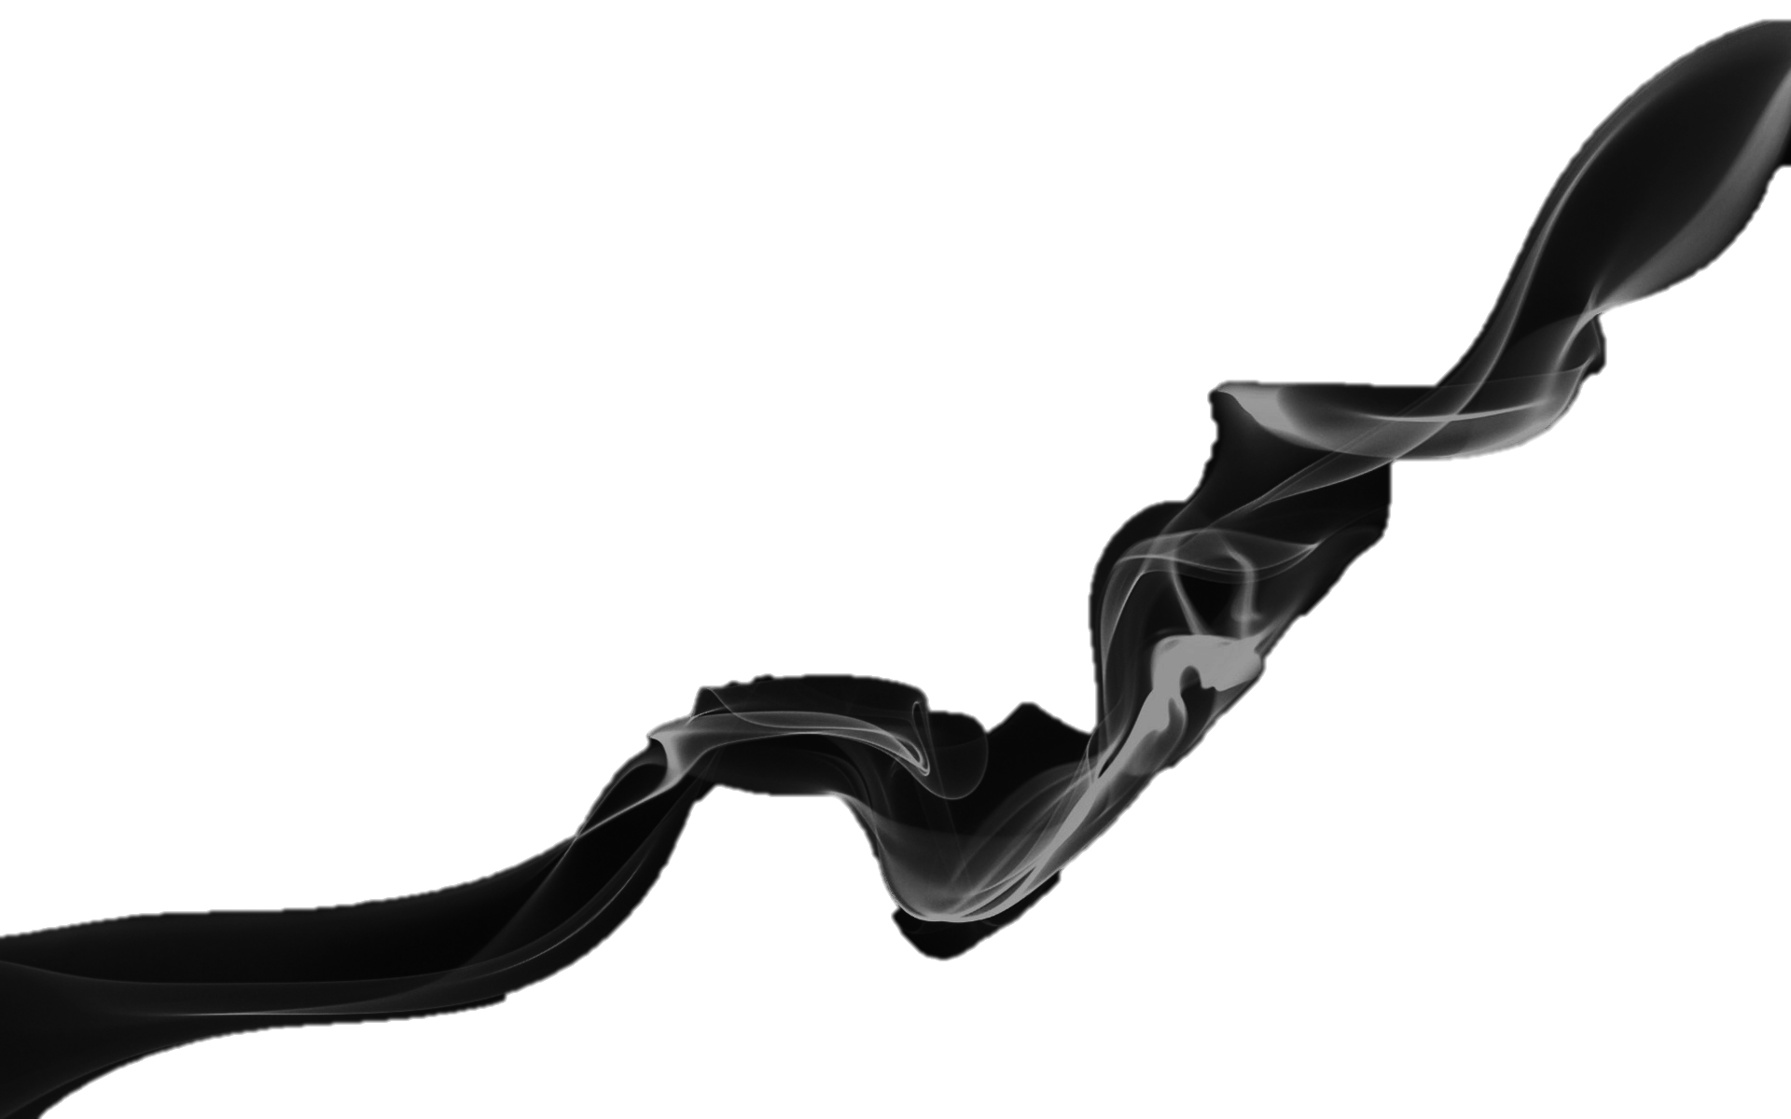
What is setTimeout
setTimeout(function, milliseconds)
This method calls the function once after a specified number of milliseconds elapses, until canceled by a call to clearTimeout.
The methods returns a timerID which may be used in a
subsequent call to clearTimeout to cancel the interval.
—— http://www.w3.org/TR/Window/#window-timers
3. HYPOTHESIS & RQs

Slide 4
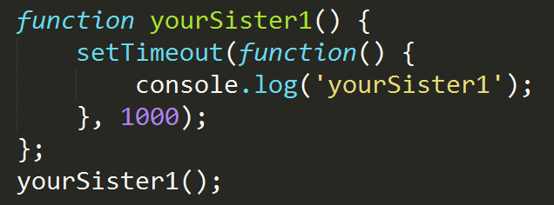
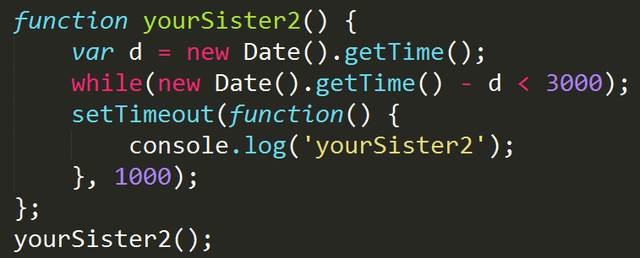
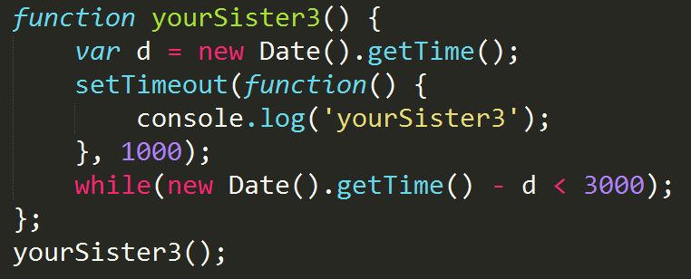
一秒之后，log出yourSister1
好几秒之后，log出yourSister2
跟楼上的一样……好几秒之后……
3. HYPOTHESIS & RQs

Slide 5
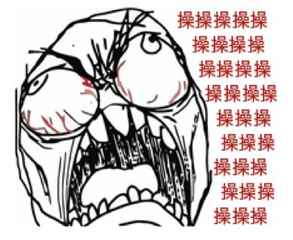
What is setTimeout
？
过milliseconds后调用function
3. HYPOTHESIS & RQs

Slide 6
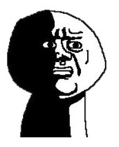
What is setTimeout
Why？What the fucking 影响setTimeout执行呢？
- 硬件本身
- 浏览器实现
- UI线程
3. HYPOTHESIS & RQs

Slide 7

UI Thread
共用于执行JavaScript代码和更新用户界面的进程通常称为“浏览器UI线程”。
UI线程的工作基于一个简单的队列系统，任务会保存到队列中直到进程空闲。
3. HYPOTHESIS & RQs

Slide 8
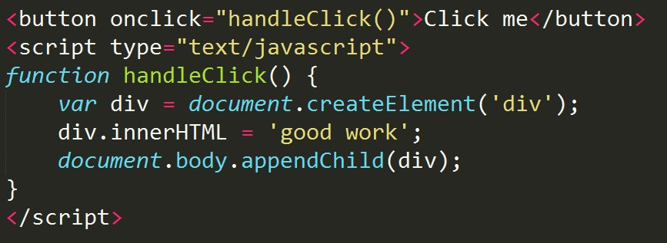
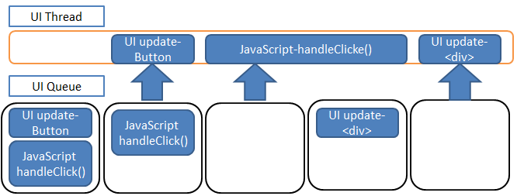
UI Thread
3. HYPOTHESIS & RQs

Slide 9

The Real setTimeout
setTimeout(function, milliseconds)：
- 过milliseconds时间后，调用 function
将
添加到任务队列中
- 什么时候调用function？
不知道……看你丫的代码去

Slide 10
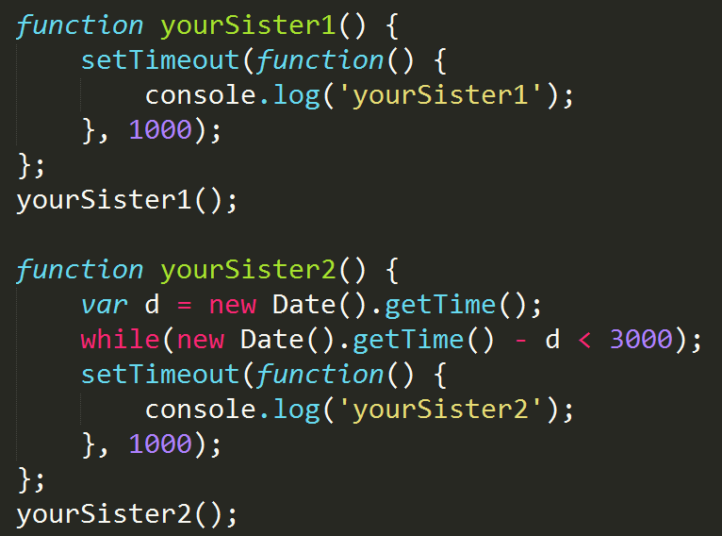
The Real setTimeout

Slide 11
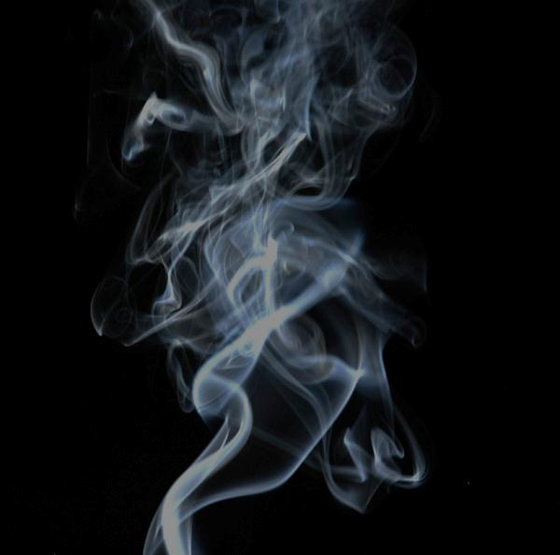
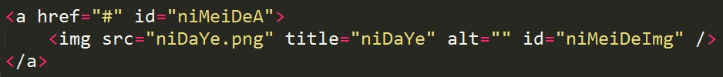
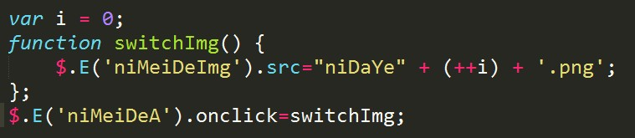
A Fuking Example
- IE6（7？）下改变img的src，图片有时无法正常显示

Slide 12
Others
- scope & this
- setInterval
- DOM的处理

Slide 13
The End
Q & A
THANK YOU

