Slide 1


NEXT GEN EMPLOYABILITY PROGRAM
CREATING A FUTURE-READY WORKFORCE
Student Name :
Vuddaraju Satyanarayana Raju
Student ID :
STU615488937cd371632929939
Mobile No:
6304223835
Mail ID:
vr2038@srmist.edu.in
College Name :
S.R.M Institute of Science and Technology.

Slide 2
CAPSTONE PROJECT SHOWCASE
Project Title
Power BI Driven Exhaustive Analysis of Indian Agriculture Sector.
Abstract | Problem Statement | Project Overview | Proposed Solution | Technology Used | Modelling & Results | Conclusion | Q&A

Slide 3
Abstract
1
This project utilizes Power BI to analyze 19 years of Indian agricultural data.
2
It aims to uncover trends in crop production, predict future yields based on historical information.
3
This Project also determines the minimum support prices for crops in specific years.
4
This project offers valuable insights into data analysis, visualization, and exploration using Power BI.

Slide 4


Problem Statement
India's agricultural sector is vast and complex. To improve crop production and ensure farmer livelihoods, it's crucial to analyze trends, predict yields, and optimize minimum support prices. However, manually analyzing 19 years of agricultural data is time-consuming and inefficient.
Solution: This project proposes using Power BI to analyze 19 years of Indian agricultural data. By leveraging data visualization and exploration capabilities, the project aims to:
1. Identify trends in crop production over time
2. Develop data-driven predictions for future crop yields
3. Recommend minimum support prices for crops based on historical data and market trends

Slide 5

Project Overview
Goal: Analyze 19 years of Indian agricultural data to gain insights into crop production trends, predict future yields, and determine minimum support prices.
Data Source: 19 years of Indian agricultural data (specific details about the data source would be beneficial if available).
Analysis Techniques: Power BI will be used for data exploration, visualization, and analysis.
Expected Outcomes: Identify trends in crop production, predict crop yields, and recommend minimum support prices based on data analysis.
Benefits: This project will provide valuable insights for stakeholders in the Indian agricultural sector, potentially leading to improved crop production planning, yield prediction accuracy, and optimized minimum support prices.

Slide 6
Proposed Solution
The proposed solution for this project involves utilizing Power BI to analyze 19 years of Indian agricultural data.
Power BI is a business intelligence tool that allows for data exploration, visualization, and manipulation and it facilitates data exploration and visualization, enabling the project to uncover trends in crop production over the past 19 years.
By leveraging Power BI's capabilities, the project aims to uncover trends in crop production over time, predict future yields based on historical data, and recommend minimum support prices for crops in specific years.

Slide 7

Technology used
Power BI

Slide 8
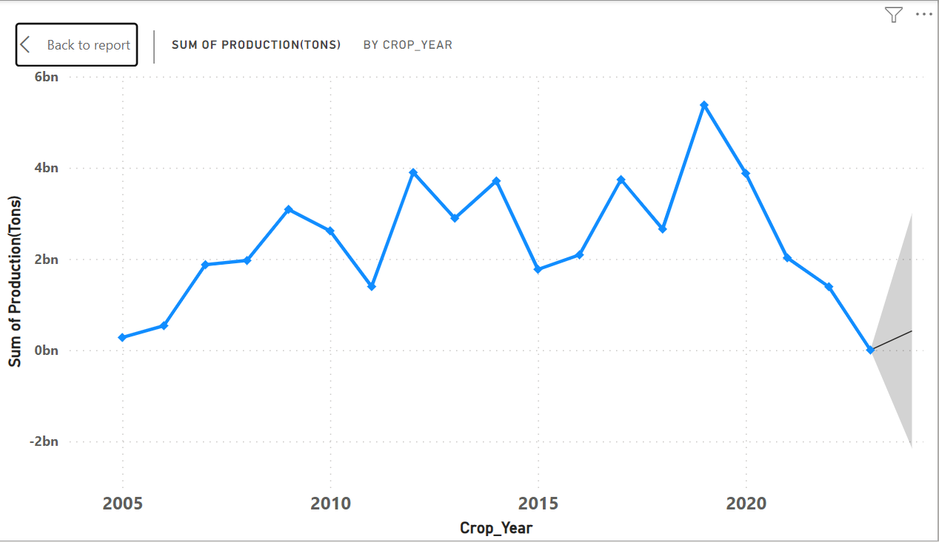
Modelling & Result

Slide 9
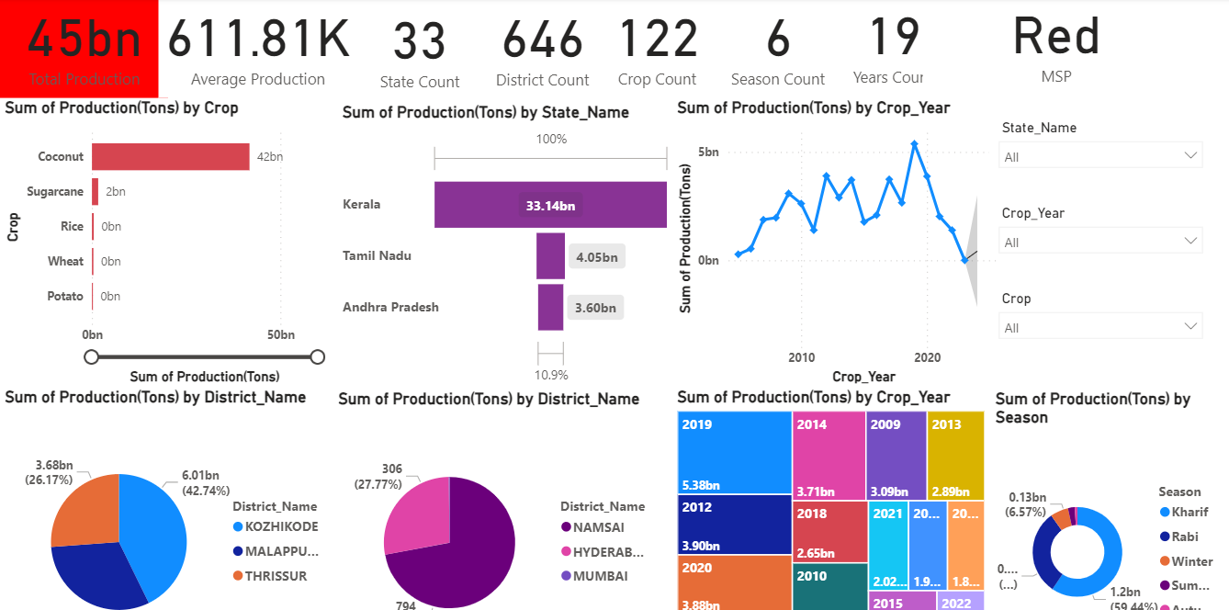
Modelling & Result

Slide 10
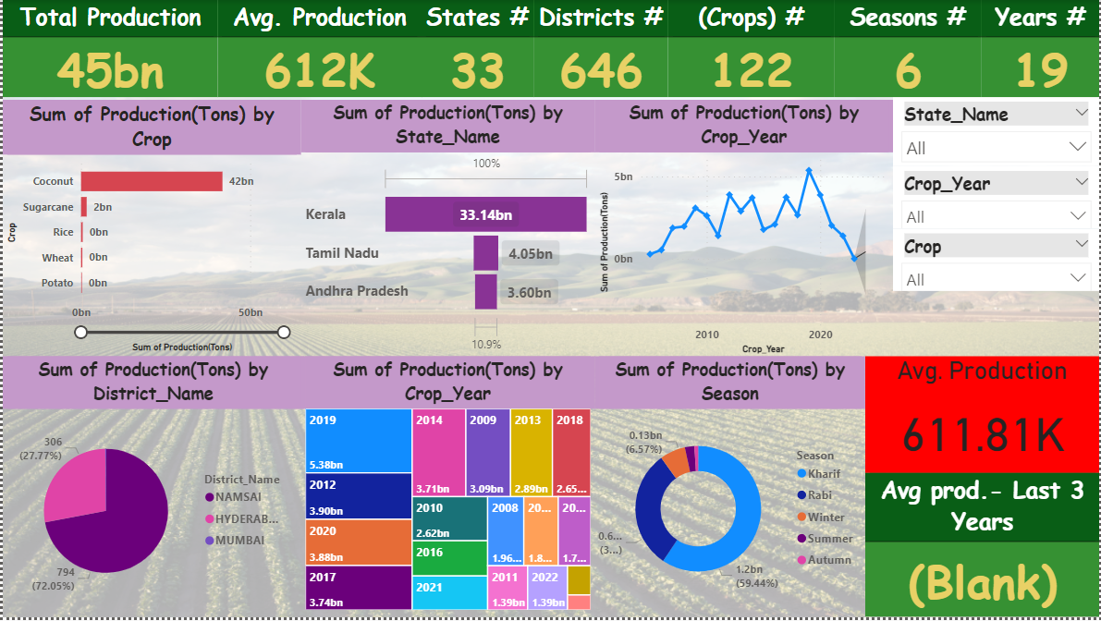
Modelling & Result

Slide 11
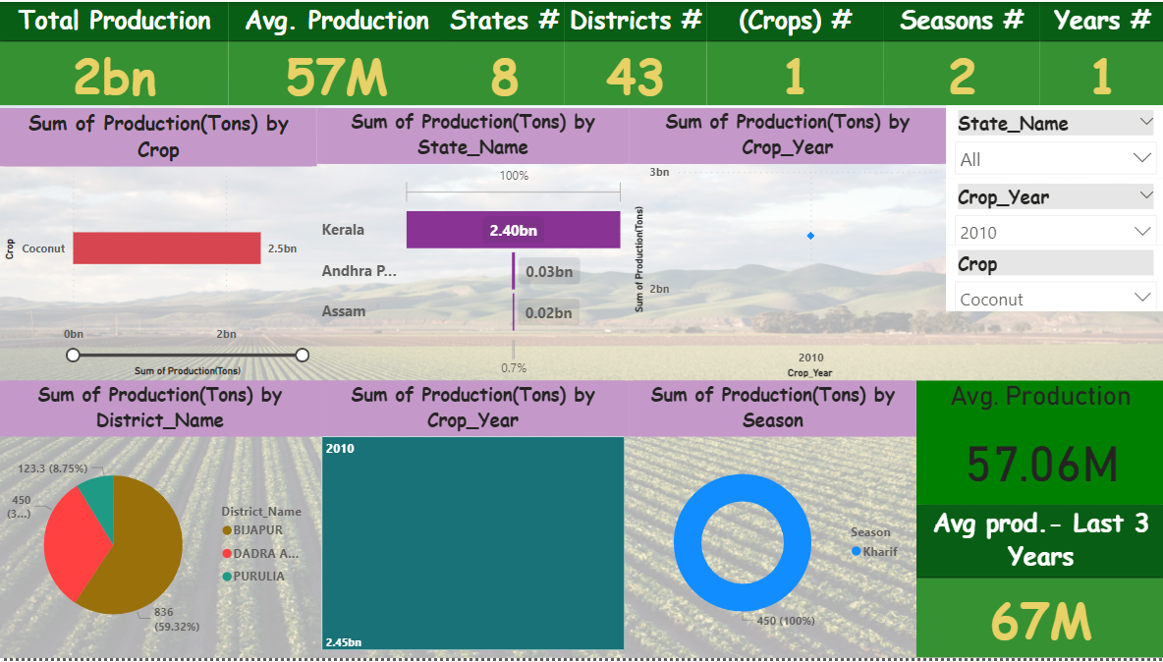
Modelling & Result

Slide 12

Conclusion
This project utilized Power BI to glean valuable insights from 19 years of Indian agricultural data.
By analyzing trends and historical information, the project successfully identified patterns in crop production, predicted future yields, and recommended minimum support prices.
This data-driven approach offers significant potential to improve agricultural planning, optimize resource allocation, and ensure better outcomes for stakeholders in India's agricultural sector.

Slide 13


Notes:
Thank You !!

