Slide 1
Altair Data Science Contest
By: Mithun V R
3rd Year Btech CSE Student

Slide 2
What I Analysed?
I took a data set of students which contains student details and their scores in test.
The data set contains many factors like family size, time spend studying and etc.
What I done is I analysed those attributes and done a prediction model out of it through various process.
In this ppt I take you through the process of making a predictive model for students with their details as input.

Slide 3
Attributes Definition
school - student's school (binary: "GP" - Gabriel Pereira or "MS" - Mousinho da Silveira)
sex - student's sex (binary: "F" - female or "M" - male)
age - student's age (numeric: from 15 to 22)
address - student's home address type (binary: "U" - urban or "R" - rural)
famsize - family size (binary: "LE3" - less or equal to 3 or "GT3" - greater than 3)
Pstatus - parent's cohabitation status (binary: "T" - living together or "A" - apart)
Medu - mother's education (numeric: 0 - none, 1 - primary education (4th grade), 2 – 5th to 9th grade, 3 – secondary education or 4 – higher education)
Fedu - father's education (numeric: 0 - none, 1 - primary education (4th grade), 2 – 5th to 9th grade, 3 – secondary education or 4 – higher education)
Mjob - mother's job (nominal: "teacher", "health" care related, civil "services" (e.g. administrative or police), "at_home" or "other")
Fjob - father's job (nominal: "teacher", "health" care related, civil "services" (e.g. administrative or police), "at_home" or "other")

Slide 4
Attributes Definition
reason - reason to choose this school (nominal: close to "home", school "reputation", "course" preference or "other")
guardian - student's guardian (nominal: "mother", "father" or "other")
traveltime - home to school travel time (numeric: 1 - <15 min., 2 - 15 to 30 min., 3 - 30 min. to 1 hour, or 4 - >1 hour)
studytime - weekly study time (numeric: 1 - <2 hours, 2 - 2 to 5 hours, 3 - 5 to 10 hours, or 4 - >10 hours)
failures - number of past class failures (numeric: n if 1<=n<3, else 4)
schoolsup - extra educational support (binary: yes or no)
famsup - family educational support (binary: yes or no)
paid - extra paid classes within the course subject (Math or Portuguese) (binary: yes or no)
activities - extra-curricular activities (binary: yes or no)
nursery - attended nursery school (binary: yes or no)

Slide 5
Attribute Definition
higher - wants to take higher education (binary: yes or no)
internet - Internet access at home (binary: yes or no)
romantic - with a romantic relationship (binary: yes or no)
famrel - quality of family relationships (numeric: from 1 - very bad to 5 - excellent)
freetime - free time after school (numeric: from 1 - very low to 5 - very high)
goout - going out with friends (numeric: from 1 - very low to 5 - very high)
Dalc - workday alcohol consumption (numeric: from 1 - very low to 5 - very high)
Walc - weekend alcohol consumption (numeric: from 1 - very low to 5 - very high)
health - current health status (numeric: from 1 - very bad to 5 - very good)
absences - number of school absences (numeric: from 0 to 93)
G1 - first period grade (numeric: from 0 to 20)
G2 - second period grade (numeric: from 0 to 20)
G3 - final grade (numeric: from 0 to 20, output target)

Slide 6
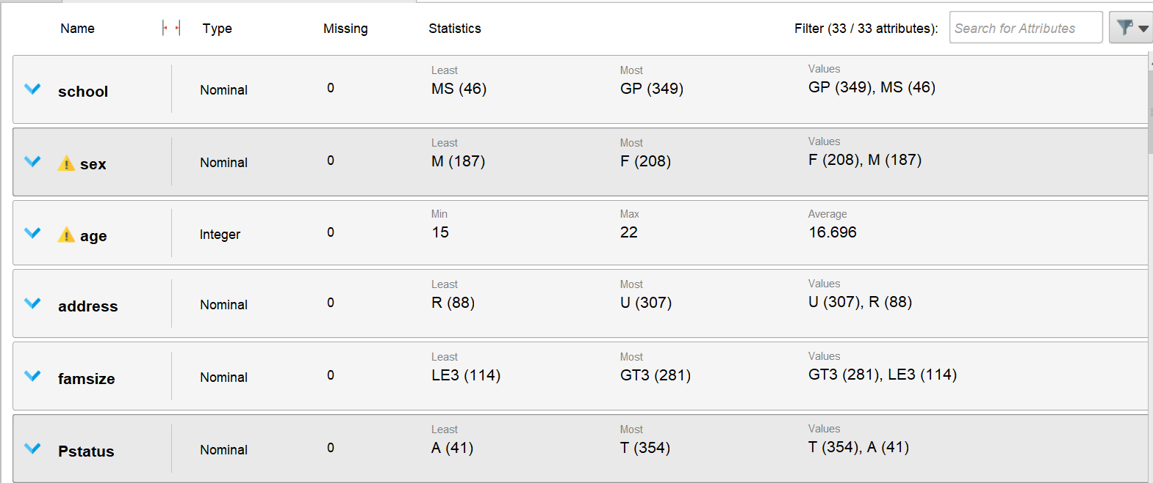
Lets Start with EDA
Summary Stats:

Slide 7
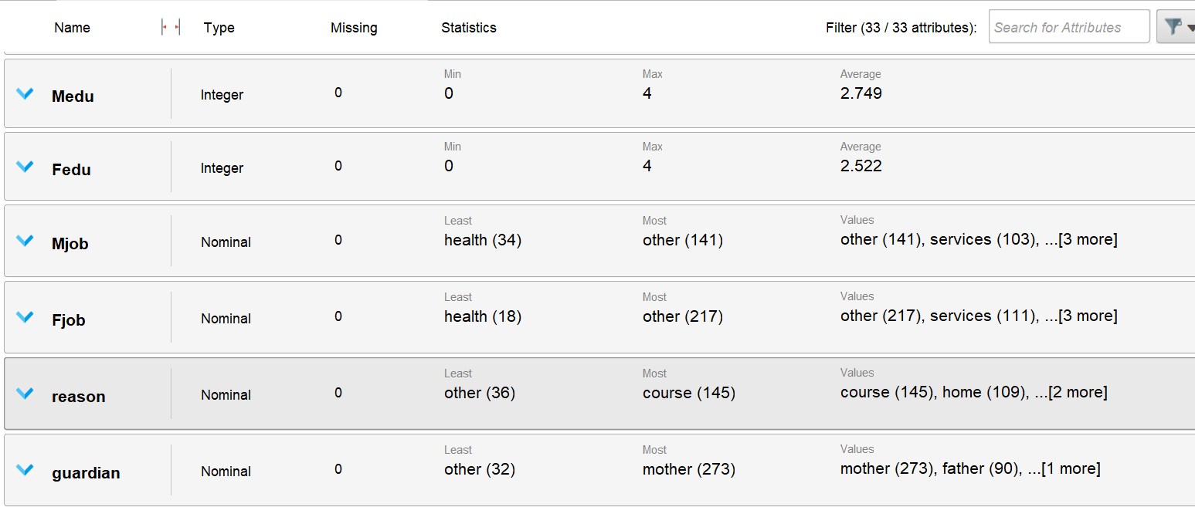
Summary Stats:

Slide 8
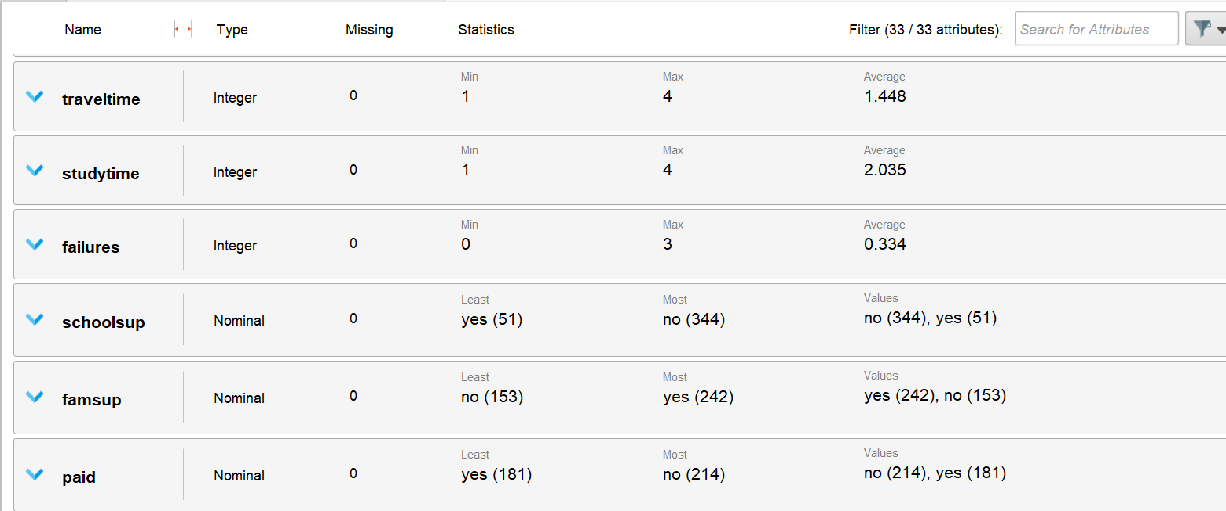
Summary Stats

Slide 9
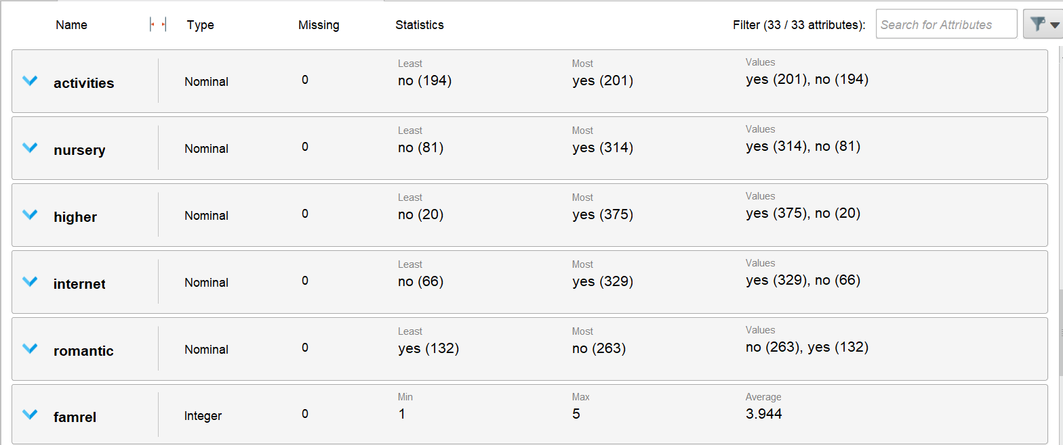
Summary Stats

Slide 10
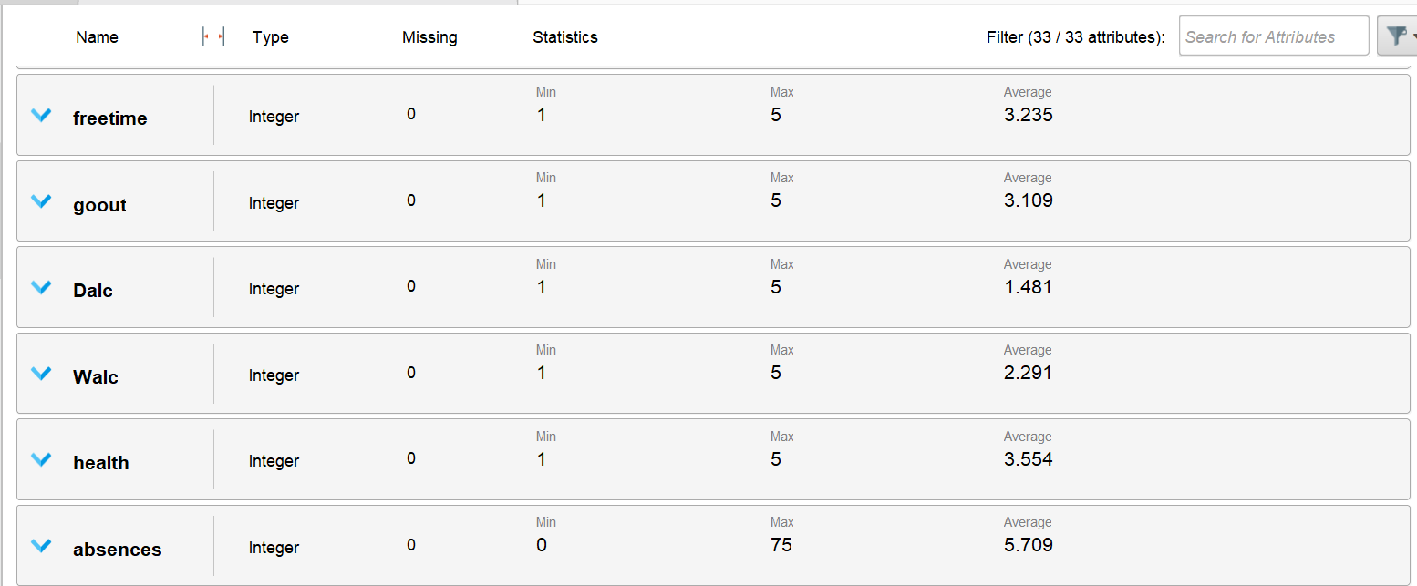
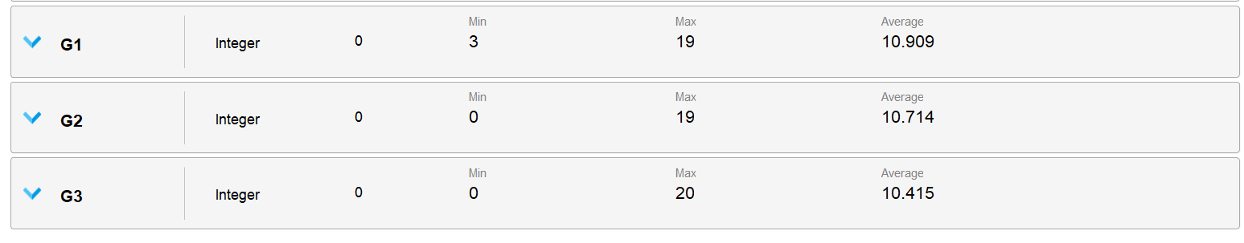
Summary Stats

Slide 11
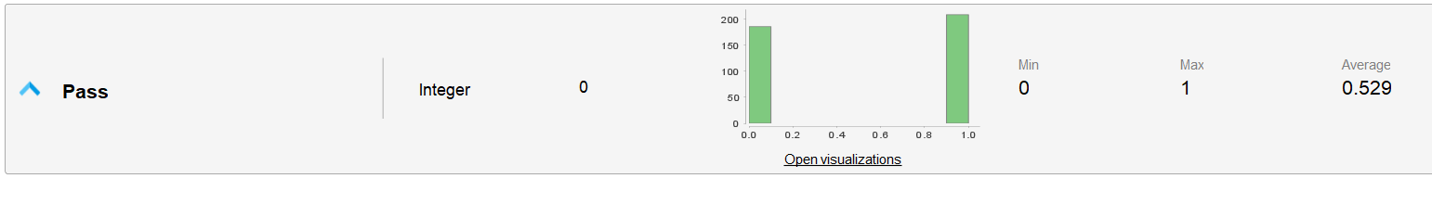
Adding New Attribute
If G3 score is greater than 10 we consider the student pass else fail.
0 indicates the student failed and 1 indicates the student passed

Slide 12
Dataset Summary – Student Performance
Size: 395 student records × 33 attributes
Target Variable:
G3 (final grade, range: 0–20)
Pass (derived label: 1 = pass, 0 = fail, based on G3)
Class balance: ~53% pass, ~47% fail → fairly balanced
Attribute Types:
  Numeric (continuous/ordinal): age, study time, travel time, failures, absences, alcohol consumption (workdays/weekends), health, family relation quality, free time, going out, grades (G1, G2, G3).
  Categorical (nominal): school, sex, address (urban/rural), family size, parent status, parental education/job, reason for school choice, guardian, extracurricular activities, internet access, romantic relationship, higher education intention, school/family support

Slide 13
Dataset Summary – Student Performance
Key Statistics:
  Age: Mean ~16.7 (range: 15–22 years)
  Grades:
    G1 (first period): Mean ~10.9 / 20
    G2 (second period): Mean ~10.7 / 20
    G3 (final): Mean ~10.4 / 20
  Absences: Mean ~5.7, but highly skewed (max = 75)
  Failures: Most students have 0 failures; max recorded = 3
  Parental education (Medu, Fedu): Averages around “high school level” (2–3 on scale 0–4)
  Supports:
    School support: 51 yes vs 344 no (rare)
    Family support: 242 yes vs 153 no (balanced)
  Internet: Majority have internet (329 yes vs 66 no)
  Romantic relationship: 132 yes vs 263 no

Slide 14
Dataset Summary – Student Performance
Observations:
  Dataset is clean: no missing values.
  Some attributes are imbalanced (e.g., higher education = almost all yes, school support = mostly no).
  Some features have outliers/skewness (absences, alcohol consumption).
  Target variable (Pass/Fail) is balanced → good for modeling.

Slide 15
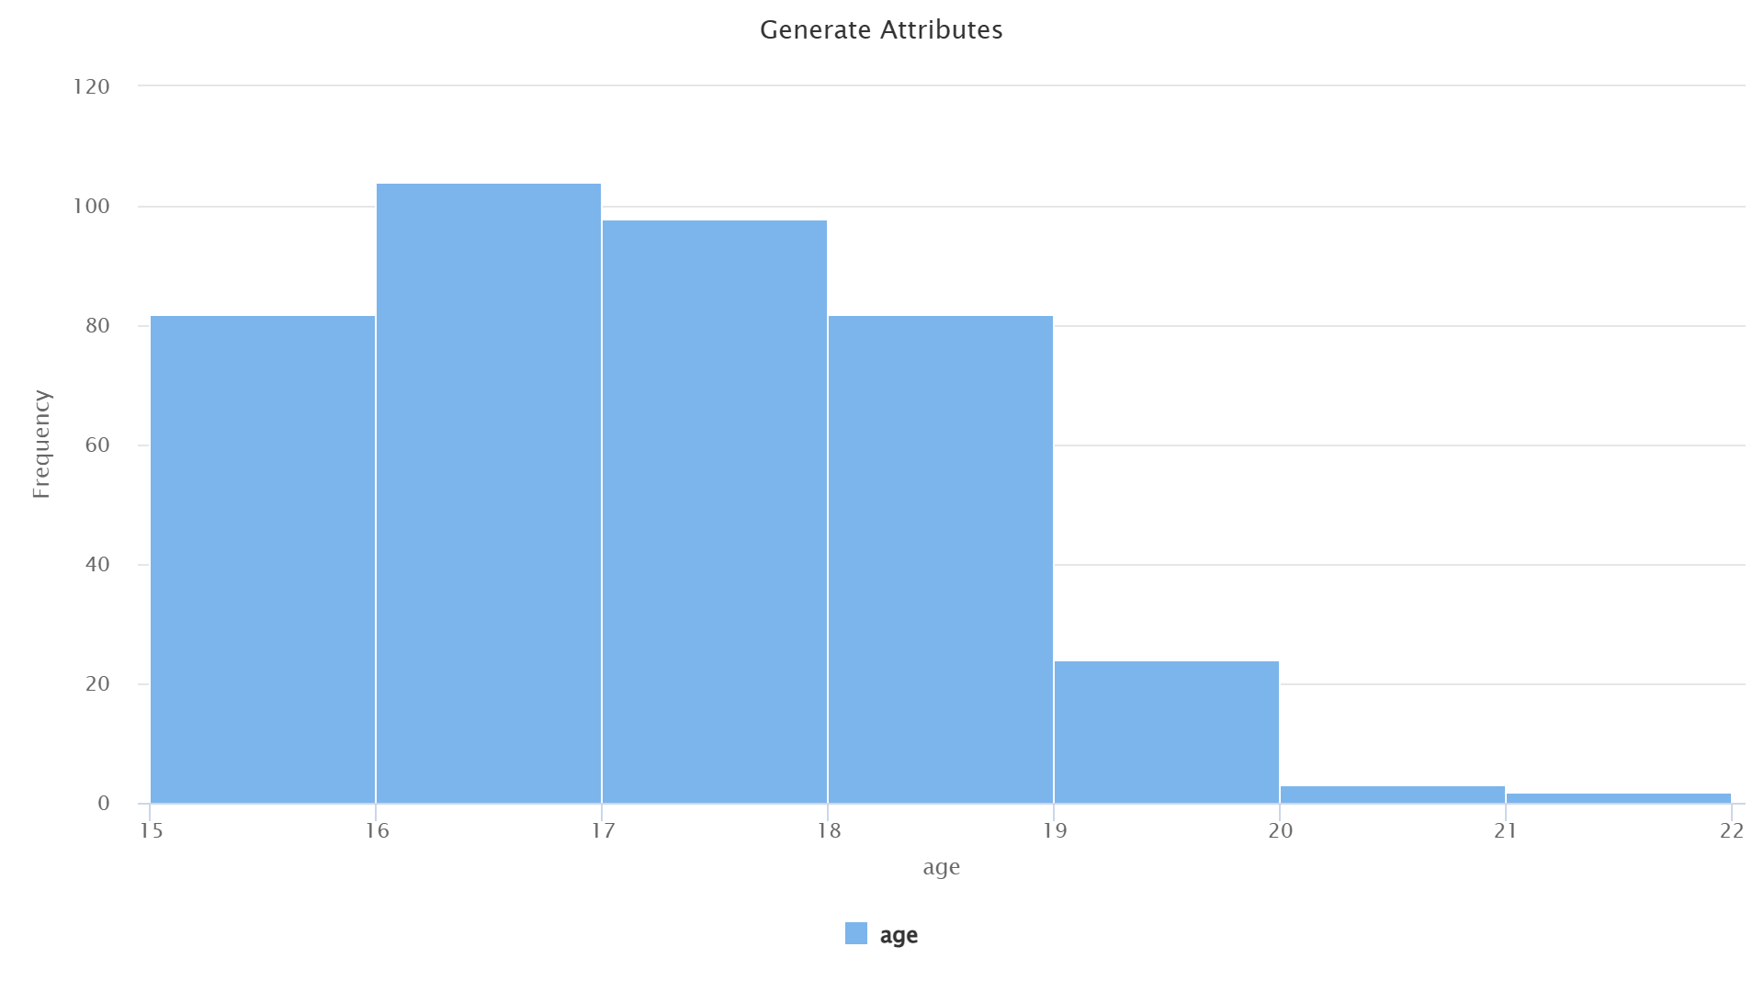
Univariate EDA
Age Distribution:
Majority of students are between 15–19 years, which matches the typical high school range.
Only a few students are above 20 → they might be repeaters.

Slide 16
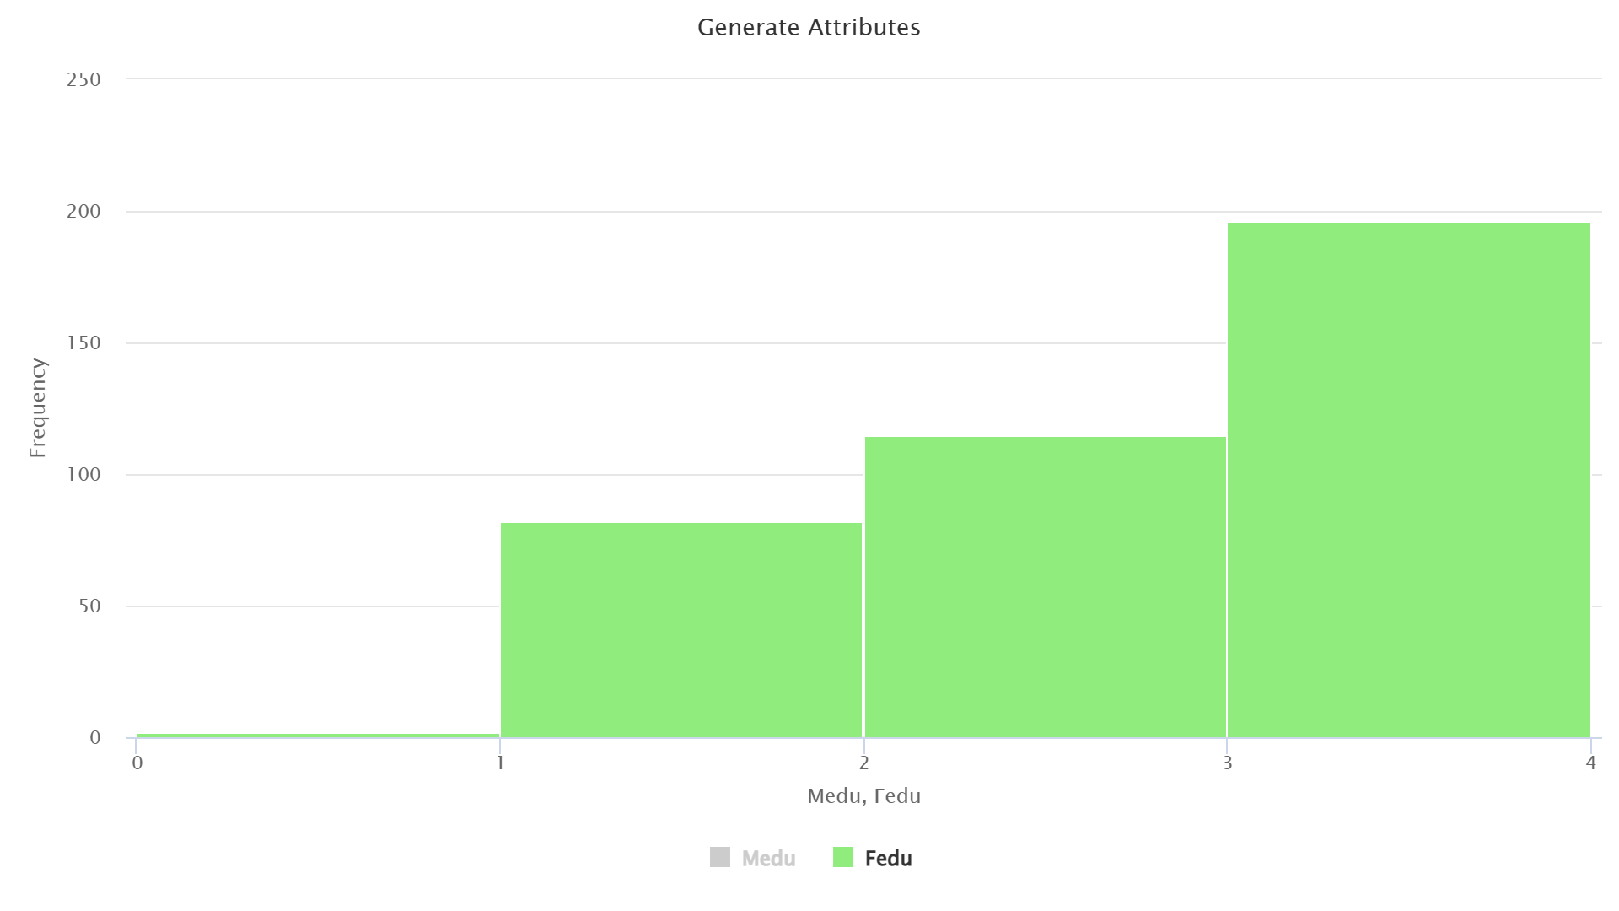
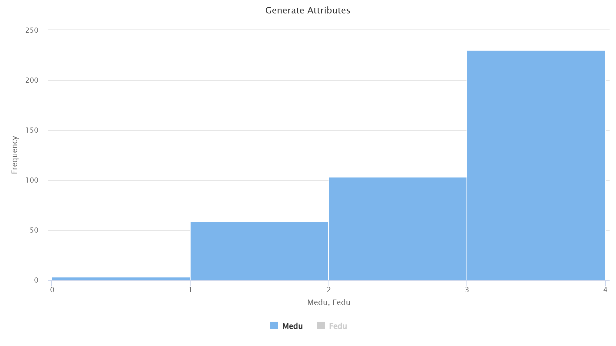
Univariate EDA
Parental Education (Medu & Fedu)
Most parents fall between 1–4 levels (primary to higher education).
Extreme values (0 = no education) are rare → dataset not heavily skewed toward illiterate parents.

Slide 17
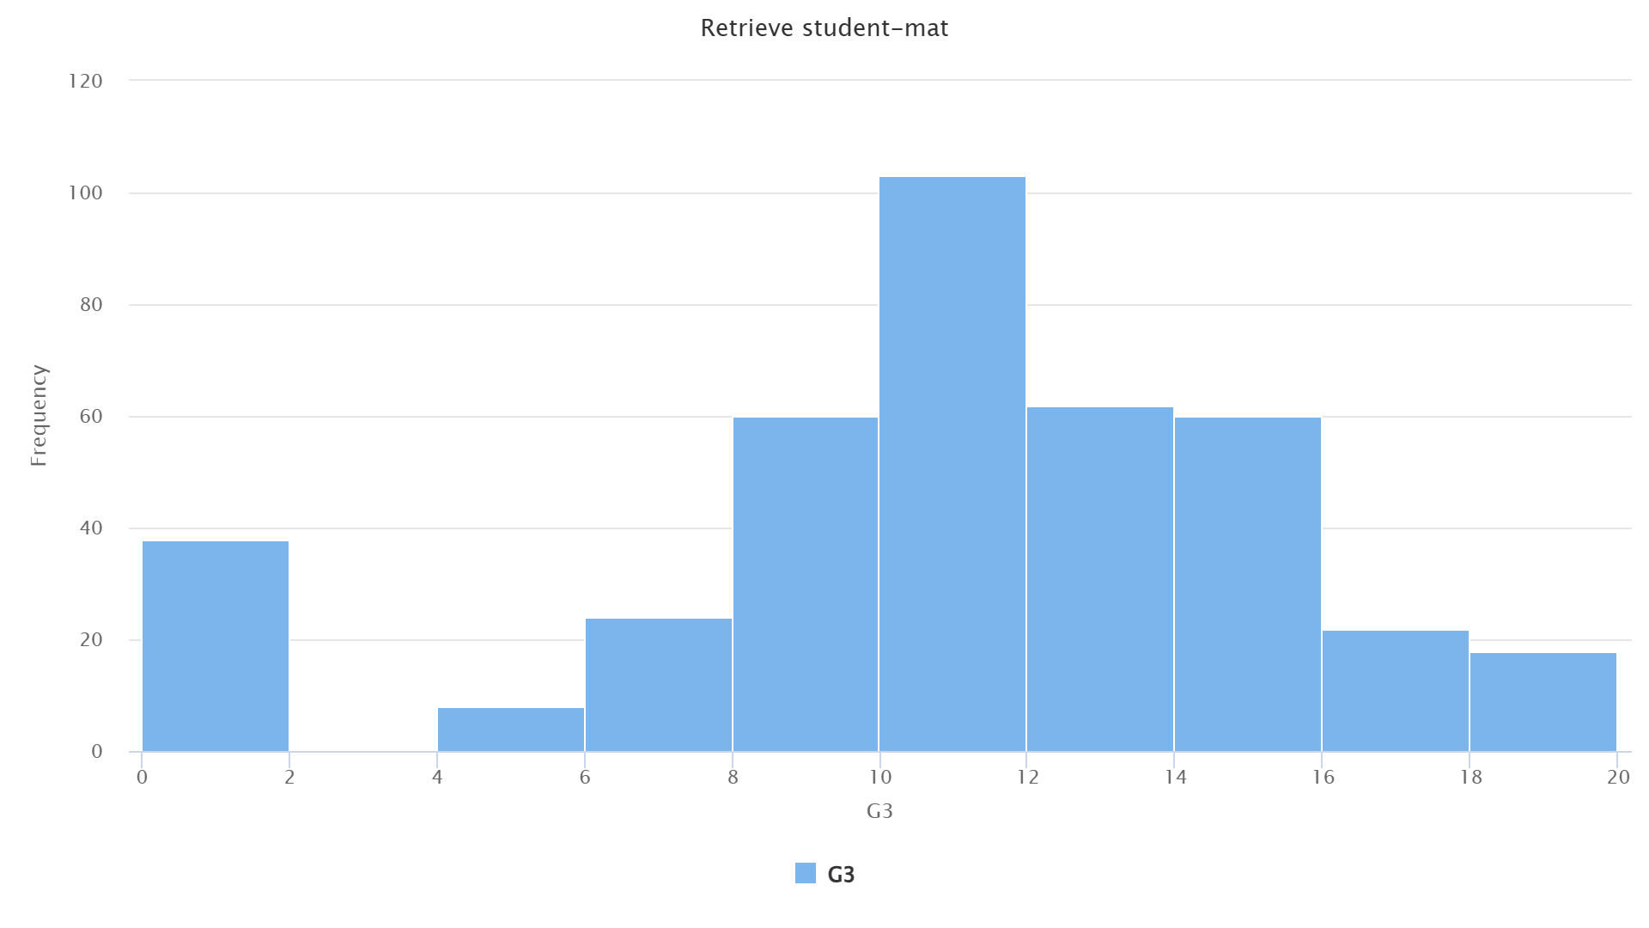
Univariate EDA
Final Grade (G3)
Histogram of G3 is approximately normal, no strong skewness.
Suggests performance distribution is balanced, not dominated by either low or high scorers.

Slide 18
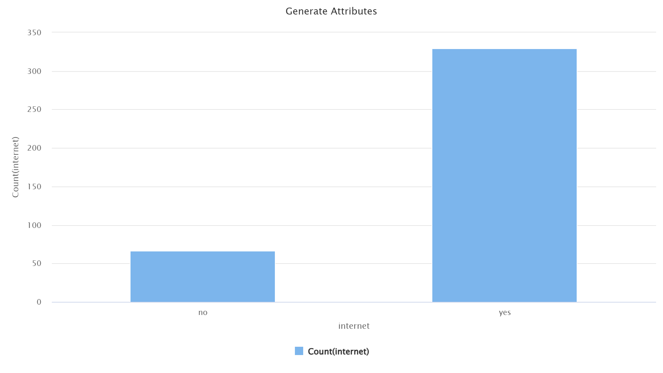
Univariate EDA
Internet Access
~350 students have internet, while ~70 don’t.
Majority having internet access means it may not be a strong differentiator unless linked with outcomes.

Slide 19
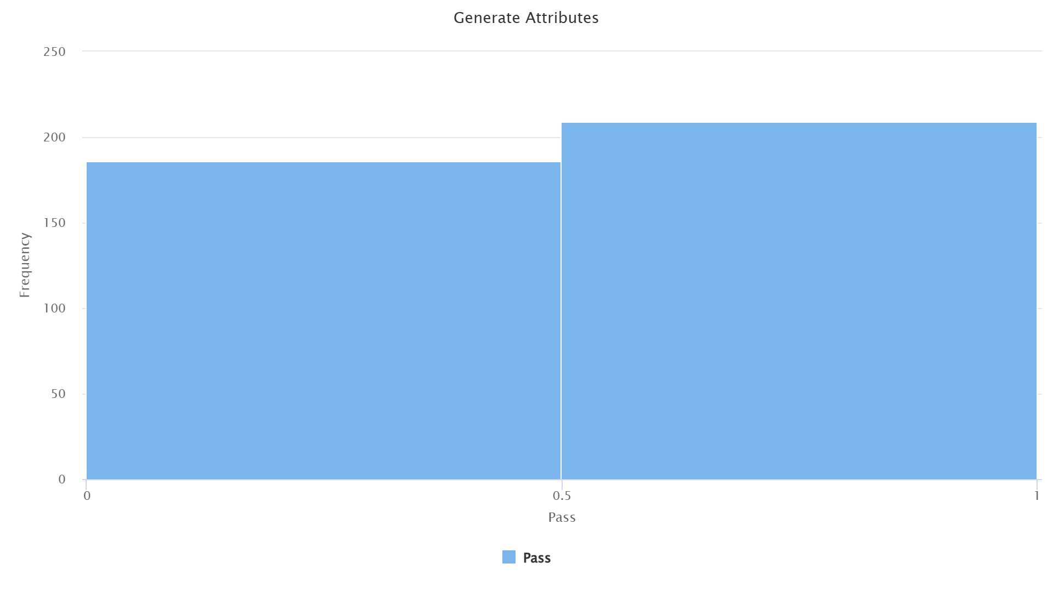
Univariate EDA
Pass/Fail Distribution
Almost equal split between pass and fail → good for classification (balanced target variable).

Slide 20
Bivariate EDA
Bivariate Analysis
  The purpose of bivariate analysis is to understand how individual attributes relate to student performance (G3 / Pass). By studying pairwise relationships, we can identify factors that strongly influence final grades and separate meaningful predictors from weaker ones.
We focus on the following groups of attributes:
  Study-Related Factors
    Attributes: studytime, failures, absences
    Reason: These directly represent learning effort and attendance, which are expected to correlate with academic success.
  Performance History
    Attributes: G1, G2 (previous period grades)
    Reason: Earlier grades often indicate consistency and are strong predictors of the final grade (G3).

Slide 21
Bivariate EDA
Family & Parental Background
  Attributes: famrel, famsup, Medu, Fedu
  Reason: Family environment and parental support can provide motivation and resources, which may influence academic performance.
Social & Lifestyle Factors
  Attributes: romantic, goout, Dalc, Walc
  Reason: Social life and lifestyle habits can distract students from studies, potentially lowering performance.
Other Environment Factors
  Attributes: school, internet, activities, sex
  Reason: School resources, internet access, and gender differences might play a role in performance, though possibly weaker compared to study/lifestyle factors.

Slide 22
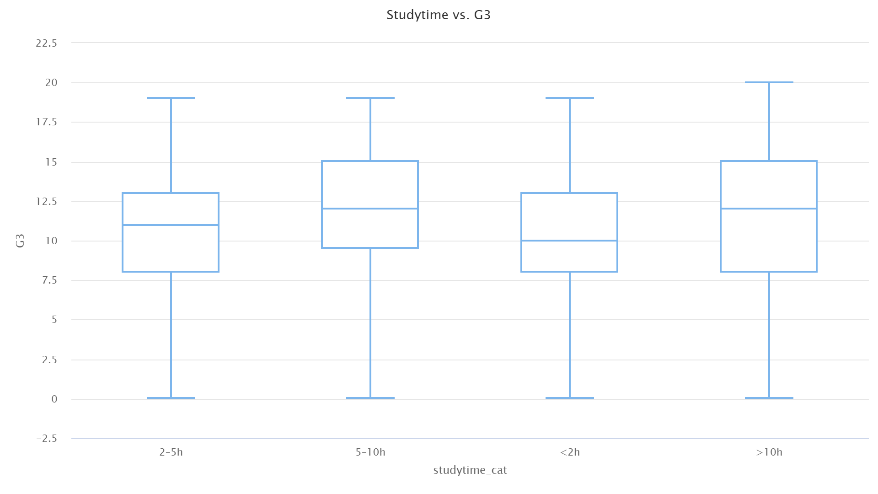
Bivariate EDA
Studytime vs. G3 (Boxplot):
The grade distribution across studytime categories shows minimal skewness and no major outliers.
Students with higher studytime tend to achieve better grades, though the improvement isn’t dramatic.

Slide 23
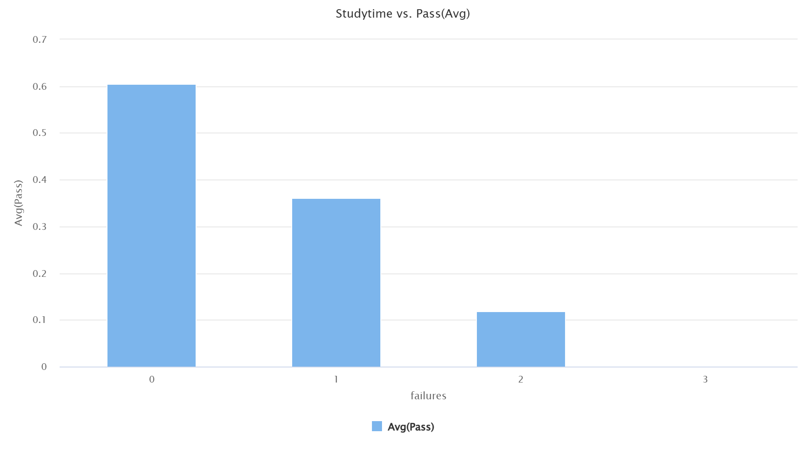
Bivariate EDA
Studytime vs. Pass Rate (Aggregated Barplot):
By averaging the Pass variable (0 = fail, 1 = pass), we see a clear positive correlation.
Students who dedicate more weekly study hours have a higher likelihood of passing, confirming that study effort matters.

Slide 24
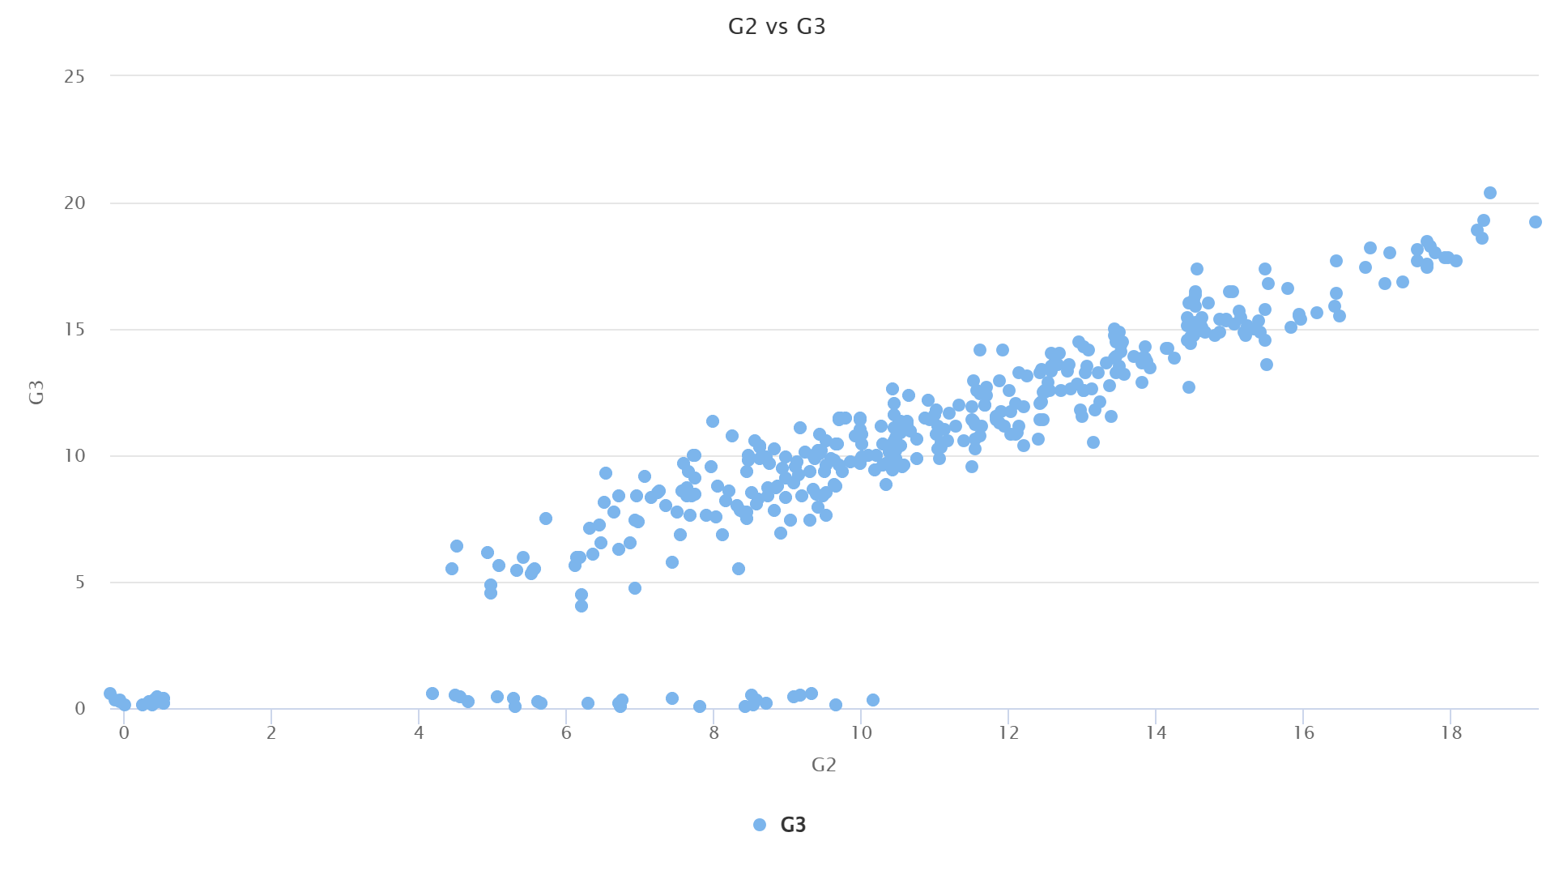
Bivariate EDA
G2 vs. G3 (Scatterplot):
A strong linear relationship is observed: students with higher second-period grades (G2) almost always secure higher final grades (G3).
This indicates that academic consistency is a major factor in predicting final outcomes.

Slide 25
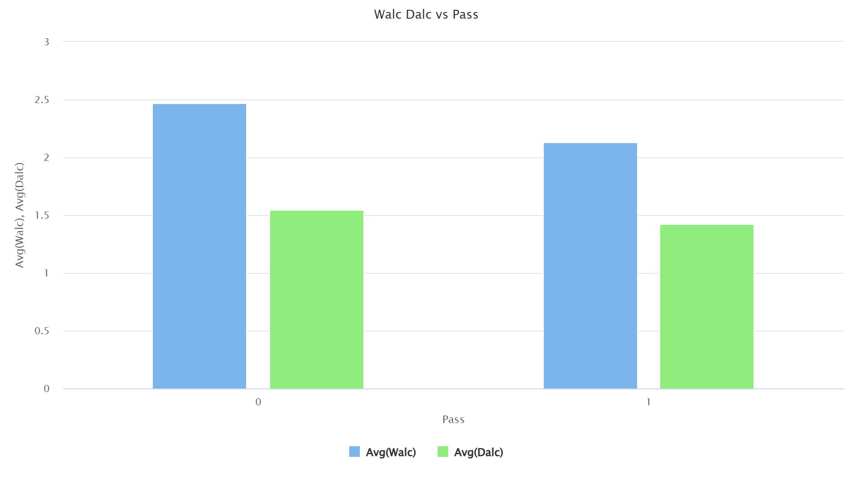
Bivariate EDA
Weekend Alcohol Consumption
(Walc) vs Pass (Aggregate Barplot):
Observation:
  Average alcohol consumption is slightly lower in pass=1 compared to pass=0.
Insight:
  Heavy alcohol use is linked with slightly lower pass rates.
  Though not a huge difference, it supports the intuition that lifestyle habits affect academic outcomes.

Slide 26
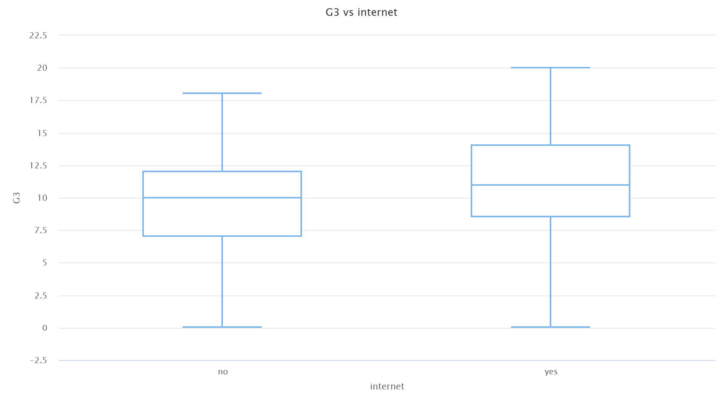
Bivariate EDA
Internet Access vs G3 (Boxplot):
Observation:
  Students without internet: median ≈ 10, range 0–18.
  Students with internet: median ≈ 11, range 0–20.
Insight:
  Having internet shows a slight positive effect on final grades.
  The difference isn’t huge, but availability of internet access might provide better resources for study and homework.

Slide 27
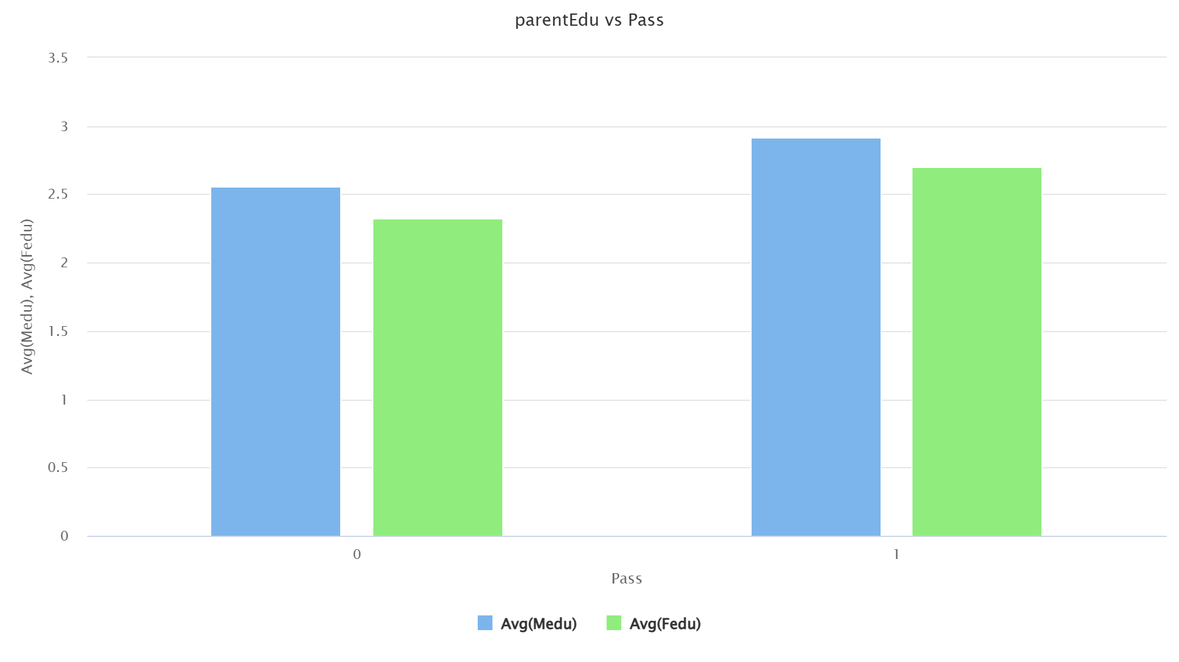
Bivariate EDA
Parental Education (Fedu & Medu) vs Pass (Grouped Barplot):
Observation:
  Average parental education is higher for pass=1 compared to pass=0.
Insight:
  Students whose parents are better educated are more likely to pass.
  This suggests family background and guidance influence academic success.

Slide 28
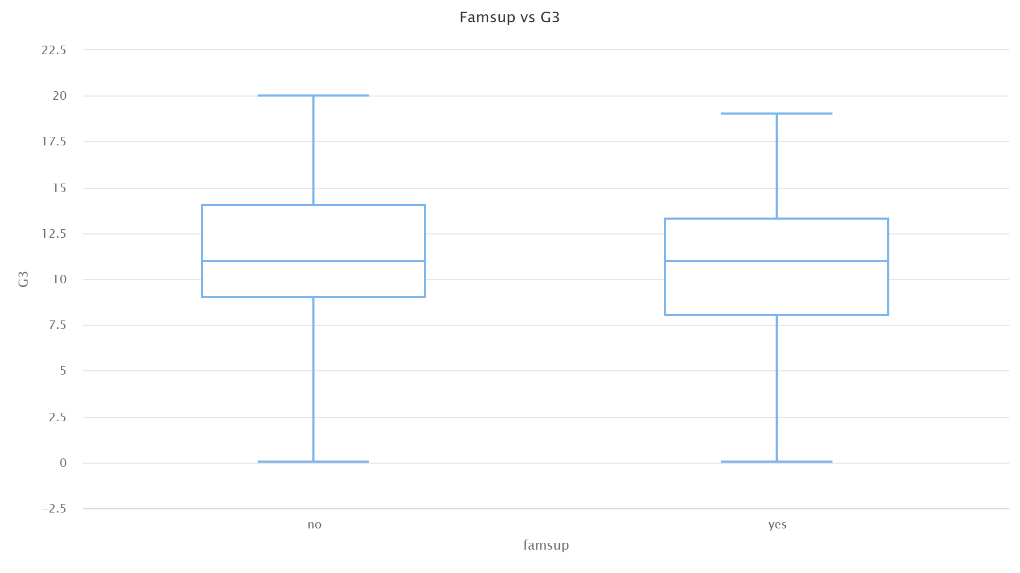
Bivariate Analysis
Family Support (famsup) vs G3 (Boxplot):
Students with family support have slightly higher median scores (13.25 vs 14), but the difference is very small.
Both groups show a similar spread of scores, meaning family support alone may not strongly influence G3.
Insight: Family support might help, but it’s not a decisive factor.

Slide 29
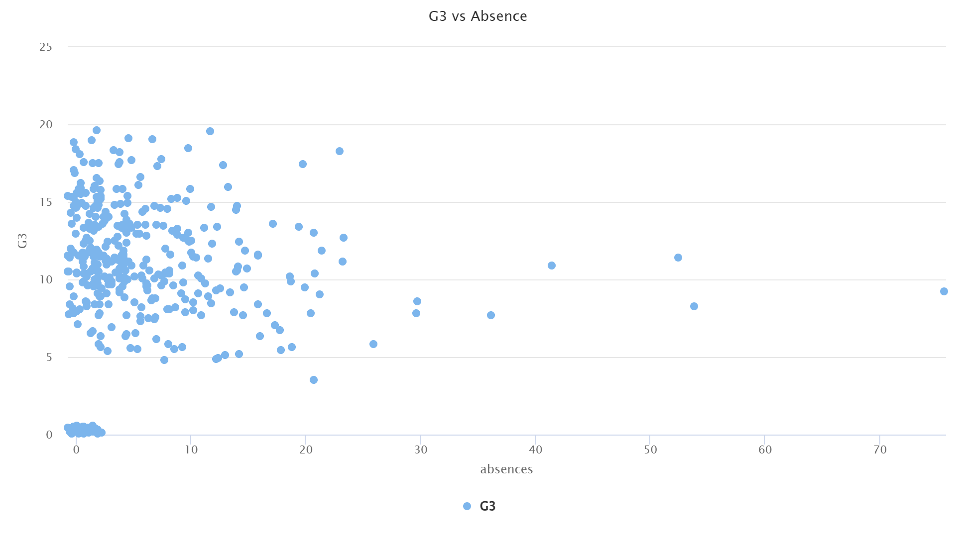
Bivariate EDA
Absences vs G3 (Scatter Plot):
Majority of students have 0–10 absences, and their G3 scores range widely (5–20).
As absences increase, the number of students decreases, and scores become more scattered.
Insight: High absences generally align with lower performance, though occasional absences don’t seem to impact much.

Slide 30
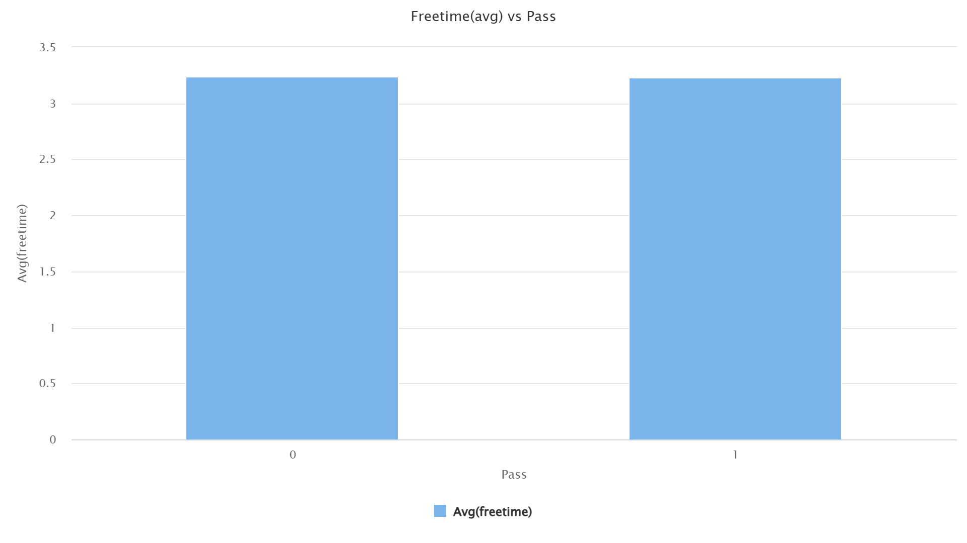
Bivariate EDA
Free Time vs Pass (Bar Plot):
Average free time for pass=0 and pass=1 is nearly the same.
Insight: Free time doesn’t show a strong direct relationship with passing. It might only matter when combined with other lifestyle factors (like going out, alcohol).

Slide 31
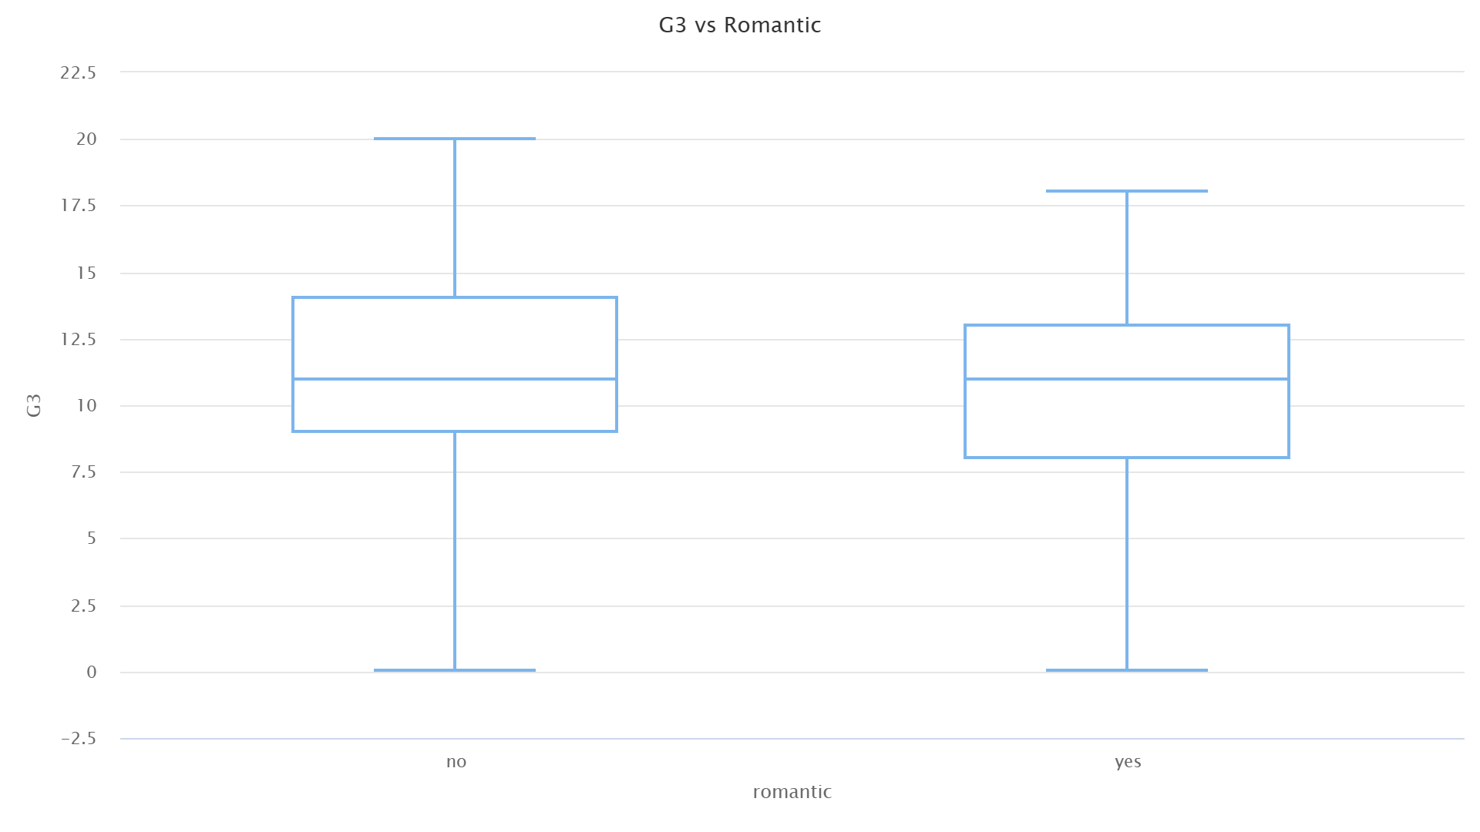
Bivariate EDA
Romantic Relationship vs G3
Median G3 for both groups (yes/no) is quite close (11).
Slightly higher spread in the no relationship group, with max values going up to 20.
Interpretation: Being in a relationship doesn’t drastically reduce performance, but students without romantic relationships have a slightly higher upper range in scores.

Slide 32
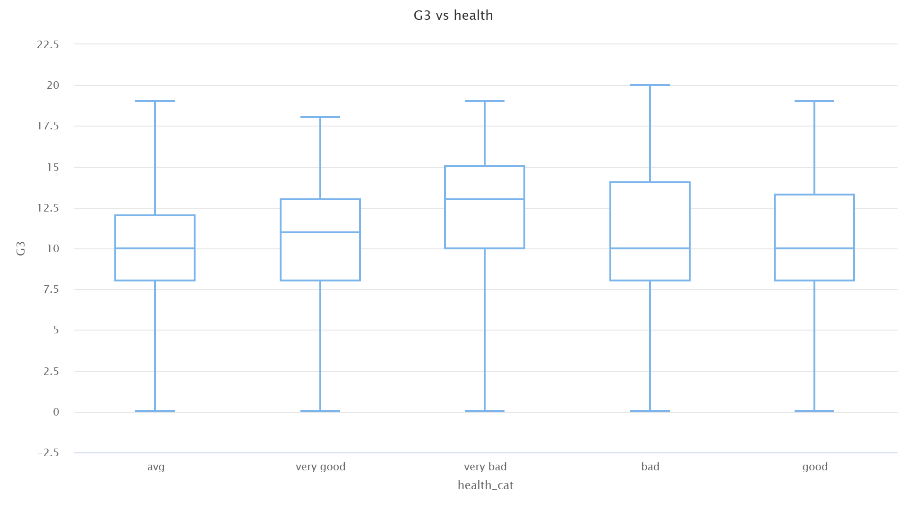
Bivariate EDA
Health vs G3:
Median scores across health groups are all around 10–13, fairly stable.
Health = 1 group (poorest health) actually had some students reaching max scores (19).
Interpretation: Surprisingly, health does not show a strong linear relationship with G3. Students with poor or excellent health both achieve good scores, suggesting other factors dominate academic performance.

Slide 33
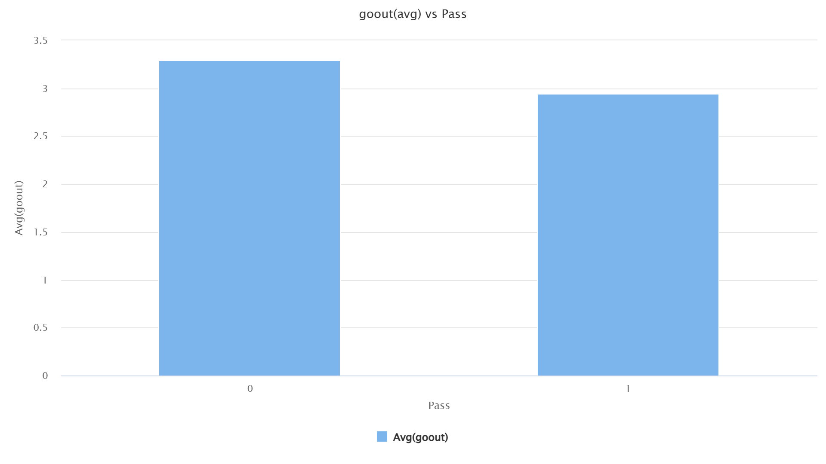
Bivariate EDA
GoOut vs Pass:
Avg goout for Pass=0 → 3.3
Avg goout for Pass=1 → 2.95
Interpretation: Students who fail tend to go out slightly more often, suggesting social activities could be a distraction from academics. The difference isn’t huge, but it’s consistent.

Slide 34
Feature Selection
Based on EDA insights and domain intuition, the following features were selected:
  Academic performance indicators: G1, G2, studytime, failures, absences
  Family/Support factors: famsup, schoolsup, internet
  Social & lifestyle factors: goout, freetime, romantic, activities
  Health & Well-being: famrel, health, Dalc, Walc, traveltime, age
  Features like reason, guardian, higher, school, and detailed parental jobs were excluded as they showed minimal influence in EDA.

Slide 35
Model Selection
Since the task is binary classification (Pass = 1, Fail = 0):
Logistic Regression
  Simple, interpretable baseline model.
  Good to check which features influence Pass/Fail.
Random Forest Classifier
  Handles categorical + numerical features well.
  Captures non-linear relationships.
  Provides feature importance ranking for better insights.
We go with Logistic Regression.

Slide 36
Data Preprocessing – Label Transformation
The original dataset had the target variable Pass as a nominal attribute.
Since Logistic Regression only supports binary (0/1) labels, we applied a Nominal-to-Binomial transformation.
After transformation:
  Pass = 1 → Student successfully passed.
  Pass = 0 → Student did not pass.
This preprocessing ensures:
  Compatibility with logistic regression.
  Clear interpretation of prediction outcomes.

Slide 37
Train-Test Split
To evaluate model performance fairly, the dataset was divided into training and testing subsets.
Configuration used:
  Training Data → 70% of records
  Testing Data → 30% of records
Why this step is important?
  Prevents the model from memorizing the data.
  Helps measure how well the model generalizes to unseen students.

Slide 38
Logistic Regression – Model Setup
Why Logistic Regression?
  It is well-suited for binary classification problems like Pass vs Fail.
  Outputs probabilities (likelihood of passing).
  Coefficients are easily interpretable (positive = increases chance of passing, negative = decreases chance).
Parameters Configured:
  Lambda Search → Enabled for automatic tuning of regularization strength.
  Alpha (0–1) → Balances Lasso (feature selection) and Ridge (regularization). Prevents overfitting.
  Reproducible Mode → Ensures same results across multiple runs.
  Max Threads → Set to utilize available system cores for faster computation.
Expected Behavior:
  Penalize irrelevant/noisy features.
  Focus on attributes with stronger predictive power (e.g., G1, G2, failures, parental education).

Slide 39
Model Performance Metrics
Algorithm Used: Logistic Regression (Binomial GLM)
Key Metrics:
  MSE (Mean Squared Error): 0.144
  RMSE (Root Mean Squared Error): 0.379
  R² (Coefficient of Determination): 0.422 → Explains ~42% of variability in outcomes.
  AUC (Area Under ROC Curve): 0.988 → Excellent ability to distinguish between Pass and Fail.
  PR AUC: 0.990 → Very strong precision-recall performance.
  LogLoss: 0.469 → Low, indicates well-calibrated probabilities.
  Mean Per-Class Error: 0.0376 → Low error across both Pass and Fail categories.

Slide 40
Confusion Matrix
Default Threshold = 0.508
Results:
  Correctly Predicted Failures: 122 / 130 (Error 6.15%)
  Correctly Predicted Passes: 144 / 146 (Error 1.37%)
  Total Accuracy = 96.38% (10 misclassifications out of 276 students).
Shows the model is highly reliable in predicting both outcomes.

Slide 41
Variable Importance
Top Predictors of Student Performance:
  G2 (2nd Period Grade) – Strongest predictor.
  G1 (1st Period Grade) – Almost equally predictive.
  G3 (Final Grade) – Very strong positive influence.
  Failures – Strong negative influence.
  Age – Older students slightly less likely to pass.
  Parental Education (Fedu, Medu) – Higher parental education → Higher pass likelihood.
  Goout (socializing) – Negative impact when excessive.
  School Support – Positive impact when provided.
Less influential features: Job type, reasons for school choice, guardianship, etc.

Slide 42
Interpretation & Insights
Strong Academic Predictors:
  Prior performance (G1, G2) is the most reliable indicator of final success.
  Failures strongly reduce chances of passing.
Family & Support Factors:
  Parental education correlates positively with student success.
  School support programs improve outcomes.
Lifestyle Factors:
  Excessive social outings and alcohol consumption negatively influence results.
  Internet access shows slight positive effect (helps in study resources).

Slide 43
Conclusion & Recommendations
Conclusion:
  Logistic Regression achieved 96.38% accuracy with an AUC of 0.988, showing strong predictive ability.
  Academic history (G1, G2, G3) is the most reliable factor for predicting student success.
  Parental education and school support significantly improve student outcomes.
  Failures, absenteeism, and lifestyle habits (e.g., frequent outings, alcohol use) negatively impact performance.
Recommendations:
  Early Intervention:
    Monitor students with low G1/G2 grades and provide targeted academic support.
  Parental Involvement:
    Encourage educational involvement at home; higher parental education correlates with better outcomes.
  School Support Programs:
    Expand tutoring, mentoring, and extra help initiatives.
  Balanced Lifestyle:
    Promote healthy habits: controlled socializing, reduced alcohol use, better time management.
  Data-Driven Monitoring:
    Regularly analyze student data to identify at-risk groups early and prevent failures.

