Slide 1
Analytica: Data-Driven Insights for Urban Grocers Evaluating Business Performance and Growth Opportunities
Done by:
Anuj A
Jei Akash M A
Mithun V R

Slide 2
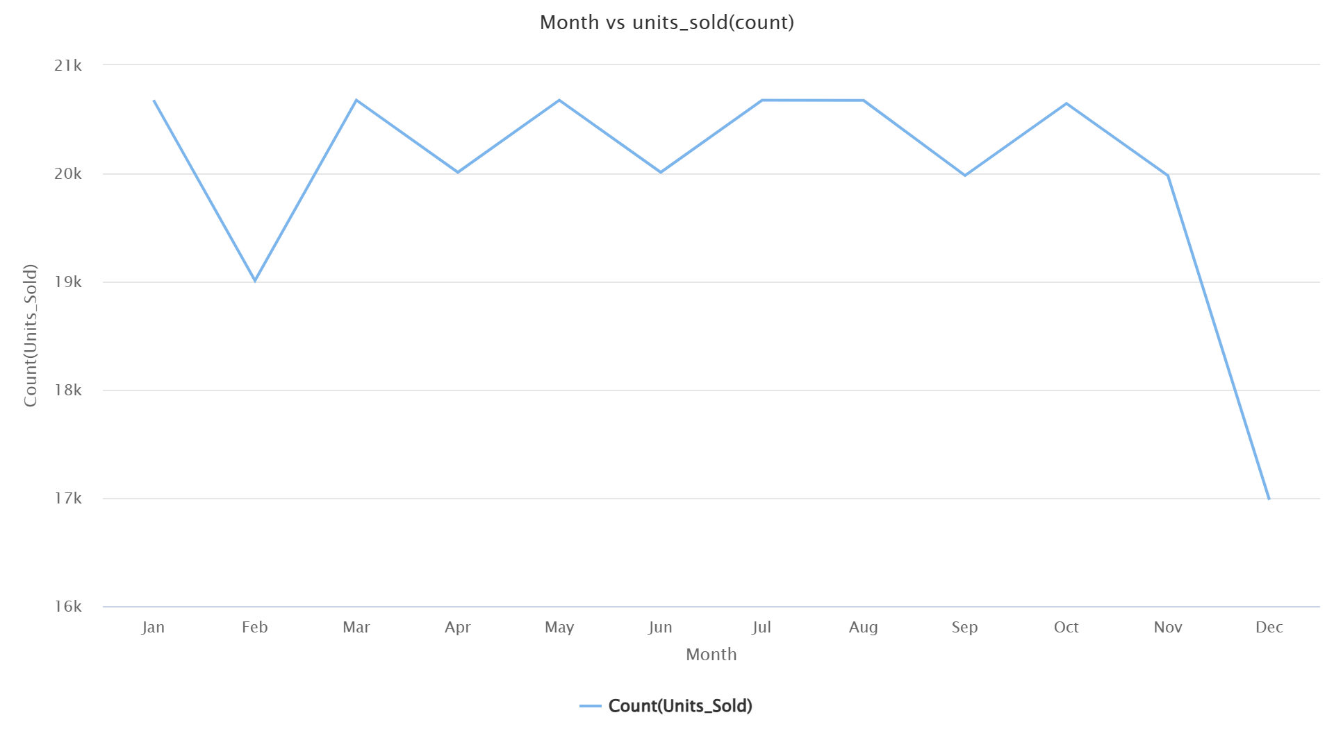
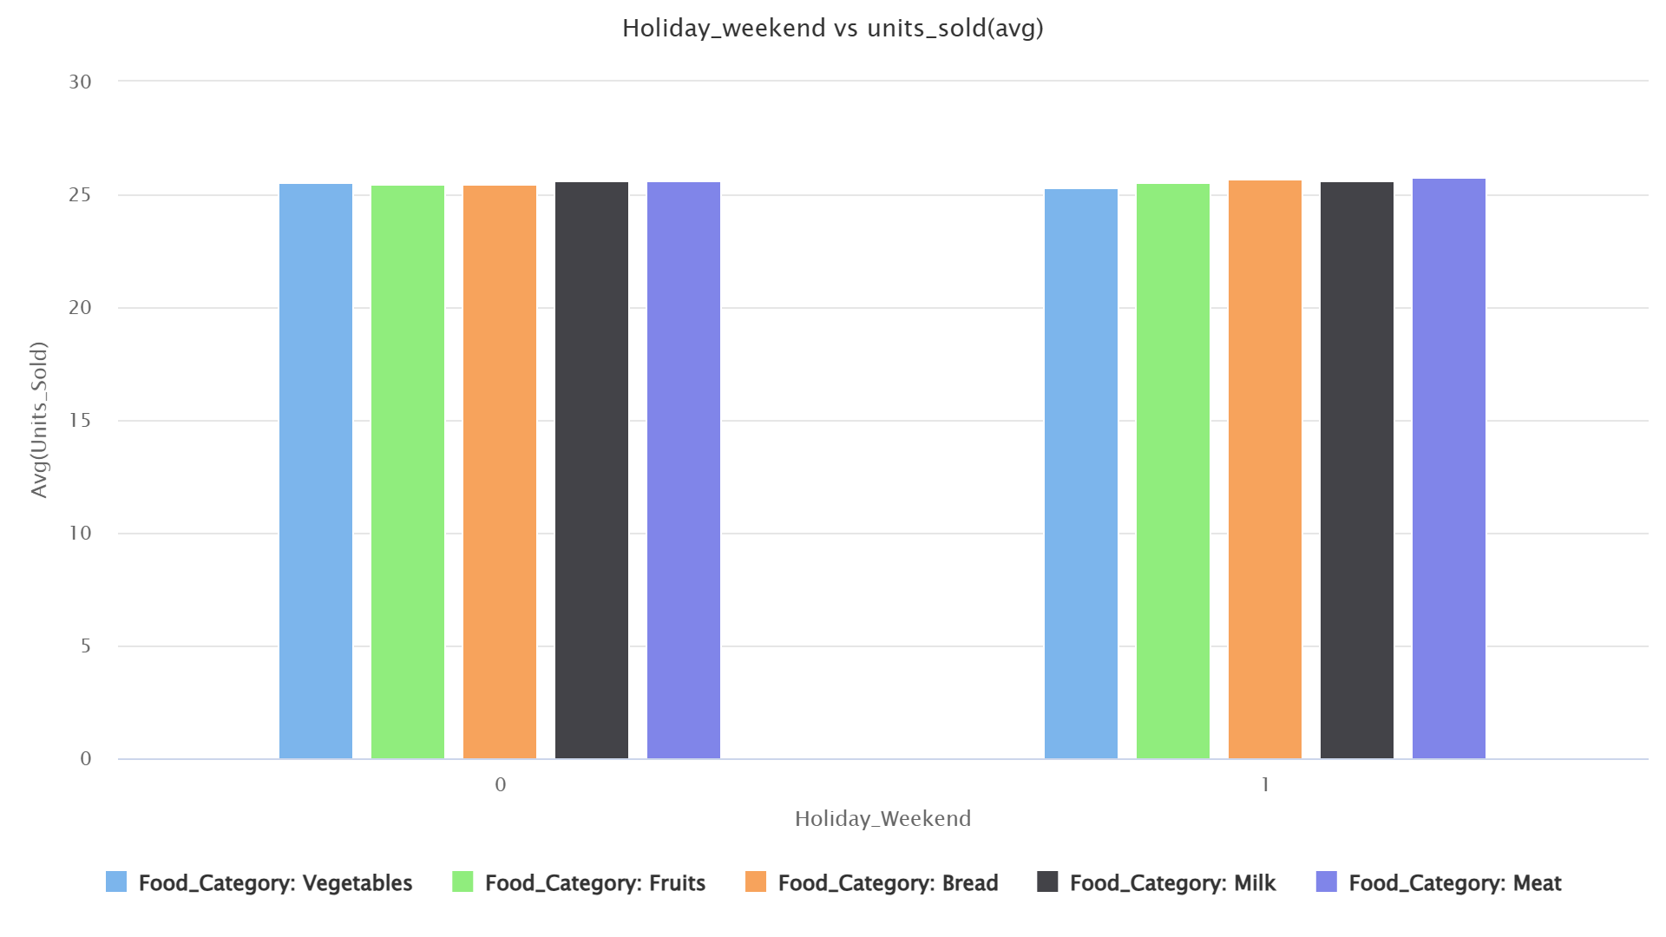
Sales Rhythms: Peaks, Holidays & Weekends
Key Findings:
Monthly Sales Volatility:
Contrary to stable expectations, sales show clear fluctuations from month to month, ranging from approximately 19,000 to 20,700 units.
This suggests that demand is not consistent, and there may be external factors influencing performance.
End-of-Year Sales Dip:
The data reveals a significant ~18% drop in sales during the final month, representing a major seasonal downtrend that needs further investigation.
Minimal Holiday & Weekend Impact:
Despite the monthly volatility, sales on holidays and weekends are surprisingly flat, averaging ~26 units sold per day.
This is a missed opportunity, as the company is not leveraging peak customer periods to drive significant sales growth.

Slide 3
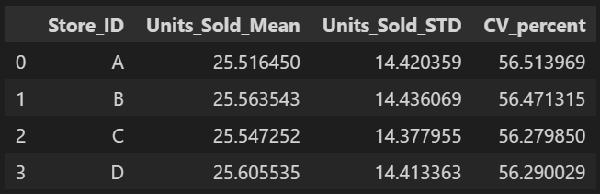
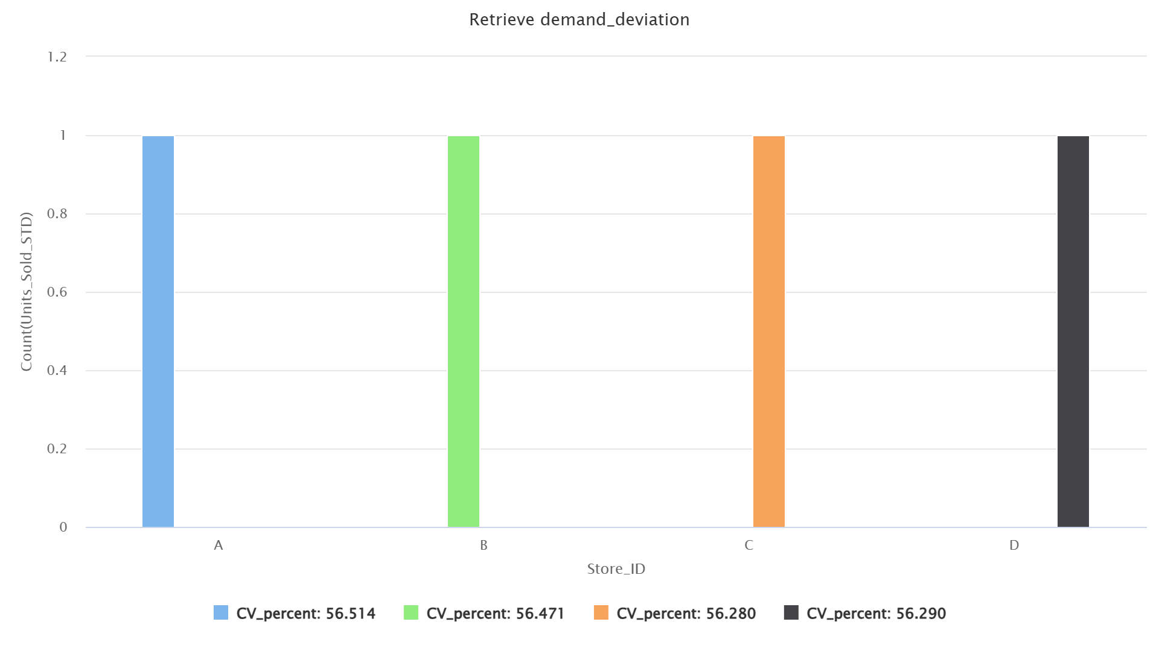
Demand Volatility: A Systemic Challenge
Key Findings:
Consistent Volatility:
The data indicates that all of Urban Grocers' stores share a remarkably similar level of demand volatility, with a consistent Coefficient of Variation (CV) of approximately 56%.
No Single 'Problem' Store:
This finding reframes the challenge from a store-specific problem to a company-wide operational issue.
Strategic Implication:
To manage this high level of unpredictability, the company should focus on implementing a single, unified strategy for inventory management and operational planning across all locations.

Slide 4
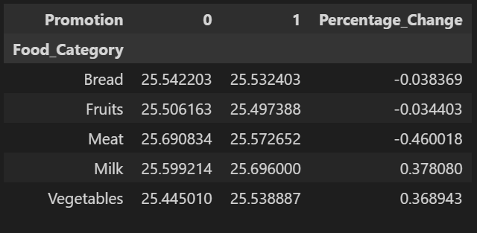
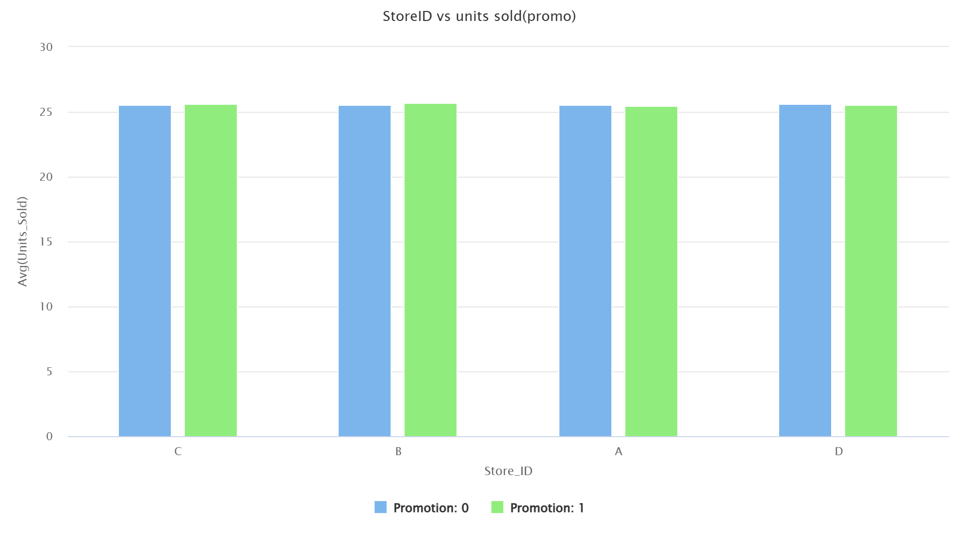
Promotion Effectiveness: Driving Sales or Just Increasing Costs?
Key Findings:
Minimal Overall Impact:
The current promotion strategy yields an almost negligible 0.04% overall increase in sales, suggesting it is not a primary driver of revenue.
No "Demand Creation" Effect:
The core reason for this finding is that these products are essentials. Customers will purchase Bread, Milk, and Meat as needed, regardless of a minor discount. Promotions on such items are unlikely to significantly boost sales volume, as they don't create new demand.
Unexpected Negative Effects:
Promotions on Bread, Fruits, and Meat had an unexpected negative impact on average sales volume. This may be due to other factors or a direct cost to the business without a sales benefit.
Targeted Success:
Promotions were only effective for Milk and Vegetables, boosting sales by approximately 0.4%. This suggests promotions should be targeted to these categories, and the company should reassess its approach for other product lines.

Slide 5
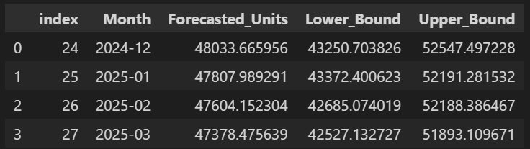
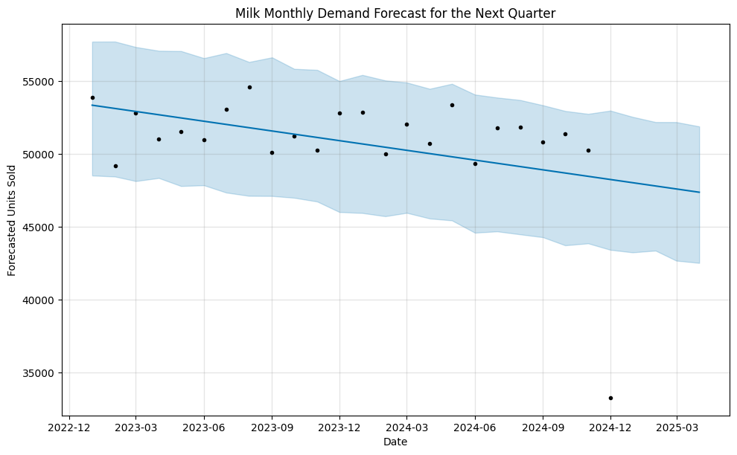
Demand Patterns & Forecast: A Strategic Look Ahead
1. Key business challenges
Overall sales volatility: monthly demand fluctuates by 5-10%, making planning difficult.
Recurring seasonal lows: There's a significant drop in sales in December and other months, highlighting a consistent business challenge.
2. Strategic forecast: the case for milk
We chose to forecast demand for milk because it’s an essential grocery item and the only product that responded positively to promotions.
This forecast shows how we can use data to drive a better business strategy.
3. The milk forecast: key insights
Our model predicts stable demand for milk over the next quarter, averaging ~47,000 units per month.
The forecast provides a clear, actionable range for sales (e.g., 42,848 to 51,740 units in march 2025), which is crucial for optimizing inventory and minimizing waste.

Slide 6
Investment Status: A Long Road to Recovery
1. The Financial Reality
Initial Investment: The analysis indicates that the company's initial investment was approximately Rs. 20 crore (200,000,000).
Current Status: Despite generating a total profit of Rs. 4.3 crore, Urban Grocers has only recovered about 21.5% of its initial investment.
The Shortfall: This leaves a substantial shortfall of Rs. 15.7 crore to be recouped from future profits.
2. The Opportunity: A Path to Recovery
The company is profitable, but the primary challenge is the recovery of its massive initial investment. This presents a clear objective for management.
3. Actionable Recommendations from Our Analysis
Optimize Inventory Management: Leverage demand forecasts to reduce overstock and costly waste.
Refocus Promotion Strategy: Shift from essentials to non-essentials. Promotions on staple items like bread and milk have little impact, but discounts on non-essential, "treat" items (if they were sold) could effectively create new sales and a significant lift in revenue.
Monetize Weekend & Holiday Traffic: Develop targeted marketing to capture revenue from missed sales opportunities on high-traffic days.

Slide 7
Thank You

