Slide 1
Linux Based Personal Robots
Tully Foote
Willow Garage
Background subtle image to carry through
PR2 Photo
TurtleBot Photo

Slide 2
Visual icons of future sections
Notes:
Overview slide
What are robots currently
What is my background
Why should robotics follow linux model
How ROS makes it happen
How the PR2 was used to prove ROS was capable to the community
How the TurtleBot has demonstrated ROS for the rest of us. – Reference HBRC.
How the community has been built up
Where w're going in the future
Organization for self

Slide 3
Reveal: wall-e iRobot Rosie
Notes:
What do you think of Robots? Use comic rendition

Slide 4
Personal Robots
Photo PR2
Photo Rosie
Photo Asimo
Photo HRP234
Photo Care-O-Bot
Photo Nao
Notes:
When you think of personal robotics, you think of scipy humanoind ones
How many of these regularlly use Linux?
How many of these have been used with ROS? 5
How many of these have open source drivers? 4

Slide 5
More Robots
Photo TurtleBot
Photo Pioneer
Photo rovio
Photo Quadrotors
Photo Surfboard
Photo Aibo
Notes:
Other Robots which aren't humanoid but can be more personal
Personal – hollywood == human replacement
In my home – much less capable

Slide 6
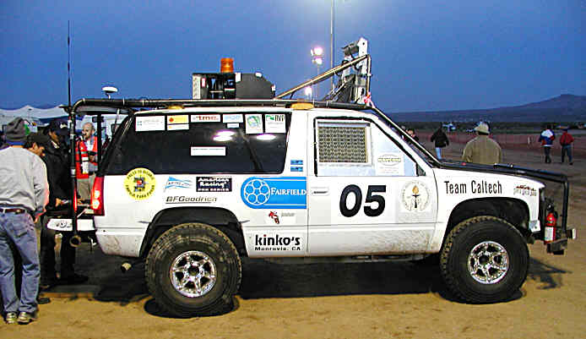
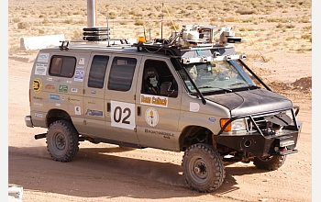
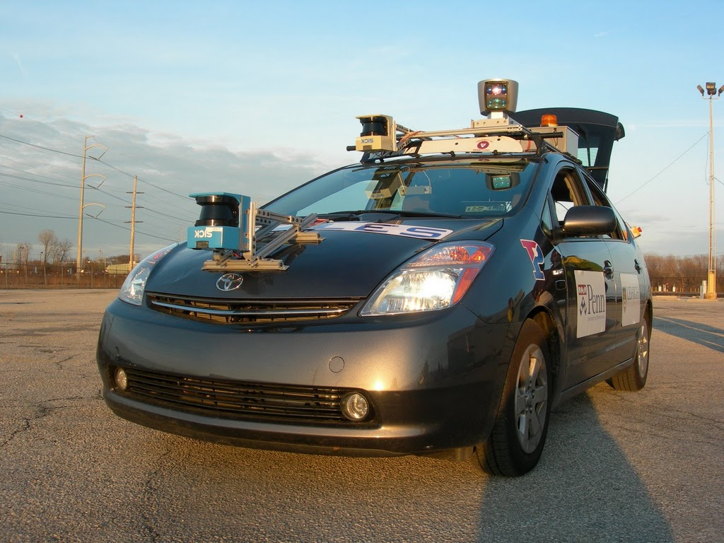
My Projects Before Willow
Build in photos as I talk about them
– Bob – 2004
Alice – 2005 –
– Little Ben – 2007
Notes:
Linux Variants:
Dell Gentoo/Slackware RTAI Servers with Fedora desktop
IBM Servers with Slackware installation
Mac Mini's with Ubuntu and Matlab
Custom i7 servers with Ubuntu + ROS
Who's familiar with DARPA Grand Challenges? Ask them to summarize, or if noone explain myself
My Roles:
Safety Driver + hardware mounts
Safety Driver + low level controllers
Safety Driver + perception programming beginning systems programming
Systems programmer

Slide 7
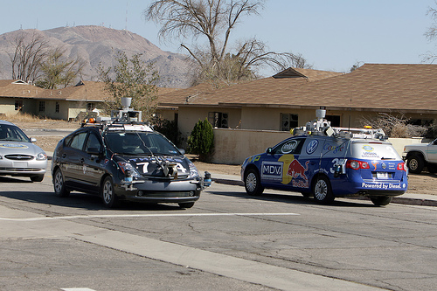
Notes:
Lots of shared sensors and characteristics but no shared code.
6 teams completed the challenge
Virtually no shared infrastructure
90% of effort duplicated between teams did not differentiate them
At the event there was lots of sharing of physical tools and extra parts, no sharing of code evident.
Sharing of code is almost impossible without shared infrastructure.
No standard interfaces
After the race/qualification many altorigthms shared as academic papers, but implementations were lots
Some drivers were open sourced afterwords, but that's the majority of code which was meaningfully shared.

Slide 8
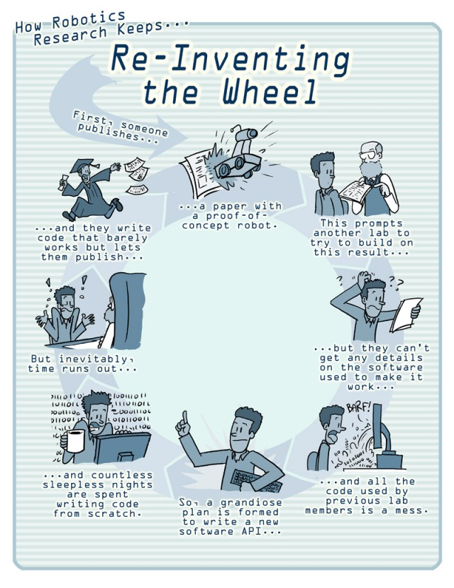
Wipe out text
And speak it
Notes:
Many papers from Granc Challenges ->> Many reimplementations
One video or experiment is enough to publish
No way to verify or reproduce results
By external scientific standards this would be considered a joke

Slide 9
Question mark
Notes:
Ask group “retorically?” what can be done?

Slide 10

What can be done?
Clip Art of Many people building a pyramid
Best so far is jigsaw pyramid on istockphoto
Notes:
Reduce Reuse Recycle
Reduce – duplicated code
Reuse – Foster code reuse
Recycle – indistinguishable from reuse for software
Split to a second slide VV
Community – needed to share
Documentation – Primary form of communication needed to enable sharing
Infrastructure – Get the same tools to everyone so that their parts can plug into whole
You've heard this before. Draw parallel to Linux

Slide 11


Designing ROS
+
First reveal linux then reveal + research as talking
Notes:
Linux – as a:
Model
Core infrastructure
Academic Robotics research community:
Community
ROS does:
Forms a common Basis for research
A way share components –
A way to facilitate derivative works (no reimplementing)

Slide 12
Capabilities from around the world → one robot graphic
Notes:
Everyone is using state of the art in other fields
For example the PR2
OMPL from Rice
SBPL from Upenn
…
…
Imagine the fluidity of Linux coming to robotics, not single research labs reimplementing everything at each school

Slide 13


Implementing ROS
Roadmap/direction clipart
Notes:
Provide Vision and Roadmap
A vision of the future
A process to follow to get there
Standards to follow
Tools for developers
Making users/developers more productive
A reason to join the common eco system
C++ and Python environment (java in alpha)
Open Source
Provide a role model
Actively promote contributions
Set the tone and expectation
Get enough people doing it so you can say, why aren't you??
Build on top of extensive open source tools and techniques

Slide 14
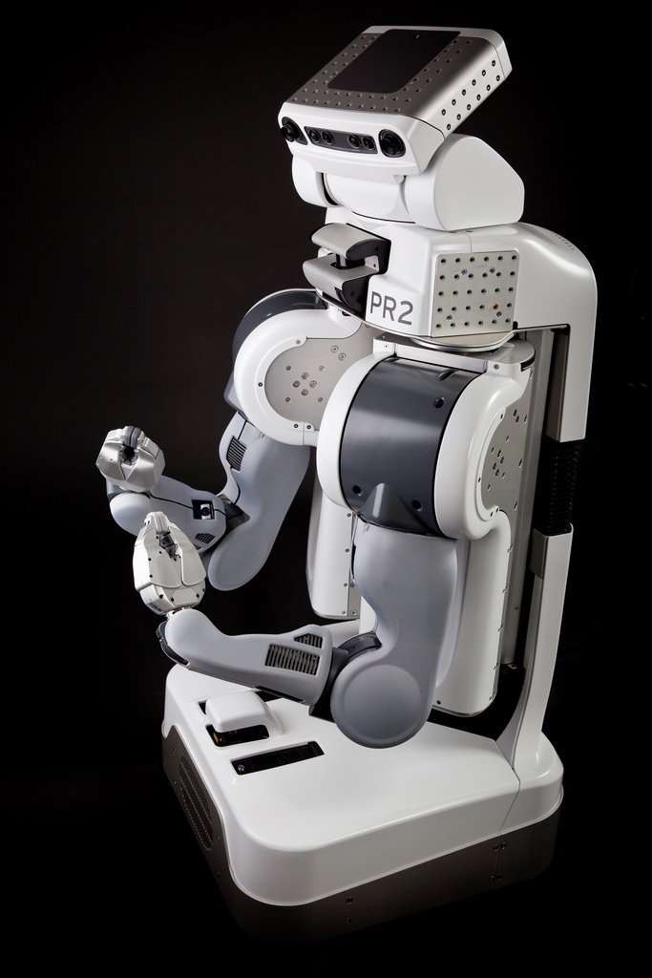
A robot to prove ROS
Notes:
2x Dual Quad Core i7 Servers = 16 i7 Cores
1kW power
64 GB Ram
Wifi Client and AP
Bluetooth
VPN connection w/ dynamics routing
Motors only 200W at full strength
Designed to be a software developers dream
Focus on robustness
Low payload for safety
Simulation for people to test when they don't have access to the robot
Standardized platform to promote sharing of research
Video clip of rubics cube solving

Slide 15
Picture of marathon, with PR2 overlayed.

Slide 16
PR2 Proving its metal
Office Marathon Video
Notes:
To prove that the PR2 was capable we set a milestone of a marathon unassisted.
2-3 hours of battery means it must reacharge → taught it to find and use outlets
Also taught it to open doors to get into offices with outlets
Later returned to the challenge and ran it for 100 miles in 13 days
Demonstrating:
Robustness
Reliability

Slide 17
The Personal side of PR2
Split into 4 slides with brief videos as I talk
Beer Video
Poolshark Video
Towel Video
Towel Video revisited
Notes:
Not just boring marathons, other fun challenges
Focus on perception and fine manipulation
Billiards
Beer fetching
Towel Folding – Example of improving tools and community
UC Berkeley lab
Preproduction demo of towel folding 10 towels in 2 hours
One year later almost an order of magnitude faster, not using external sensors

Slide 18
Tools for ROS Developers
Pr2 dashboard Screenshot
Screenshot RVIZ
Rxconsole screenshot
Notes:
Transition: Tools developed to make this possible...
Visualization tools
– rviz
Debugging tools
– pr2_dashboard – runtime diagnostics aggreagated into a single pane for constant awareness
– I won't help debug a robot unless the user has the dashboard showing and everything is green.
– rxconsole – runtime configurable logging with filtering, can turn on debug for a specific node or module while it's running on a remote machine and see the output

Slide 19
Infrastructure to support ROS Development
Rosmake “building 3 of 25 packages” screenshot
Hudson screenshot testing and release
Notes:
Modular build system – required for large modular system
Development workspace management – easier development
Integrated unit tests – keep up quality
Easy user switching – for sharing pr2s
Continuous integration system for all packages
– Critical for usability
Release process to help stabilize codebase

Slide 20
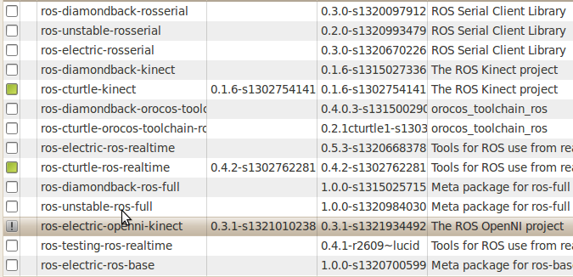

Community Infrastructure for ROS
Notes:
Development infrastructure becomes community infrastructure
Continuous integration builds → debbuilding
Image above shows that I have cturtle-kinect packages and electric-openni-kinect packages are ready to update
Documentation builds prepopulate wiki macros
Wiki for general documentation
Stack overflow style Forum for Q&A
– Great for getting community involvement over 1400 users and growing at 20% a month
In general bringing Open Source software development best practices to robotics

Slide 21
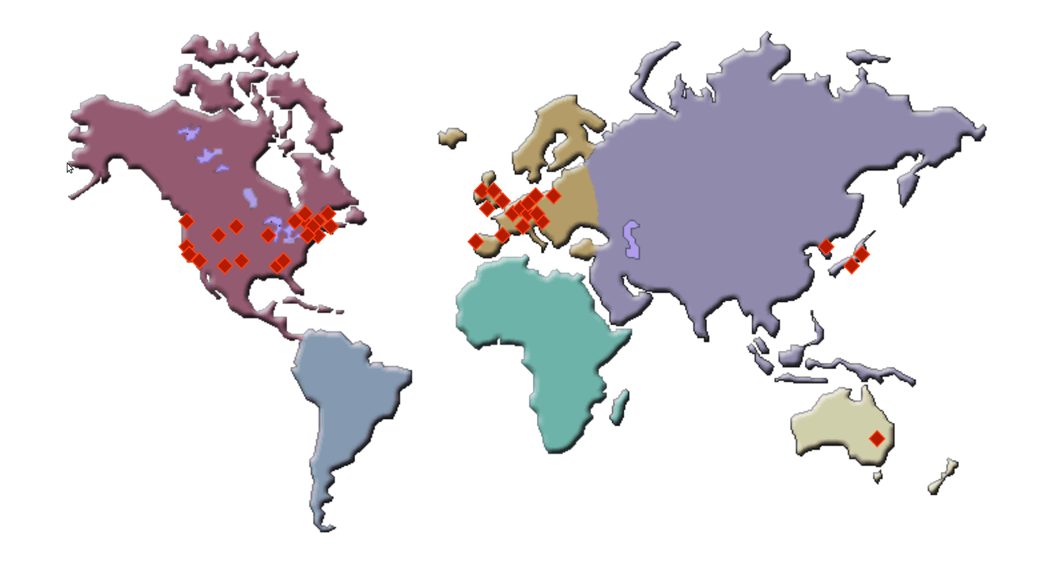
World Wide Community
100+ Groups Releasing Open Source Code
Notes:
Over 3000 packages world wide
Over 100 groups contributing open source software
Transition to Community Supported Robots

Slide 22
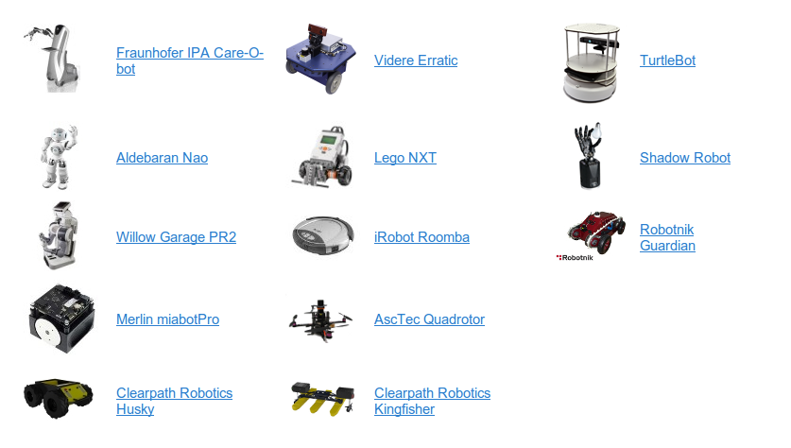
Community Supported Robots
Randomize robots, no text
Notes:
Do you recognize these robots?
Lots of production robots running ROS
Many more prototype robots running ROS
All of these robots have drivers which you can download and get started by just following the Tutorials
You can see the two Willow Garage robots.
Now there are many more from other people.
The latest is the Guardian
Scale from hundreds of ounces to hundreds of pounds.
Price from hundreds of dollars to hundreds of thousands of dollars.
Seeking to make robotics easier and easier to deploy
Transition to upstream distributions

Slide 23


Where to Next?
Add android
Notes:
All robots with full drivers and tutorials for setting up your own.
What do you think should be next??
How many of you have a smartphone or tablet? This can be the next generation robot control interface. Coming with android integration
Future plans:
More integration with smartphones and tablets as remote sensors and controls
More capabilities in microprocessors
Improvements in deployment and standardization for upstream Linux adoption – Targeting
Ubuntu Precise Pangolin
Fedora 17

Slide 24
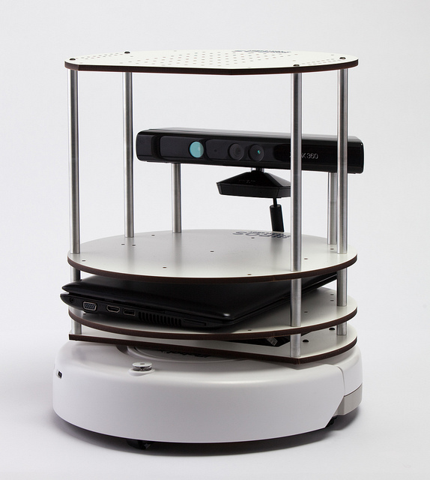
The TurtleBot
Notes:
Before I finish...
As it's hard to bring a PR2 here in my car, I've brought a TurtleBot
TurtleBot open source Hardware
Platform for introduction to ROS
Teaching tool, used in classrooms across the country
Live Demo
Kinect visualization
Follower app
Android telop

Slide 25
Conclusion
Graphic, maybe pr2 waving goodbye
Notes:
The Linux Open Source Development Model has proven very powerful.
We're now taking it to the Robotics community.
Look for lots of innovation in the area.
And as open source community members feel free to get involved in the robotics community. Your experience will be a great help in educating the new community.

Slide 26
Questions?
Notes:
Thanks to SVLUG for inviting and hosting me.
Think about flow and continuity, possibly icons for tools infrastructure and community to connect intro to in depth slides.

